Slide 1
MINI PROJECT ON AIR QUALITY ANALYSIS
Made by,
Vanshika Agrawal
Under the Guidance of
Zaid Kamil Sir
Submitted to:
DIGIPODIUM

Slide 2
INTRODUCTION
The topic of Project is Air Quality Analysis, and the technology used here is Data Science.
I’ve written the code part in VS Code and used streamlit for front-end.
Firstly, I’ve attached the snapshot of my code part and after that the output of my Project.

Slide 3
Code Part

Slide 4
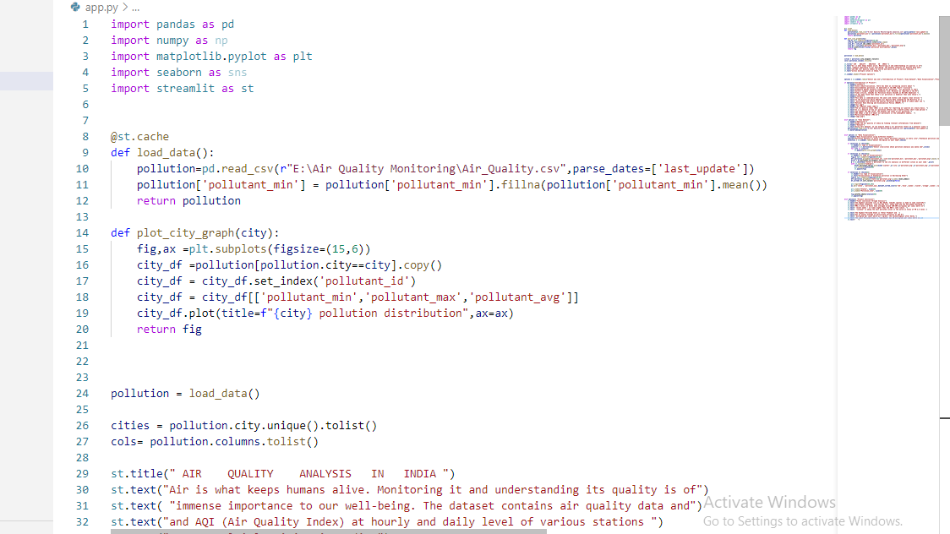

Slide 5
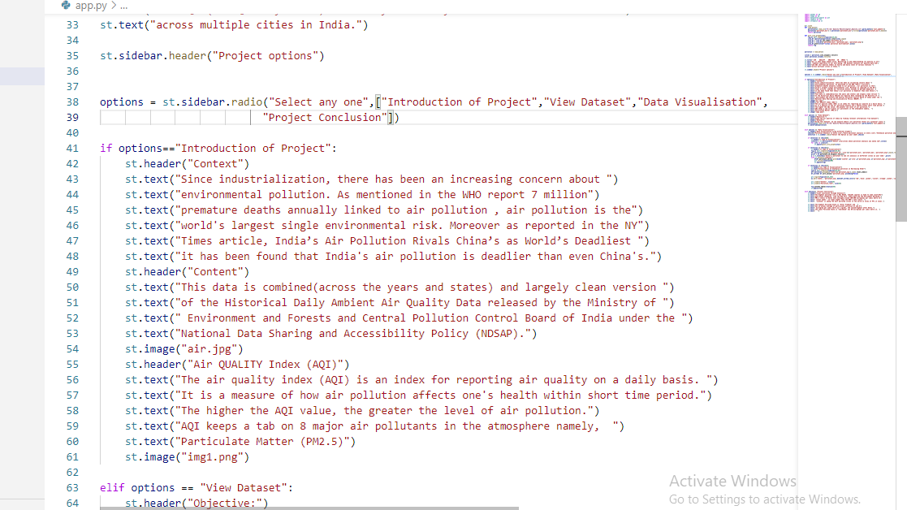

Slide 6
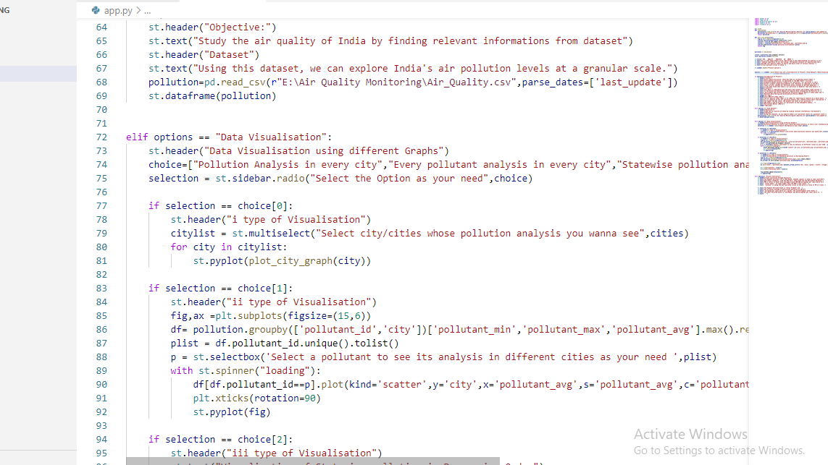

Slide 7
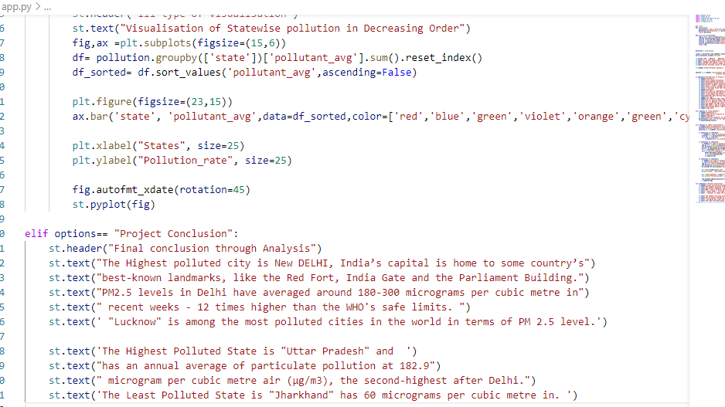

Slide 8
Output of Project, i.e
Objective
About Data Sets,
Data Visualisation
Conclusion

Slide 9
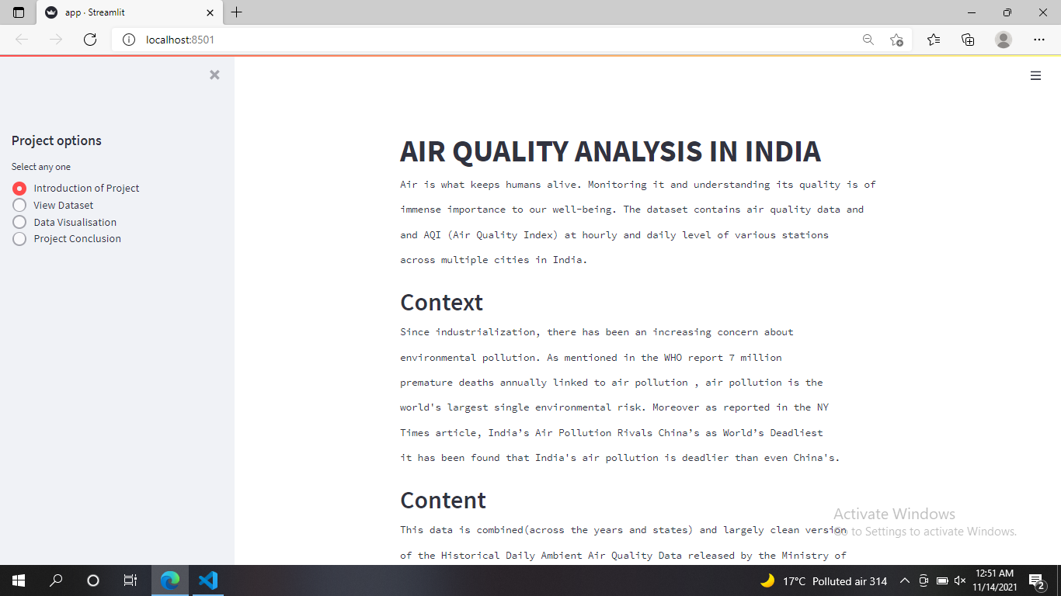

Slide 10
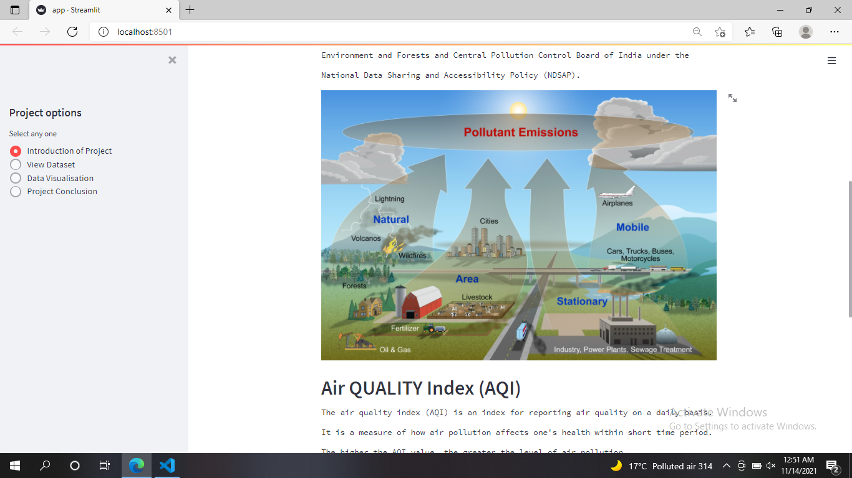

Slide 11
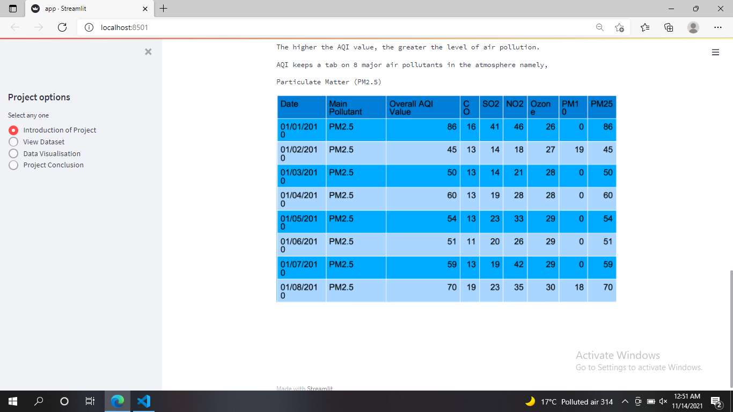

Slide 12
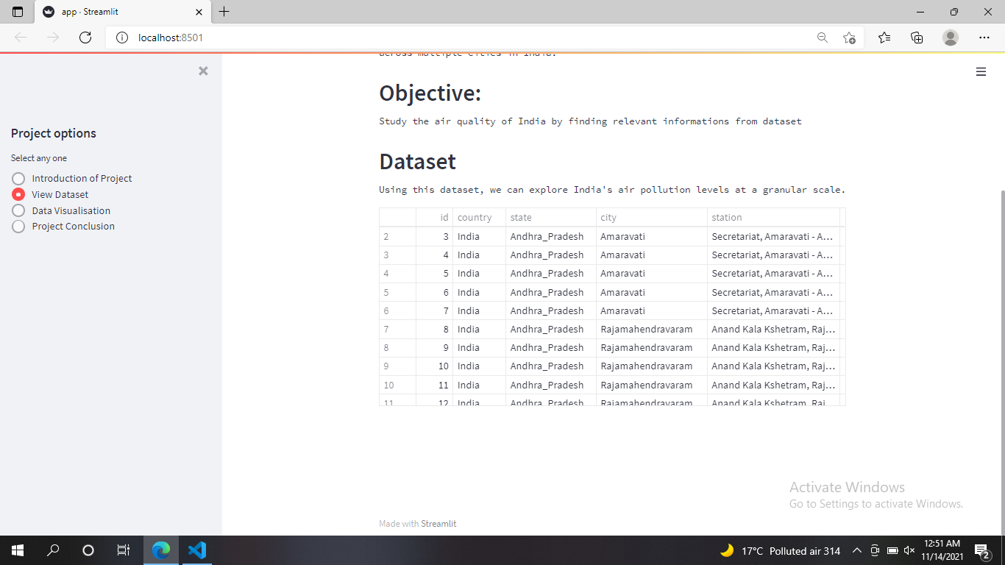

Slide 13
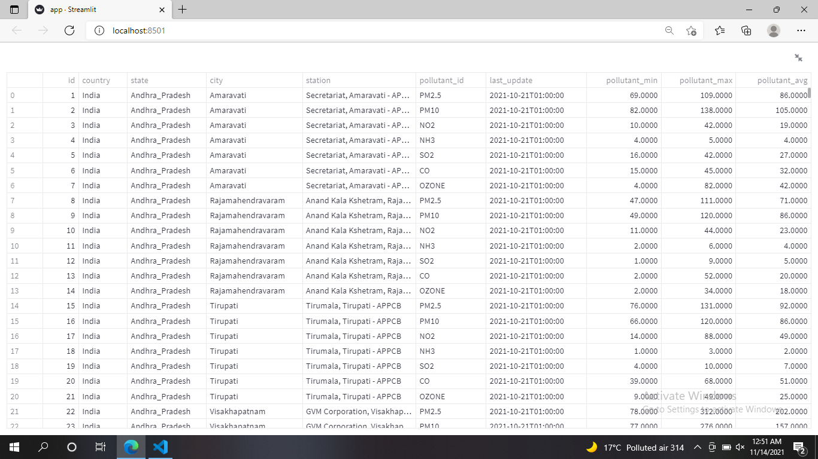

Slide 14
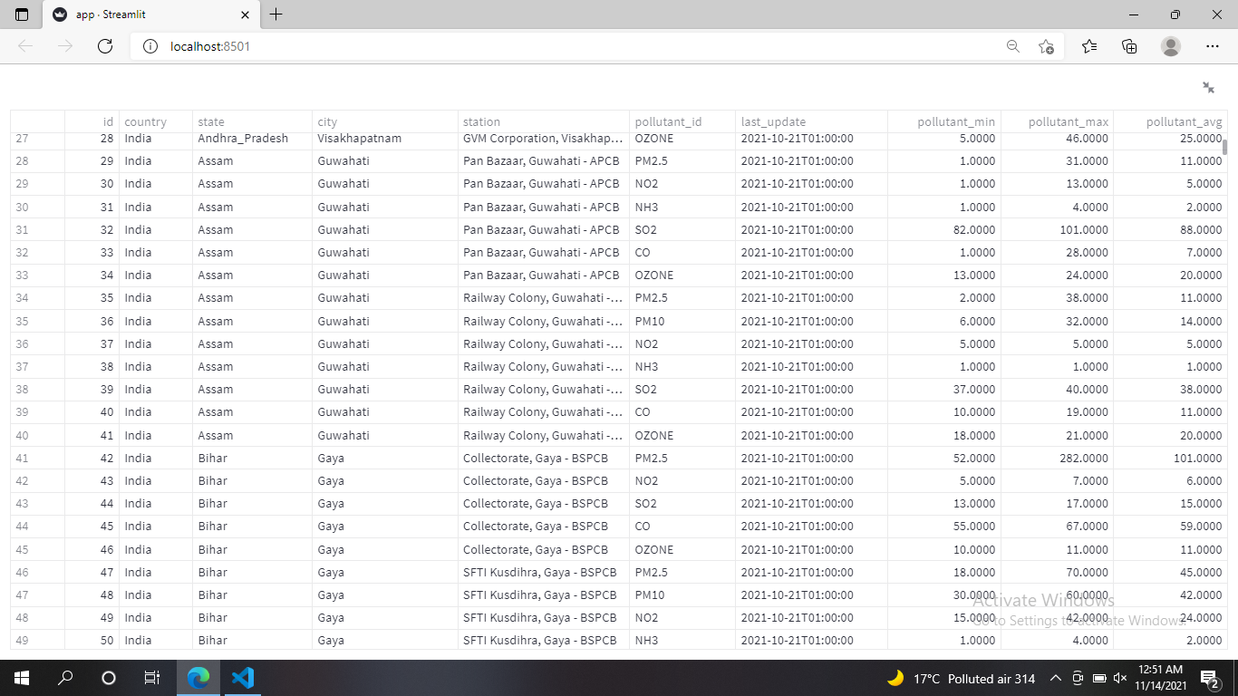

Slide 15
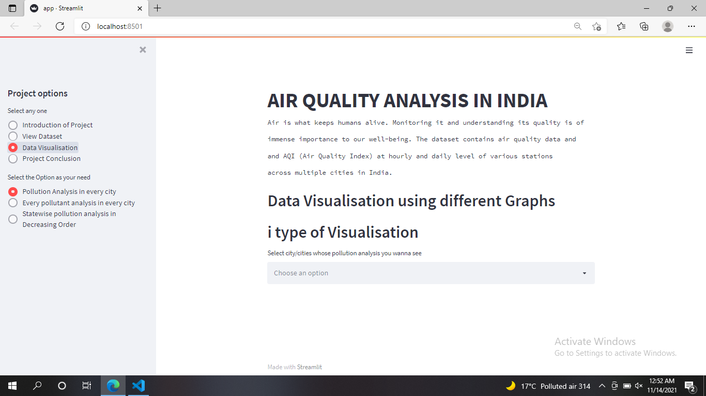

Slide 16
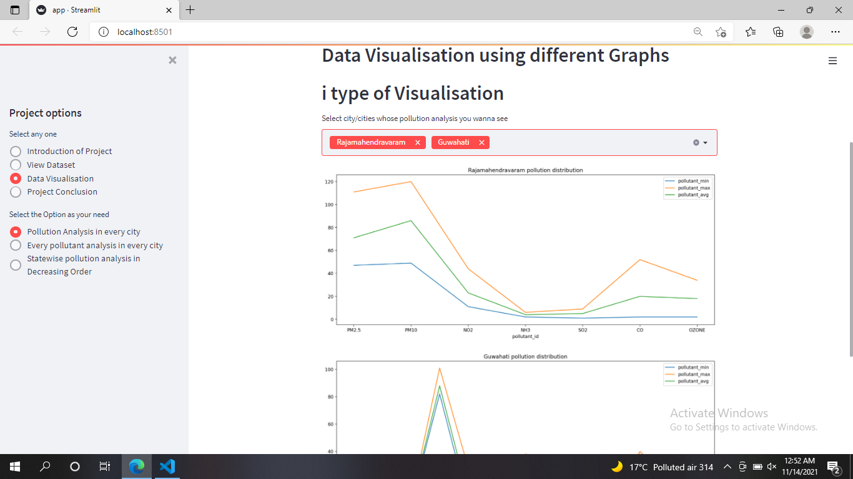

Slide 17
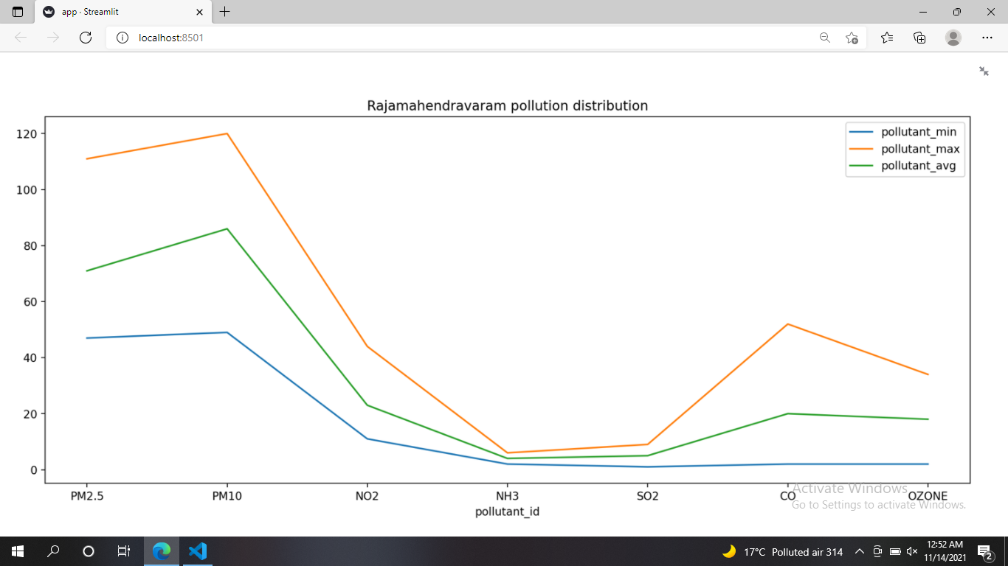

Slide 18
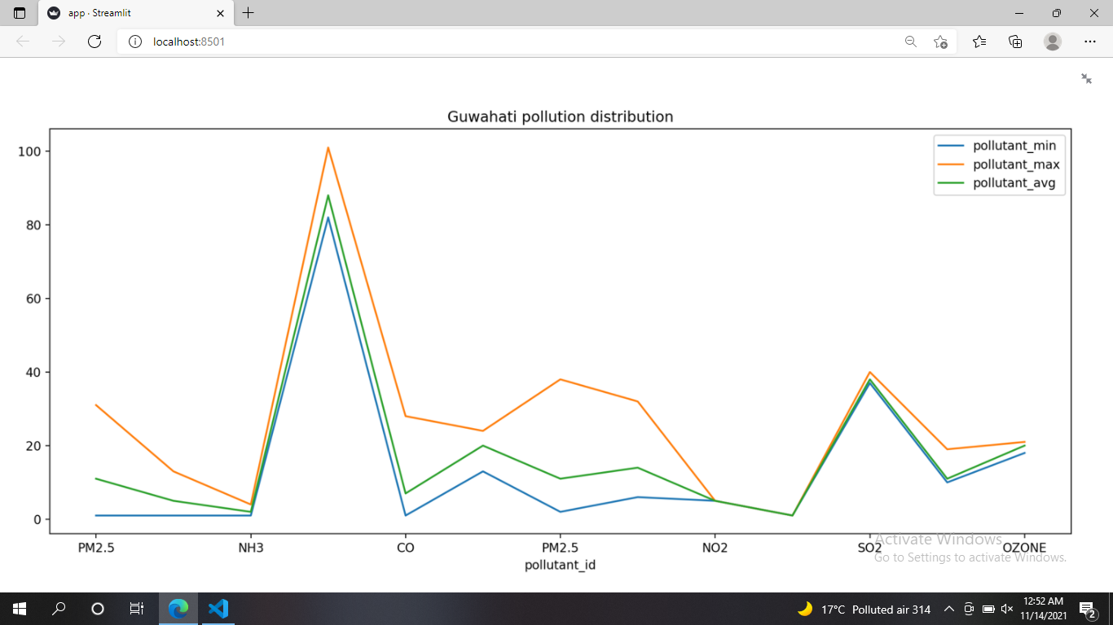

Slide 19
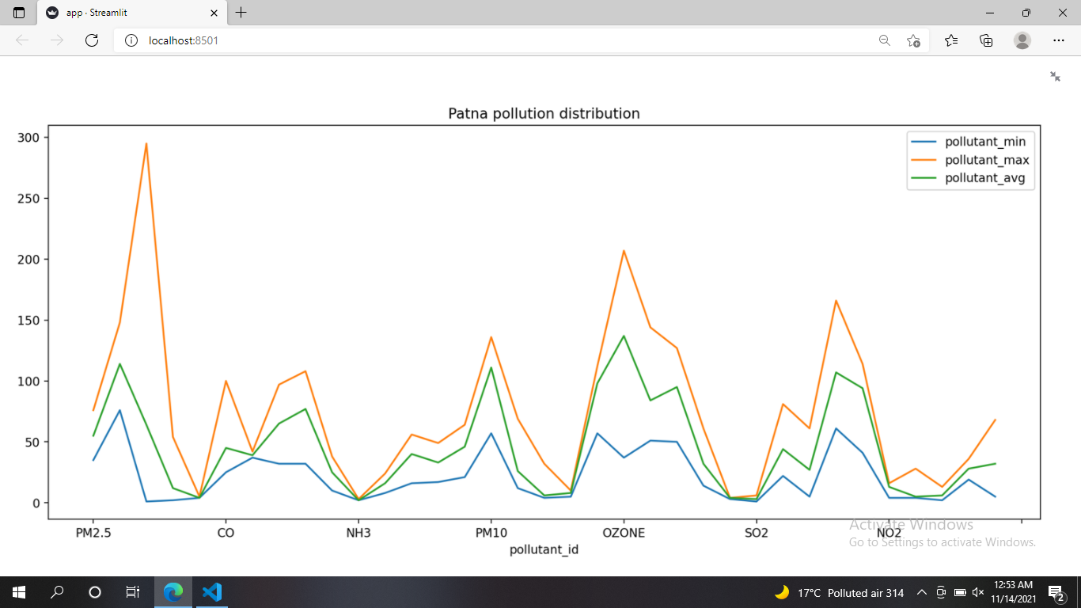

Slide 20
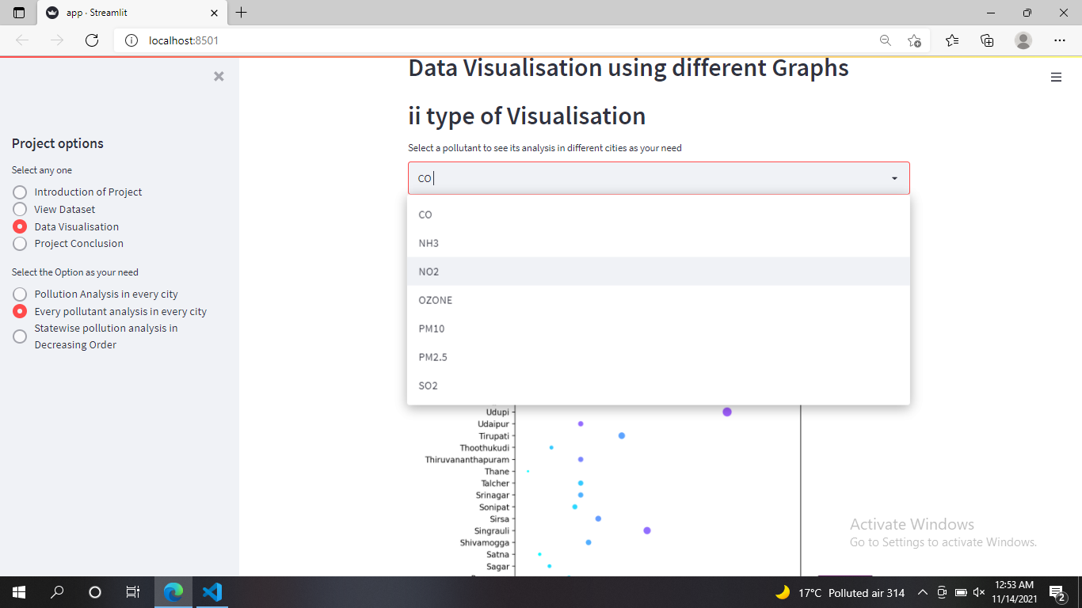

Slide 21
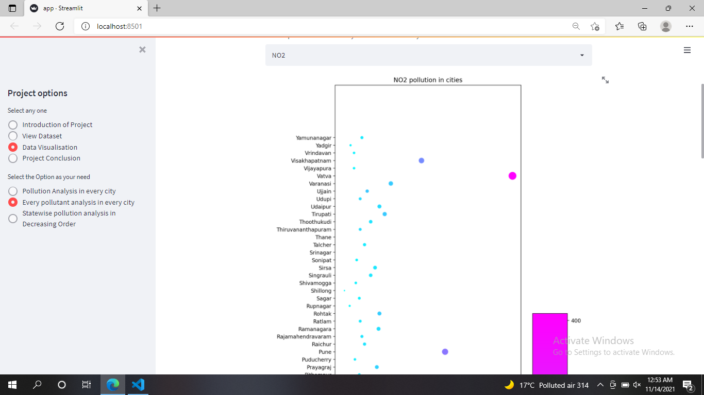

Slide 22
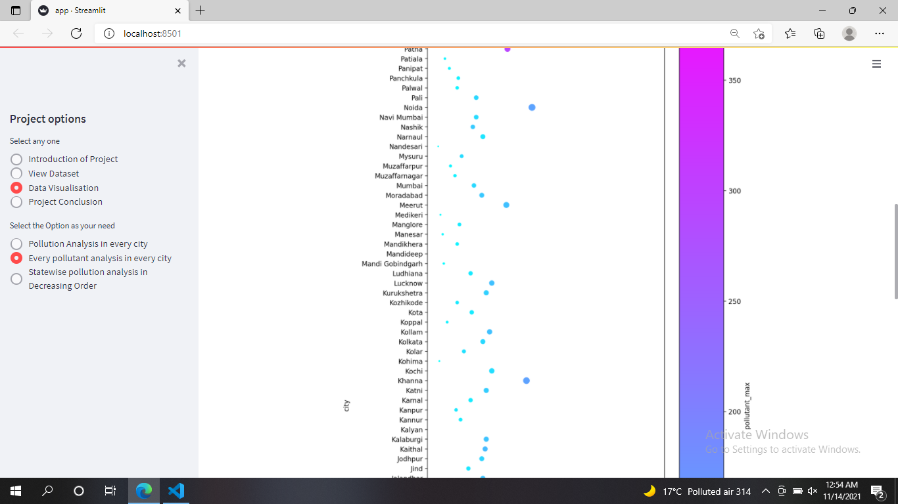

Slide 23
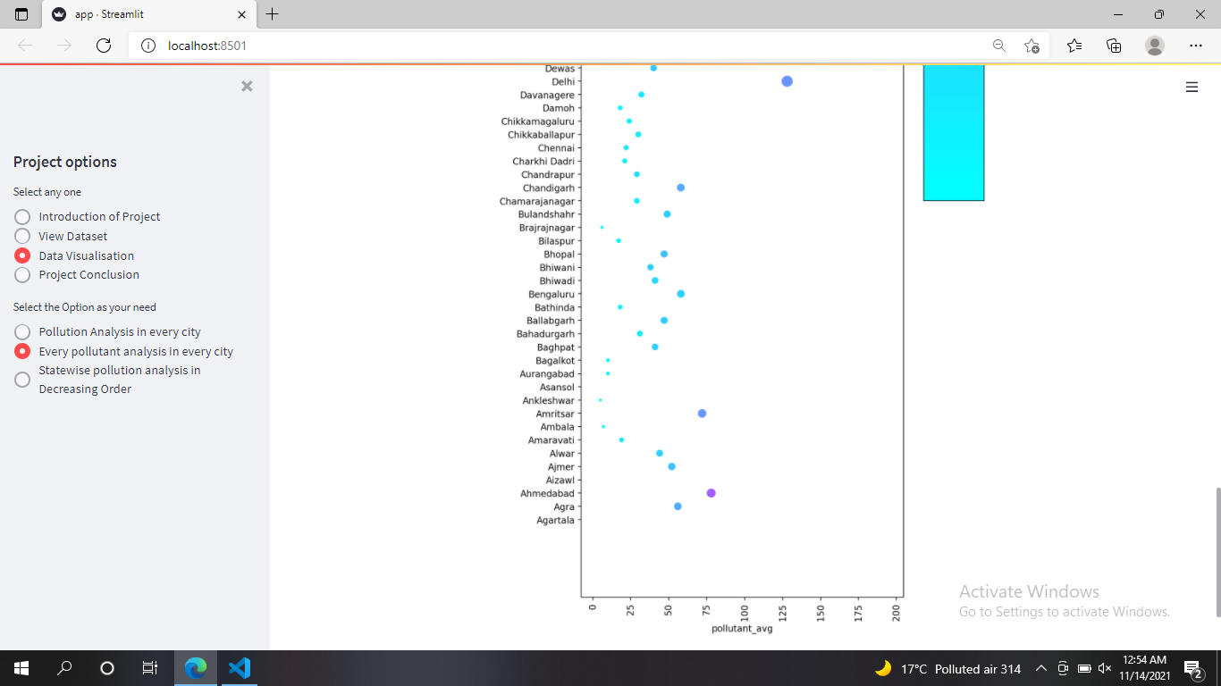

Slide 24
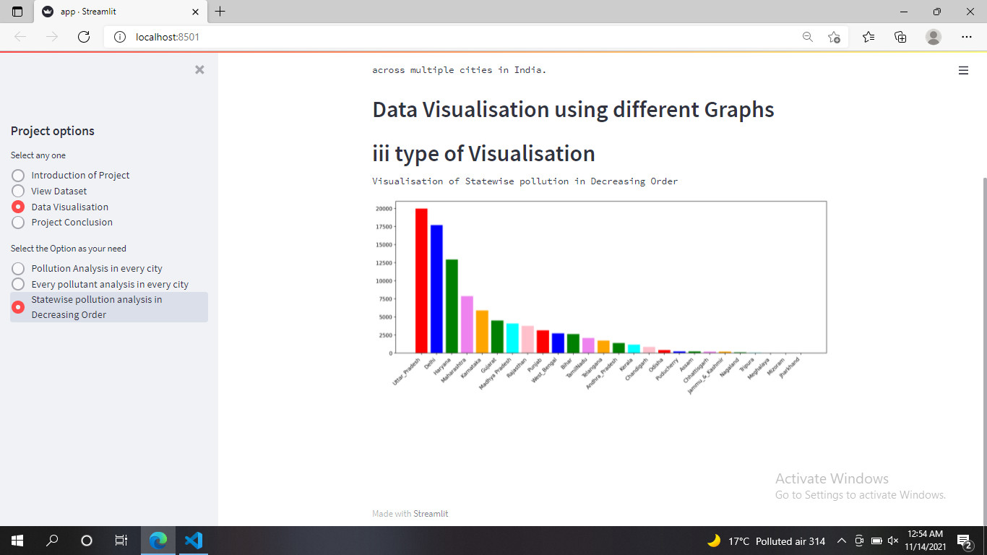

Slide 25
