Slide 1
NEVER MISS BUS
Secure School Bus Live-Tracking App
SRBS INTERNATIONAL SCHOOL
Android + iOS · Flutter + Firebase · Student · Driver · Admin
Presented by: [Apna naam yahan] | August 2026
Notes:
OPENING (30 sec): 'Good morning! Kya aapke bachhe ne kabhi bus miss ki hai? Ya aap sardi/baarish mein stop pe khade intezaar karte rahe ho bina jaane bus kahan hai? Main aapko dikhata hoon Never Miss Bus — hamare school ke liye ek secure live bus tracking app.'

Slide 2
THE PROBLEM
Roz ki pareshani — bus ka intezaar
Students stop pe intezaar karte hain
pata nahi bus 2 minute door hai ya 20
Parents ko tension rehti hai
bachha nikla, bus aayi ya nahi — koi jaankari nahi
Bus miss = poora din kharab
late arrival, extra trips, phone calls
School office pe calls ka bojh
'Bus kahan hai?' — har roz wahi sawaal
Generic GPS apps safe nahi hain
public tracking links = privacy risk for children
Notes:
PROBLEM (1 min): Relatable banao. Audience se poochho — 'Kitne logon ne yeh feel kiya hai?' Last point important hai: normal GPS-sharing apps bachhon ke liye unsafe hain kyunki koi bhi link se location dekh sakta hai.

Slide 3
THE SOLUTION
Never Miss Bus — ek app, teen roles
STUDENT / PARENT
DRIVER
SCHOOL ADMIN
✓ Apni bus LIVE map pe dekho
✓ Ek button: START TRIP
✓ Buses, routes, stops manage
✓ Route, stops, apna stop
✓ GPS automatic share hota hai
✓ Students/drivers assign karo
✓ '~8 min mein aa rahi hai' ETA
✓ Driving ke waqt kuch nahi karna
✓ Saari buses ek map pe
✓ Bus approaching alerts
✓ END TRIP — tracking band
✓ Announcements bhejo
Har role ko sirf wahi dikhta hai jo uske liye hai — backend rules se enforced.
Notes:
SOLUTION (1 min): Teen roles clearly batao. Key line: 'Student sirf APNI bus dekh sakta hai — yeh app ka rule nahi, server ka rule hai. Koi hack karke bhi doosri bus nahi dekh sakta.'

Slide 4
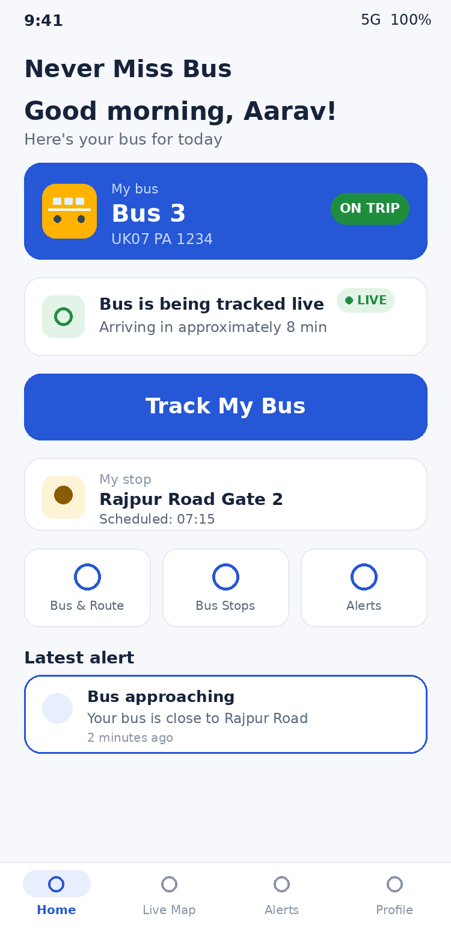
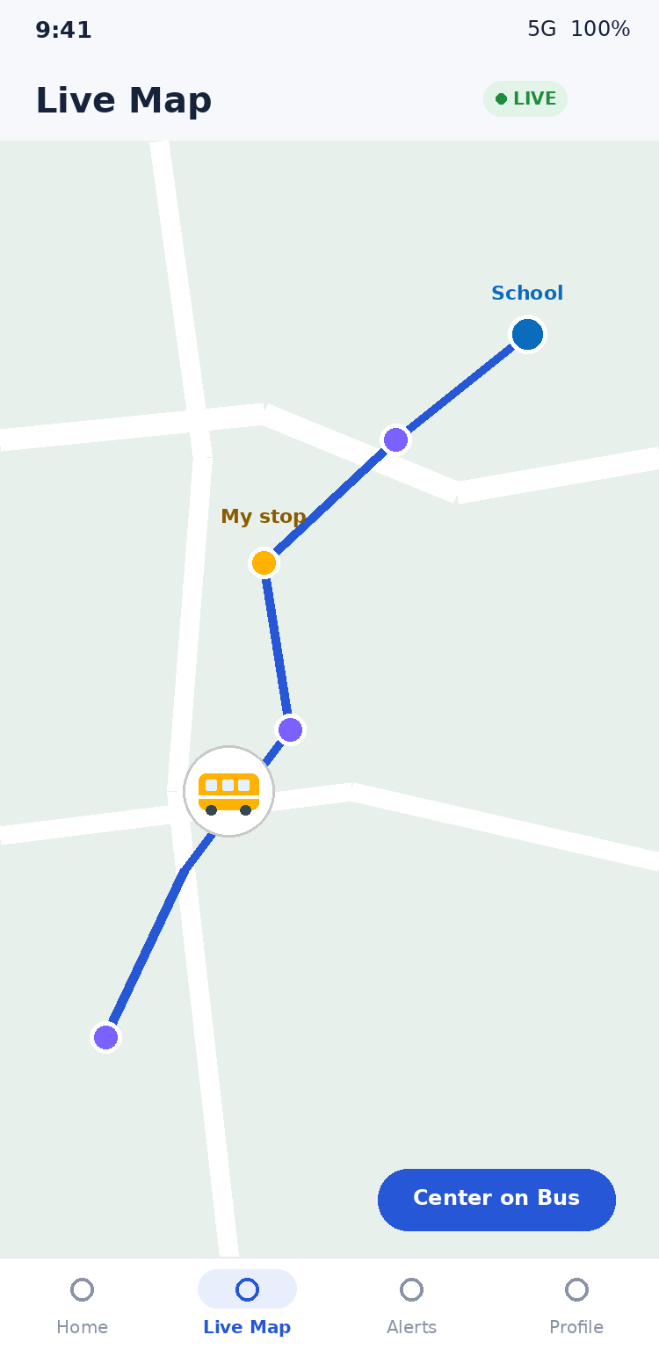
STUDENT EXPERIENCE
Bachhon ke liye — simple aur friendly
• Greeting + apni bus card — bus number, plate, ON TRIP status
• Bada 'Track My Bus' button — ek tap — live map khul jaata hai
• School-bus marker 🚌 — route line, saare stops, apna stop star ke saath
• Honest ETA — 'approximately 8 min' — kabhi jhootha vaada nahi
• Alerts — trip started, bus approaching, bus reached stop
• Agar signal chala jaye — 'Last updated 2 min ago' dikhata hai — purani location ko live nahi bolta
Notes:
STUDENT (1.5 min): Mockups pe point karo. Honest-status wali baat highlight karo — 'Agar driver ka network chala jaye, app jhooth nahi bolti. Saaf batati hai location kitni purani hai.' Yeh trust build karta hai.

Slide 5
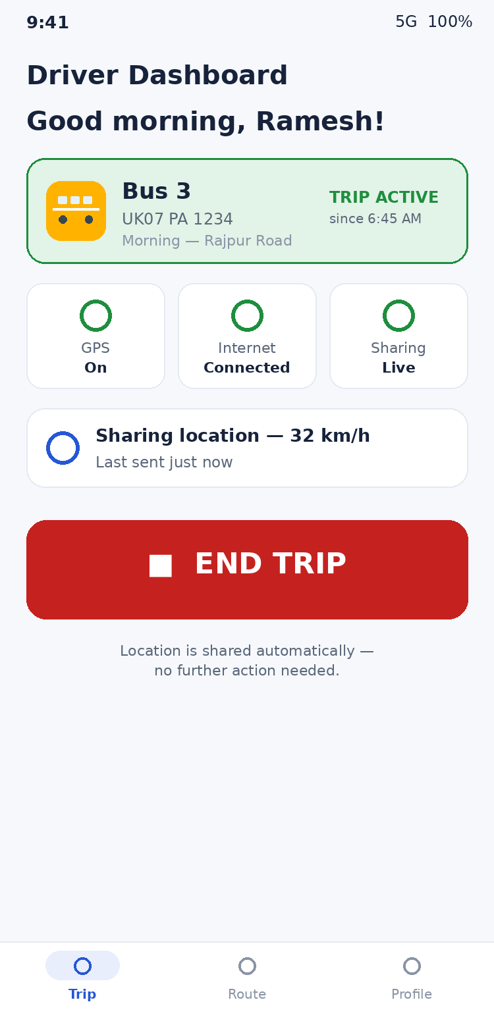
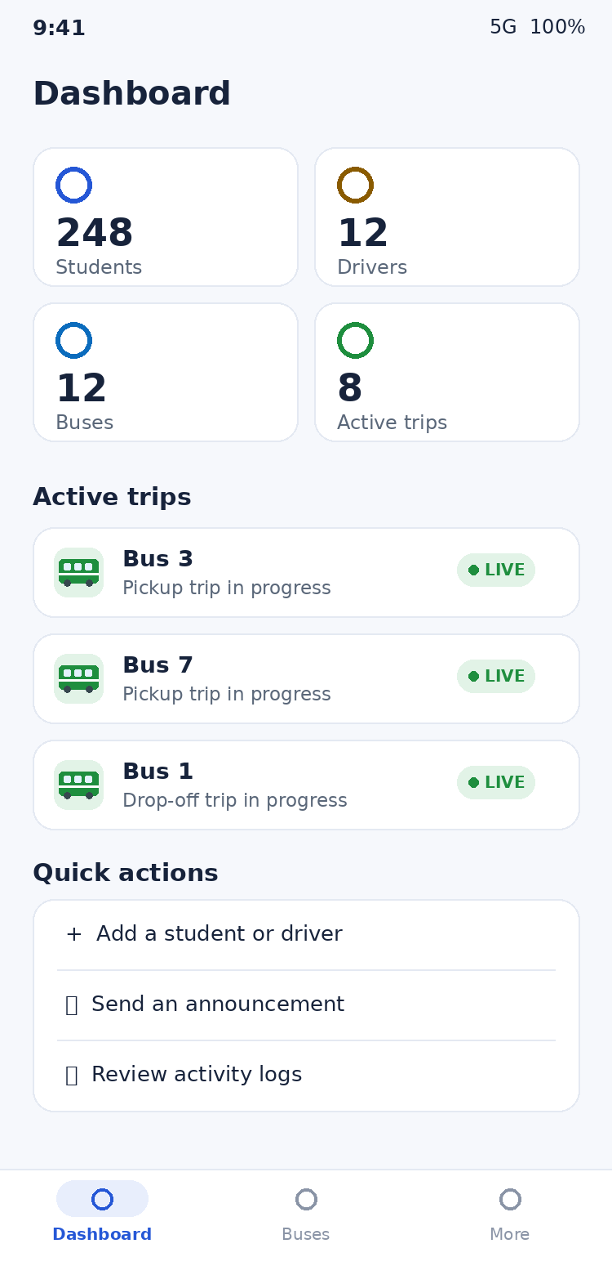
DRIVER & ADMIN
Driver ke liye 1 button · Admin ke liye full control
• Driver: START TRIP dabao, bas — GPS apne aap share hota hai — screen band ho toh bhi
• Driving ke waqt zero distraction — koi interaction ki zaroorat nahi — safety first
• Admin: poora transport structure — Bus → Driver → Route → Stops → Students
• Live monitoring — saari active buses ek hi map pe
• Ek click mein account disable — koi phone kho jaye toh turant access band
• Activity logs — kaun kya kab kiya — sab recorded
Notes:
DRIVER+ADMIN (1.5 min): Driver safety pe zor do — 'Driver ko driving ke time phone chhoona hi nahi padta.' Admin side pe school ka control dikhao — 'School ke paas poora control hai, parents ko sirf dekhne ka access.'

Slide 6
SECURITY & PRIVACY
Bachhon ki safety = sabse pehli priority
🔒
Student sirf apni bus dekh sakta hai
server-side rules — app hack karke bhi bypass nahi hota
🔒
Koi public tracking link nahi
bina school-account login ke kuch nahi dikhta
🔒
Accounts sirf school banata hai
koi khud register nahi kar sakta, koi apni bus change nahi kar sakta
🔒
Students ka personal data minimal
sirf naam, class, bus/stop — phone number tak store nahi hota
🔒
Location history store nahi hoti
trip khatam = location data delete
🔒
Passwords encrypted (Google Firebase)
kabhi plain text mein store nahi hote
🔒
Har admin action ka record
tamper-proof audit log — koi mita nahi sakta
Notes:
SECURITY (1.5 min): Yeh slide parents/principal ke liye sabse important hai. Bolo: 'Yeh WhatsApp location sharing ya generic tracker se bilkul alag hai. Yahan security database ke level pe hai — Google ke Firebase rules — app todne se bhi data nahi milta.'

Slide 7
TECHNOLOGY
Modern, proven, scalable stack
Flutter
Firebase
Google Maps
Cloud Functions
Ek codebase → Android + iOS dono. Google ki technology.
Google ka secure backend — Auth, database, notifications.
Wahi maps jo sab roz use karte hain.
Server-side logic — accounts, alerts, security.
Quality metrics:
✓ 63 Dart files, ~8,000 lines — clean architecture, 0 analyzer issues
✓ 15/15 automated tests passing (freshness honesty, ETA guardrails, security parsing)
✓ Working APK built & verified — aaj hi install karke dikha sakta hoon
✓ Running cost: chhote school ke liye lagbhag ₹0/month (Firebase free limits ke andar)
Notes:
TECH (1 min): Non-technical audience ke liye simple rakho — 'Google ki hi technologies pe bana hai. Cost ki baat zaroor karo: Firebase ka free tier chhote school ke liye kaafi hai.'

Slide 8
LIVE DEMO
Ab main aapko chala ke dikhata hoon
1
Admin login
Bus 3 banayi, route + 4 stops add kiye
2
Student assign
Aarav ko Bus 3 + Rajpur Road stop diya
3
Driver phone
START TRIP dabaya — GPS on
4
Student phone
Track My Bus → bus LIVE chal rahi hai 🚌
5
Notification
'Bus approaching' alert aaya
6
END TRIP
tracking band — student ko saaf dikh gaya
Notes:
DEMO (3-4 min): Do phone use karo — ek driver, ek student. Agar live demo risky lage toh pehle se screen-recording bana lo (backup video). Demo se pehle sab login karke ready rakho. Wow moment: student phone pe bus marker MOVE hota hua dikhao.

Slide 9
NEXT STEPS
Launch plan aur aage ka roadmap
Phase 1 — Pilot (2 hafte)
Phase 2 — Full rollout
Phase 3 — Future ideas
• 1 bus, 1 driver, ~20 students
• Saari buses + routes
• Parent-specific accounts
• Feedback lo, tuning karo
• Parents ko onboarding SMS/note
• Attendance on boarding
• Hindi language option
Never Miss Bus — kyunki har bachhe ka time, safety aur sukoon important hai.
Questions? Main demo ke liye taiyaar hoon. 🚌
Notes:
CLOSING (30 sec): Confident khatam karo. Pilot ka idea do — 'Hum ek bus se shuru kar sakte hain, 2 hafte mein results dikha denge.' Phir Q&A kholo. Common questions ki taiyaari DEMO_SCRIPT mein hai.

