Slide 1
NEVER MISS BUS
School Bus Live-Tracking App — Ab Bus Miss Nahi Hogi! 🚌
SRBS INTERNATIONAL SCHOOL
📱 Android + iOS (iPhone) dono ke liye · Ek hi app — Student, Driver, Admin
Presented by: [Apna naam] | Version 1.2.0 | 2026
Notes:
OPENING (30 sec): 'Good morning! Ek sawaal — kitne logon ke ghar mein roz subah yeh tension hoti hai: bus aayi ya nikal gayi? Aaj main aapko dikhata hoon iska solution — Never Miss Bus, hamare school ka apna secure bus tracking app, jo Android aur iPhone dono par chalta hai.'

Slide 2
THE PROBLEM / SAMASYA
Roz Subah Ki Tension — Bus Kahan Hai?
Students stop par wait karte hain
pata nahi bus 2 minute door hai ya 20 minute
Parents pareshan rehte hain
bachcha nikla, bus aayi ya nahi — koi information nahi
Bus miss = poora din kharab
late arrival, extra trip, phone calls
School office par calls ka load
'Bus kahan hai?' — daily wahi question
Normal GPS apps children ke liye unsafe hain
public tracking links = privacy risk
Notes:
PROBLEM (1 min): Relatable banao — audience se poochho 'Kitne logon ne yeh feel kiya hai?' Last point important: normal GPS-sharing apps bachchon ke liye unsafe hain kyunki koi bhi link se location dekh sakta hai.

Slide 3
THE SOLUTION / SAMADHAN
Ek App — Teen Roles, Sabka Kaam Easy
STUDENT / PARENT
DRIVER
SCHOOL ADMIN
✓ Apni bus LIVE map par dekho
✓ Sirf ek button: START TRIP
✓ Buses, routes, stops manage karo
✓ Class + Roll number se login — email nahi chahiye!
✓ GPS automatic share hota hai
✓ Students class-wise add/edit karo
✓ Route, stops, apna stop ⭐
✓ Driving ke time kuch touch nahi karna
✓ Saari buses ek map par LIVE
✓ '~8 min mein aa rahi hai' — ETA
✓ Screen band ho toh bhi chalta hai
✓ Kaun logged in hai — sab dikhega
✓ Bus approaching alerts
✓ END TRIP — tracking band
✓ Force logout + password reset
Notes:
SOLUTION (1.5 min): Teen roles clearly batao. Key line: 'Student ko email yaad rakhne ki zaroorat nahi — bas Class, Section, Roll number aur password. Aur student sirf APNI bus dekh sakta hai — yeh rule server par hai, hack karke bhi nahi tuteta.'

Slide 4
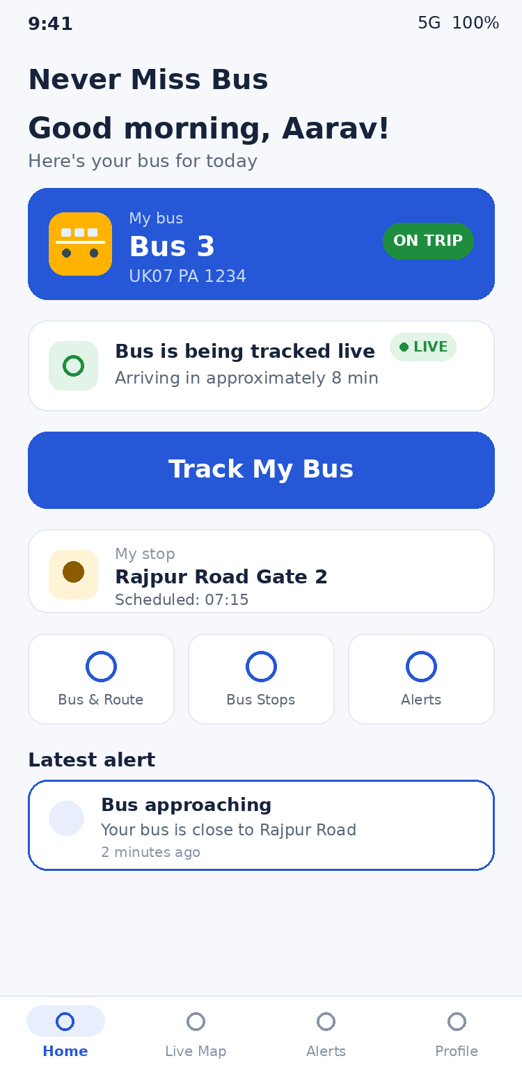
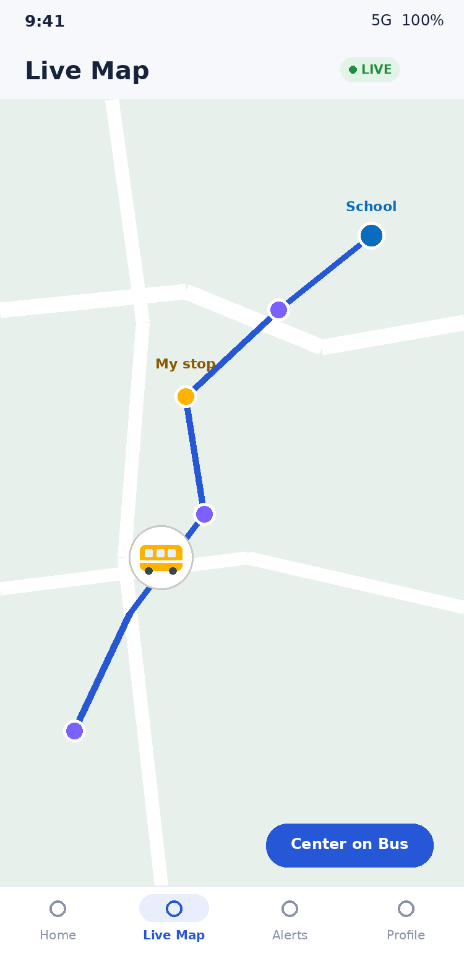
STUDENT EXPERIENCE
Bachchon Ke Liye — Simple, Friendly, Safe
• Login super easy — Class dropdown + Section + Roll number + password — bas!
• Home screen — greeting, apni bus card, ON TRIP status, bada 'Track My Bus' button
• Live Map 🚌 — school-bus marker, route line, saare stops, apna stop star ke saath
• Honest ETA — 'approximately 8 min' — app kabhi jhootha promise nahi karti
• Signal chala jaye toh? — 'Last updated 2 min ago' dikhata hai — purani location ko LIVE nahi bolta
• Alerts — trip started, bus approaching, bus reached stop — automatic
Notes:
STUDENT (1.5 min): Mockups par point karo. Honest-status highlight karo: 'Agar driver ka network chala jaye, app clearly batati hai location kitni purani hai. Yeh trust build karta hai.'

Slide 5
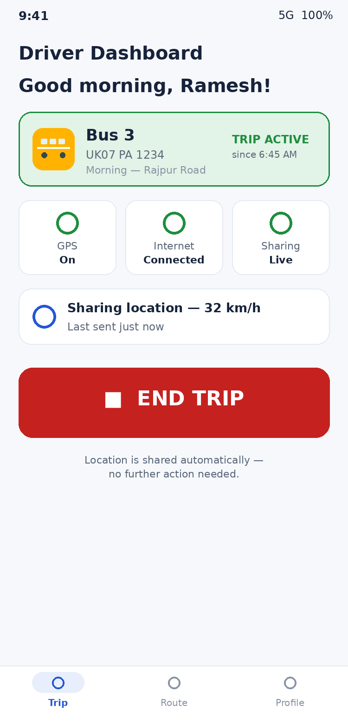
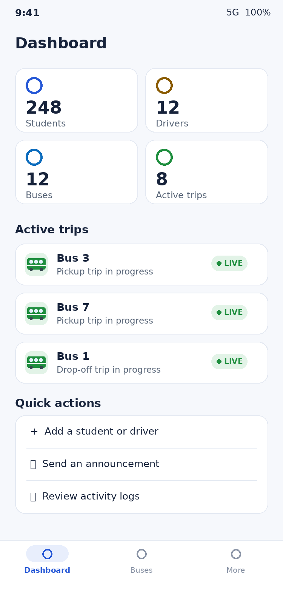
DRIVER & ADMIN
Driver: 1 Button · Admin: Full Control
• Driver: START TRIP dabao, done — GPS apne aap share hota hai — screen off ho toh bhi
• Zero distraction while driving — safety first — koi interaction ki zaroorat nahi
• Admin Dashboard — buses, active trips, students, drivers — sab ek nazar mein
• Class-wise students — Class 7-B ke sab bachche ek tap mein filter
• Trip History — kaunsi bus kab chali, kitni der — poora record
• Activity logs — kaun kya kab kiya — sab recorded, koi mita nahi sakta
Notes:
DRIVER+ADMIN (1.5 min): Driver safety par zor do — 'Driver ko driving ke time phone chhoona hi nahi padta.' Admin side: 'School ke paas full control hai.'

Slide 6
SECURITY & PRIVACY
Bachchon Ki Safety = #1 Priority 🔐
🔒
Ek ID = Ek Phone (Single-Device Login)
dusre phone par login karo toh pehla automatically logout — password sharing ka misuse impossible
🔒
Admin ko dikhta hai kaun LOGGED IN hai
har student/driver ka device status + Force Logout button
🔒
Student sirf apni bus dekh sakta hai
server-side rules — app hack karke bhi bypass nahi hota
🔒
Koi public tracking link nahi
bina school account ke kuch nahi dikhta
🔒
Accounts sirf school banata hai
koi khud register nahi kar sakta
🔒
Data minimal & private
location history store nahi hoti — trip khatam, data delete
🔒
Passwords encrypted (Google Firebase)
kabhi plain text mein store nahi hote
Notes:
SECURITY (2 min): Yeh slide parents/principal ke liye sabse important. Single-device feature highlight karo: 'WhatsApp jaisa — ek account ek hi phone par. Password share ho bhi jaye, ek time par ek hi device chalega, aur admin ko dikhega kaun kahan logged in hai.'

Slide 7
TECHNOLOGY
Modern Tech — Android + iPhone Dono Par
Flutter
Firebase
OpenStreetMap
Real-time GPS
Google ki technology — ek code se Android + iOS dono apps
Google ka secure backend — login, database, real-time
Free world map — koi paid API nahi chahiye
Bus location har 5 second update hoti hai
Quality & Platform facts:
✓ Android APK ready & tested — aaj hi install ho sakta hai
✓ iOS (iPhone) — same code, sirf Apple Developer account chahiye ($99/year, school ke naam par)
✓ ~9,000 lines code · 0 analyzer errors · 15/15 automated tests passing
✓ Running cost: chhote school ke liye approx ₹0/month (Google free tier)
✓ Version 1.2.0 — single-device security, roll-number login, trip history
Notes:
TECH (1 min): Simple rakho — 'Google ki hi technology par bana hai. Android phone ke liye APK ready hai. iPhone ke liye same code hai, bas Apple ka developer account chahiye jo school le sakta hai. Chalane ka kharcha lagbhag zero.'

Slide 8
LIVE DEMO
Ab Main Chala Ke Dikhata Hoon 🎬
1
Admin login
Dashboard — buses, students, active trips ek nazar mein
2
Student add karo
Class dropdown + Roll number — 30 second ka kaam
3
Driver phone
START TRIP dabaya — GPS sharing on
4
Student phone
Class 7-B + Roll 23 + password se login → Track My Bus → LIVE! 🚌
5
Security demo
Dusre phone par same ID login → pehla phone auto-logout!
6
Admin panel
LOGGED IN status + Force Logout button dikhao
Notes:
DEMO (3-4 min): 2 phones ready rakho. Step 5 ka single-device demo sabse impressive hai — audience ko live dikhao ki dusre phone par login karte hi pehla logout ho jaata hai. Backup video zaroor banao pehle se!

Slide 9
NEXT STEPS
Launch Plan — Chhota Start, Bada Impact
Phase 1 — Pilot (2 weeks)
Phase 2 — Full Rollout
Phase 3 — Future
• 1 bus, 1 driver, ~20 students
• Saari buses + routes
• iPhone version launch
• Feedback lo, improve karo
• Parents ko onboarding note
• Parent accounts
• Aur bhi features
Never Miss Bus — kyunki har bachche ka time, safety aur parents ka sukoon important hai.
Questions? Demo ready hai! 🚌 | Android + iOS | Secure | ~₹0/month
Notes:
CLOSING (30 sec): Confident end karo. Pilot proposal do — 'Ek bus se shuru karte hain, 2 hafte mein results dikha denge.' Phir Q&A. All the best! 🚀

