Slide 1




Process Mining using bupaR for Healthcare process
Snehal Agrawal

Slide 2
Purpose and Goals
Problem
There are vast volumes of data collected and stored in the healthcare industry, as in many industries, but left unanalyzed. This is untimely as the data may provide historical details or patterns that could assist in the development of current and future models of processes, strategies, and predictions.
Solution
Process Mining - To provide a broad summary of processes in a short time, explain unstructured and multidisciplinary processes, design advancement opportunities for processes, and incorporate domain knowledge into process validation.
Challenges
Healthcare processes are complex and involve actions carried out by workers from multiple backgrounds and offices. This complexity makes examining and understanding the dynamic, complex, and cross-functional processes fascinating but difficult.
Data
We would be exploring a pre-loaded event log object (dataset) in bupaR package in R called patients. patients is an artificial event log about a hospital's processes involving patients’ admission.
The project focuses on process analysis to help extract the processes involved in an event and make use of tools to redesign the system as the businesses want it 'to-be'.

Slide 3
Concepts of Process Mining
Event log - The key data source within process mining is event log. The event log is the historical record of the execution of the business processes, containing all their different instances like Order 121, the activities involved like receiving the goods from the supplier, the people in charge of each activity, and the starting and finishing times of each activity and other associated data like the product to be purchased, supplier or requesting department.
Activity - Activity is a well-defined step in a process, e.g., registration, blood test.
Case Identifier - A case identifier is a unique identifier that allows activities to be tagged to the respective case, e.g., patient identifier.
Activity instance identifier - The activity instance identifier is a unique identifier that allows an activity instance to be tagged to the related activity.
Process Model – Process model is the graphical representation of business processes or workflows in an organization, as a means of identifying possible improvements. Process models describe the ordering of activities in a process.

Slide 4

Method of Process Mining
Define
Define the scope and goals of the project and questions to be answered
Extract
Extract the data on cases, activities, and timeframe
Format
Format event data as event logs and abstract or filter as sub-processes
Visualize
Visualize event logs in a log/pattern investigation activity to obtain the limitations and opportunities of the datasets
Apply
Apply the process mining techniques to find answers
Evaluate
Evaluate the answers and gather the scope of improvements
Use
Use the findings to create process improvement proposals

Slide 5
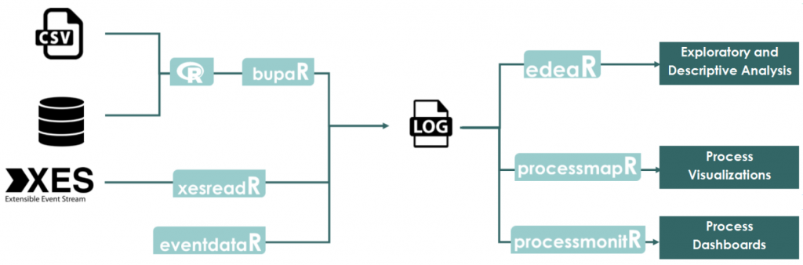

bupaR
Notes:
bupaR
bupaR consists of various R packages, each with a specific purpose to fulfill in the process analysis. The package bupaR itself acts as the core of the suite bupaR provides support for various stages in process analysis, such as importing event data, calculating descriptive, process monitoring and process visualization. bupaR includes basic functionality for generating event log objects in R.
edeaR
edeaR stands for Exploratory and Descriptive Event-Based Data Analysis, and its purpose is to perform more in-depth analyses of event logs. It basically contains two sets of functions: process metrics to describe and explore event logs and data filters for data subsetting. The process metrics are based on Lean Six Sigma literature and can be analyzed and visualized at different levels of granularity [5].
eventdataR
The eventdataR package provides a data repository with both artificial and real-life event logs to experiment with new techniques and algorithms. Currently, both artificial event data such as patients dataset, as well as real-life event data, such as the sepsis dataset, exist in this package. Each of them can be loaded very easily with the data function in R [5].
xesreadR
The xesreadR package allows to read and write xes-files. This makes bupaR compatible with the IEEE standard for sharing and storing event data, and thus with other process mining tools. For example, this is beneficial if we want to combine bupaR with RapidProM, as RapidMiner also supports the use of R-scripts [5].
processmapR
The package processmapR provides a means of creating visualizations of the process, such as process maps and dotted charts, using customizable map profiles [6]. The visualizations produced are highly customizable and can be used to provide insights into various aspects of the process. The default profile is the frequency profile on both arcs and nodes, with absolute frequencies. The combination of processmapR functions with edeaR subsetting functions will simplify complex graphs.
processmonitR
processmonitR provides a limited set of process dashboards. These can be used in a permanent, real-time fashion, as well as for interactive data analysis. The available dashboards, which build upon the Shiny framework [7], are largely organized along with the metrics of edeaR.

Slide 6
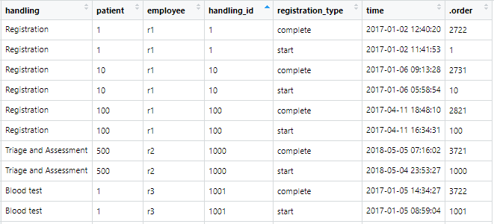
Data Summary
The patients dataset contains 5442 observations of 500 patients and 7 variables.
handling: the activities involved in the patients’ admission in the hospital (factor)
patient: patient id, unique for each patient (character)
employee: individual responsible for the instance of the process/activity (factor)
handling_id: uniquely identifies instances of activity treated as different from others (character)
registration_type: status as start or complete of the activity (factor)
time: timestamp at which logging was done (date time)
.order: a unique identifier for the whole dataset (integer)
Each row in the event log dataset is an event that belongs to a case (a patient).
Different events together can form an activity instance, or execution (e.g. event 3-4 belong to Registration 10).
Each event in such execution will have a different transactional lifecycle status as start or complete.
There can be different instances of a specific activity (e.g., there are two registrations).
Each event has a timestamp, indicating when it happened, and a resource (employee), indicating who performed it.

Slide 7
Explanatory Data Analysis

Slide 8
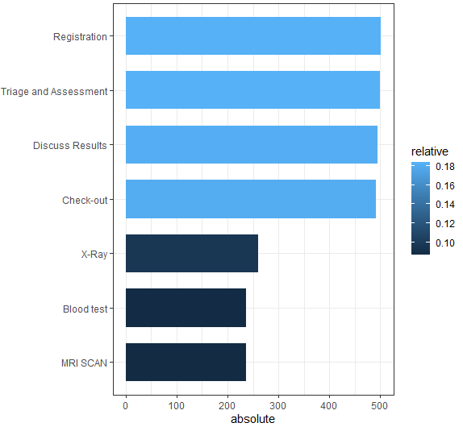
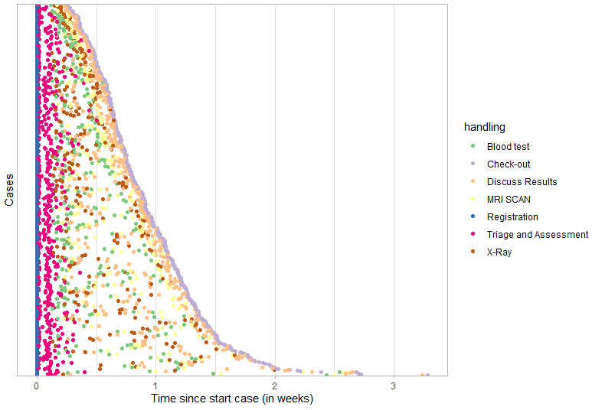
Plot between case identifiers and time
Plot between activities and their frequency
The plot shows that the highest frequency activity is Registration and Triage and Assessment, which is to be expected. Also, Discuss Results and Check-out has high frequency. X-Ray, Blood test, and MRI Scan have least frequency since not all patients go through these phases.
The plot shows that there is a considerable variation in terms of cycle time. Further, the chart suggests that there might be three distinct classes of cases: those that take no more than 1 week, those taking between 1 to 2 weeks, and a small class of cases taking longer than 2 weeks.

Slide 9
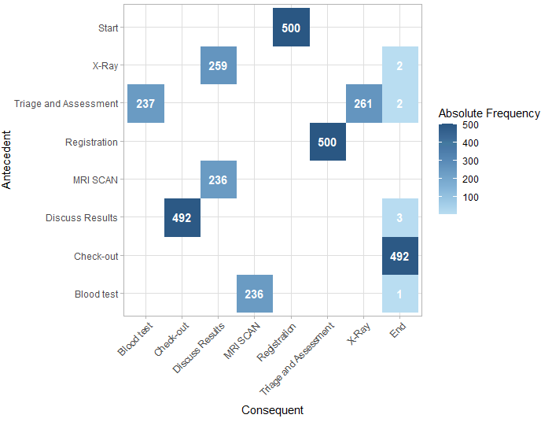
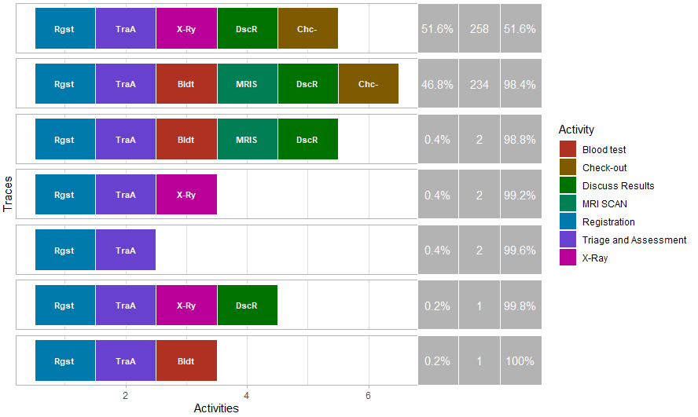
Plot of frequent traces
Plot between activities (Precedence Matrix)
The plot shows that Start point is always Registration whereas the End point is usually Check-out but not always. Registration and Triage and Assessment goes together in 500 cases (which is the total number of cases). Triage and Assessment goes together with Blood test in 237 times of cases, while with X-Ray in 261 times of cases. Discuss Results and Check-out goes together in 492 times of cases.
The plot shows that the first two activity sequences cover 98.4% of the event log, meaning maximum of the cases follow these 2 paths of activities. All the remaining sequence together covers only 1.6% of the cases which means a very few proportions of the cases follow the other paths in the hospital admission.

Slide 10
Summary statistics of processing time of each activity
Summary statistics of processing time of case
Activity | min | q1 | mean | median | q3 | max | std_dev | iqr | relative_freq
Registration | 49.3 | 124.2 | 165.2 | 162.8 | 204.1 | 338.0 | 57.2 | 79.8 | 0.184
Triage and Assessment | 352.1 | 681.1 | 786.3 | 800.4 | 901.8 | 1128.1 | 165.5 | 220.7 | 0.184
Discuss Results | 80.0 | 138.9 | 166.5 | 166.3 | 193.2 | 272.1 | 37.6 | 54.3 | 0.182
Check-out | 40.0 | 96.7 | 123.7 | 124.3 | 148.3 | 233.7 | 37.2 | 51.6 | 0.181
X-Ray | 137.7 | 233.2 | 290.7 | 287.5 | 338.9 | 490.1 | 76.8 | 105.7 | 0.096
Blood test | 185.7 | 285.4 | 332.1 | 328.1 | 376.0 | 488.2 | 63.5 | 90.6 | 0.087
MRI Scan | 149.4 | 216.4 | 248.9 | 245.4 | 281.8 | 355.4 | 44.1 | 65.3 | 0.086
min | q1 | median | mean | q3 | max | std_dev | iqr
0.45 | 1.04 | 1.155 | 1.156 | 1.28 | 1.59 | 0.17 | 0.24
We see that the Triage and Assessment usually takes much longer time than all the other activities. Whereas Registration, Check-out, and Discuss Results takes the least amount of time.
We see, on average, a case lasts for 1.156 days with a minimum of 0.45 days and a maximum of 1.59 days being invested.

Slide 11
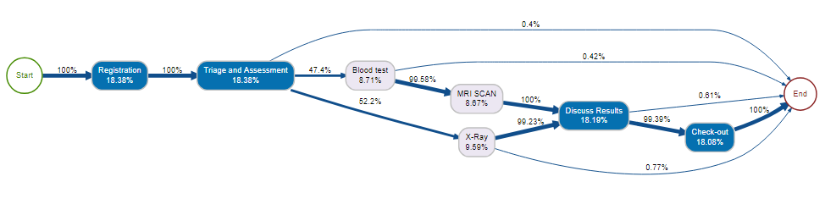
Process Model
The process starts from the Start where 100% of the cases moves to the Registration and then to Triage and Assessment, denoting that all the patients must have to go through these 2 steps during healthcare admission. The arrows represent the transition or next activity in the process. The activity of Triage and Assessment leads to a series of steps, whether to X-Ray, Blood test, as well as to the End with 52.2%, 47.4%, 0.4% of chances respectively, as each patient follows a different route, based on their condition and encounter. Also, it appears in some cases, that after the Blood test or X-Ray results, patients were then released without Check-out. Furthermore, in 99.58% of the patient cases getting Blood test, the patients go through MRI Scan.

Slide 12
Other Tools
ProM and Apromore both provide an easy to use graphical user interface for non-expert usability. Though the user-friendly interface attracts the non-expert users to use and showcase process mining capabilities to a broader audience, it hinders the usability of the tools for large-scale scientific experimentation.
RapidMiner is connected to the process mining framework ProM to form the RapidProM tool to allow for repeated execution of large-scale experiments with process mining algorithms. RapidProM does not provide a way to either customize an algorithm or integrate custom-developed algorithms.

Slide 13
Conclusions
Advantages
Effective and efficient
Highlights vast areas for investigation
Easy to use
Provides overview of processes in a user-friendly manner
Improved techniques for use
Limitations
Data used was artificial
Only one dataset was used
Many other packages available
Complex process models are difficult to read
Improvement points
Actual process can be compared with logged process
Wait-time for customers can be reduced
Resources can be distributed accordingly
Processes can be automated
Invalid traces can be eliminated
Proper logging should be placed

Slide 14
References
[1] Alessandro Berti, Sebastiaan J. van Zelst, Wil M.P. van der Aalst - RWTH Aachen University, "Process Mining for Python (PM4Py): Bridging the Gap Between Process- and Data Science", 15 May 2019
[2] W. van der Aalst, Process Mining Data Science in Action. Springer-Verlag Berlin Heidelberg, 2016.
[3] Aguirre, S., Parra, C. and Sepúlveda, M. (2017) ‘Methodological proposal for process mining projects’, Int. J. Business Process Integration and Management, Vol. 8, No. 2, pp.102–113.
[4] Tugba Gurgen Erdogan and Ayca Tarhan, "A Goal-Driven Evaluation Method Based On Process Mining for Healthcare Processes" Received: 7 April 2018; Accepted: 27 May 2018; Published: 30 May 2018
[5] Gert Janssenswillen, Benoˆıt Depaire, UHasselt - Hasselt University, Faculty of Business Economics, Agoralaan, 3590 Diepenbeek, Belgium, Research Foundation Flanders (FWO), Egmontstraat 5, 1060 Brussels, Belgium, "bupaR: Business Process Analysis in R"
[6] Janssenswillen, G., Depaire, B., Swennen, M., Jans, M., & Vanhoof, K. (2019). bupaR: Enabling reproducible business process analysis. Knowledge-Based Systems, 163, 927-930.
[7] Chang, W., Cheng, J., Allaire, J., Xie, Y., McPherson, J.: shiny: Web application
framework for r, 2015. URL http://CRAN. R-project. org/package= shiny. R package version 0.11 (2015)
[8] Gert Janssenswillen, September 29, 2017 , “bupaR: Business Process Analysis with R”
[9] Shannon Feeley, Ian Jacoway, Gina Rios, WORCESTER POLYTECHNIC INSTITUTE, April 27, 2017, “Process Mining the Credit Suisse Advisory Process”
[10] Renee M. Hendricks, Published online 2019 Sep 19., “Process Mining of Incoming Patients with Sepsis”

Slide 15
Thank You

