Slide 1
Substation
Automation
System
By :-Ayush Agrawal
2018A8PS0568G

Slide 2
Substation

Slide 3
A substation is a part of an electrical generation, transmission, and distribution system.
Substations transform voltage from high to low, or the reverse, or perform any of several other important functions.
Between the generating station and consumer, electric power may flow through several substations at different voltage levels.
A substation may include transformers to change voltage levels between high transmission voltages and lower distribution voltages, or at the interconnection of two different transmission voltages.

Slide 4
Significance of Substations

Slide 5
To accommodate new power generation sources.
Helps in isolating faults quickly.
To maintain reliability requirements
With increasing congestion in the cities, substations help in providing proper electricity supply.
To step up or step down AC voltage using transformer(s)

Slide 6
Automation

Slide 7
Automation is the technology by which a process or procedure is performed with minimal human assistance.
Automation is the use of various control systems for operating equipment such as machinery, processes in factories, and other applications and vehicles with minimal or reduced human intervention.
Automation can be performed in many ways in various industries. For example, in the information technology domain, a software script can test a software product and produce a report.

Slide 8
Significance of Automation

Slide 9
Produce high-quality goods for the consumers.
Automation can help in producing high quality goods at faster speed.
Generates a high ROI for the investors
Automation may incur hefty initial costs but helps to save a lot of money in the long run
Increases safety in factories
Automation enables machines to do dangerous tasks in the industries which earlier were done by humans.

Slide 10
PLCs

Slide 11
A programmable logic controller (PLC) is an industrial digital computer which has been ruggedized and adapted for the control of manufacturing processes, such as assembly lines, or robotic devices, or any activity that requires high reliability, ease of programming and process fault diagnosis.
One side of PLC is connected to sensors which act as inputs.
CPU of a PLC processes data and takes required action using actuators.

Slide 12
SCADA

Slide 13
SCADA is an acronym for supervisory control and data acquisition.
It is a computer system for gathering and analyzing real time data.
SCADA systems are used to monitor and control a plant or equipment in industries such as telecommunications, water and waste control, energy, oil and gas refining and transportation.

Slide 14
Softwares Used

Slide 15
WPLSoft
WPLSoft is a software for PLC. WPLSoft is used to monitor the set value or temporarily saved value in timer (T), counter (C), and register (D) and force On/Off of output contacts when PLC is in operation.
Control Expert
EcoStruxure Control Expert is a unique software platform, by Schneider Electric, to increase design productivity and performance of PLCs.
Citect SCADA
Citect SCADA is a reliable, flexible and high performance Supervisory Control and Data Acquisition (SCADA) software solution for industrial process customers, offered by Schneider Electric.

Slide 16
Ladder Logic

Slide 17
Ladder logic is one of the five popular PLC programming language.
The name is based on the observation that programs in this language resemble ladders, with two vertical rails and a series of horizontal rungs between them.
Rung input : checkers (contacts)
—[ ]— Normally open contact, closed whenever its corresponding coil or an input which controls it is energized. (Open contact at rest)
—[\]— Normally closed ("not") contact, closed whenever its corresponding coil or an input which controls it is not energized. (Closed contact at rest)
Rung output: actuators (coils)
—( )— Normally inactive coil, energized whenever its rung is closed. (Inactive at rest)
—(\)— Normally active ("not") coil, energized whenever its rung is open. (Active at rest)

Slide 18
Substation Automation

Slide 19
Substation Automation refers to using IEDs to remotely control devices to control a substation.
Makes power grids smarter and more reliable.
Controls both generation and delivery of power.
Monitoring of power delivery systems reduces chances of outages.
It also shortens the duration of outages that do occur.

Slide 20
Need of Substation Automation

Slide 21
Intelligent bus failover and load restoration.
Prevents overloading of transformer when another transformer fails.
Supply line sectionizing
Equipment conditioning monitoring.
Automatically detects the emergence of various abnormal operating conditions, using specialized sensors and diagnostic tools.
Adaptive Relaying
Automatically alters the settings of protective relay IEDs based on system conditions.

Slide 22
Implementation

Slide 23
We had to develop a demo of a smart substation system.
In this system there are 4 feeders that draw power from a main feeder.
Each feeder has 2 loads attached to it.
Whenever there’s a fault in any of the feeder, the supply to the feeder is disconnected preventing loads from any harm.
The circuit was implemented in Control Expert using Ladder Logic.
The simulation was done in Citect SCADA.

Slide 24
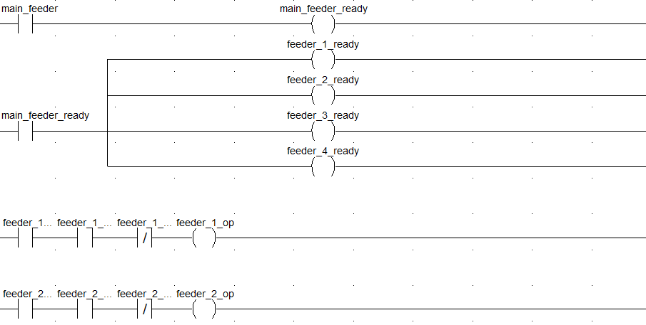
Ladder Logic Diagram

Slide 25
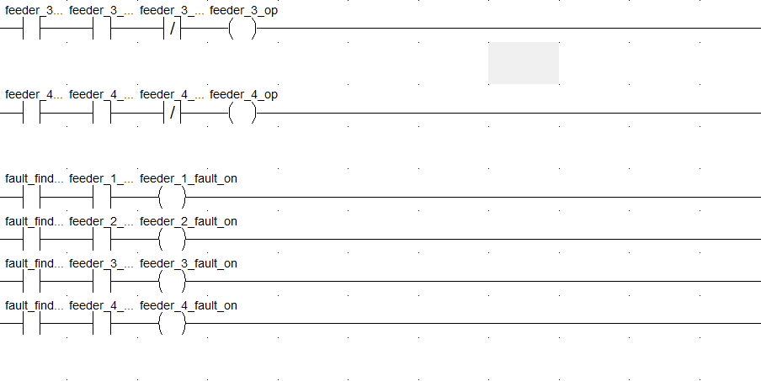
Ladder Logic Diagram

Slide 26
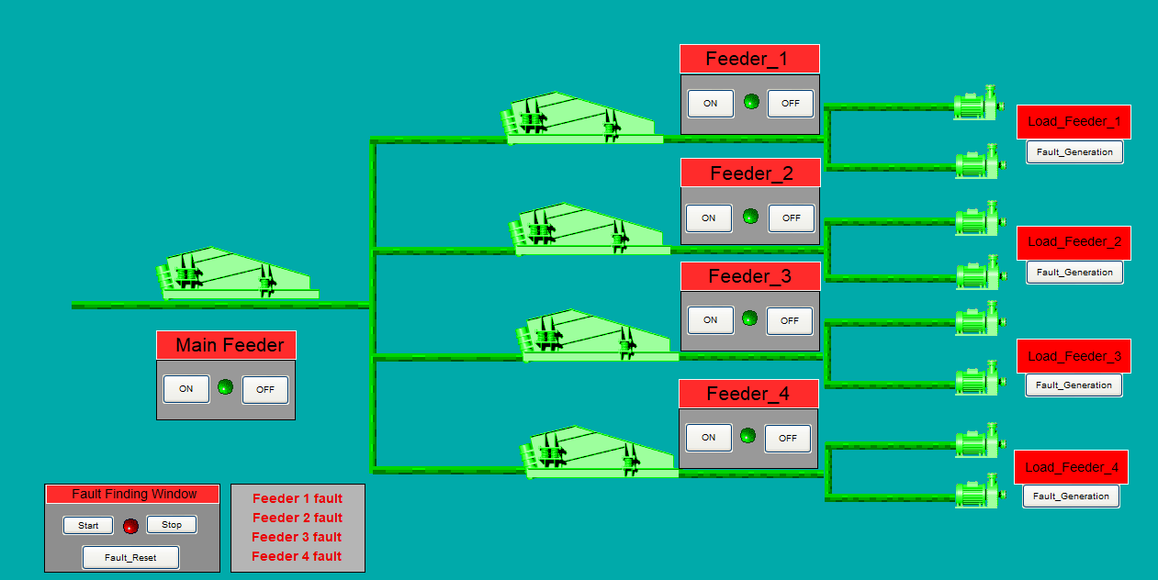
SCADA Screen

Slide 27
Learnings from PS - I

Slide 28
Got to learn about RMJ Automation and its role in the automation industry.
Learned about Automation & its importance.
Learned about PLCs, SCADA, HMI.
Programmed PLCs using ladder logic in WPLSoft and Control Expert.
Simulated PLC programs in Control Expert.
Simulated a circuit in Citect SCADA.
Programmed a Substation Automation demo using Control Expert and used Citect SCADA for simulation and better visual aids.

Slide 29
Thank
You
Instructor-: Prof. Vinay Belde
Mentor-: Kiran Ma’am

