Slide 1
S
SHINE STUDIO | System Architecture & Product Blueprint
01 / 24
End-to-End AI Video Studio Architecture
Shine — Next-Gen AI Micro-Drama Studio
Transforming raw text prompts into viral 9:16 vertical drama series (20–50 episodes) with multi-agent AI directors, consistent character personas, in-browser WebGL editing, and Google Cloud serverless infrastructure.
MARKET SEGMENT Vertical Micro-Drama $10B+ Global Market Boom
CREATIVE BRAIN Multi-Agent AI Director Gemini 3.5 Flash & Veo 3.1
EDITOR CORE Pixi.js WebGL NLE In-Browser Zero-Cost Render
INFRASTRUCTURE Cloud Run Serverless Scale-to-Zero ($0 Idle Cost)

Slide 2
S
SHINE STUDIO | System Architecture & Product Blueprint
02 / 24
MARKET CONTEXT
The Explosive Rise of Vertical Micro-Dramas
$10B+ GLOBAL MARKET BY 2027 Pioneered by Chinese Wēi Duǎnjù and rapidly expanding across the US, Southeast Asia, Latin America, and Europe via TikTok, ReelShort, DramaBox, and Shorts.
1–3 Min EPISODIC FORMULA Serialized 20–50 episode dramas with fast conflict escalation, intense emotional payoffs, and cliffhangers every 60–90 seconds to maximize viewer retention.
3.5x HIGHER MONETIZATION VELOCITY Micro-dramas convert viewers into paying subscribers 3.5x faster than traditional streaming platforms through pay-per-episode paywalls.
📊 Opportunity: The creator economy needs automated software to produce hundreds of high-quality vertical drama episodes per month with minimal budget.

Slide 3
S
SHINE STUDIO | System Architecture & Product Blueprint
03 / 24
MARKET PAIN POINTS
Core Production Bottlenecks in Vertical Drama
1. High Physical Production Costs Traditional filming requires casting actors, renting sets, filming crews, and extensive editing suites, costing $30,000–$100,000+ per series. 2. Character Visual Drift in Generative AI Existing text-to-video tools fail to preserve consistent facial geometry, attire, and lighting across consecutive scenes, ruining narrative immersion.
3. Prohibitive Localization & Dubbing Costs Translating video series into foreign languages traditionally requires re-rendering video clips from scratch, incurring massive GPU compute bills. 4. Disconnected Toolchains Creators waste hours juggling separate tools for scriptwriting (ChatGPT), image gen (Midjourney), video gen (Runway), and NLE editors (Premiere).

Slide 4
S
SHINE STUDIO | System Architecture & Product Blueprint
04 / 24
TARGET MARKET
Product-Market Fit & Ideal Customer Profiles
Independent Writers & Creators Web novel authors and solo creators who want to transform written stories into monetizable vertical video series without camera crews. [Value: 100x faster production]
Digital Media Studios & Agencies Agencies producing high-volume serialized content for TikTok, YouTube Shorts, and Reels to capture ad revenue and subscriber paywalls. [Value: 80% cost reduction]
Global Localization Teams Publishers localizing domestic drama hits into international markets (EN, VI, ZH, JA, KO, ES) with instant neural voice swapping. [Value: Zero-video-render dubbing]
🎯 The Shine Value Proposition: Turn a single creative individual or small team into a full-fledged serialized drama production studio.

Slide 5
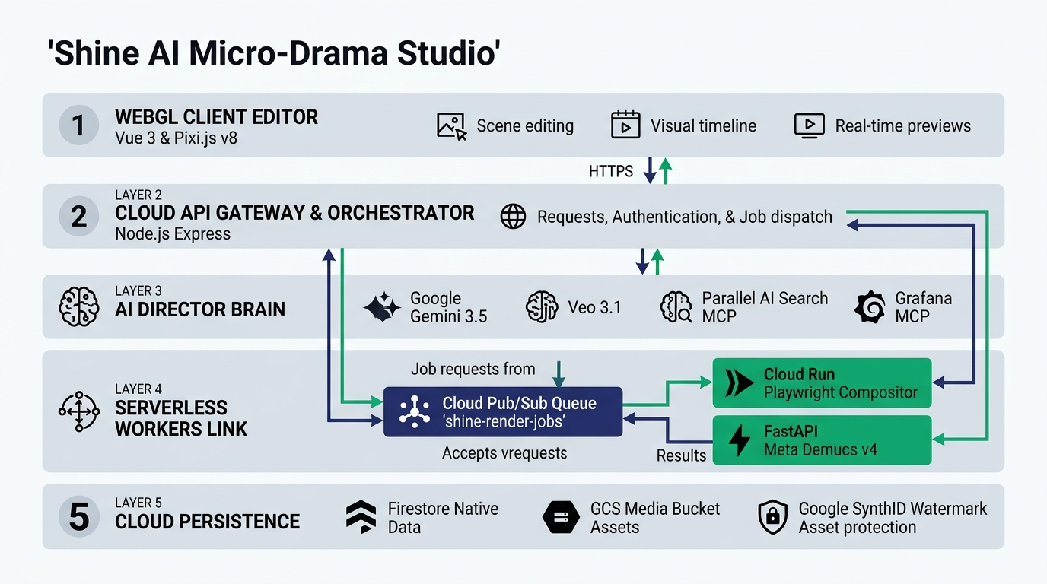
S
SHINE STUDIO | System Architecture & Product Blueprint
05 / 24
SYSTEM BLUEPRINT
High-Level System Architecture & 5-Tier Pipeline
1. Client WebGL Studio Vue 3 SPA + Pixi.js v8 NLE. Zero-render scrub & WebCodecs MP4.
2. Cloud API Gateway Node 22 Express :3001 + JWT Auth & 31 REST Controllers.
3. AI Director Brain Gemini 3.5 & Veo 3.1 + Parallel MCP & Grafana Loki MCP.
4. Serverless Workers Link Cloud Pub/Sub (shine-render-jobs) dispatches to Playwright & Demucs v4.
5. Data & Storage Firestore Native (shine-db), GCS Media Bucket & SynthID.
WORKER BUS: Cloud Pub/Sub (shine-render-jobs) • REST/SSE • 100% Google Cloud Native

Slide 6
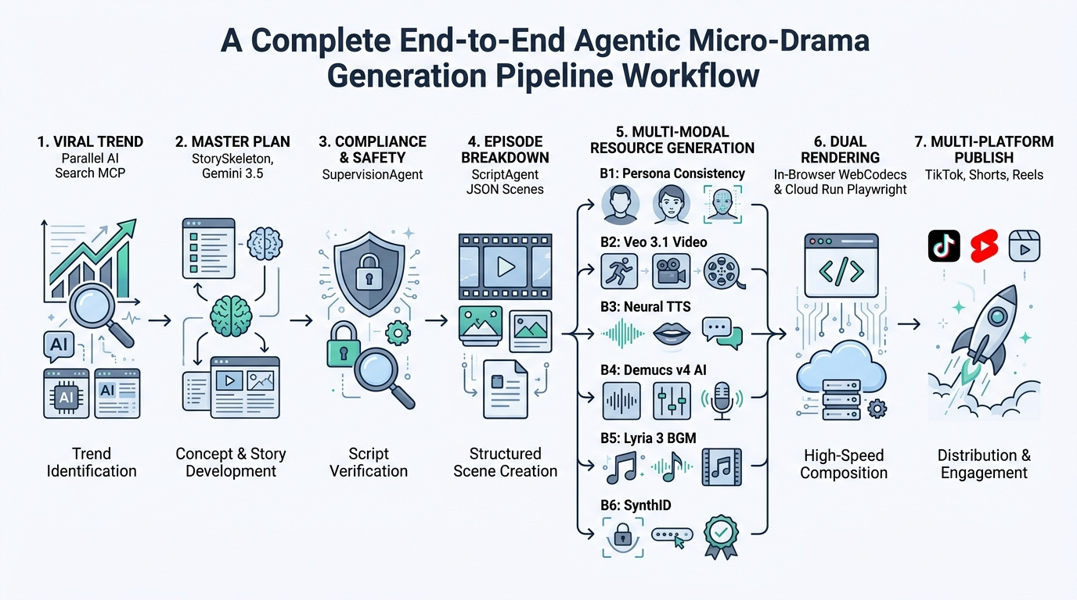
S
SHINE STUDIO | System Architecture & Product Blueprint
06 / 24
END-TO-END EXECUTION FLOW
Agentic Micro-Drama Generation Pipeline Workflow
1. Viral Trend Parallel MCP
2. Master Plan StorySkeleton
3. Compliance Supervision
4. Breakdown ScriptAgent
5. Gen B1–B6 Persona/Veo/TTS
6. Rendering WebCodecs/Run
7. Publish TikTok/Shorts

Slide 7
S
SHINE STUDIO | System Architecture & Product Blueprint
07 / 24
LAYER 1: PRESENTATION (ACTIVE CORE)
OpenVideo Pixi.js WebGL & WebCodecs Engine
1. Real-Time WebGL Compositor (Pixi.js v8) The browser viewport renders 9:16 vertical frames at >= 30 FPS using client GPU hardware. • Zero-Render Preview: Scrub playhead across buffers with 0ms cloud latency. • GLSL Fragment Shaders: Real-time chroma keying & color grading. • Microsecond Timeline Model: Sub-millisecond timing precision (1s = 1,000,000µs).
2. In-Browser Export (WebCodecs API) Renders MP4 video directly on the user computer via hardware-accelerated WebCodecs (mediabunny). • Zero Server Cost ($0): 100% computed on client device. • Lightning Speed: Encodes a 90s 1080p episode in ~12 seconds. • In-Memory ISOBMFF Muxing: Assembles MP4 container in memory.

Slide 8
S
SHINE STUDIO | System Architecture & Product Blueprint
08 / 24
PLANNED ROADMAP SPECIFICATION (PHASE 2)
Real-Time Team Collaboration Architecture
Delta Patch Protocol (PatchSyncService) Designed to broadcast atomic RFC 6902 delta patches (<1KB) over Socket.io instead of heavy 500KB blobs:
{
"op": "update",
"path": "/clips/clip_01/timing/display/to",
"value": 4500000,
"author": "usr_sarah"
}
Planned Concurrency Controls State synchronization engine ensuring smooth concurrent timeline workflows: • Clip-Level Mutex Locking: Optimistic locking to prevent race conditions. • Live Teammate Cursors: Playhead markers broadcasting peer listening at 30Hz. • Immutable Version Checkpoints: Continuous timeline revision snapshots saved to Firestore.
Status: Architecture & Backend Service Designed ➔ Full Client Integration in Phase 2.

Slide 9
S
SHINE STUDIO | System Architecture & Product Blueprint
09 / 24
LAYER 3: AI BRAIN (ACTIVE CORE)
Hierarchical Multi-Agent AI Director
1. Discovery & Skeleton TrendRadar: Scans viral drama trends via Parallel MCP. StorySkeleton: Designs 20–50 episode narrative master plans with cliffhangers. [Model: gemini-3.5-flash-lite]
2. Screenplay Breakdown ScriptAgent: Breaks each episode into 15–45 short scene blocks (4–8s) with visual prompts, actions, and dialogues in JSON. [Model: gemini-3.5-flash-lite]
3. QA & In-Editor Copilot SupervisionAgent: Audits pacing & safety. ChatbotAgent: Modifies timeline state via natural language commands. [Model: gemini-3.5-flash-lite / 2.5-pro]
🧠 4-Tier Memory Mesh: Active Session State ➔ Vertex Vector Search RAG (text-embedding-004) ➔ Series Knowledge Graph Lineage ➔ Token Compressor.

Slide 10
S
SHINE STUDIO | System Architecture & Product Blueprint
10 / 24
LAYER 3: LOCALIZATION (ACTIVE CORE)
Decoupled Audio-Visual Dubbing Engine
Track 1: Pure Visual Motion (VIDEO 1) Generated as silent video clips via Google Veo 3.1 (veo-3.1-generate-001). Immutable during multi-language dubbing operations.
[Scene 01: 6.00s] ── [Scene 02: 5.50s] (Fixed Visuals)
Track 2: Neural TTS Dialogue (AUDIO 1) Synthesized per language track via gemini-3.1-flash-tts-preview (30 distinct voices) with word-level phonetic timestamps.
EN: "Where are you?" (2.1s)
VI: "Anh đang ở đâu?" (2.6s, Δt)
💡 Unfair Cost Advantage: To distribute in 5 languages, Shine only swaps the voice track and recalculates timeline timings (Δt). You never re-render expensive video AI clips!

Slide 11
S
SHINE STUDIO | System Architecture & Product Blueprint
11 / 24
LAYER 4: CLOUD WORKERS (ACTIVE CORE)
Serverless Cloud Run Video Render Worker
1. Asynchronous Jobs & Headless Playwright Episode render tasks are dispatched asynchronously (/render-job), tracking progress from 0% to 100% via API polling or SSE stream. • shine-render-worker container launches headless Chromium WebCodecs compositors. • Renders master-quality 1080p/4K video frames on Cloud Run.
2. Scale-to-Zero & Parity Audit Container lifecycle engineered for extreme cost efficiency: • Scale-to-Zero ($0 Idle): Scales to 0 instances when idle, eliminating static server bills. • Automated SSIM diff tool ensures the final cloud video matches editor preview with SSIM > 0.999 parity.

Slide 12
S
SHINE STUDIO | System Architecture & Product Blueprint
12 / 24
LAYER 4: AUDIO AI (ACTIVE CORE)
Meta Demucs v4 AI Stem Separation & 3D Audio
FastAPI Demucs v4 AI Microservice Dedicated FastAPI Python microservice on Cloud Run (services/demucs-worker) separates mixed audio into isolated stems: • Vocal Isolation: Separates character dialogue from background ambient noise. • Music Extraction: Strips vocal tracks to create clean instrumental soundtracks. • Parametric Auto-Ducking: Attenuates BGM by 80% with 250ms attack during dialogue intervals.
3D Binaural Spatial Audio Engine Calculates real acoustic physics based on where characters stand on the phone screen: • Sabine RT60 Decay: Simulates realistic room reverb (hallway, bedroom, street). • Woodworth Head Model: Computes Interaural Time Differences (ITD) between ears.

Slide 13
S
SHINE STUDIO | System Architecture & Product Blueprint
13 / 24
LAYER 5: STORAGE & TRUST (ACTIVE CORE)
Pluggable Persistence, SynthID & C2PA Provenance
Pluggable Database Architecture (IDatabaseProvider) Enforces strict repository interfaces, enabling database switching via environment variables: • Firestore Native (shine-db) — Primary Cloud NoSQL • MongoDB Atlas — Document Database • SQLite (shine.db) — Local Development
Digital Watermarking & Provenance Enterprise trust and media integrity suite: • Google SynthID: Embeds imperceptible digital watermarks into audio & video. • C2PA Content Credentials: Cryptographically signs provenance manifests. • V4 Signed URLs: Generates temporary 30-minute GCS links for secure media streaming.

Slide 14
S
SHINE STUDIO | System Architecture & Product Blueprint
14 / 24
INFRASTRUCTURE SYNERGY
Google Cloud Unified Service Synergy
Compute & Scaling Cloud Run: Serverless execution with --min-instances 0 scaling to 0 when idle. Cloud Scheduler: Periodic cron (*/5 * * * *) token sync heartbeat. [$0 Idle Compute Cost]
Data & Messaging Firestore Native: Document persistence for scripts, timelines & version snapshots. Cloud Storage (GCS): V4 signed URLs for high-throughput media streaming. [gs://shine-studio-media]
Security & Observability Cloud IAM & Secret Manager: Least-privilege roles (aiplatform.user, datastore.user). Cloud Logging: Real-time structured telemetry & P99 latency tracking. [Enterprise IAM & Audit Trails]
🔗 Synergy Advantage: Native identity & networking across all GCP services eliminates ingress/egress transit bottlenecks and simplifies DevOps automation.

Slide 15
S
SHINE STUDIO | System Architecture & Product Blueprint
15 / 24
GENERATIVE AI STACK
Multimodal Generative AI Model Matrix
Domain / Task | Active Production Model | Supported Models & Fallbacks | Technical Role in Shine
Script & Planning | gemini-3.5-flash-lite | gemini-2.5-pro, 3.1-pro | Story master plan, 15–45 scene JSON breakdown, cliffhangers.
Agent Orchestrator | gemini-3.5-flash-lite | Multi-Agent ADK Router | TrendRadar, ScriptAgent, SupervisionAgent coordinator.
Video Generation | veo-3.1-generate-001 | veo-3.0, 2.0, 2.1 | 9:16 vertical silent video motion clips with camera steering.
Facial Consistency | gemini-3.1-flash-lite-image | imagen-3.0, imagen-3.5 | 8-angle facial consistency keyframes & character visual DNA.
Neural TTS Speech | gemini-3.1-flash-tts-preview | 30 Gemini Voices | Multi-speaker dialogue with word-level timestamps in 6 languages.
Live Audio Dialogue | gemini-live-2.5-flash-native-audio | Bidirectional WebSocket | Low-latency live interactive character voice conversations.
Soundtrack & SFX | lyria-3-clip-preview | Lyria-v1 | Dynamic mood-adaptive background music & suspense crescendo risers.
Vector Search (RAG) | text-embedding-004 | Vertex Vector Search | Sub-50ms semantic search across scene bibles & character lineage.
Stem Separation | Meta Demucs v4 (htdemucs) | FastAPI PyTorch Container | Vocal isolation, BGM extraction, and parametric auto-ducking.
Watermarking | Google SynthID | C2PA Manifest Signing | Steganographic imperceptible watermarking on generated waveforms.

Slide 16
S
SHINE STUDIO | System Architecture & Product Blueprint
16 / 24
PROTOCOL INTEGRATION
Model Context Protocol (MCP) Integration Fabric
1. Parallel AI Search MCP (search.parallel.ai/mcp) Connects Shine multi-agent director to real-time web search for discovering viral drama tropes and performing safety audits: • Trend Radar Agent: Scans real-time trending tropes across 6 regions. • Supervision Agent: Automated pre-flight copyright check on titles & novel synopses. • SfxService: Discovers open sound effects across Freesound & web sources.
Client: server/src/integrations/mcp/ParallelMCPClient.ts
2. Grafana MCP & Loki Observability Unifies live system monitoring, container health, and error tracing through the official Grafana MCP endpoint: • Telemetry Streaming: Auto-flushes structured logs & RSS to Grafana Loki every 15s. • P99 Latency & Probes: Exposes GET /api/admin/observability tracking WebSockets. • Automated Alerts: Triggers instant email alerts upon critical AI pipeline failures.
Service: server/src/services/observability/GrafanaObservabilityService.ts

Slide 17
S
SHINE STUDIO | System Architecture & Product Blueprint
17 / 24
COMPETITIVE EDGE
Shine's 4 Unique Selling Points (USPs)
1. Decoupled Multi-Language Dubbing Silent visual clips + neural speech allow swapping dialogue into 6+ languages and auto-aligning timeline bounds (Δt) without re-rendering expensive video AI clips.
2. In-Browser $0 GPU WebCodecs Render Creators export 1080p MP4 episodes directly in browser memory in ~12 seconds, delivering fast turnarounds with zero server GPU overhead.
3. Persona Studio & 8 Facial Anchors Locks facial geometry, wardrobe, and character embeddings across 50 episodes, eliminating visual drift and inconsistency.
4. Scale-to-Zero Serverless Economy 100% serverless infrastructure on Google Cloud Run automatically scales containers to 0 instances when idle, ensuring $0 static maintenance costs.

Slide 18
S
SHINE STUDIO | System Architecture & Product Blueprint
18 / 24
CONSISTENCY ENGINE
Persona Studio: 8 Facial Consistency Anchors
8-Angle Facial Consistency Locking When a character is registered, Persona Studio generates 8 multi-angle reference keyframes to lock their biometric DNA: • Frontal Portrait & 45° Left/Right Profile • Full Side Profile & High/Low Angle Cinematic Shots • Emotional Smirk & Dramatic Anger expressions
Prompt DNA & Reference Injection During video and storyboard generation, the character visual traits and reference image URLs are automatically injected into Gemini and Veo prompts: • Preserves signature hairstyles, scars, and attire continuity. • Links voice IDs (Gemini Audio) to specific character personas. • Guarantees cast continuity across all 20–50 episodes.

Slide 19
S
SHINE STUDIO | System Architecture & Product Blueprint
19 / 24
AUDIENCE RETENTION
Kinetic Subtitles & Dynamic Cliffhanger Engine
Word-Level Animated Kinetic Captions Captions drive over 60% of short-form video watch time. Shine automatically generates viral animated subtitles: • Karaoke Pop-In: Active words highlight & bounce on beat with speech. • Typography Presets: Dramatic Punch, Neon Cyberpunk, Clean Minimalist. • One-Click Translation: Translates subtitles while preserving millisecond timings.
Dynamic Cliffhanger Engine Automatically identifies the episode climax and injects an intense 3-second hook sequence: • GLSL Shaders: Triggers glitch, flash, or keyframe zoom-in effects. • Audio Stinger: Injects dramatic crescendo risers on AUDIO 3. • Call-to-Action Overlay: Displays "Episode 2 Unlocked in 3s".

Slide 20
S
SHINE STUDIO | System Architecture & Product Blueprint
20 / 24
DEVELOPMENT EVOLUTION
Agile Engineering Roadmap (Sprints 1–7)
Sprint 1: Foundation, Vertex AI SDK, Pluggable DBs (Firestore/SQLite), and Auth Suite.
[v0.1 Alpha]
Sprint 2: Multi-Agent Script Pipeline, Trend Radar (Parallel MCP), Persona Studio.
[v0.2 Beta]
Sprint 3: OpenVideo Pixi.js WebGL Editor, Undo/Redo Commands, Dual-Render Parity.
[v0.5 NLE Beta]
Sprint 4: Neural Voiceover, Kinetic Subtitles, Cliffhanger Engine, Meta Demucs v4.
[v0.8 RC1]
Sprint 5: WebSocket Delta Sync Architecture, Quality Linter & i18n Key Parity.
[v0.9 RC2]
Sprint 6 & 7: Multi-Platform Publishing, Grafana MCP Observability & Playwright E2E Suite.
[v1.1 Commercial]

Slide 21
S
SHINE STUDIO | System Architecture & Product Blueprint
21 / 24
FUTURE PLANNING (PHASE 2 & 3 ROADMAP)
Planned Roadmap Innovations
1. Real-Time Multi-User Co-Editing Full client integration of the Socket.io RFC 6902 JSON Pointer delta patch engine for live collaborative timeline editing. [Phase 2: Live Team Collaboration]
2. Distributed Batch Render Queue Automated multi-episode batch queueing across a pool of parallel Cloud Run Playwright worker nodes via Cloud Pub/Sub. [Phase 2: Automated 50-Episode Batch Queue]
3. Platform Analytics & Synthetic Audience Viewer retention heatmaps, drop-off prediction curves, and cross-platform publishing analytics (TikTok / Shorts / Reels). [Phase 3: Platform Analytics & Audience Simulator]
4. Live Interactive Drama & Marketplace Branching narrative trees (@antv/g6) for live voting + AI character asset trading marketplace. [Phase 3: Branching Drama & Character Hub]

Slide 22
S
SHINE STUDIO | System Architecture & Product Blueprint
22 / 24
COST ARCHITECTURE
Cloud Run Sizing & $0 Idle Cost Model
Service | Specs | Autoscaling | Concurrency | Idle Cost
shine-app | 2 vCPU / 4Gi | 0 to 3 instances | 80 req/instance | $0.00
shine-render-worker | 4 vCPU / 8Gi | 0 to 3 instances | 1 job (Isolated) | $0.00
demucs-worker | 2 vCPU / 4Gi | 0 to 3 instances | 2 req/instance | $0.00
💡 Scale-to-Zero Guarantee: When no users are actively editing or rendering, all 3 Cloud Run services scale to 0 instances. Zero monthly server bills when idle!

Slide 23
S
SHINE STUDIO | System Architecture & Product Blueprint
23 / 24
DEVOPS & AUTOMATION
1-Click Full Ecosystem Cloud Run Deployment
Automated Cloud Provisioning Lifecycle Full automated deployment in 5 sequential steps: • 1. Auto-enables 10 GCP APIs (run, pubsub, firestore, aiplatform, etc.). • 2. Grants least-privilege IAM roles to Default Compute Service Account. • 3. Auto-provisions Firestore Native database shine-db and GCS bucket. • 4. Creates Pub/Sub topics (shine-render-jobs, shine-render-status). • 5. Builds and deploys all 3 containers with dynamic YAML configuration.
Single Execution Command Deploy entire ecosystem with a single command:
# Windows PowerShell
.\scripts\deploy-cloudrun.ps1
# Linux / macOS / Cloud Shell
./scripts/deploy-cloudrun.sh
# Health Check
curl https://<APP_URL>/api/health

Slide 24
S
SHINE STUDIO | System Architecture & Product Blueprint
24 / 24
Strategic Summary
Redefining Global Storytelling for the Short-Form Video Era
Shine unites cutting-edge Google generative AI models (gemini-3.5-flash-lite, veo-3.1, gemini-live-2.5, lyria-3), Model Context Protocol integrations (Parallel MCP & Grafana MCP), and serverless scale-to-zero infrastructure to turn any creator into a global micro-drama studio.
100x Faster Script to Video
80% Cheaper Zero-Render Dubbing
$0 Idle Cost Serverless Run

