Slide 1
DETECTION OF THE COFFEE LEAF RUST USING DECISION TREES
Andrés Grimaldos Echavarría
Alejandro Salazar Arango
Medellín, Date of the oral presentation

Slide 2
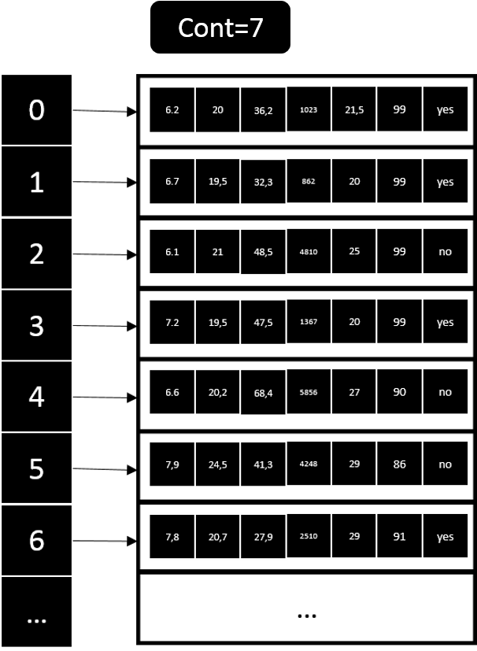
Data Structure Designed
Graph 1: Python dictionary (hash table) of data. Each one has ph, soil temperature, soil moisture, illuminance,, env. temperature, env. humidity and label

Slide 3
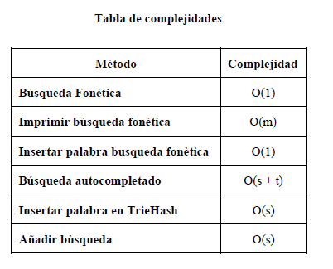
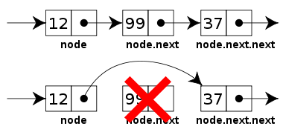
Data Structure Operations
Keep this title
Gráfico 2: Operación de borrado
de una estructura de datos
Tabla 1: Complejidad de las operaciones
de la estructura de datos
Include your own figures, tables and explanation

Slide 4
Design Criteria of the Data Structure
Complexity of the operations.
Easy to use.
Allow to create a decision tree for predictions.

Slide 5
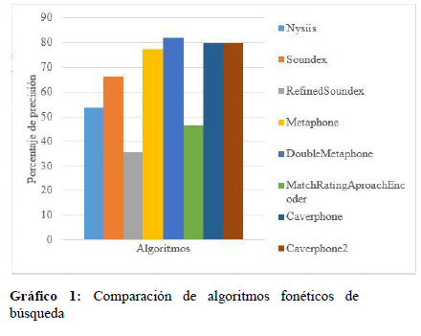
Time and Memory Consumption
Use this title
Include your own figures and explanations

Slide 6
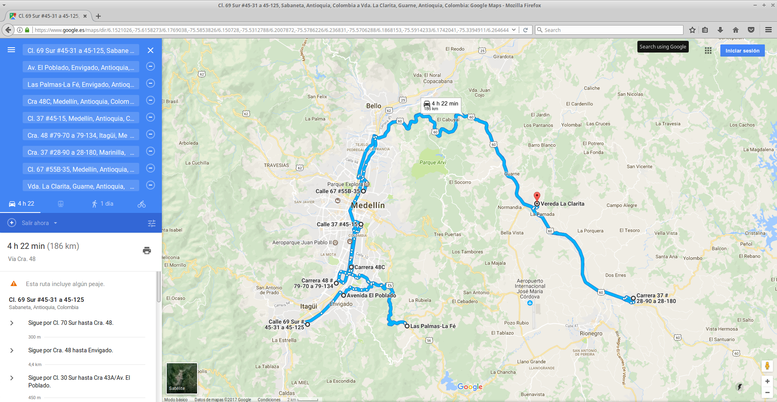
Implementation
Keep this title
Gráfico 4: Sistema de planificación óptima de domicilios
Include your own figures and explanations

