Slide 1







Your spouse needs professional help: Determining the Contextual Appropriateness of Messages through Modeling Social Relationships
David Jurgens*
jurgens@umich.edu
Agrima Seth*
agrima@umich.edu
Jackson Sargent†
jacsarge@umich.edu
Athena Aghighi†
aaghighi@ucdavis.edu
Michael Geraci†
megeraci@buffalo.edu

Slide 2

Is English your first language?
Appropriate?

Slide 3
Is English your first language?
Appropriate?
Gender
Age
Value System
Communication between individuals are a complex functions of multiple factors.

Slide 4
Is English your first language?
Appropriate?
Relationship shared
Gender
Age
Value System
Communication between individuals are a complex functions of multiple factors.

Slide 5







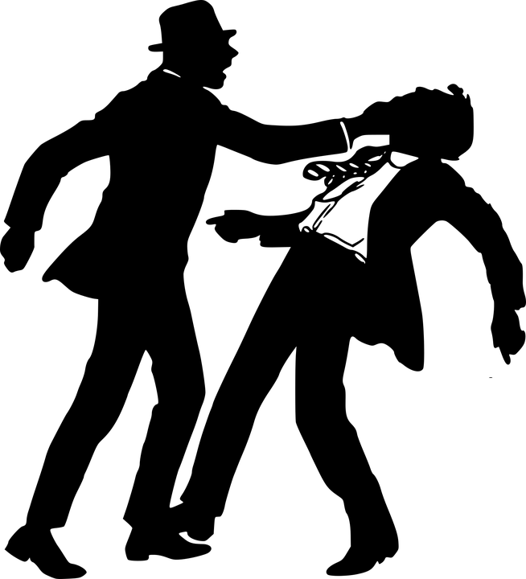
Language has many ways to describe our relationship to others. Each relationship has its own norms!
Family
Social
Romance
Para-Social
Organizational
Peer-group
Role-based
Antagonist

Slide 6

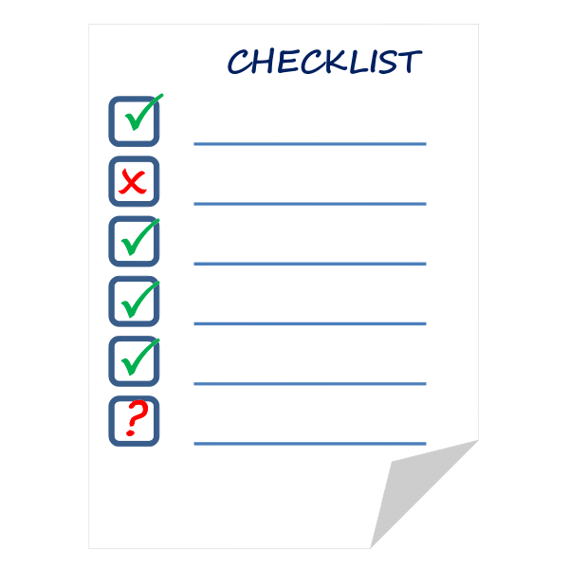

Dataset
Creation
Building a Model
Apply the model to understand
How much of the conversations are context-sensitive
Its usefulness to model other language behavior in conversations

Slide 7
Dataset
Creation
Building a Model
Apply the model to understand
How much of the conversations are context-sensitive
Its usefulness to model other language behavior in conversations

Slide 8



Dataset Creation (Phase 1)
Manually generated 401 sentences such that their appropriateness differs across relationships
Phase 1 classifier
“You look super cute today”
☺️ Parent to their child
😬 Boss to their employee

Slide 9

Dataset Creation (Phase 2)
Phase 1
classifier
Annotate
Conversational
&
Controversial
Interesting data to label

Slide 10

Dataset Creation (Phase 2)
Phase 1
classifier
Annotate
Conversational
&
Controversial
Interesting data to label

Slide 11
Dataset Creation (Phase 2)
Phase 1
classifier
Annotate
Conversational
&
Controversial
Interesting data to label

Slide 12
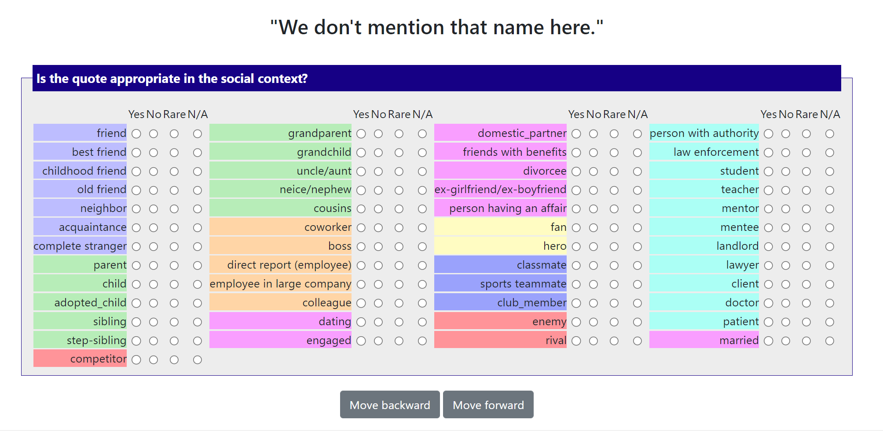
Annotating appropriate is complex!

Slide 13
Measuring Annotation Quality
Two trained annotators labeled 41 contexts, making 2,159 initial appropriateness judgments
Initial agreement: Kripperdoff’s 𝛼 = 0.46 😰
Why did annotators disagree? (in order)
Disagreement on message meaning (most cases)
Mistakes
Disagreement on appropriateness
Solution: Annotators adjudicate the meaning of each message and then re-annotated
Final agreement 𝛼 = 0.92
Caveat: One dataset—not necessarily expected to generalize

Slide 14
Dataset
Creation
Building a Model
Apply the model to understand
How much of the conversations are context-sensitive
Its usefulness to model other language behavior in conversations

Slide 15
Can computational models identify contextual appropriateness?
Task: Given the social relationship identify if it would be appropriate to say a particular message
Example: Would asking “Is English your first language?” be considered appropriate between work colleagues
Prompt-based: ‘Is it appropriate for person1 to say "quote" to person2, "yes" or "no"? [mask]’
Positive class: Inappropriate
Fine-tuning: Person1 saying “Quote" to person2 is inappropriate. Label (1/0)

Slide 16
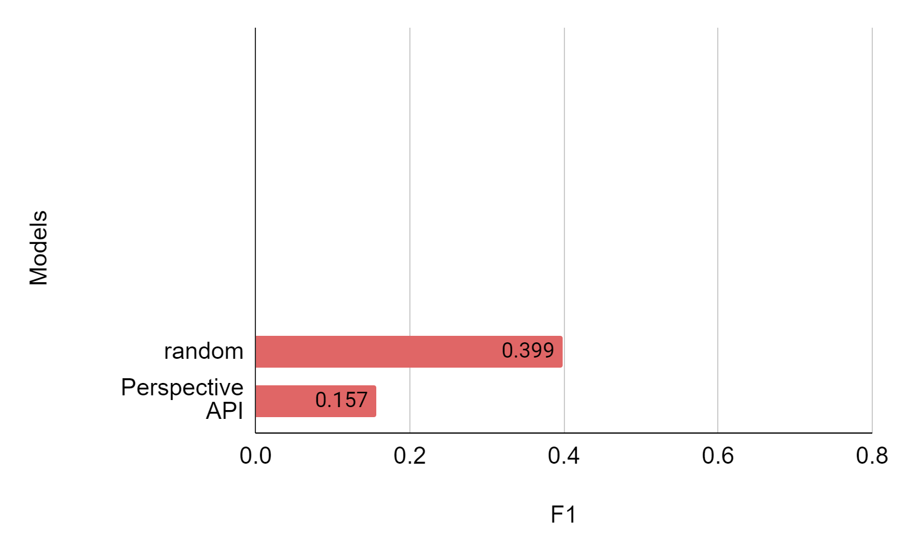
Can computational models identify contextual appropriateness?
Baseline

Slide 17
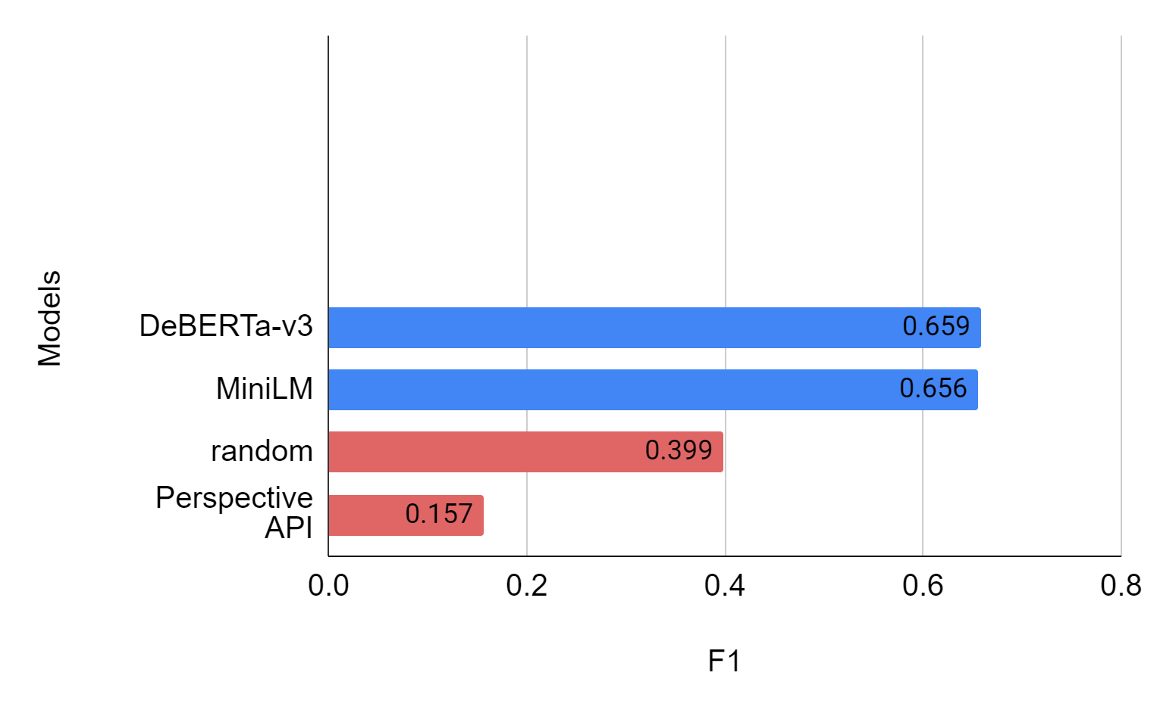
Can computational models identify contextual appropriateness?
Fine-Tuning
Baseline

Slide 18
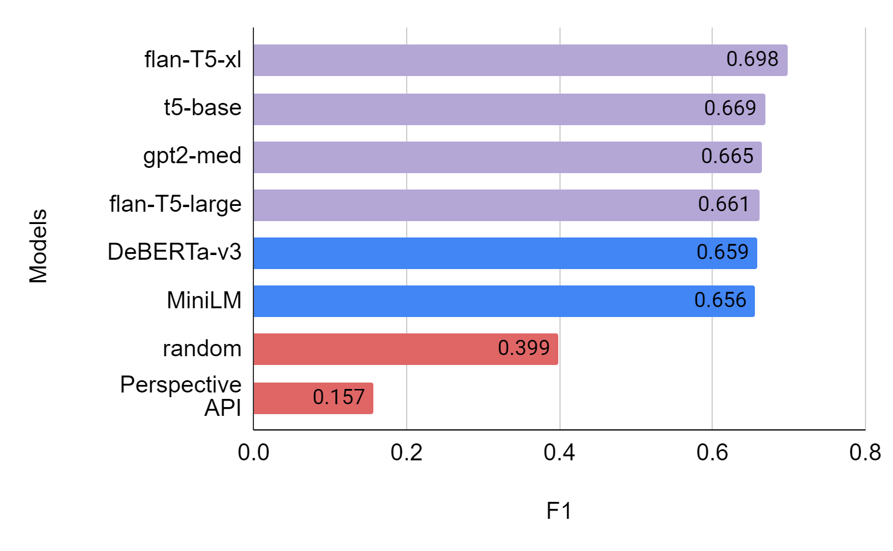
Can computational models identify contextual appropriateness?
Prompt-based
Fine-Tuning
Baseline

Slide 19
Dataset
Creation
Building a Model
Apply the model to understand
How much of the conversations are context-sensitive
Its usefulness to model other language behavior in conversations

Slide 20


How much of the conversations are sensitive to relationship-context?
Still appropriate?
What if we switch context?
“When you die do you want to be buried or cremated?”
“When you die do you want to be buried or cremated?”

Slide 21
How much of the conversations are sensitive to relationship-context? (PRIDE; Tigunova et al 2021)
Dialogue dataset with a known relationship between speaker and spoken to.
Based on movie dialog but filtered down to generic messages
We use a dataset of 47,801 messages across 18 relationships

Slide 22
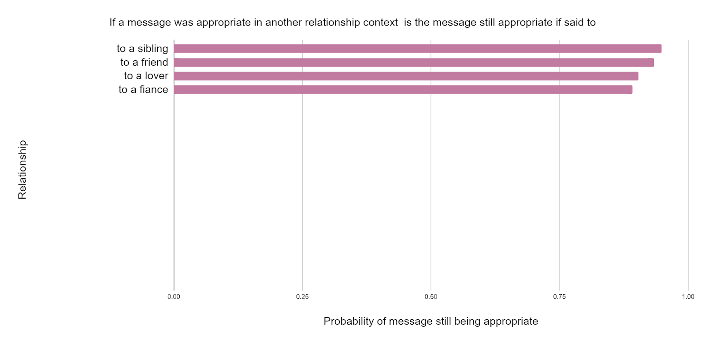
“When you die do you want to be buried or cremated ?”

Slide 23
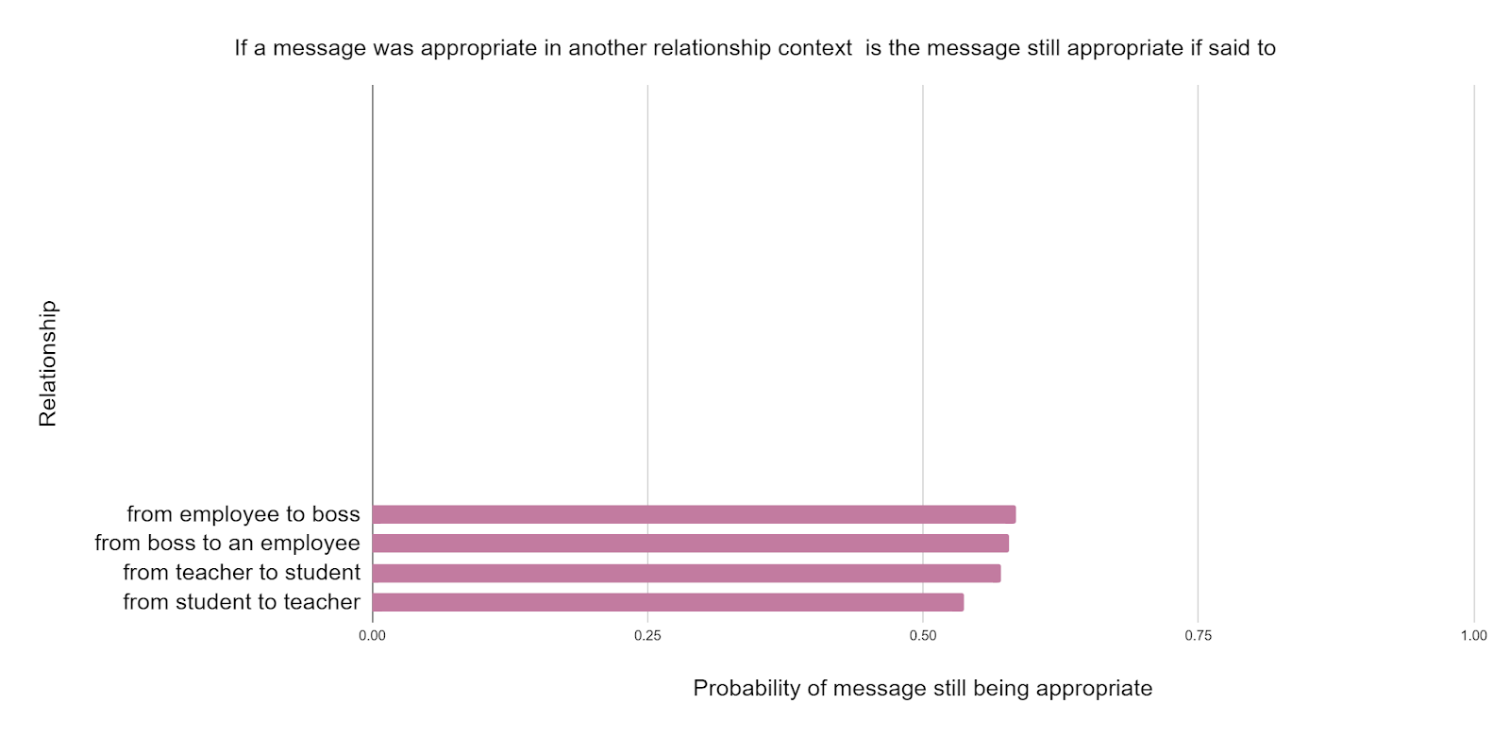
“When you die do you want to be buried or cremated ?”

Slide 24
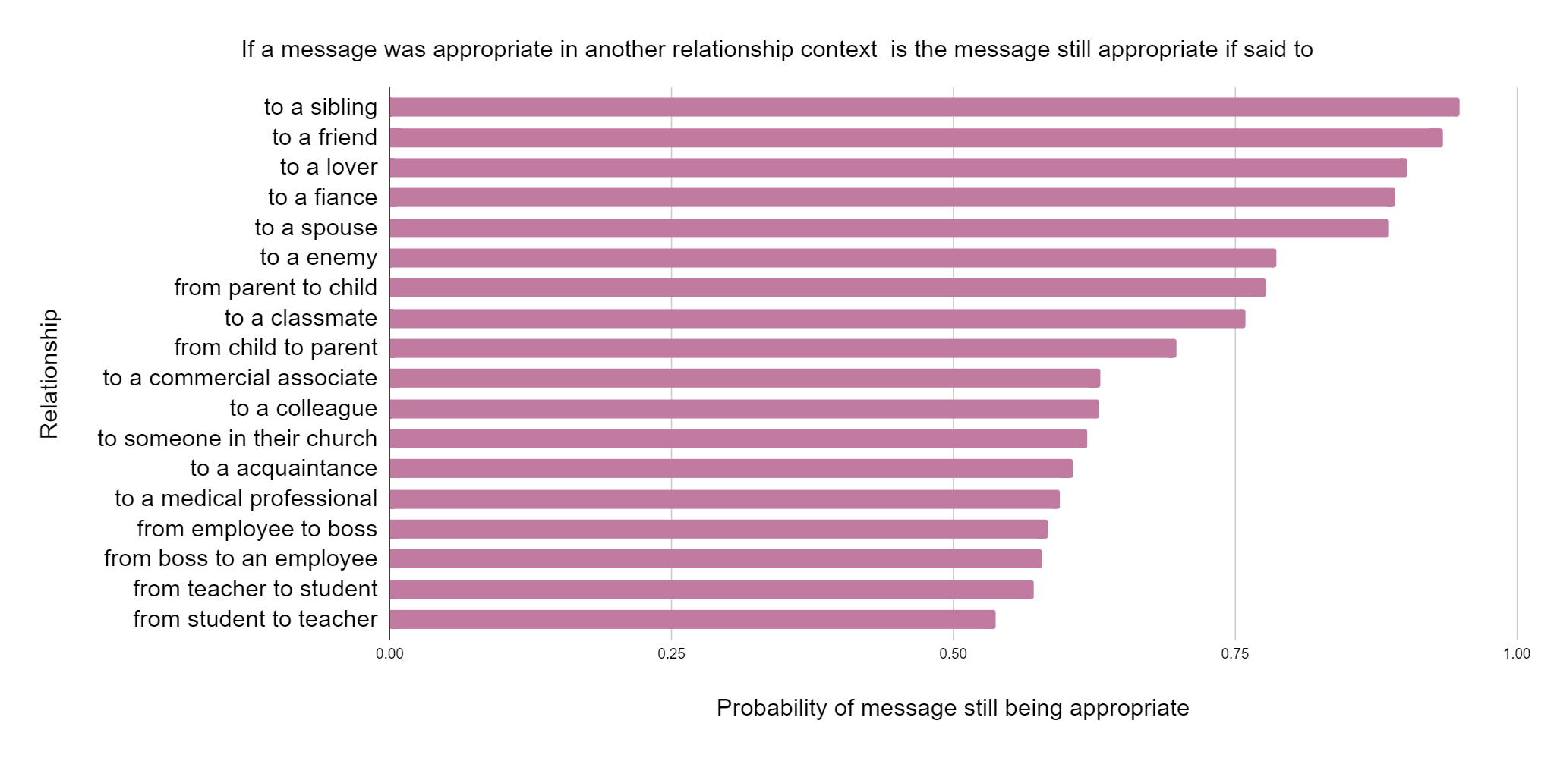
~1/5th of the conversations
change their appropriateness with context

Slide 25
Is appropriateness helpful for modeling other language behaviors? (Talkdown; Wang and Potts 2019)
Aim: Detect condescending utterances.
Binary Classification task.
Why:
Appropriateness and condescension are related
Condescension is inappropriate in hierarchical relationships.
“Bro, calm down and come back to real life.”

Slide 26
Is appropriateness helpful for modeling other language behaviors?
Condescending /
Not-condescending
LOGISTIC REGRESSION
Judgement of inappropriateness for
Relationship 1
… … …
…
Relationship 49
Contextually appropriate trained FLAN-T5-XL
“Bro, calm down and come back to real life.”

Slide 27
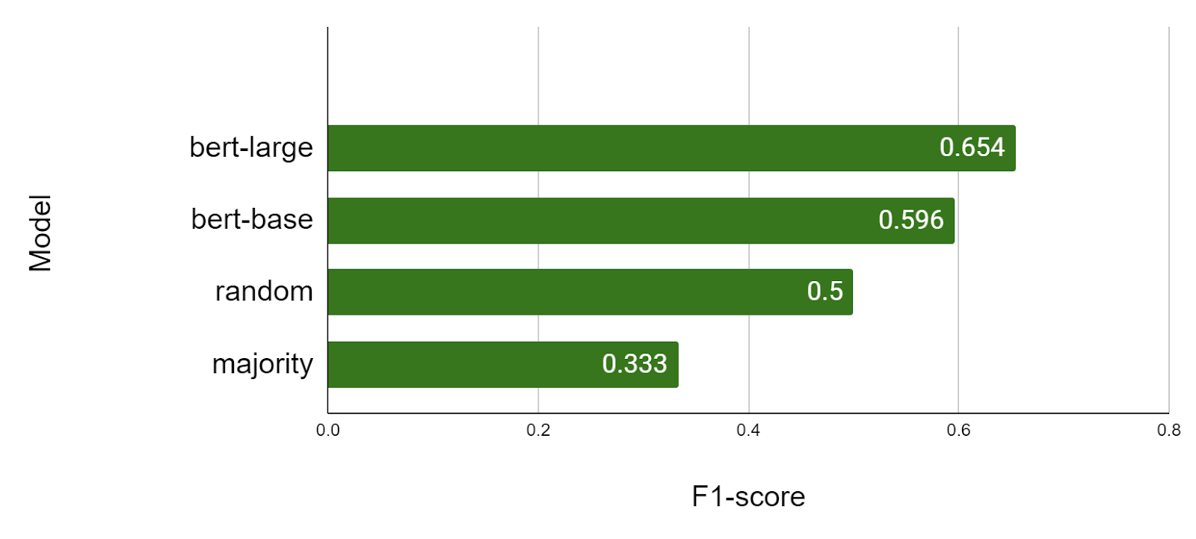
Is appropriateness helpful for modeling other language behaviors?
Fine-Tuning
Baseline
“Bro, calm down and come back to
real life.”
Balanced Dataset

Slide 28
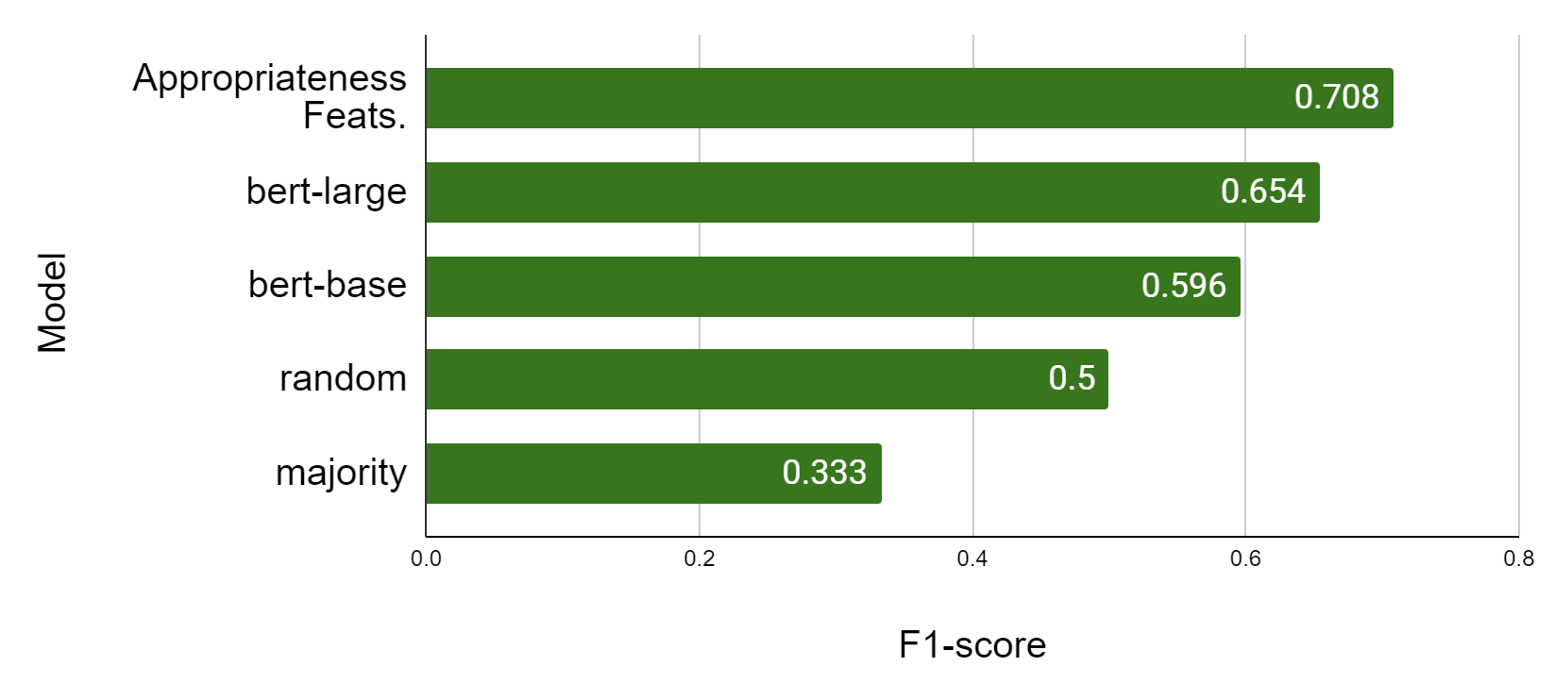
Is appropriateness helpful for modeling other language behaviors?
Logistic
Regression
Fine-Tuning
Baseline
“Bro, calm down and come back to
real life.”
Balanced Dataset

Slide 29
Limitations
More relationships to be analyzed; each with more nuance
More #annotators; diverse viewpoints.
Group norms, culture, ideologies
Relationship between individuals
This work focuses on this aspect
Individual level characteristics

Slide 30
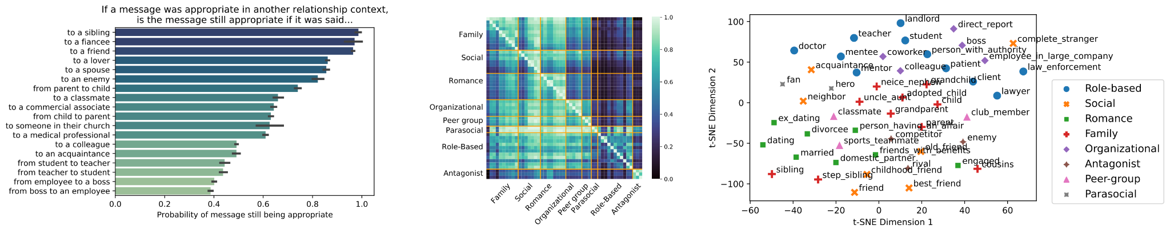
Thank you!!
We introduce a new dataset of 12K appropriateness judgments across 49 relationships.
An estimated 1 in 5 messages change their appropriateness in a new context
Incorporating contextuality helps understand other antisocial behaviors
https://github.com/davidjurgens/contextual-appropriateness
David Jurgens
jurgens @umich.edu
Agrima Seth
agrima @umich.edu
Jackson Sargent
jacsarge @umich.edu
Athena Aghighi
aaghighi @ucdavis.edu
Michael Geraci
megeraci @buffalo.edu

