Slide 1


SMART INDIA HACKATHON 2026
TITLE PAGE
Problem Statement ID: 26057
Problem Statement Title: AI-Powered Automated Underwater Marine Debris and Anomaly Detection System using Side-Scan Sonar Imagery​
Theme: Disaster Management
PS Category: Software
Team Name: Team Unstable

Slide 2

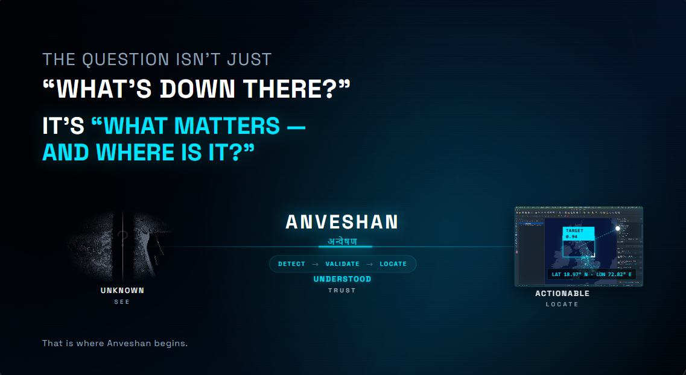
ANVESHAN
Your Team Name

Slide 3
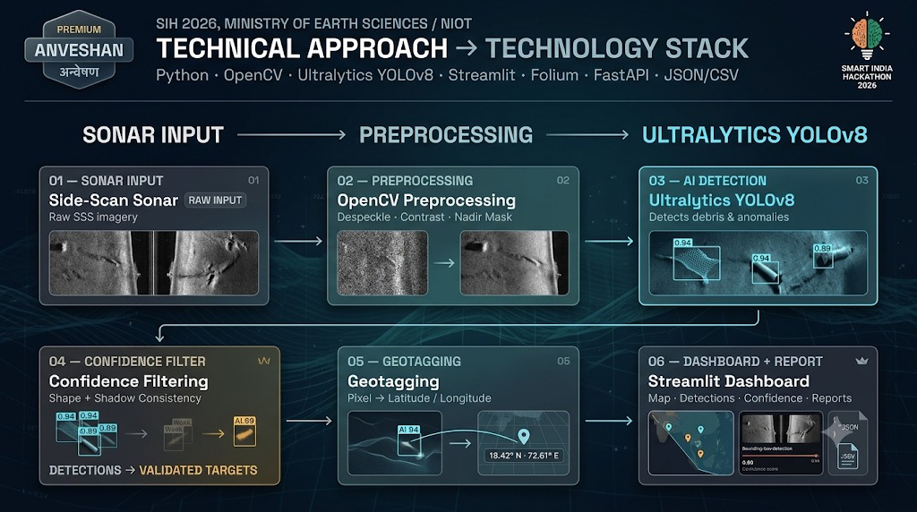
TECHNICAL APPROACH
Your Team Name

Slide 4
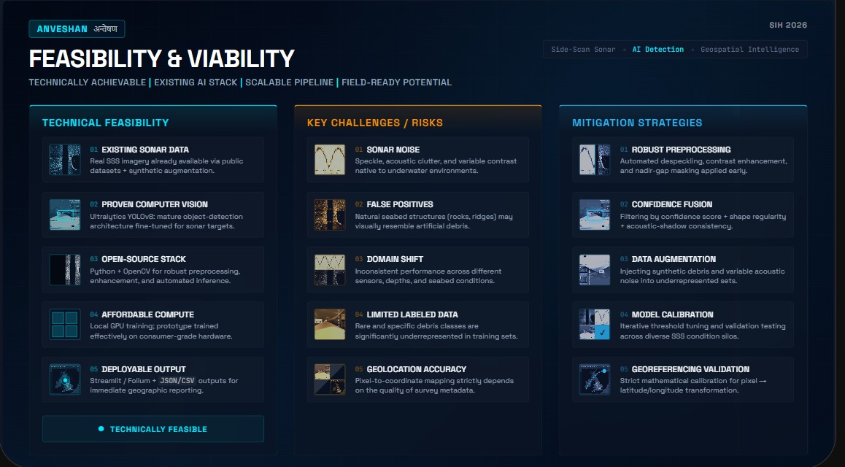
FEASIBILITY AND VIABILITY
Your Team Name
✅

Slide 5
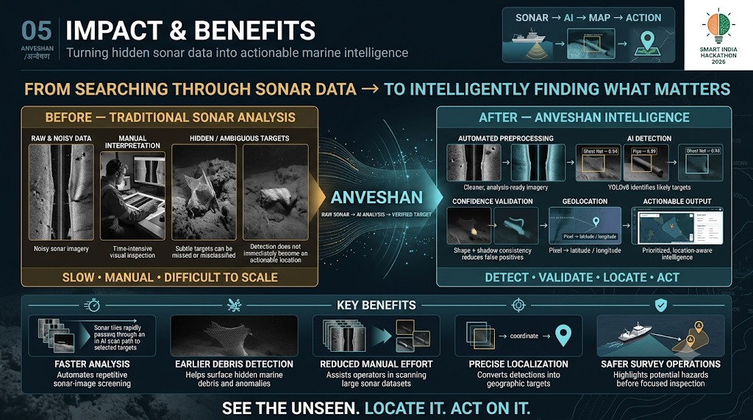
IMPACT AND BENEFITS
Your Team Name

Slide 6
RESEARCH AND REFERENCES
Your Team Name
https://huggingface.co/datasets/PINGEcosystem/sss-crab-pot-detection-ds
https://www.kaggle.com/datasets/enochkwatehdongbo/seabedobjects-klsg-dataset
https://doi.org/10.5281/zenodo.7922705

