Slide 1
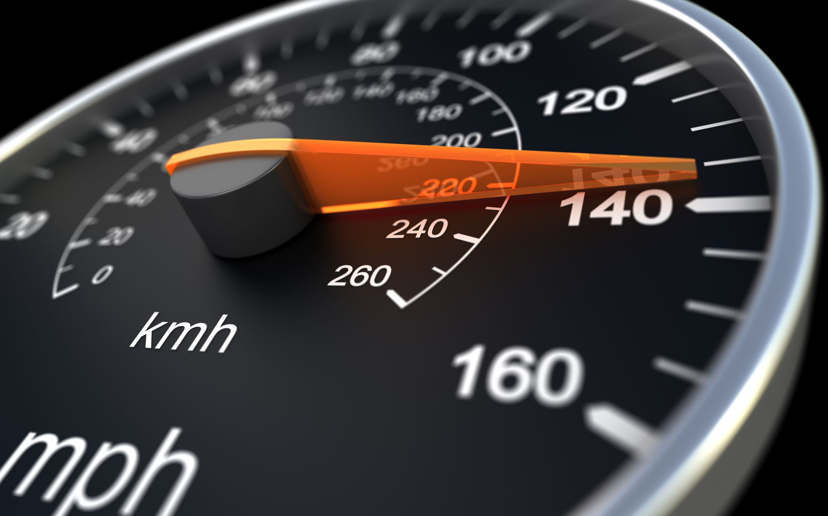
PID Control of DC Motor
Team - 4
PROJECT PRESENTATION

Slide 2
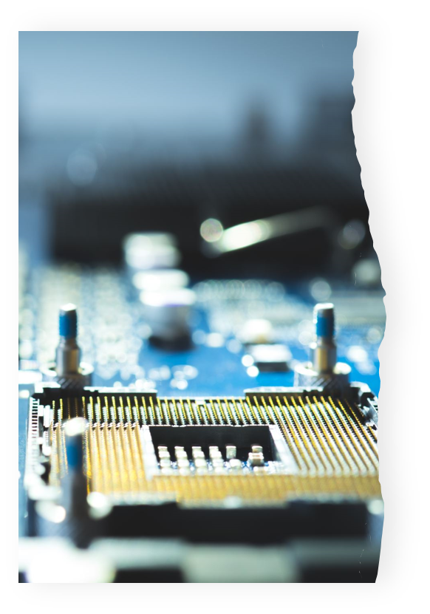
Motivation
The motivation behind the PID control of a DC motor experiment is to showcase the fundamental concept of feedback control in engineering and its real-world application
Feedback control systems are crucial in various industries to regulate processes, maintain stability, and achieve desired performance
DC motors are widely used in automation, robotics, and manufacturing, making them an excellent choice for demonstrating how feedback control can enhance their performance

Slide 3
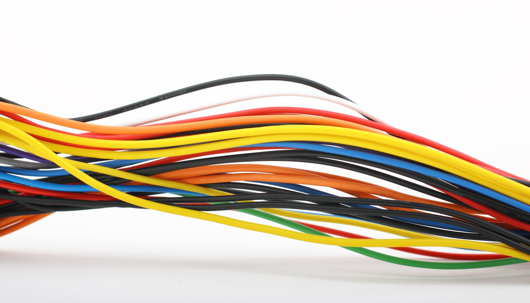
Sensors & Components Used
DC Motor
RPM Sensor
ESP32 Dev Module
Connecting Wires and Breadboard
Wheel (for testing)
Motor Driver (L293D IC)

Slide 4

Implementation
The RPM is measured using RPM sensor. Input is taken from the user through the dashboard.
The error values (P, I and D) are calculated and the input voltage is adjusted accordingly using Ziegler-Nichols Method and sent to the motor.
Graph of the readings (RPM) is plotted on ThingSpeak for analysis.
An alert mechanism is in place which sends an Email if the average RPM value < 100.

Slide 5
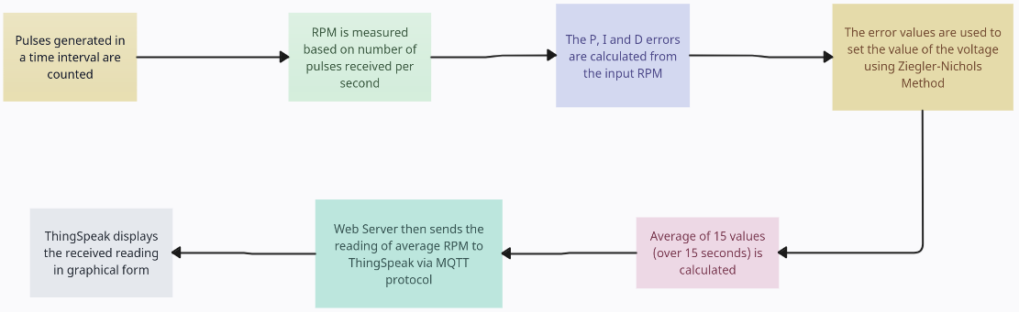
BLOCK DIAGRAM

Slide 6

Working
The RPM sensor beeps every time a pulse is generated (pulse is generated when there is a state change, i.e., Block Open or Open Block).
The code checks for the total number of beeps and divides with the total time. Using further calculations, it calculates the RPM of the wheel.
The PID algorithms are used to calculate thw errors and adjust the voltage which is sent over to the motor.
The readings are plotted on the ThingSpeak interface and is also displayed on the UI interface.

Slide 7

User Interface (UI)
The UI is responsible for taking inputs from the user that include:
RPM value
K_{p}
K_{i}
K_{d}
The page also displays the ThingSpeak graph

Slide 8
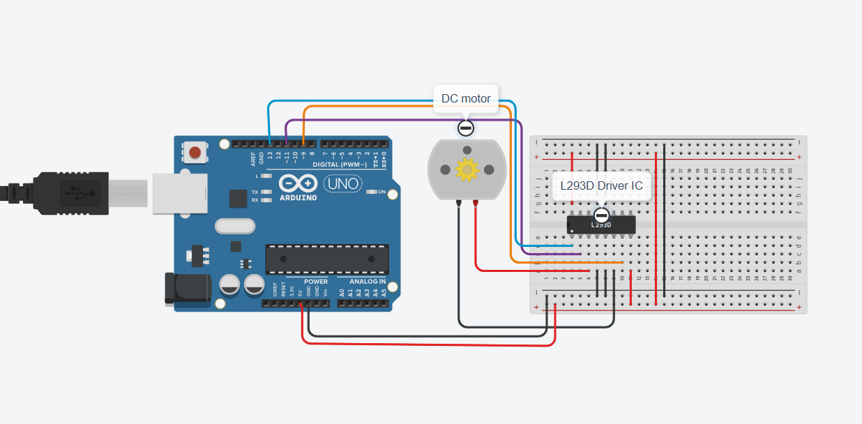
Tinkercad Simulation
Simulation Link

Slide 9

THANK YOU

