Slide 1

Max’s Miscellaneous Research Topics:
HClib, HiHAT, and HOOVER
Max Grossman
Postdoctoral Researcher, Habanero Extreme Scale Software Research Group
Co-Founder/CEO, 7pod Technologies

Slide 2
Outline
HClib
A simple API for low overhead, task-parallel programming
HiHAT
A low overhead, retargetable, community-driven tasking API
HOOVER
A framework for writing scalable, distributed, dynamic graph applications on top of OpenSHMEM
Processors

Slide 3
HClib https://github.com/habanero-rice/hclib
C/C++ task-parallel programming model, w/ two components:
HClib-core: Core, *simple*, low overhead tasking API for CPUs
HClib-ext: Custom, third-party extensions to HClib-core
finish([] {
([=] { ...; });
forall_async(N, [=] (int iter) {
...;
});
promise_t *prom = new promise_t();
async_await(prom, [=] { ...; });
prom->put(3);
});
Processors

Slide 4
HClib-core APIs
HClib-core enables expression of:
Description | Example
Asynchronous task creation | async([=] -> { S1; });
Bulk task synchronization | finish([=] -> { async([=] { S1; async([=] S2;); }); });
Futures and promises | async([=] { prom->put(42); }); async([=] { prom->get_future()->wait(); });
Bulk task creation | forall(loop, [](int i, j, k) -> { S3; });
Locality control | async_at(pl, [=] { S4; });
Processors

Slide 5
HClib-core Runtime
Hierarchical work-stealing runtime built on a fixed-size thread pool.
Memory
Place₆
T₂
L2
Place₄
Place₅
T₇
L1
Place₀
Place₁
Place₂
Place₃
T₁
T₅
T₆
T₀
T₃
T₄
Processors
Worker₀
Worker₁
Worker₂
Worker₃

Slide 6
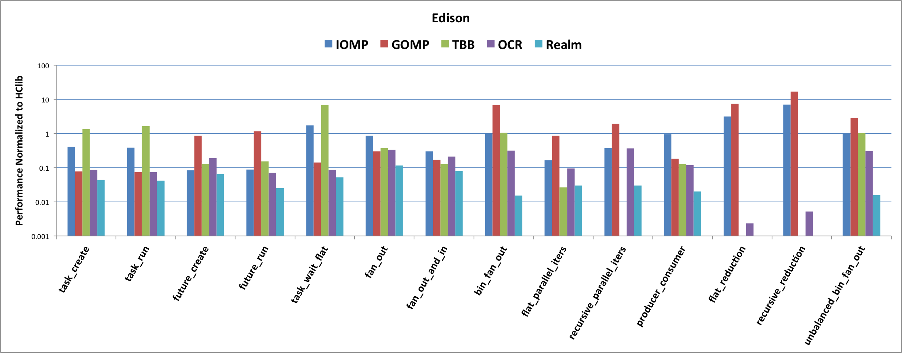
HClib-core Performance Comparison
Micro-benchmark performance normalized to HClib. Higher is better.
Processors
https://github.com/habanero-rice/tasking-micro-benchmark-suite

Slide 7
HClib-ext
Extend the HClib namespace with standard HPC APIs (e.g. MPI, CUDA, UPC++, OpenSHMEM)
Taskify heterogeneous operations for unified scheduling
Future-based APIs for composability
future_t *copy = async_copy_await(...);
future_t *req[4];
req[0] = MPI_Isend_await(..., copy);
req[1] = MPI_Irecv_await(... , copy);
req[2] = MPI_Isend_await(... , copy);
req[3] = MPI_Irecv_await(... , copy);
copy = async_copy_await_all(..., req);
forasync_cuda(copy, [=] (int i) {
...;
});
Processors

Slide 8
HClib-ext Runtime
Pluggable Modules – expose familiar HPC APIs, map them to tasks placed on platform model
System
OSHMEM
MPI
CUDA
etc.
HClib-ext Platform Model
Platform Model – Representation of available hardware resources for modules
GPU
NIC
CPU₀
CPU₁
CPU₂
CPU₃
CPU₄
x86
x86
x86
x86
HClib-core

Slide 9
Example: MPI Module
Extends HClib namespace with familiar MPI APIs
Programmers can use the APIs they already know and love
Built on 1) an MPI implementation, and 2) HClib-core tasking APIs.
Asynchronous APIs return futures rather than MPI_Requests, enabling composability in programming layer with all other future-based APIs:
hclib::future_t<void> *MPI_Irecv/Isend(...);
Enables non-standard extensions, e.g.:
hclib::future_t<void> *MPI_Isend_await(..., hclib::future_t<void> *await); | Start an asynchronous send once await is satisfied.
hclib::future_t<void> *MPI_Allreduce_future(...); | Asynchronous collectives.

Slide 10
Example API Implementation
hclib::future_t<void> * hclib::MPI_Isend_await(..., hclib::future_t<void> *await) {
// Create a promise to be satisfied on the completion of this operation
hclib::promise_t<void> *prom = new hclib::promise_t<void>();
// Taskify the actual MPI_Isend at the NIC, pending the satisfaction of await
hclib::async_nb_await_at([=] {
// At MPI place, do the actual Isend
MPI_Request req;
::MPI_Isend(..., &req));
// Create a data structure to track the status of the pending Isend
pending_mpi_op *op = malloc(sizeof(*op));
...
hclib::append_to_pending(op, &pending, test_mpi_completion, nic);
}, fut, nic);
return prom->get_future();
}
Periodic polling function

Slide 11
Experimental Setup
Experiments shown here were run on Titan @ ORNL and Edison @ NERSC.
Application | Platform | Dataset | Modules Used | Scaling
ISx | Titan | 2²⁹ keys per node | OpenSHMEM | Weak
HPGMG-FV | Edison | log2_box_dim=7 boxes_per_rank=8 | UPC++ | Weak
UTS | Titan | T1XXL | OpenSHMEM | Strong
Graph500 | Titan | 2²⁹ nodes | OpenSHMEM | Strong
LBM | Titan |  | MPI, CUDA | Weak

Slide 12
HiPER Evaluation – Regular Applications
HIPER is low-overhead, no impact on performance for regular applications
ISx
HPGMG Solve Step

Slide 13
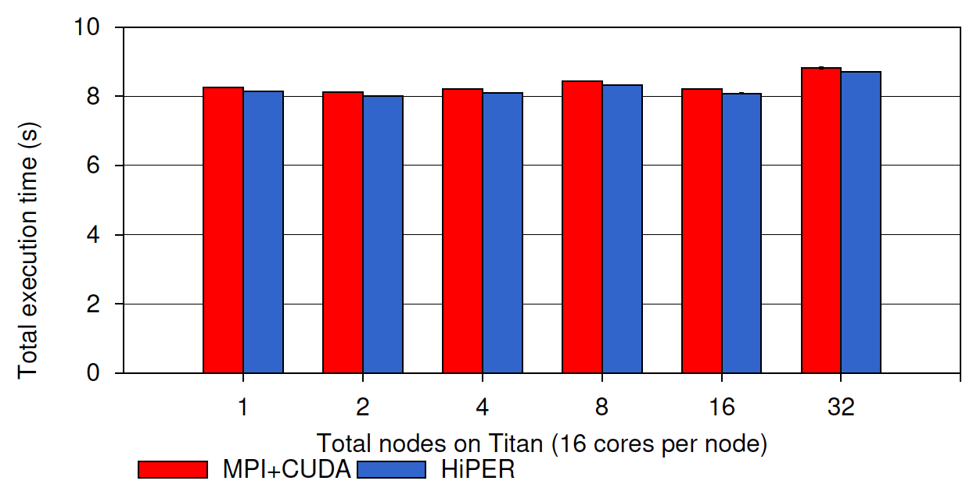
HiPER Evaluation – Regular Applications
~2% performance improvement through reduced synchronization from futures-based programming.
LBM

Slide 14
HiPER Evaluation – UTS
HIPER integration improves computation-communication overlap, scalability, load balance

Slide 15
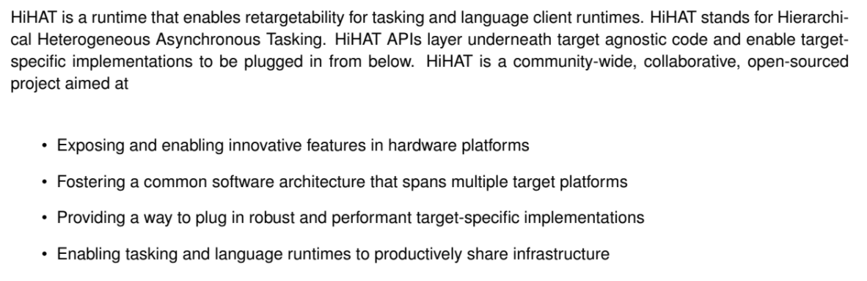
HiHAT Goals https://wiki.modelado.org/Hierarchical_Heterogeneous_Asynchronous_Tasking
From the HiHAT Reference Manual:

Slide 16
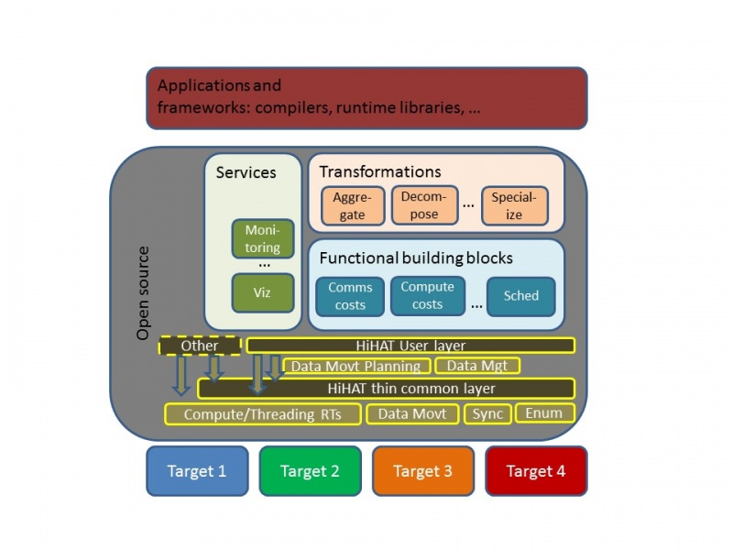
HiHAT Design
Current status:
Monthly community calls, presenting status updates and work from the community
Two calls per week, rapidly iterating on spec and implementation
Proof of concept implementation complete with paper in PMES17

Slide 17
What is OpenSHMEM?
PGAS, SPMD programming model
Core abstraction = symmetric heap and symmetric allocations
Supports efficient communication for applications with small to medium sized messages.
RDMA, remote atomics, collectives, point-to-point sync.
Fences and quiets
PE 0
PE 1
sheap
sheap
shmem_put
PE 2
shmem_get
PE 3
sheap
sheap

Slide 18
What is OpenSHMEM?
PE 0
int *a = shmem_malloc(sizeof(*a));
int *b = shmem_malloc(sizeof(*b));
*b = 43;
// Send 42 to the sym var a on PE 1
shmem_int_p(a, 42, 1);
// Collective barrier
shmem_barrier_all();
PE 1
int *a = shmem_malloc(sizeof(*a));
int *b = shmem_malloc(sizeof(*b));
// Wait for receipt of 42 in a
shmem_int_wait_until(a,
SHMEM_CMP_EQ, 42);
// Retrieve the value 43 from PE 0
shmem_int_g(b, 0);
// Collective barrier
shmem_barrier_all();

Slide 19
HOOVER https://github.com/agrippa/hoover
Goal: Build a general framework for creating dynamic graph applications on top of OpenSHMEM.
General – express a wide variety of applications (infectious diseases, insider thread, social networks, etc)
Programmable – user fills in application-specific kernels, no awareness of distribution.
Scalable – no barriers, minimal synchronization, minimal memory overheads.

Slide 20
HOOVER Programming Model
Graph is made up of actors with positional and logical attributes, updates to positional attributes define “movement”.
Positional attributes define some idea of “location”, edges are dynamically updated based on location.

Slide 21
HOOVER Programming Model
Graph is made up of actors with positional and logical attributes, updates to positional attributes define “movement”.
Positional attributes define some idea of “location”, edges are dynamically updated based on location. Logical attributes define other actor metadata.

Slide 22
HOOVER Programming Model
Actors are partitioned across OpenSHMEM PEs (user-defined).
PEs start *entirely de-coupled* (use RDMA to grab data when they need it, no synchronization). PEs become “coupled” at user direction, i.e. lockstep.
PE 0
PE 1
PE 2
PE 3
PE 4
PE 5

Slide 23
HOOVER Execution Flow
while not done:
for each local actor:
update actor attributes
for each local actor:
update edges for this actor based on updated positional attributes
update coupled PEs at user direction
compute reduction across coupled PEs
update done

Slide 24
HOOVER API
Callback-based; user defines a number of callbacks that HOOVER then uses:
update_metadata: provided the neighbors of an actor, update its attributes.
update_summary_data, might_interact: update a user-defined data structure summarizing the positional attributes of actors in a given PE, and check if actors in different PEs might be neighbors based on that summary.
check_abort: compute a local value for coupled reduction, and then check if this PE might abort.

Slide 25
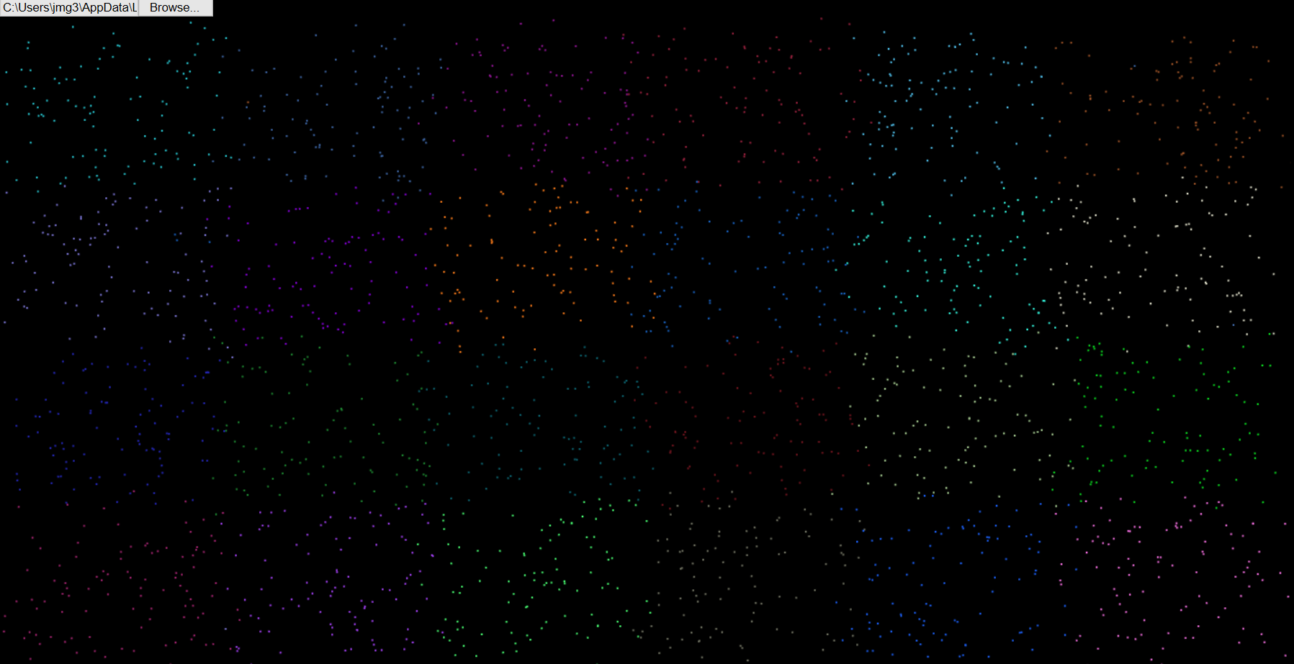
HOOVER Toolset
Includes an offline visualization component.
file:///C:/Users/jmg3/AppData/Local/lxss/home/jmg3/hoover/viz/index.html

Slide 26
HOOVER Status
Very much a work in progress.
Have built out simple test cases.
Currently building out a simple infectious disease modeling use case, using it to motivate feature extensions and performance optimization.

Slide 27
Conclusions
HClib – low overhead, simple API, excellent substrate for building out research projects on top.
HiHAT – more community-driven, production-focused (not a research tool), retargetable (not performance-portable).
HOOVER – in-progress, distributed, dynamic graph framework. Main challenge: how to support entirely decoupled execution without losing simulation fidelity?

Slide 28






Acknowledgements

