Slide 1
Setup
ssh to DAVINCI and grab a GPU node (if you don’t already have one):
$ source /projects/k2i/hpc/scripts/login-gpu.sh
Setup your environment once you have a GPU node (***this will take 10-15 minutes***):
$ source /projects/k2i/hpc/scripts/gpu-day-two-setup.sh
You should already have the code from yesterday, but if not you can grab it from Github:
$ module load GCCcore/6.4.0 Git/2.17.1
$ git clone https://github.com/agrippa/hpc-bootcamp.git $HOME/bootcamp-gpu
$ module unload Git/2.17.1 GCCcore/6.4.0
Useful API references for today’s projects:
Numba: http://numba.pydata.org/numba-doc/latest/index.html
Tensorflow: https://www.tensorflow.org/api_docs/python
Slides are accessible in your browser in Github and Box:
Github: https://github.com/agrippa/hpc-bootcamp Box: http://bit.ly/hpc-bc19

Slide 2
GPU Accelerated Computing (Day 2)
Productive GPU Programming
Max Grossman
Habanero Extreme Scale Software Research Group, Rice University
Principal & Co-Founder, 7pod Technologies
Author, Professional CUDA C Programming

Slide 3
Outline
Cons of CUDA
CUDA Libraries
Numba
Tensorflow

Slide 4

About Me
Habanero Research Group
Runtime Systems for HPC (“Big Compute”)
Data Analytics (“Big Data”)
Compilers and Programmer Tools
Co-Founder, 7pod Technologies (7pod.tech)
Consulting on new applications of data analytics and high performance computing
HPC and data analytics training

Slide 5
Cons of CUDA

Slide 6
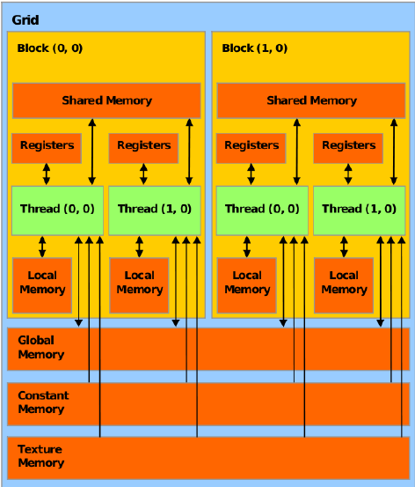
Massive Number of New Concepts
Memory management – manually managing multiple non-coherent address spaces.
Memory hierarchy – what the &#^$ is texture memory? Shared? Constant?
Thread hierarchy - Thread blocks, grids of thread blocks.
…
The most common CUDA illustration… even it is bewilderingly complex.

Slide 7
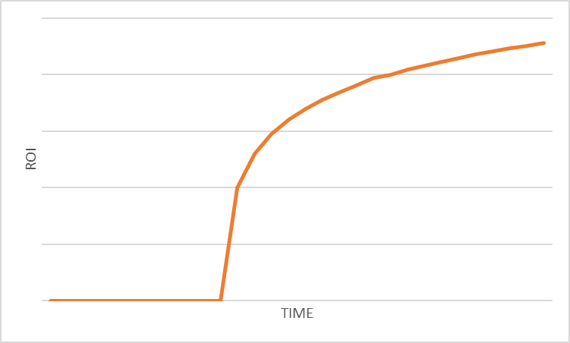
Massive Initial Investment
Investment for porting non-trivial kernels is a step function.
Initial ports are often much slower than their CPU counterparts.
Performance benefits only realized with determined, profile-driven optimization
Return-on-investment often unclear.
The most common CUDA question: will kernel foo run faster on a GPU?
For simple kernels the answer can be obvious, for more complex ones less so.

Slide 8
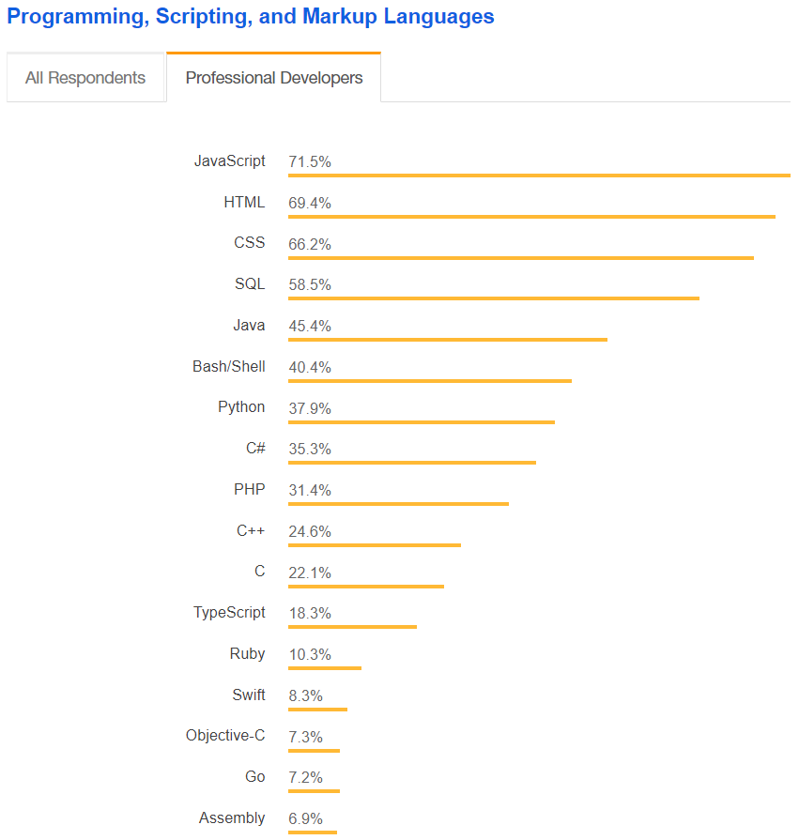
Language
Much/most of the world’s application code and application programmers do not use C/C++.
Makes it harder to find CUDA developers, harder to integrate CUDA kernels with the rest of your code base.
2018 Stack Overflow Developer Survey

Slide 9
Productive GPU Programming
Many commercial, open source, and research products available today that make GPU programming easier
Generally there is a tradeoff in either features or generalizability
Today we’ll explore three different approaches with hands-on exercises for each:
CUDA Libraries: NVIDIA-supported domain-specific libraries
Numba: Program CUDA devices in Python
Tensorflow: Machine learning library commonly used to target GPUs

Slide 10
CUDA Libraries

Slide 11
CUDA Libraries
CUDA Libraries offer high-level, high performance, domain-specific APIs for GPUs.
Examples:
CUSPARSE: Sparse linear algebra
CUBLAS: Dense linear algebra
CUDNN: Deep Neural Networks
CUFFT: Fast Fourier Transforms
Take advantage of expert-tuned kernels without writing a line of kernel code.
Many CUDA libraries emulate their host counterparts (e.g. CUBLAS and BLAS).

Slide 12
Common Library Workflow
Create a library-specific handle that manages contextual information useful for the library’s operation.
Many CUDA Libraries have the concept of a handle which stores opaque library-specific information on the host which many library functions access
Programmer’s responsibility to manage this handle
For example: cublasHandle_t, cufftHandle, cusparseHandle_t, curandGenerator_t
Allocate device memory for inputs and outputs to the library function.
Use cudaMalloc as usual

Slide 13
Common Library Workflow
If inputs are not already in a library-supported format, convert them to be accessible by the library.
Many CUDA Libraries only accept data in a specific format
For example: column-major vs. row-major arrays
Populate the pre-allocated device memory with inputs in a supported format.
In many cases, this step simply implies a cudaMemcpy or one of its variants to make the data accessible on the GPU
Some libraries provide custom transfer functions, for example: cublasSetVector optimizes strided copies for the CUBLAS library

Slide 14
Common Library Workflow
Configure the library computation to be executed.
In some libraries, this is a no-op
Others require additional metadata to execute library computation correctly
In some cases this configuration takes the form of extra parameters passed to library functions, others set fields in the library handle
Execute a library call that offloads the desired computation to the GPU.
No GPU-specific knowledge required

Slide 15
Common Library Workflow
Retrieve the results of that computation from device memory, possibly in a library-determined format.
Again, this may be as simple as a cudaMemcpy or require a library-specific function
If necessary, convert the retrieved data to the application’s native format.
If a conversion to a library-specific format was necessary, this step ensures the application can now use the calculated data
In general, it is best to keep the application format and library format the same, reducing overhead from repeated conversions

Slide 16
Common Library Workflow
Release CUDA resources.
Includes the usual CUDA cleanup (cudaFree, cudaStreamDestroy, etc) plus any library-specific cleanup
Continue with the remainder of the application.

Slide 17
Common Library Workflow
Not all libraries follow this workflow, and not all libraries require every step in this workflow
In fact, for many libraries many steps are skipped
Keeping this workflow in mind will help give you context on what the library might be doing behind the scenes and where you are in the process
Next, we’ll look at one simple illustration of this workflow

Slide 18
cuBLAS
cuBLAS is a port of a popular linear algebra library, BLAS
cuBLAS (like BLAS) splits its subroutines into multiple levels based on data types processed:
Level 1: vector-only operations (e.g. vector addition)
Level 2: matrix-vector operations (e.g. matrix-vector multiplication)
Level 3: matrix-matrix operations (e.g. matrix multiplication)

Slide 19
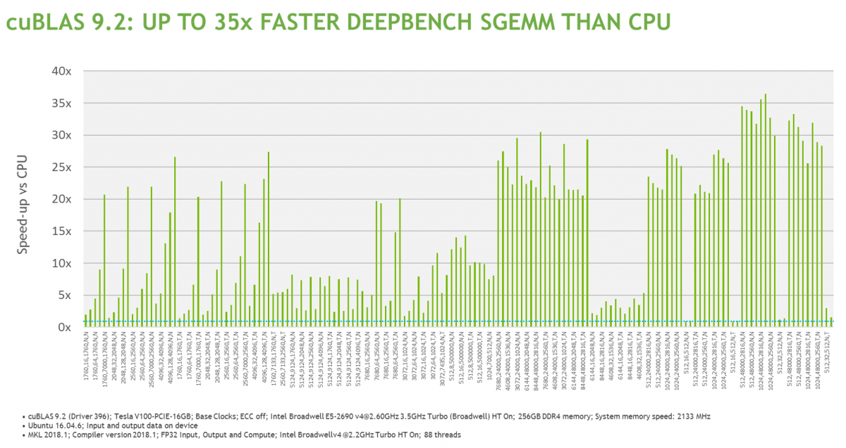
cuBLAS Performance
https://developer.nvidia.com/cublas

Slide 20
cuBLAS Portability
Porting to cuBLAS from BLAS is a straightforward process. In general, it requires:
Adding device memory allocation/freeing (cudaMalloc, cudaFree)
Adding device transfer functions (cublasSetVector, cublasSetMatrix, etc)
Transform library routine calls from BLAS to cuBLAS (e.g. cblas_sgemv ➔ cublasSgemv)

Slide 21
cuBLAS Ideosyncracies
For legacy compatibility, cuBLAS operates on column-major matrices
3 0 0
6 0 0
0 2 1
3
6
0
0
0
2
0
0
1

Slide 22
cuBLAS Data Management
Device memory in cuBLAS is allocated as you’re used to: cudaMalloc
Transferring data to the device uses cuBLAS-specific functions: cublasGetVector/cublasSetVector and cublasGetMatrix/cublasSetMatrix

Slide 23
cuBLAS Data Management
Example:
cublasStatus_t cublasSetVector(int n, int elemSize,
const void *x, int incx, void *y, int incy);
where:
n is the number of elements to transfer to the GPU
elemSize is the size of each element (e.g. sizeof(int))
x is the vector on the host to copy from
incx is a stride in x of the array cells to transfer to
y is the vector on the GPU to copy to
incy is a stride in y of the array cells to transfer to

Slide 24
cuBLAS Data Management
Example:
cublasSetVector(5, sizeof(int), h_x, 3, d_x, 2);
h_x
d_x

Slide 25
cuBLAS Data Management
Similarly:
cublasStatus_t cublasSetMatrix(int rows, int cols,
int elemSize, const void *A, int lda, void *B, int ldb);
where:
rows is the number of rows in a matrix to copy
cols is the number of cols in a matrix to copy
elemSize is the size of each cell in the matrix (e.g. sizeof(int))
A is the source matrix on the host
lda is the number of rows in the underlying array for A
B is the destination matrix on the GPU
ldb is the number of rows in the underlying array for B

Slide 26
cuBLAS Data Management
Similarly:
cublasSetMatrix(3, 3, sizeof(int), h_A, 4, d_A, 5);
4
5

Slide 27
Hands On - cuBLAS
Let’s take a look at a simple cuBLAS example that performs a matrix-vector multiplication. This example uses 6 of the 10 steps in the common library workflow:
Create a cuBLAS handle using cublasCreateHandle
Allocate device memory for inputs and outputs using cudaMalloc
Populate device memory using cublasSetVector, cublasSetMatrix
Call cublasSgemv to run matrix-vector multiplication on the GPU
Retrieve results from the GPU using cublasGetVector
Release CUDA and cuBLAS resources using cudaFree, cublasDestroy

Slide 28
Hands On - cuBLAS
The 10_cublas/ folder contains a template program with helpful TODOs.
Try completing these TODOs.
Compile and run the program to verify the correctness of the output – this example will print a percent error on the generated output. Any value below 3% is acceptable.

Slide 29
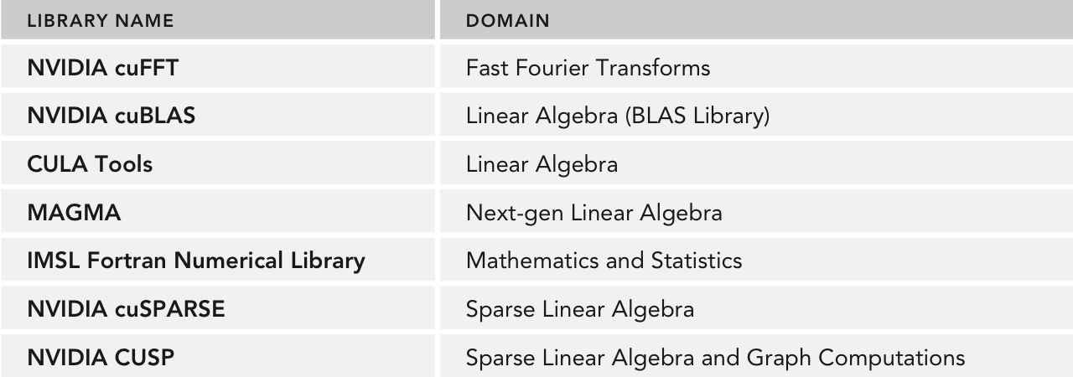
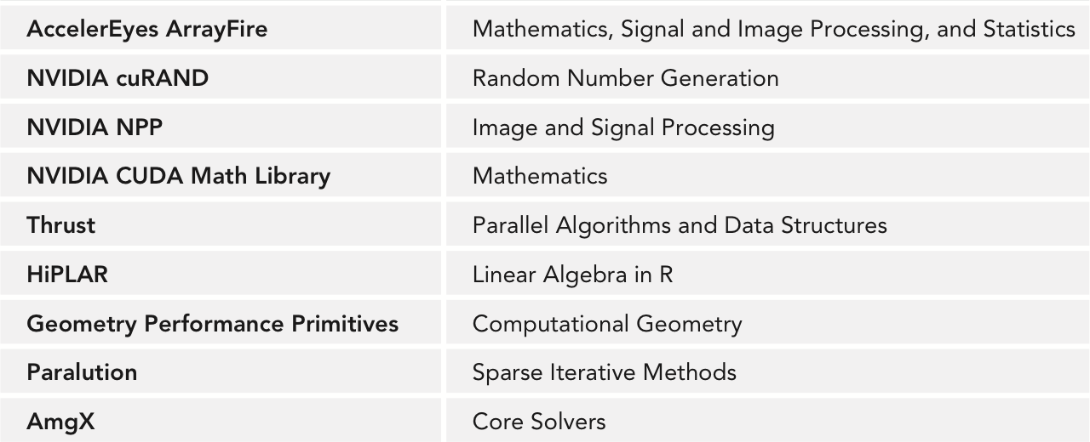
Review – CUDA Libraries
CUDA Libraries offer high-level, high performance, domain-specific APIs for GPUs.
Deliberately designed to facilitate porting from legacy, host-only libraries.

Slide 30
Numba

Slide 31
Numba Overview
from numba import cuda
import numpy as np
@cuda.jit
def vecadd(A, B, C):
tid = cuda.blockIdx.x * cuda.blockDim.x + \
cuda.threadIdx.x
C[tid] = A[tid] + B[tid]
threads_per_block = 256
blocks_per_grid = 10
N = blocks_per_grid * threads_per_block
A = np.random.rand(N)
B = np.random.rand(N)
C = np.zeros(N)
vecadd[blocks_per_grid, threads_per_block](A, B, C)
Numba enables programming CUDA devices in Python.
Uses Numpy arrays for data structures.
Uses just-in-time CUDA code generation from Python to create kernels.

Slide 32
Quick Numpy Introduction
Foundational library for numerical computing in Python.
Most commonly used for creating, slicing, manipulating N-dimensional arrays.
Includes other utilities, e.g. random number generation.
Numba uses Numpy arrays to store data copied to and from CUDA devices.
import numpy as np
# Create a 100-element array of zeros
arr = np.zeros(100)
# Read the 4th element of arr
… = arr[3]
# Create a 100x100 array of zeros
arr = np.zeros((100, 100))
# Write an element in the array
arr[4, 4] = …
# Copy the 4th column to the 3rd row
arr[2, :] = arr[:, 3]

Slide 33
Writing Numba Kernels
Declared as regular Python methods.
Decorated with @cuda.jit
Launched with threads per block, blocks per grid.
Have access to special blockIdx, blockDim, threadIdx variables.
@cuda.jit
def vecadd(A, B, C):
tid = cuda.blockIdx.x * cuda.blockDim.x + \
cuda.threadIdx.x
C[tid] = A[tid] + B[tid]

Slide 34
Hands On – 1D Iterative Averaging
for iter in range(niters):
for i in range(1, N + 1):
next[i] = curr[i - 1] + curr[i + 1] / 2.0
tmp = curr
curr = next
next = tmp

Slide 35
Hands On – 1D Iterative Averaging
The 11_numba_baseline/ folder contains a reference Python implementation of 1D iterative averaging.
$ python 1d_iter_avg.py <N> <niters> # Try N=8000, niters=5000
Let’s try a first port to Numba. There are helpful TODOs in 1d_iter_avg.py.
1d_iter_avg.py writes an image file img.png plotting the results of the iterations, use these images to verify your port is correct (eog img.png).
What kind of performance do you see (try repeating each experiment multiple times)?

Slide 36
Hands On – 1D Iterative Averaging
Dataset | Performance | Improvement Relative to Python
Python | 195.64 iters / s
Numba | 420.28 iters / s | 2.15x
CUDA | 353,085.61 iters / s | 1,804.77x
Massive performance discrepancy between CUDA and numba.
nvprof works just as well on numba programs!
Let’s start with nvprof’s Summary Mode:
$ nvprof python 1d_iter_avg.py 8000 5000

Slide 37
Hands On – 1D Iterative Averaging
 | CUDA memcpy DtoH | CUDA memcpy HtoD | Kernel
numba | 43.50% | 51.40% | 5.10%
CUDA | 0.10% | 0.11% | 99.79%
numba is spending the majority of time copying data around.

Slide 38
Numba Memory Management
Numba is by default conservative in its memory management.
for iter in range(niters):
kernel[blocks_per_grid, threads_per_block](nxt, curr, len(curr) - 2)
for iter in range(niters):
cudaMemcpy(d_nxt, nxt, len(nxt), cudaMemcpyHostToDevice)
cudaMemcpy(d_curr, curr, len(curr), cudaMemcpyHostToDevice)
kernel[blocks_per_grid, threads_per_block](nxt, curr, len(curr) - 2)
cudaMemcpy(nxt, d_nxt, len(nxt), cudaMemcpyDeviceToHost)
cudaMemcpy(curr, d_curr, len(curr), cudaMemcpyDeviceToHost)

Slide 39
Numba Memory Management
Numba exposes simple APIs for explicit memory management of CUDA devices.
Device array objects can then be passed to Numba kernels to avoid transfers:
Copy to device:
# Create a new numpy array and
# copy it to the device
arr = np.arange(100)
d_arr = cuda.to_device(arr)
Copy from device:
# Copy into a new host array
h_arr = d_arr.copy_to_host()
# Copy into an existing host array
existing_arr = np.zeros(100)
d_arr.copy_to_host(existing_arr)
kernel[blocks_per_grid, threads_per_block](d_arr)

Slide 40
Hands On – 1D Iterative Averaging
Try extending the template in the 12_numba_mem/ folder to use explicit memory management in numba.
Re-measure performance with timers and nvprof, what changes do we see?

Slide 41
Hands On – 1D Iterative Averaging
Try extending the template in the 12_numba_mem/ folder to use explicit memory management in numba.
Dataset | Performance | Speedup Relative to Python
Python | 195.64 iters / s
Numba | 2,595.46 iters / s | 13.27x
CUDA | 353,085.61 iters / s | 1,804.77x
 | CUDA memcpy DtoH | CUDA memcpy HtoD | Kernel
numba | 0.09% | 0.21% | 99.70%
CUDA | 0.10% | 0.11% | 99.79%

Slide 42
Hands On – 1D Iterative Averaging
Performance has clearly improved as a result of reduced data transfer, but still is much slower than CUDA.
Let’s look at the following metrics in nvprof for both numba and CUDA, in order to start diagnosing the performance delta
ipc
sm_efficiency
alu_fu_utilization
gld_transactions
gst_transactions
gld_transactions_per_request
gst_transactions_per_request
gld_efficiency
gst_efficiency

Slide 43
Hands On – 1D Iterative Averaging
Metric | numba | CUDA
ipc | 0.829075 | 0.463110
sm_efficiency | 30.76% | 21.68%
alu_fu_utilization | Mid (4) | Low (2)
gld_transactions | 1680 | 840
gst_transactions | 1120 | 560
gld_transactions_per_request | 3.36 | 1.68
gst_transactions_per_request | 4.48 | 2.24
gld_efficiency | 59.52% | 59.52%
gst_efficiency | 80.00% | 80.00%
gld/gst efficiency is actually reasonable for auto-generated code…
Lower IPC for CUDA likely due to more concise kernel.
Nothing that explains 100x performance difference.

Slide 44
Hands On – 1D Iterative Averaging
Let’s take a look at the performance outside the kernel.
Analyze the sequence of kernel calls and copies performed by numba and CUDA using:
$ nvprof --print-gpu-trace ...

Slide 45
Hands On – 1D Iterative Averaging
Let’s take a look at the performance outside the kernel.
Start Duration Grid Size Block Size Regs* Name
202.91ms 1.7930us (8 1 1) (256 1 1) 8 kernel(float*, float*, int)
202.92ms 1.0720us (8 1 1) (256 1 1) 8 kernel(float*, float*, int)
202.93ms 1.0560us (8 1 1) (256 1 1) 8 kernel(float*, float*, int)
Start Duration Grid Size Block Size Regs* Name
371.09ms 2.5560us (8 1 1) (256 1 1) 12 cudapy::__main__::kernel$241
371.40ms 1.5950us (8 1 1) (256 1 1) 12 cudapy::__main__::kernel$241
371.67ms 1.5530us (8 1 1) (256 1 1) 12 cudapy::__main__::kernel$241
CUDA
0.0090 ms between kernels
numba
0.2639 ms between kernels

Slide 46
Review – Numba
Numba makes rapid prototyping of CUDA-accelerated programs easy.
Quick path from Python to GPUs, with incremental, profile-driven optimization possible.
Dataset | Performance | Speedup Relative to Python
Python | 195.64 iters / s
Numba | 2,595.46 iters / s | 13.27x
CUDA | 353,085.61 iters / s | 1,804.77x
Most relevant for:
Quick validation that GPUs may yield speedup
Long-running kernels, where overheads of Python can be hidden
Heavy Python kernels that do not make use of advanced Python features

Slide 47
Tensorflow

Slide 48

Tensorflow
Open source, free, portable library from Google – expresses computation as a graph of operations.
Supports multiple backends to target GPUs, CPUs, TPUs, etc.
Supports an easy-to-use Python frontend.
Most commonly used for training and deploying neural nets.
Supports execution on everything from mobile devices to supercomputers.
https://github.com/tensorflow/tensorflow

Slide 49
Tensorflow
Core abstraction of Tensorflow is the computation graph.
Defines the operations to perform and the dependencies between them.
Let’s consider a simple 3-component dot product example:
a = (0, 1, 2)
b = (3, 4, 5)
c0 = a[0] * b[0]
c1 = a[1] * b[1]
c2 = a[2] * b[2]
s = c0 + c1 + c2
Procedural Python

Slide 50
Tensorflow
Core abstraction of Tensorflow is the computation graph.
Defines the operations to perform and the dependencies between them.
Let’s consider a simple 3-component dot product example:
a = (0, 1, 2)
b = (3, 4, 5)
c0 = a[0] * b[0]
c1 = a[1] * b[1]
c2 = a[2] * b[2]
s = c0 + c1 + c2
a = (0, 1, 2)
b = (3, 4, 5)
c1 = a[1] * b[1]
c0 = a[0] * b[0]
c2 = a[2] * b[2]
s = c0 + c1 + c2
Procedural Python
Does the answer change?

Slide 51
Tensorflow
Core abstraction of Tensorflow is the computation graph.
Defines the operations to perform and the dependencies between them.
Let’s consider a simple 3-component dot product example:
a = (0, 1, 2)
b = (3, 4, 5)
c0 = a[0] * b[0]
c1 = a[1] * b[1]
c2 = a[2] * b[2]
s = c0 + c1 + c2
a = (0, 1, 2)
b = (3, 4, 5)
c1 = a[1] * b[1]
c0 = a[0] * b[0]
c2 = a[2] * b[2]
s = c0 + c1 + c2
No!
Indicates that the fundamental computation graph is over-restricted by step-by-step execution.
Procedural Python
Does the answer change?

Slide 52
Tensorflow
Core abstraction of Tensorflow is the computation graph.
Defines the operations to perform and the dependencies between them.
Let’s consider a simple 3-component dot product example:
a = (0, 1, 2)
b = (3, 4, 5)
c0 = a[0] * b[0]
c1 = a[1] * b[1]
c2 = a[2] * b[2]
s = c0 + c1 + c2
0
3
1
4
2
5
*
*
*
+
Procedural Python
Computation Graph

Slide 53
Tensorflow
A TF Graph is constructed once (i.e. compiled).
A TF Graph can then be executed multiple times with different inputs.
TF runtime will transparently execute this graph on available compute resources (e.g. GPU, CPU, TPU) without the programmer writing any kernels or data transfer.
While you can explicitly create graph objects to add operations to, TF also has a default graph which is always present (similar to the default CUDA stream).
0
3
1
4
2
5
*
*
*
+
Graph

Slide 54
Tensorflow
A TF graph is composed of four types of nodes: constants, placeholders, operations, variables.
Constant: zero inputs, fixed output.
Placeholder: placeholder for a value that must be supplied at execution.
Operation: accepts 1 or more inputs and produces an output.
(Variables discussed later)
Placeholders
Constants
0
3
1
4
v1
v2
*
*
*
Operations
+

Slide 55
Tensorflow
A TF Session encapsulates the state and operations of a TF graph.
Responsible for mapping that graph to hardware resources.
A TF graph cannot be run without a TF session
Graph
Session
CPU
GPU
GPU
GPU

Slide 56
Hands On – Hello World in TF
‘Hello, TensorFlow!’
import tensorflow as tf
hello = tf.constant('Hello, TensorFlow!')
sess = tf.Session()
print(sess.run(hello))
Output
Inspired by: https://github.com/aymericdamien/TensorFlow-Examples

Slide 57
Hands On – Hello World in TF
To validate your environment, try running the provided helloworld.py under 13_tf_hello_world/.
$ python helloworld.py
Python will print a couple of warnings, these can be safely ignored.
Caveat: While TF can run on GPUs, today we’ll simply be running it on CPUs. The code is the same, but unfortunately DAVINCI’s GPUs are not supported by TF.
‘Hello, TensorFlow!’
Output
Inspired by: https://github.com/aymericdamien/TensorFlow-Examples

Slide 58
Hands On – Hello World in TF
Consider helloworld_placeholder.py under 13_tf_hello_world/.
Semantically identical to helloworld.py, but uses a placeholder to set the printed message.
{message: 'Hello, TensorFlow!’}
message
message = tf.placeholder(dtype = tf.string,
name = 'message')
sess = tf.Session()
print(sess.run(message, feed_dict = {message: 'Hello, TensorFlow!'}))
Output
Inspired by: https://github.com/aymericdamien/TensorFlow-Examples

Slide 59
Hands On – Hello World in TF
Consider helloworld_op.py under 13_tf_hello_world/.
Demonstrates the definition of an operation (+).
{v: 5}
v
3
c = tf.constant(3)
v = tf.placeholder(dtype = tf.int32, name = 'v')
sum = tf.add(c, v)
sess = tf.Session()
sess.run(sum, feed_dict = {v: 5})
+
Output
Inspired by: https://github.com/aymericdamien/TensorFlow-Examples

Slide 60
Machine Learning w/ Tensorflow
While Tensorflow can be used to execute general purpose computation graphs, it is most commonly used to perform supervised training of machine learning models.
A supervised machine learning model seeks to approximate some unknown function through observations of its inputs (X) and outputs (Y).
Given the following, what would you guess W and B are?
Y = F(X) = W * X + B
X | Y
1 | 2
2 | 4
3 | 6
4 | 8
5 | 10

Slide 61
Machine Learning w/ Tensorflow
In supervised learning, labeled data points are split into training and testing datasets.
Training data teaches the model what the expected outputs are
Testing data measures how well the model is approximating the hidden function
Training_X
Training_Y
Supervised
Data points are labeled.
X
Y
Testing_X
Testing_Y

Slide 62
Machine Learning w/ Tensorflow
Supervised machine learning in TF generally takes the following steps:
Define the structure of a model as a TF graph.
Load our training dataset.
For a given number of epochs/iterations:
Compute error of the model on the training data
Update the model to reduce error
Y = W * X + B
X = [0, 1, 3, 6, 10]
Y = [0, 2, 6, 12, 20]
err = MSE(calc_Y, Y)
Update W, B

Slide 63
Machine Learning w/ Tensorflow
Supervised machine learning in TF generally takes the following steps:
Define the structure of a model as a TF graph.
Load our training dataset.
For a given number of epochs/iterations:
Compute error of the model on the training data
Update the model to reduce error
Y = W * X + B
X = [0, 1, 3, 6, 10]
Y = [0, 2, 6, 12, 20]
err = MSE(calc_Y, Y)
Update W, B
Uses TF Graph APIs
Generally loaded into numpy arrays
Easy to hand-code or use TF utilities
Handled by TF optimizers

Slide 64
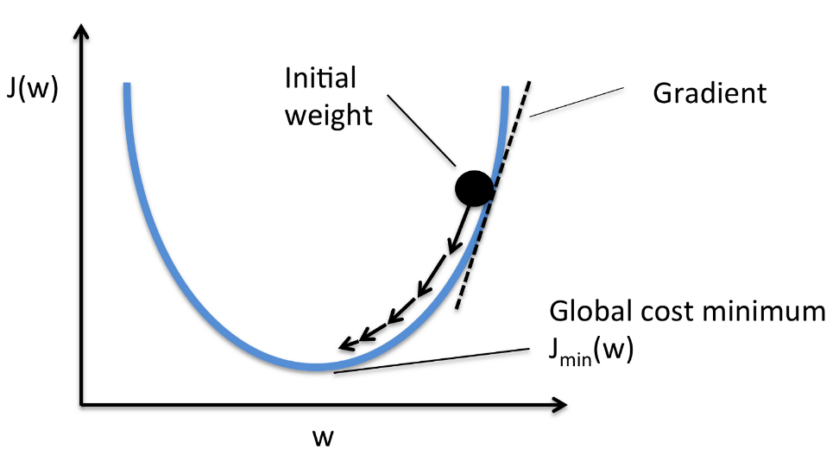
Tensorflow Optimizers
More generally, optimizers are used to minimize/maximize a function given constraints.
In ML, we generally want to minimize the error between our labels/expected values and the values computed by our model.
Optimization frameworks are used to update the variables of our model.
TF offers a variety of optimizers for just this.

Slide 65
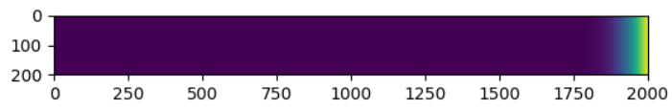
Hands On – Linear Regression in TF
Recall in the 1D Iterative Averaging example, each cell was updated according to:
arr[i] = 1/2 * arr[i - 1] + 1/2 * arr[i + 1]
1D iterative averaging has properties similar to some physical systems (e.g. heat propagation along a metal cylinder).
What if I gave you experimental temperature data from such a system? Could you use machine learning to recover/approximate the rules of that system?

Slide 66
Hands On – Linear Regression in TF
Consider the contents of the 14_tf_regress/ folder.
X.bin: Data sampled from an execution of 1d_iter_avg.py, in the form arr[i - 1], arr[i], arr[i + 1].
Y.bin: Data sampled from an execution of 1d_iter_avg.py, the value of arr[i] computed from the corresponding values in X.bin.
linear_regression.py: An example TF program that loads these data files and trains a linear model with the structure W1 * arr[i - 1] + W2 * arr[i + 1].
Let’s try walking through the code together, and then train the model:
$ python linear_regression.py
Inspired by: https://github.com/aymericdamien/TensorFlow-Examples

Slide 67
Hands On – Linear Regression in TF
0.52333724 * arr[i-1] * 0.4807585 * arr[i+1]
$ python linear_regression.py
...
Epoch: 39800 cost= 0.000000092 W= 0.52370435 0.48045552
Epoch: 39900 cost= 0.000000090 W= 0.5235196 0.4806075
Epoch: 40000 cost= 0.000000089 W= 0.52333724 0.4807585
Optimization Finished!
Training cost= 8.899919e-08 W= 0.52333724 0.4807585
Testing... (Mean square loss Comparison)
Testing cost= 2.9966046e-08
Absolute mean square loss difference: 5.903314e-08
Low training cost, optimizer did a good job minimizing
Low testing cost, suggests the model is general enough to work on unseen data

Slide 68
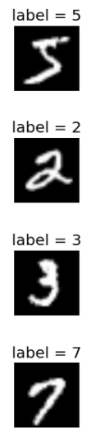
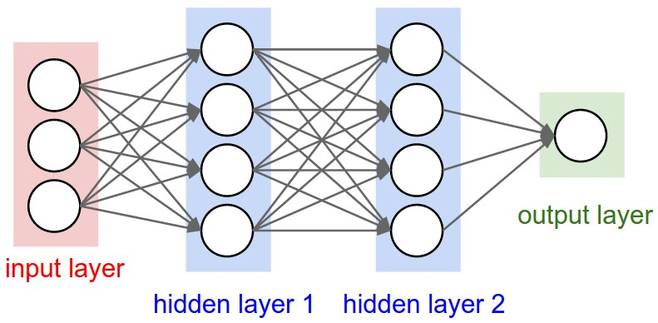
Tensorflow Neural Nets
No TF tutorial is complete without neural nets…
Going into detail on all the variants of neural nets would require more than 1 day.
We’ll look at a simple example of using dense neural nets to predict handwritten digits in the MNIST dataset.
5
2
3
7

Slide 69
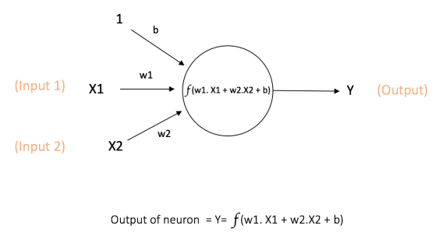
What is a Neural Net?
A single neuron
X = neuron’s inputs
Y = neuron’s output
B = bias
W = weights

Slide 70
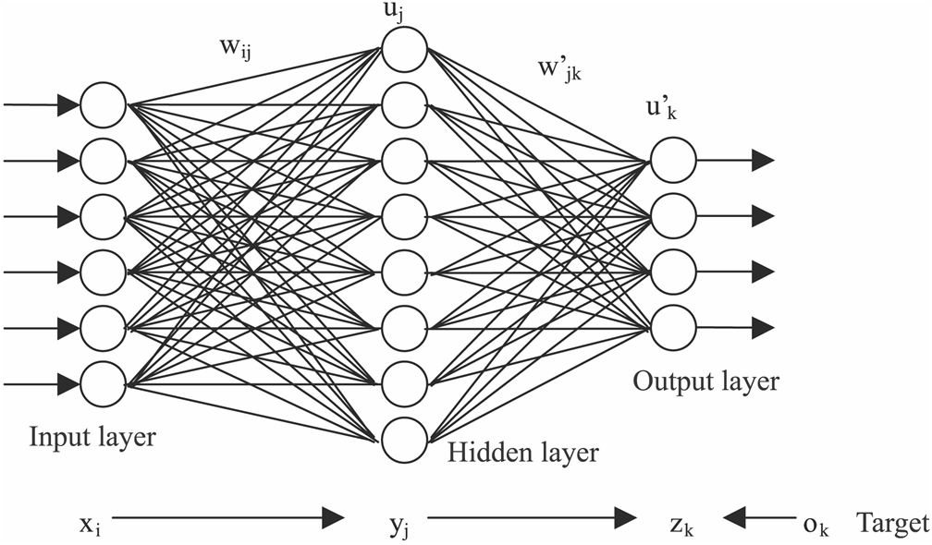
The Renaissance of Neural Nets
A neural net is a directed graph of neurons.
Power to accurately approximate a wide range of functions¹.
Only recently has training practically useful nets become feasible:
Large, clean data sets.
Improved computational and memory throughput, via GPUs.
“Universal Function Approximation by Deep Neural Nets with Bounded Width and ReLU Activations”. Boris Hanin. https://arxiv.org/abs/1708.02691

Slide 71

Tensorflow Neural Nets
The MNIST dataset consists of handwritten digits (encoded as pixels) and their expected labels (i.e. the digit itself).
We want to train a neural net to predict the number these flattened vectors represent.
0
0
1
1
...
0
1
0
0

Slide 72
Hands On – Neural Nets in TF
15_tf_nn/ contains an example code for training a neural net on the MNIST dataset:
$ python neural_network.py
This script will print a percent accuracy at completion (i.e. how many labels in the testing dataset match).
What accuracies are you able to achieve?

Slide 73
Hands On – Neural Nets in TF
Try experimenting with network structure.
The current model uses two layers, each of 256 neurons.
x = tf.placeholder('float', shape = (batch_size, num_input), name = 'images')
layer_1 = tf.layers.dense(x, n_hidden_1)
layer_2 = tf.layers.dense(layer_1, n_hidden_2)
out_layer = tf.layers.dense(layer_2, num_classes)
Does adding layers help? Does increasing the size of current layers help?
layer_2 = tf.layers.dense(layer_1, n_hidden_2)
Input layer
# of neurons in this layer

Slide 74
Hands On – Neural Nets in TF
Model | Epochs | Accuracy | Time
256 x 256 | 20 | 91.306% | 41.60 s
256 x 256 | 80 | 91.677% | 166.07 s
256 x 256 x 256 | 80 | 91.386% | 211.22 s
256 | 80 | 91.907% | 122.22 s
128 | 80 | 91.957% | 81.76 s
16 | 80 | 92.037% | 63.50 s
8 | 80 | 91.577% | 51.57 s
4 | 80 | 87.049% | 45.49 s
2 | 80 | 69.481% | 47.54 s
Increasing epochs yields a slight improvement in accuracy.
Increased model complexity doesn’t yield improved results – complex models may yield better results, but with more variables they take longer to train.
Reduced model complexity is more accurate up to a point – fewer variables learn quicker.

Slide 75
Review – Tensorflow
High level library that supports general purpose computation, but is most commonly used to train and deploy supervised machine learning models.
Can transparently offload computation to GPUs – generally yields massive training performance improvements.
Supports a wide range of features we didn’t cover:
Different types of layers: CNN, RNN, pooling, deconv
Distributed training
Estimators
…

Slide 76
Summary

Slide 77

Productive GPU Programming
Many options for productive GPU programming above the level of CUDA
High level, domain specific libraries
Ahead-of-time or just-in-time compilers/interpreters
In general, trade off performance/generality for usability/time-to-solution.
Full list of CUDA libraries across deep learning, signal processing, linear algebra, and more: https://developer.nvidia.com/gpu-accelerated-libraries

