Slide 1

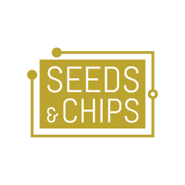
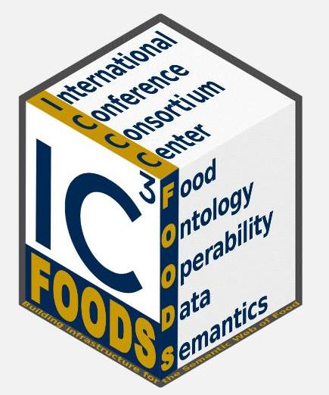

Global Agricultural Concept Scheme (GACS) and Agrisemantics
Seeds & Chips – The Global Food Innovation Summit
Session: “The Semantic Web of Food”
Milano, May 8, 2017

Slide 2
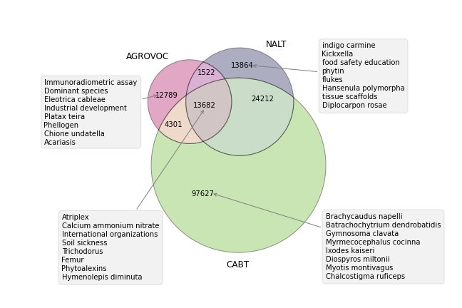


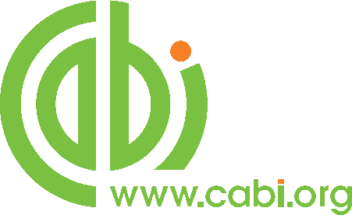
Global Agricultural Concept Scheme
GACS
GACS Beta 3.1
15,000+ concepts
350,000+ labels in 29 languages
reasonably stable
testing and feedback welcome
Notes:
Agrisemantics was undertaken by FAO, CAB International, and the USDA National Agricultural Library to integrate their overlapping thesauri into a common concept scheme, or hub.
The beta version of Global Agricultural Concept Scheme, or GACS, has 15,000 concepts, with labels in over twenty languages.
GACS is a Semantic Web vocabulary and uses URIs to identify concepts.

Slide 3
Example concept: “Grain”
http://id.semantics.org/gacs/C1825
Labels in 25 languages
Korn (German)
зерно (Russian)
अनाज (Hindi)
...
Broader
cereal products
Narrower:
brewers grains
cereal grains
cereals
feed grains
GACS
grain (Product) is related to:
grain crops (Organism)

Slide 4
Part of a Semantic Ecosystem
Agrisemantics
The Web
GACS
Vocabularies
Mappings
Ontologies
Mappings
Thesauri
Mappings
Mappings
Vocabularies
Mappings
Ontologies
Taxonomies
Thesauri
Notes:
Thirty organizations came together last year to formulate a vision for broadening the semantic network to ontologies, taxonomies, code lists, and other types of vocabulary used for describing data and research. The Agrisemantics idea is inclusive: to offer, but not require, a shared methodology and infrastructure in support of mapping.
The ultimate goal is to help researchers and farmers analyze data more efficiently and find innovative solutions in a changing world.

Slide 5
Supported by AgroPortal
Agrisemantics
The Web
GACS
support for annotation,
search, and mapping
Vocabularies
Mappings
Ontologies
Mappings
Thesauri
Mappings
Mappings
Vocabularies
Mappings
Ontologies
Taxonomies
Thesauri
Notes:
Thirty organizations came together last year to formulate a vision for broadening the semantic network to ontologies, taxonomies, code lists, and other types of vocabulary used for describing data and research. The Agrisemantics idea is inclusive: to offer, but not require, a shared methodology and infrastructure in support of mapping.
The ultimate goal is to help researchers and farmers analyze data more efficiently and find innovative solutions in a changing world.

Slide 6
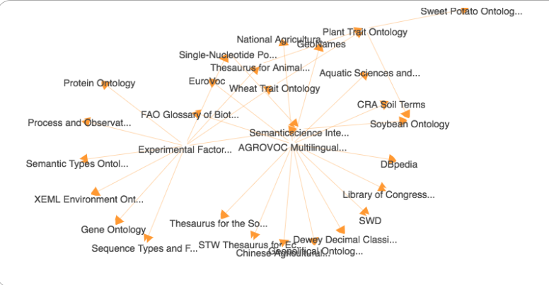
Supported by VEST Map of Standards
AgroPortal
The Web
GACS
Vocabularies
Mappings
Ontologies
Mappings
Thesauri
Mappings
Mappings
Vocabularies
Mappings
Ontologies
Taxonomies
visualize relationships
between vocabularies
Thesauri
Notes:
Thirty organizations came together last year to formulate a vision for broadening the semantic network to ontologies, taxonomies, code lists, and other types of vocabulary used for describing data and research. The Agrisemantics idea is inclusive: to offer, but not require, a shared methodology and infrastructure in support of mapping.
The ultimate goal is to help researchers and farmers analyze data more efficiently and find innovative solutions in a changing world.

Slide 7
Used for: Tagging Literature
Search for literature
about “grain”
GACS
JournalArticles
Reports
Tagging
News
Notes:
Thirty organizations came together last year to formulate a vision for broadening the semantic network to ontologies, taxonomies, code lists, and other types of vocabulary used for describing data and research. The Agrisemantics idea is inclusive: to offer, but not require, a shared methodology and infrastructure in support of mapping.
The ultimate goal is to help researchers and farmers analyze data more efficiently and find innovative solutions in a changing world.

Slide 8
Used for: Tagging Data
Generic, commonly
used concepts
“Grain”
GACS
Search for data on grain
Tagging
Datasets
Spread
sheets
Specialized concepts for experts
Crop Ontology: “grain weight” with units of measurement
Trait Ontology: distinguishes “grain weight” versus “fruit weight” and “pod weight”
Mappings
Sensor
feeds
Tagging
Ontologies
Harmonize data on grain
Notes:
Thirty organizations came together last year to formulate a vision for broadening the semantic network to ontologies, taxonomies, code lists, and other types of vocabulary used for describing data and research. The Agrisemantics idea is inclusive: to offer, but not require, a shared methodology and infrastructure in support of mapping.
The ultimate goal is to help researchers and farmers analyze data more efficiently and find innovative solutions in a changing world.

Slide 9
Partners
GODAN Global Open Data for Agriculture and Nutrition
CABI Centre for Agriculture and Biosciences International
FAO Food and Agriculture Organization of the United Nations
NAL USDA National Agricultural Library
INRA Institut national de la recherche agronomique
Syngenta AG
CGIAR Consultative Group on International Agricultural Research
AgroPortal
Organizations mapping to GACS and helping to build Agrisemantics

Slide 10
http://agrisemantics.org/gacs
#Agrisemantics
#GACS
#SemanticWebOfFood this session
#SAC17 this conference
@tombaker this speaker (me)
@godansec GODAN

