Slide 1
GACS Quality Improvement Project Summer 2017
Lori Finch Lori.Finch@ars.usda.gov
Sujata Suri Sujata.Suri@ars.usda.gov
Tom Baker Tom.Baker@tombaker.org
Osma Suominen osma.suominen@helsinki.fi

Slide 2
GACS Beta 3.1 – motivation for QIP?
GACS Beta 3.1 has not appreciably changed since May 2016.
List of Quality Improvements
“GACS Phase 4: from soft launch to Version 1.0” document dated June 20, 2016.
Tasks not done
NAL resources available
GACS survey, autumn 2016

Slide 3
GACS survey – Autumn 2016
“We wanted to hear thoughts about how GACS should be structured so that it best serves the needs of users as well as applications that make use of GACS.”
https://github.com/agrisemantics/2016_11_goettingen/blob/master/presentations/2016-11-23.gacs_survey_structure.pdf
Three hierarchical structures proposed

Slide 4
Scenario A – based on YSO and DOLCE

Slide 5
Scenario B – based on AGROVOC

Slide 6
Scenario C – thematic based on CABT classified

Slide 7
GACS survey: Conclusions and recommendations (Osma)
1) We should keep the thematic groups as an additional view, with possibly some
tweaks
– allow multiple groups for a concept, with guidance
– classify the remaining 20% of concepts which currently are not
2) We should consider adopting the current concept types (Organism, Chemical,
Geographical, Product, Topic) as top concepts
– maybe split off Property (and others?) from Topic
– maybe create an additional layer of organization below these top concepts, especially for
Topics which are quite many
– could mean dropping the notion of concept types, to avoid encoding the same information in
two different ways
3) In any case we need to continue cleaning up the hierarchy
– reduce unwarranted polyhierarchy, for example by calculating scores for each BT/NT
relationships based on metrics (e.g. shared among source thesauri?) and removing the worst ones
– flag and correct situations where BT and NT have different concept types (~1300)
– It would help to move some leaf concepts out of GACS Core
https://github.com/agrisemantics/2016_11_goettingen/blob/master/presentations/2016-11-23.gacs_survey_structure.pdf

Slide 8
GACS QIP
Resources
Lori Finch and Sujata Suri
Osma Suominen, GODAN funded
Tom Baker, GODAN funded
Main goal:
Assure thematic assigned for 100% of terms
Cleanup hierarchy
Remove polyhierarchy
BT/NT of same type
Split off property, etc.

Slide 9
GACS Core Beta 3.1 hierarchy stats
15,428 concepts
20,072 BT/NT relationships (1.3 per concept)
4,226 concepts (27%) have more than one BT
578 top concepts

Slide 10
Beginning principles
Starting with 15,428 concepts
No deletion of concepts
Working only in English
Changes to SKOS file for import into Luxid Web Studio https://github.com/agrisemantics/gacs-qip
Time limits: Working June, July, Aug (not Osma and Tom) and Sept

Slide 11
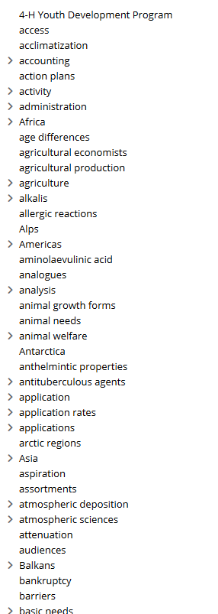
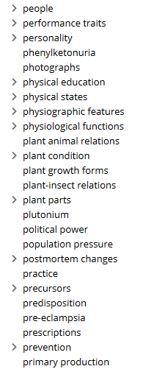
Hierarchy: “Finding homes for top terms” - moving to lower parts of hierarchy
Showing how hierarchy is “before” – 578 top terms in Web Studio,
terms with “>” have narrower terms

Slide 12
Examples of terms removed as “top term” and given BT
plutonium BT transition elements
adenosine BT nucleosides
phenylketonuria BT metabolic disorders
life expectancy BT biological properties
endocrine-disrupting chemicals BT chemical substances

Slide 13
Hierarchy problems
Example: “reproduction control” with BT “Brachyspiraceae”
Example: “people” has narrower terms including-
Zoos
Botanical gardens
Seedless cultivars

Slide 14
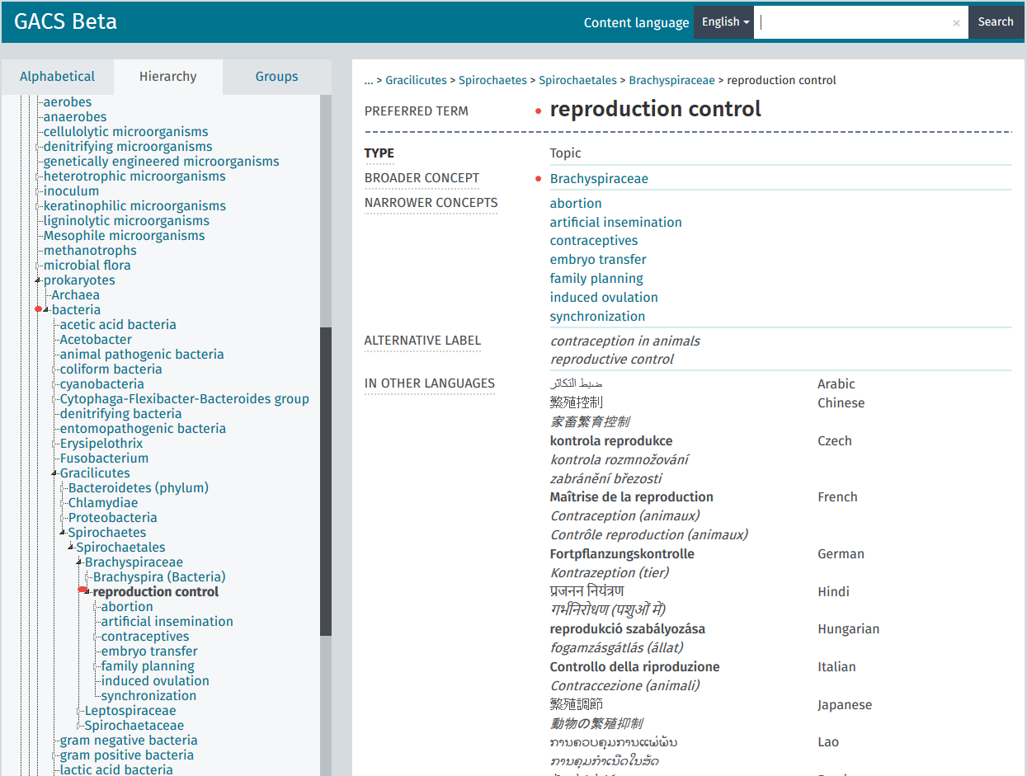

Slide 15
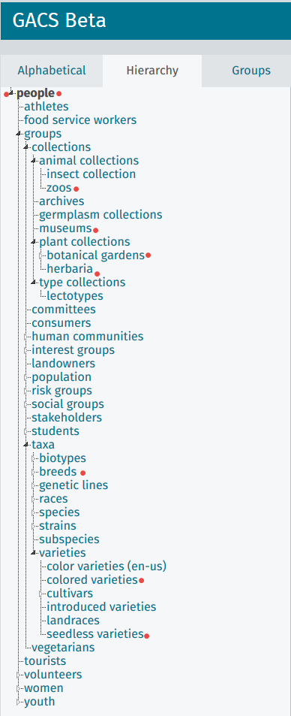
“People” hierarchy at GACS Beta
narrower terms are nonsensical:
Zoos
Museums
Botanical gardens
Herbaria
Breeds
Colored varieties
Seedless varieties

Slide 16
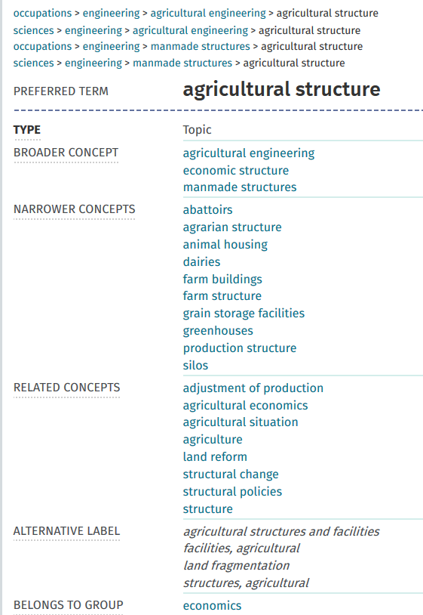
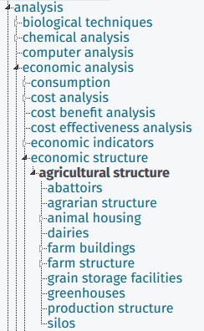
Mixed hierarchy example: agricultural structure

Slide 17
Added Upper Structure
Enables “ease of first sorting”
Like “Scenario A”
Reuse of terms useful for intellectual organization e.g., “activity”, “characteristics” now have placement
Additions, kept “separate” from GACS URIs
Reuse of YSO and UMLS structures

Slide 18
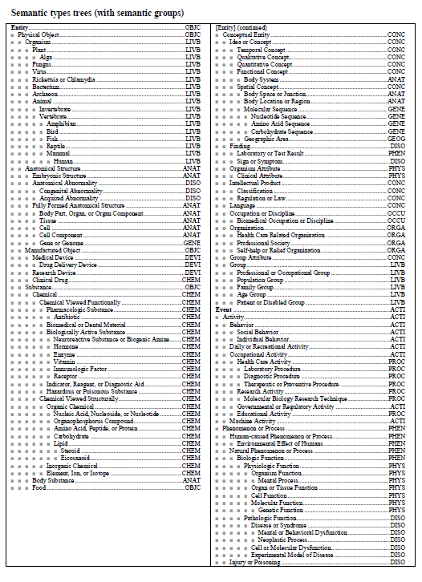
Unified Medical Language System – Semantic types

Slide 19
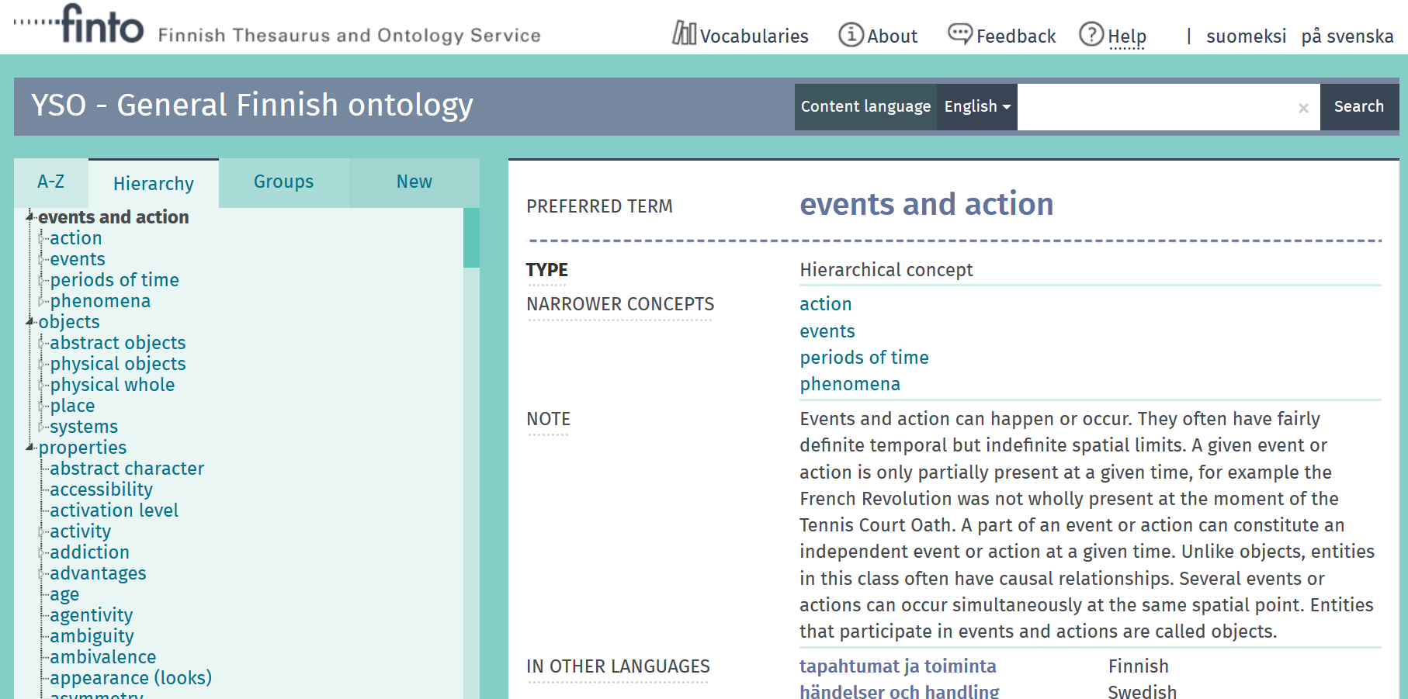

Slide 20
Upper Structure
OBJECTS
material things that can be seen or touched or visited (locations), including “abstract objects” such as ideas, models
EVENTS AND ACTIONS
something that happens, such as processes or phenomenon
PROPERTIES
attributes / characteristics / qualities of something/objects

Slide 21
Hierarchy Status
100% of terms aligned to upper structure
First draft of Scope Notes for upper structure (many taken from YSO or UMLS)
Satisfactory progress to have cleaner hierarchies that are BT/NT transitive
“Work in progress”/ not perfect, takes time

Slide 22
View the work done
All the work on the data side is in GitHub https://github.com/agrisemantics/gacs-qip/tree/master/gacs-data
SKOSMOS installation (Osma)
http://tester-os-kktest.lib.helsinki.fi/gacsdemo/gacs/en/

Slide 23
Non-Core GACS
Using top 10,000 terms from each thesaurus includes many terms very specific to one region, “not of global interest”
4-H Youth Development Program
Food and Drug Administration
Parking place for some terms ambiguous and need more work e.g., “practice”
If desired, can move more terms to this location or eliminate (only 10 terms here)

Slide 24
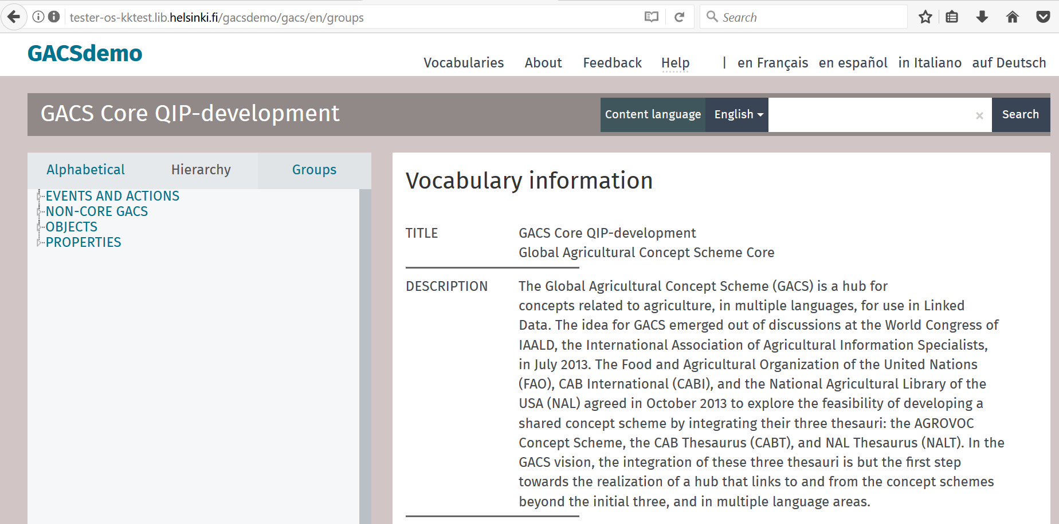

Slide 25
Thematic Classification
Based on CABT Classification / UAT
Thematic classification not assigned for ~2800 concepts. Goal: complete for 100% of concepts.
Frequency distribution of terms to categories very uneven, many categories with one or without concepts.
There are no scope notes for the classification.

Slide 26
Classification Scheme applied to GACS Concepts
Two-Letter
Code Classification Heading
CA GENERAL
FA PHYSICAL SCIENCES
JA EARTH SCIENCES
LA LIFE SCIENCES
PA APPLIED SCIENCE AND TECHNOLOGY
WA SOCIAL SCIENCES AND HUMANITIES

Slide 27
Thematic Classification progress
100% of concepts are sorted into classification
Principle: remove terms from “common terms” category if a better category found
Principle: can allow concepts to be in more than one category
First draft of Scope Notes for Classification
“thin” but with examples of Concepts assigned
Some categories with no / few GACS Concepts, these are noted

Slide 28
NY Category – “organisms of uncertain taxonomy”
Contained only 2 entries,
Pneumocystis
Pneumocystis carinii (aka P. jiroveci)
Moved to NQ category, “fungi”

Slide 29
Categories not used or with few terms
SW vermiculture
WQ arts
WS history
WY philosophy and ethics
LU evolution
LX natural history
NY organisms of uncertain taxonomy

Slide 30
QC of Category work
insulating materials http://id.agrisemantics.org/gacs/G_TL http://id.agrisemantics.org/gacs/G_CC
Removal of second category “CC=common terms”, retention of “TL=materials”

Slide 31
QC of Category work
Double category assignment –
plant protection equipment
“TN=equipment”
“PR=health protection”
milking machines
“TN=equipment”
“SS=animal production”
plant protection equipment | http://id.agrisemantics.org/gacs/G_TN http://id.agrisemantics.org/gacs/G_PR
milking machines | http://id.agrisemantics.org/gacs/G_TN http://id.agrisemantics.org/gacs/G_SS

Slide 32
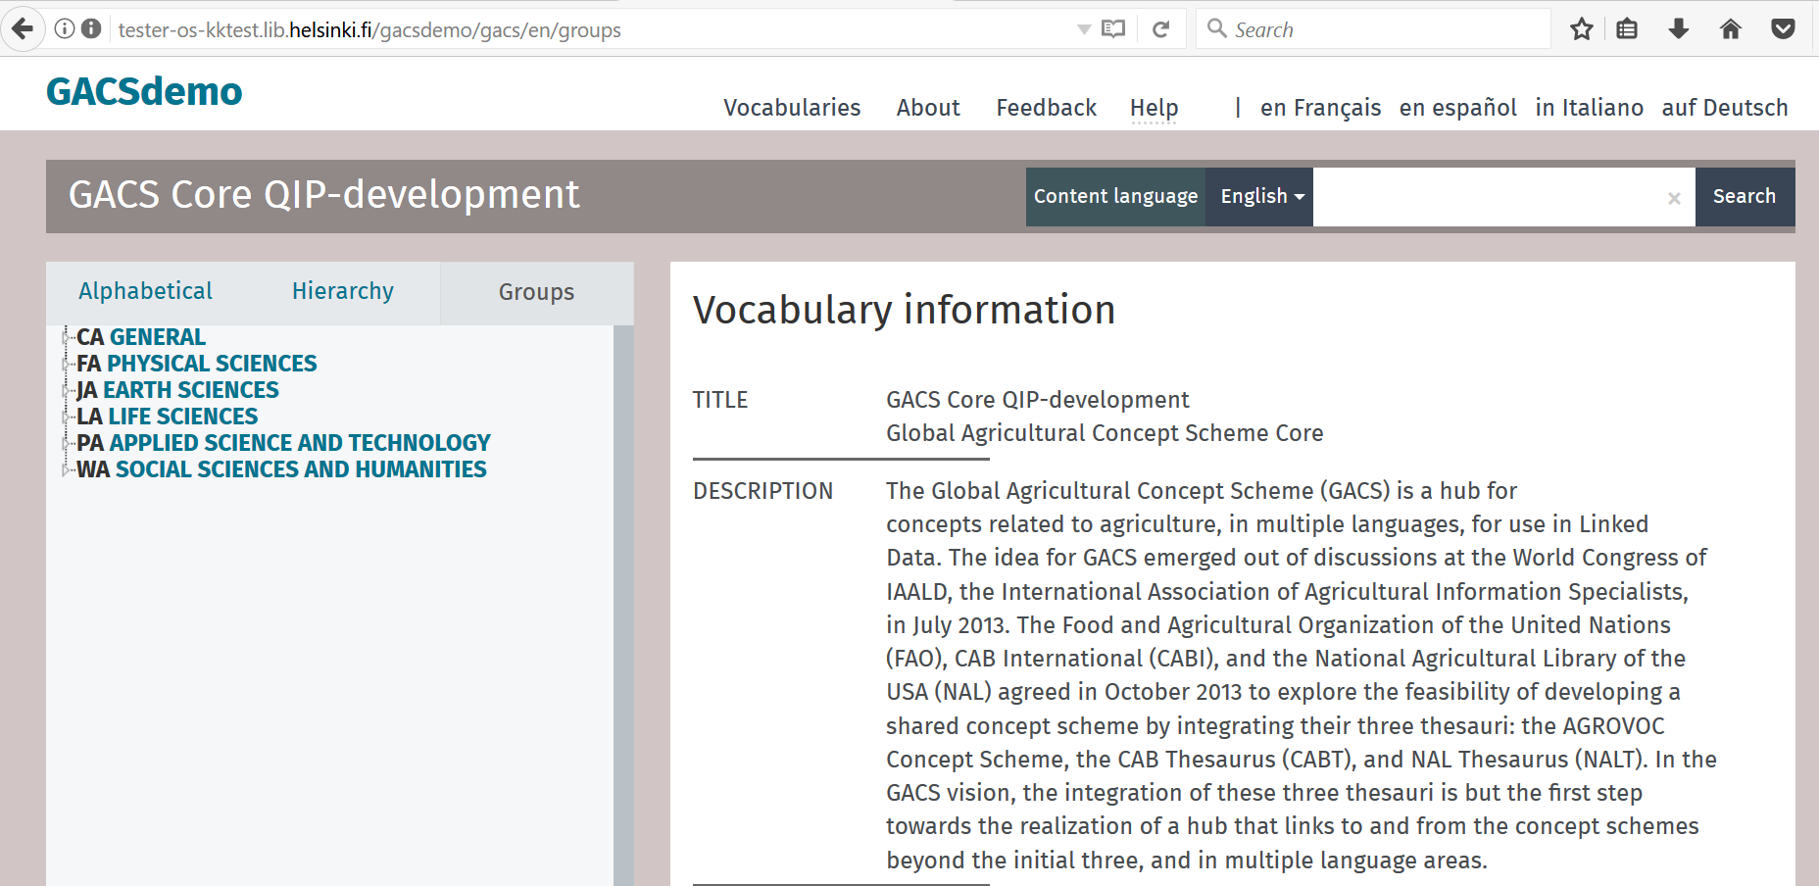

Slide 33
Some analysis of changes done to-date 28-Aug-17 version
https://github.com/agrisemantics/gacs-qip/blob/master/gacs-data/webstudio-exports/NOTES.md

Slide 34
Removed triples, by RDF property
1416 <http://www.w3.org/2004/02/skos/core#broader>
507 <http://www.w3.org/2004/02/skos/core#topConceptOf>
81 <http://www.temis.com/luxid-schema#memberOf>
18 <http://www.w3.org/2004/02/skos/core#related>
8 <http://www.w3.org/2004/02/skos/core#scopeNote>
8 <http://www.w3.org/2004/02/skos/core#prefLabel>
4 <http://www.w3.org/2004/02/skos/core#definition>

Slide 35
Added triples, by RDF property
2839 <http://www.temis.com/luxid-schema#memberOf>
1128 <http://www.w3.org/2004/02/skos/core#broader>
419 <http://www.w3.org/2004/02/skos/core#related>
43 <http://www.w3.org/2004/02/skos/core#definition>
31 <http://www.w3.org/2004/02/skos/core#prefLabel>
23 <http://www.w3.org/1999/02/22-rdf-syntax-ns#type>
2 <http://www.w3.org/2004/02/skos/core#scopeNote>

Slide 36
Next Steps
Agreement to continue work until November
Refinement of scope notes, adherence to scope notes for both hierarchical and thematic classification
Review and feedback by partners, stakeholders
Beyond November, there is still quality work to be done on definitions, scope notes as well as refinement of hierarchy / classification

Slide 37
Discussion
Lori Finch Lori.Finch@ars.usda.gov
Sujata Suri Sujata.Suri@ars.usda.gov
Tom Baker Tom.Baker@tombaker.org
Osma Suominen Osma.Suominen@helsinki.fi

Slide 38
Discussion points
WG needs time to review.
Long term: Generally, where we do think GACS is going?
Long term: maintenance? Sustainability?
Short term: Do we replace GACS Beta with this new version? When is decision point? Who?
When is next meeting GACS WG?

