Slide 1
GACS Quality Improvement Project Summer 2017
Lori Finch Lori.Finch@ars.usda.gov
Sujata Suri Sujata.Suri@ars.usda.gov
Tom Baker Tom.Baker@tombaker.org
Osma Suominen osma.suominen@helsinki.fi
Notes:
Presentation at the GACS “working group” at RDA Montreal, Canada September 21, 2017

Slide 2
GACS Beta 3.1 – motivation for QIP?
GACS Beta 3.1 has not appreciably changed since May 2016.
List of Quality Improvements
“GACS Phase 4: from soft launch to Version 1.0” document dated June 20, 2016.
Tasks not done
NAL resources available
GACS survey, autumn 2016
Notes:
What was our motivation for the Quality Improvement Project?
GACS has not been edited or changed for a long time, May 2016.
The WG put together a list of improvements that we wanted to make, but these tasks were not done.
Lori at NAL had some time during the summer to work on improving GACS, and wanted to do this before retirement.
There was a stakeholders survey done on the hierarchy issue in autumn 2016. (sag way to next slide)

Slide 3
GACS survey – Autumn 2016
“We wanted to hear thoughts about how GACS should be structured so that it best serves the needs of users as well as applications that make use of GACS.”
https://github.com/agrisemantics/2016_11_goettingen/blob/master/presentations/2016-11-23.gacs_survey_structure.pdf
Three hierarchical structures proposed
Notes:
You can go to github to learn more about the survey. The survey centered on how to structure the vocabulary. 3 hierarchical structures were proposed….

Slide 4
Scenario A – based on YSO and DOLCE
Notes:
Scenario A was based on YSO and DOLCE. Note the upper structure of “events and action”, “objects” and “properties”

Slide 5
Scenario B – based on AGROVOC
Notes:
Scenario B was based on AGROVOC with many semantic groups, such as “phenomena” “substances” “activities” “products” etc.

Slide 6
Scenario C – thematic based on CABT classified
Notes:
Scenario C was based on the CABT classified and is thematic in nature. Top groups are General, Physical Sciences, Earth Sciences, Life Sciences, Applied Science and Technology; Social Sciences & Humanities

Slide 7
GACS survey: Conclusions and recommendations (Osma)
1) We should keep the thematic groups as an additional view, with possibly some
tweaks
– allow multiple groups for a concept, with guidance
– classify the remaining 20% of concepts which currently are not
2) We should consider adopting the current concept types (Organism, Chemical,
Geographical, Product, Topic) as top concepts
– maybe split off Property (and others?) from Topic
– maybe create an additional layer of organization below these top concepts, especially for
Topics which are quite many
– could mean dropping the notion of concept types, to avoid encoding the same information in
two different ways
3) In any case we need to continue cleaning up the hierarchy
– reduce unwarranted polyhierarchy, for example by calculating scores for each BT/NT
relationships based on metrics (e.g. shared among source thesauri?) and removing the worst ones
– flag and correct situations where BT and NT have different concept types (~1300)
– It would help to move some leaf concepts out of GACS Core
https://github.com/agrisemantics/2016_11_goettingen/blob/master/presentations/2016-11-23.gacs_survey_structure.pdf
Notes:
In Github, you can view the whole presentation Osma did on the survey, and here is his slide from his presentation. In red, these are points / tasks that needed to be pursued in the Quality Improvement Project. Since we have the thematic view, we need to complete it for the 20% of terms which have no thematic designation. There is a suggestion to add “property” as a new concept type, to complement the existing types, and to further explore more finer concept types that are currently in “topics”. Cleaning up the hierarchy is necessary, and we want to reduce unwarranted polyhierarchy, clean up hierarchies where the BT and NT have different concept types, and consider moving some concepts out of GACS, which maybe are too specific for a core vocabulary.

Slide 8
GACS QIP
Resources
Lori Finch and Sujata Suri
Osma Suominen, GODAN funded
Tom Baker, GODAN funded
Main goal:
Assure thematic assigned for 100% of terms
Cleanup hierarchy
Remove polyhierarchy
BT/NT of same type
Split off property, etc.
Notes:
GACS QIP – people involved and what we wanted to accomplish over the summer of 2017.

Slide 9
GACS Core Beta 3.1 hierarchy stats
15,428 concepts
20,072 BT/NT relationships (1.3 per concept)
4,226 concepts (27%) have more than one BT
578 top concepts
Notes:
Here are the beginning statistics of GACS Beta 3.1 version. Not that there are 578 top concepts.

Slide 10
Beginning principles
Starting with 15,428 concepts
No deletion of concepts
Working only in English
Changes to SKOS file for import into Luxid Web Studio https://github.com/agrisemantics/gacs-qip
Time limits: Working June, July, Aug (not Osma and Tom) and Sept
Notes:
Here are some beginning principles established at the beginning of the work. It was necessary for Osma to prepare files for Lori to work on since we were only working in English. His work is recorded on GitHub.

Slide 11
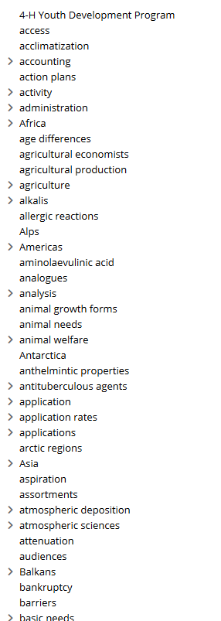
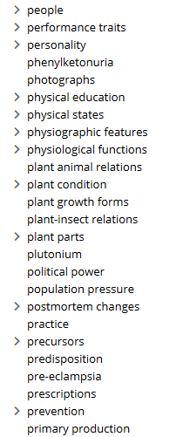
Hierarchy: “Finding homes for top terms” - moving to lower parts of hierarchy
Showing how hierarchy is “before” – 578 top terms in Web Studio,
terms with “>” have narrower terms
Notes:
At the beginning of the work, you can see some screen shots of the top hierarchy. Note that specific terms like “plutonium” is currently a top term. There is no logical structure in GACS Beta 3.1

Slide 12
Examples of terms removed as “top term” and given BT
plutonium BT transition elements
adenosine BT nucleosides
phenylketonuria BT metabolic disorders
life expectancy BT biological properties
endocrine-disrupting chemicals BT chemical substances
Notes:
Going through the 578 terms, I moved top terms that had obvious BTs in the vocabulary. Here are some examples.

Slide 13
Hierarchy problems
Example: “reproduction control” with BT “Brachyspiraceae”
Example: “people” has narrower terms including-
Zoos
Botanical gardens
Seedless cultivars
Notes:
I discovered many disturbing hierarchies that did not make any sense at all.

Slide 14
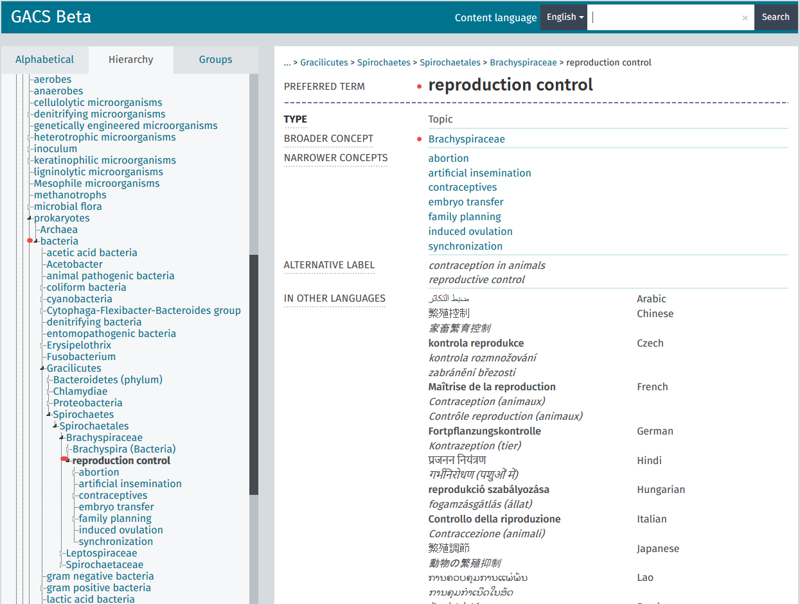
Notes:
Screen shot showing the problem of reproduction control under “bacteria” in the hierarchy.

Slide 15
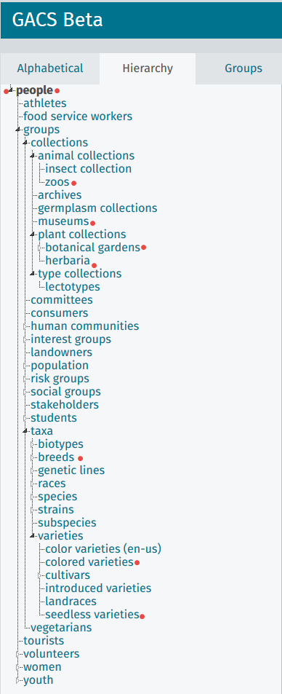
“People” hierarchy at GACS Beta
narrower terms are nonsensical:
Zoos
Museums
Botanical gardens
Herbaria
Breeds
Colored varieties
Seedless varieties
Notes:
Screen shot of GACS Beta 3.1 and how zoos is under “people”. Nonsensical hierarchy!

Slide 16
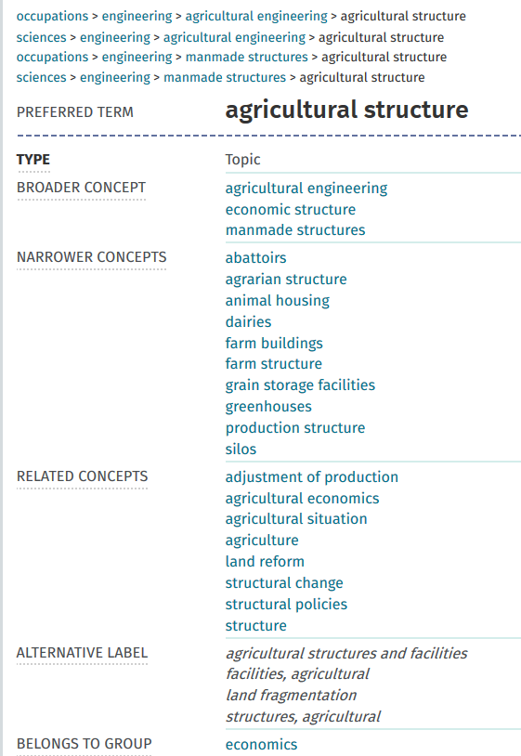
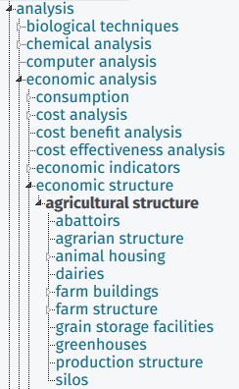
Mixed hierarchy example: agricultural structure
Notes:
Example of term that is not defined by hierarchy…. Confused by hierarchy. Is this an structure that is agricultural, such as silos and farm buildings, or is this referring to the structure of agriculture in the economic sense? Had to make some tough decisions to disambiguate concepts in this work. Not easy.

Slide 17
Added Upper Structure
Enables “ease of first sorting”
Like “Scenario A”
Reuse of terms useful for intellectual organization e.g., “activity”, “characteristics” now have placement
Additions, kept “separate” from GACS URIs
Reuse of YSO and UMLS structures
Notes:
As I proceeded, I needed some upper structure in which to hang good hierarchies. This enabled me to move forward and ease the sorting. I picked Scenario A from the GACS mostly because it was accepted by some stakeholders and the terms “activity” and “characteristics” would now have placement. As I added upper structure, I made sure these were kept separate from GACS URIs. I consulted YSO and UMLS structures to help with the sorting.

Slide 18
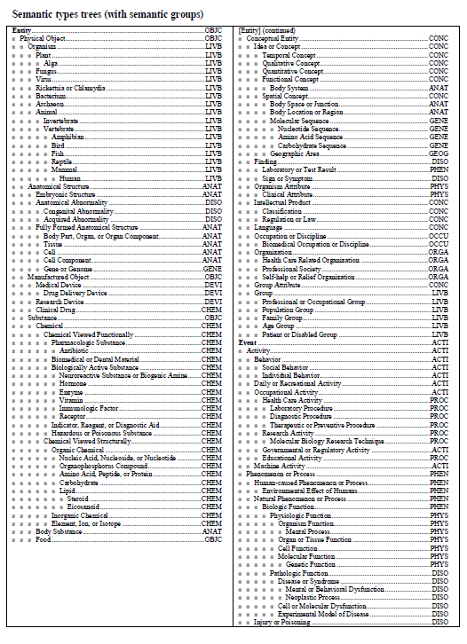
Unified Medical Language System – Semantic types
Notes:
UMLS is like YSO in some manner, with “entity” , which equals “object” in YSO and “Event” which approximates YSO’s “events and actions”

Slide 19
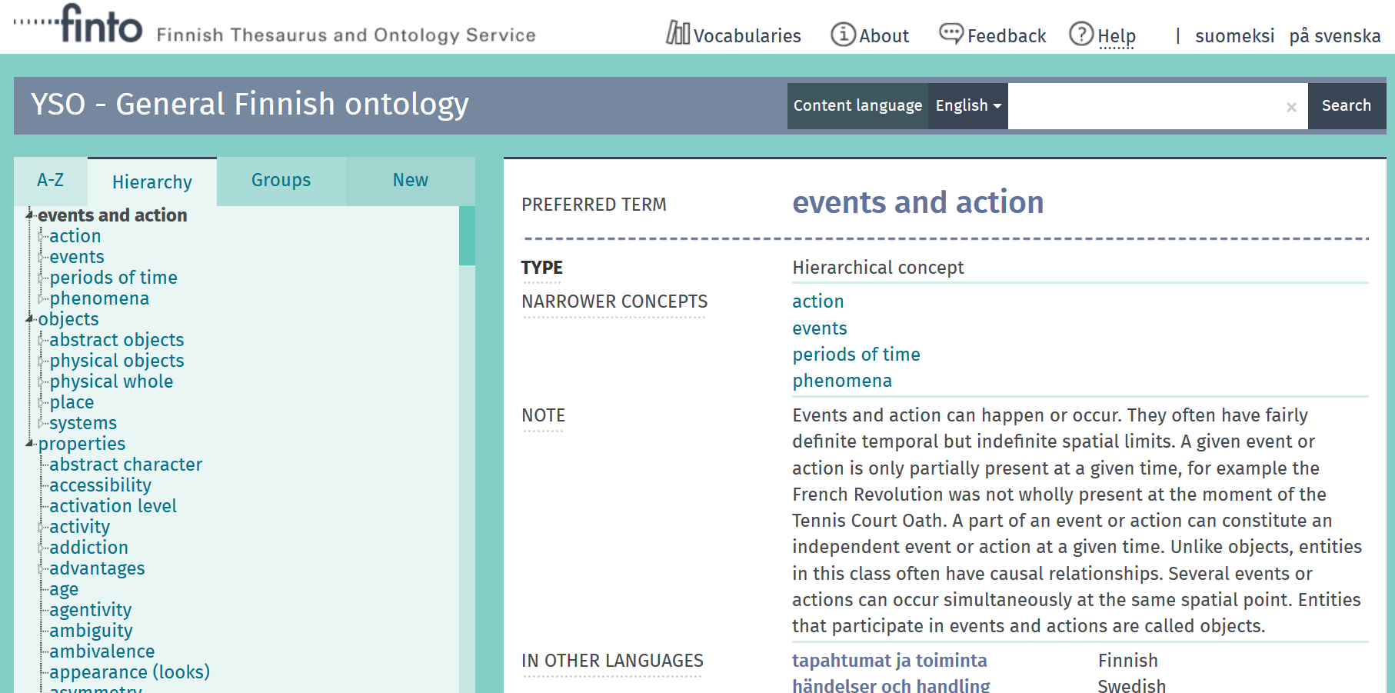
Notes:
Note upper structure.

Slide 20
Upper Structure
OBJECTS
material things that can be seen or touched or visited (locations), including “abstract objects” such as ideas, models
EVENTS AND ACTIONS
something that happens, such as processes or phenomenon
PROPERTIES
attributes / characteristics / qualities of something/objects
Notes:
The upper structure used in GACS QIP

Slide 21
Hierarchy Status
100% of terms aligned to upper structure
First draft of Scope Notes for upper structure (many taken from YSO or UMLS)
Satisfactory progress to have cleaner hierarchies that are BT/NT transitive
“Work in progress”/ not perfect, takes time
Notes:
Work accomplished – put in upper structure and moved terms and hierarchies so that there is an alignment to this structure. Can reuse scope notes from YSO for many of these. Object was to create cleaner hierarchies that are BT/NT transitive. The work is not perfect, but this is a good start. Lower level hierarchies will probably still be found that are incorrect and need tweaking.

Slide 22
View the work done
All the work on the data side is in GitHub https://github.com/agrisemantics/gacs-qip/tree/master/gacs-data
SKOSMOS installation (Osma)
http://tester-os-kktest.lib.helsinki.fi/gacsdemo/gacs/en/
Notes:
All work is viewable by anyone interested in this work at the github site. Osma put up a skosmos installation of the GACS QIP work on his server. This work will need to be moved to Tor Vergata, to replace the GACS Beta 3.1.

Slide 23
Non-Core GACS
Using top 10,000 terms from each thesaurus includes many terms very specific to one region, “not of global interest”
4-H Youth Development Program
Food and Drug Administration
Parking place for some terms ambiguous and need more work e.g., “practice”
If desired, can move more terms to this location or eliminate (only 10 terms here)
Notes:
A few terms, only 10 or so, were moved into a category called “non-core GACS”. If you remember, we used the top 10,000 terms from each vocabulary (NALT, CABT and AGROVOC). Some terms may be too specific and not of “global interest”. Also a good place for ambiguous terms that need further discussion and resolution.

Slide 24
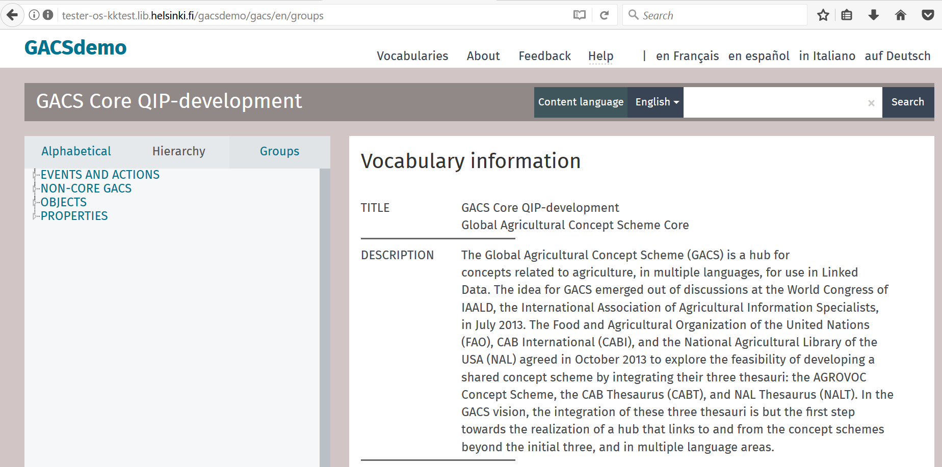
Notes:
Here is the GACS after the GACS-QIP work. Under the “hierarchy” tab, you can now view the upper structure.

Slide 25
Thematic Classification
Based on CABT Classification / UAT
Thematic classification not assigned for ~2800 concepts. Goal: complete for 100% of concepts.
Frequency distribution of terms to categories very uneven, many categories with one or without concepts.
There are no scope notes for the classification.
Notes:
Another large portion of the work done during the summer was ensuring that all terms were assigned to the thematic classification. 80% of terms were classified prior the QIP. At the end of QIP, 100% of terms were assigned to categories. The frequency distribution of terms is very uneven, and still is that way. More work can be done on this. Scope notes for the classification did not exist from CABI.

Slide 26
Classification Scheme applied to GACS Concepts
Two-Letter
Code Classification Heading
CA GENERAL
FA PHYSICAL SCIENCES
JA EARTH SCIENCES
LA LIFE SCIENCES
PA APPLIED SCIENCE AND TECHNOLOGY
WA SOCIAL SCIENCES AND HUMANITIES
Notes:
For those who have not seen the CABI classification, this is the classification scheme as has been applied to GACS concepts. Note this is like Scenario C from the GACS survey.

Slide 27
Thematic Classification progress
100% of concepts are sorted into classification
Principle: remove terms from “common terms” category if a better category found
Principle: can allow concepts to be in more than one category
First draft of Scope Notes for Classification
“thin” but with examples of Concepts assigned
Some categories with no / few GACS Concepts, these are noted
Notes:
Self explanatory slide

Slide 28
NY Category – “organisms of uncertain taxonomy”
Contained only 2 entries,
Pneumocystis
Pneumocystis carinii (aka P. jiroveci)
Moved to NQ category, “fungi”
Notes:
Example of a category without any entries in GACS, not needed for current GACS terms. The two entries we had were moved to fungi based on current knowledge of this species.

Slide 29
Categories not used or with few terms
SW vermiculture
WQ arts
WS history
WY philosophy and ethics
LU evolution
LX natural history
NY organisms of uncertain taxonomy
Notes:
Examples of categories that have few concepts assigned to them.

Slide 30
QC of Category work
insulating materials http://id.agrisemantics.org/gacs/G_TL http://id.agrisemantics.org/gacs/G_CC
Removal of second category “CC=common terms”, retention of “TL=materials”
Notes:
Quality control of the category work – example is insulating materials. I kept the TL category of materials, but removed the second category of “common terms”. Common terms has many GACS concepts classified there that could go to better places in the classification.

Slide 31
QC of Category work
Double category assignment –
plant protection equipment
“TN=equipment”
“PR=health protection”
milking machines
“TN=equipment”
“SS=animal production”
plant protection equipment | http://id.agrisemantics.org/gacs/G_TN http://id.agrisemantics.org/gacs/G_PR
milking machines | http://id.agrisemantics.org/gacs/G_TN http://id.agrisemantics.org/gacs/G_SS
Notes:
Also in work, we allowed double category assignment when it made sense. Here are two examples were double category is used for one GACS concept.

Slide 32
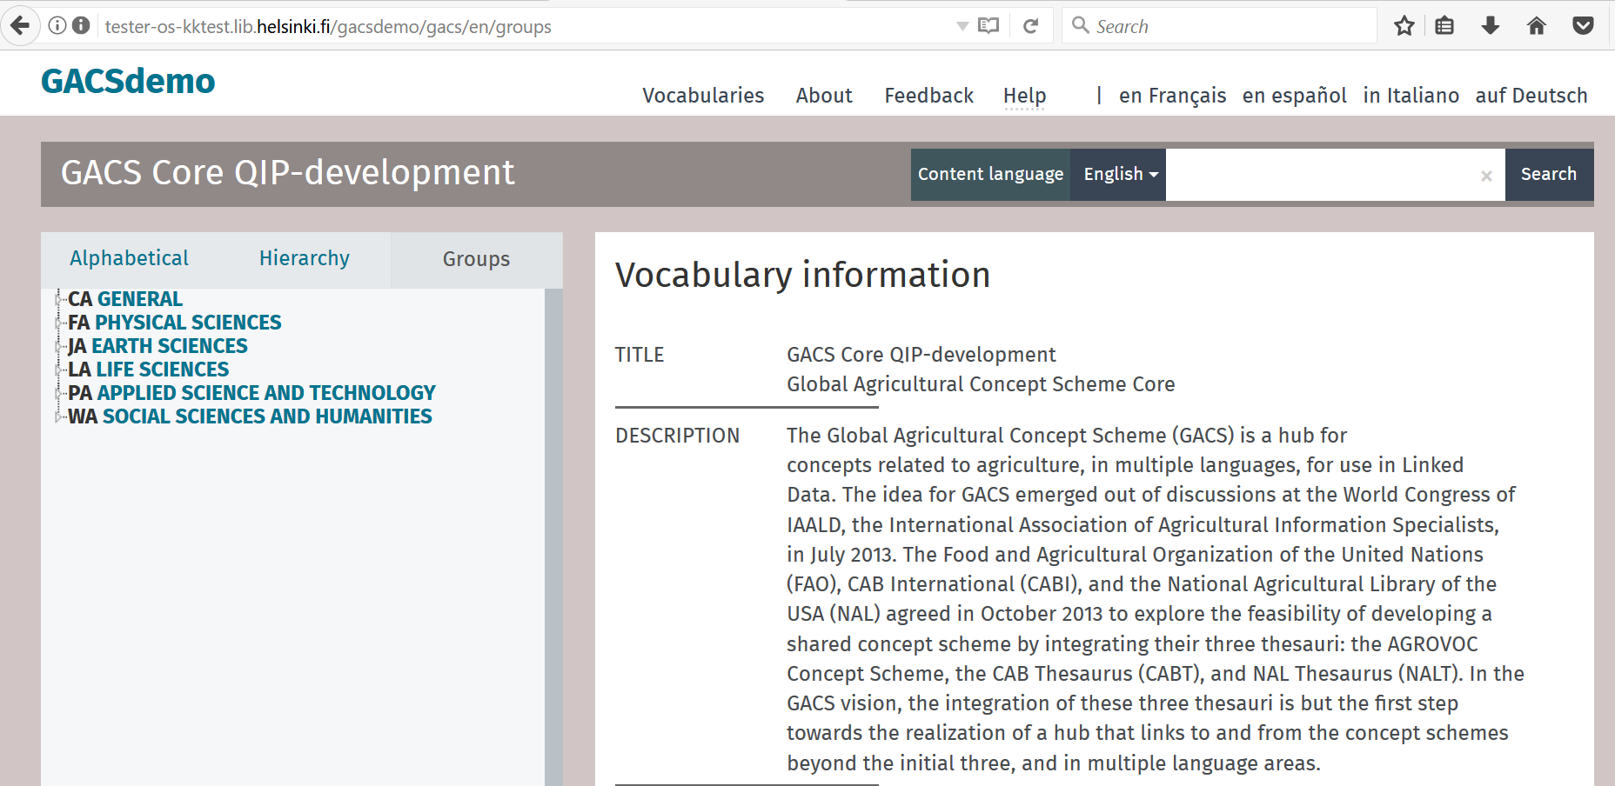
Notes:
This is Osma’s skosmos version of the GACS QIP work. You can see the “thematic” under the “groups” tab

Slide 33
Some analysis of changes done to-date 28-Aug-17 version
https://github.com/agrisemantics/gacs-qip/blob/master/gacs-data/webstudio-exports/NOTES.md
Notes:
Osma did some analysis of the numbers of changes made between the GACS Beta 3.1 version and the GACS QIP version (as of September 2017). You can see these statistics on git hub.

Slide 34
Removed triples, by RDF property
1416 <http://www.w3.org/2004/02/skos/core#broader>
507 <http://www.w3.org/2004/02/skos/core#topConceptOf>
81 <http://www.temis.com/luxid-schema#memberOf>
18 <http://www.w3.org/2004/02/skos/core#related>
8 <http://www.w3.org/2004/02/skos/core#scopeNote>
8 <http://www.w3.org/2004/02/skos/core#prefLabel>
4 <http://www.w3.org/2004/02/skos/core#definition>
Notes:
Some statistics on the number of removed triples between GACS 3.1 version and GACS QIP version (Sept 2017)

Slide 35
Added triples, by RDF property
2839 <http://www.temis.com/luxid-schema#memberOf>
1128 <http://www.w3.org/2004/02/skos/core#broader>
419 <http://www.w3.org/2004/02/skos/core#related>
43 <http://www.w3.org/2004/02/skos/core#definition>
31 <http://www.w3.org/2004/02/skos/core#prefLabel>
23 <http://www.w3.org/1999/02/22-rdf-syntax-ns#type>
2 <http://www.w3.org/2004/02/skos/core#scopeNote>
Notes:
Some statistics on the number of added triples between GACS 3.1 version and GACS QIP version (Sept 2017)

Slide 36
Next Steps
Agreement to continue work until November
Refinement of scope notes, adherence to scope notes for both hierarchical and thematic classification
Review and feedback by partners, stakeholders
Beyond November, there is still quality work to be done on definitions, scope notes as well as refinement of hierarchy / classification
Notes:
GACS QIP agreed to work until November, when Lori retires. Would like some review and feedback by partners, stakeholder. There is still plenty of work to do!

Slide 37
Discussion
Lori Finch Lori.Finch@ars.usda.gov
Sujata Suri Sujata.Suri@ars.usda.gov
Tom Baker Tom.Baker@tombaker.org
Osma Suominen Osma.Suominen@helsinki.fi

Slide 38
Discussion points
WG needs time to review.
Long term: Generally, where we do think GACS is going?
Long term: maintenance? Sustainability?
Short term: Do we replace GACS Beta with this new version? When is decision point? Who?
When is next meeting GACS WG?

