Slide 1
Making the Most of Random Tests
Joint work with:
Chaoqiang Zhang, Amin Alipour, Weng-Keen Wong, Xiaoli Fern at OSU
John Regehr, Eric Eide, Yang Chen at University of Utah
Alex Groce
Oregon State University

Slide 2


Why Random Testing?
It works, with some caveats:
Not a replacement for other testing methods
Not as good as proof, when that’s possible
Alas, that’s not often yet…
Great for testing critical systems software:
With strong assertions or differential oracles
Language implementations, file systems, etc.
Too large to prove correct, large legacy code
Too big to model check or explore symbolically
Any bug matters, worth building complex tools

Slide 3
Three Parts of the Talk
Generating better tests:
Swarm Testing [ISSTA 12]
Debugging more efficiently:
Fuzzer Taming [PLDI 13]
Re-using random tests to find bugs fast:
Reduction by Coverage [ICST 14]
Please ask questions as we go

Slide 4
Part I: Swarm Testing

Slide 5

Swarm Testing
In random testing, we usually include every feature, potentially, in every test
May try to use machine learning or feedback to “tune” the probability for each feature appearing at each test step to its ideal
Let’s call this the “kitchen sink” approach to random testing – include everything (you might miss an interaction if you don’t)

Slide 6
Swarm
Swarm doesn’t do that
Swarm divides the test effort up between configurations
Each configuration requires that some features be left out
Call the set of configurations the swarm
Likely no member of swarm has all features
Each configuration only gets a small portion of the total testing time spent on it
Inspired by swarm verification’s emphasis on search diversity in model checking

Slide 7
Swarming a Stack
Consider a stack implementation
Two API calls: push, pop
Stack has a bug: overflow when push @ 32 items
Two testing methods:
Default: choose push/pop with equal probability
Swarm: decide with a coin flip if you’re doing pushes and if you’re doing pops (throw out configurations without either) before each test

Slide 8
Swarming a Stack
How does swarming change the testing?
Pop-only tests aren’t very useful
Push+pop tests are just like before
Very, very, unlikely to do 32 pushes without any pops…
Push-only tests are going to find our bug (unless we have a very short test length) with P = 1
The key to swarm testing is:
That finding a bug is possible does not mean it is probable.

Slide 9

Swarm
Still, is swarm effective for real-world systems?
Can we just toss a coin to decide which features to omit?
Also, what are real world features?

Slide 10

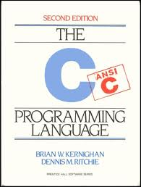

Evaluating Swarm Testing
Test system developed at OSU, based on ideas from file system testers at NASA/JPL, etc.
Target: YAFFS2, default flash file system for Android
The Csmith random test system for C compilers
Very powerful and widely used C compiler testing framework; numerous bugs found in GCC, LLVM, etc.
Target: GCC, LLVM-Clang, Intel CC, OpenCC
17 versions of 5 production-quality C compilers
Some heavily tested in the past using Csmith
Mozilla SpiderMonkey testing using jsfunfuzz
Versions 1.6, 1.7, 1.8.5 (also some Google code)

Slide 11
Evaluating Swarm Testing
YAFFS2 configurations:
Which of 47 functions to call:
open, mkdir, rmdir, read, freespace, link, rename, …
C compiler testing configurations:
Which of 19 C language features to include in the random programs generated:
pointers, arrays, gotos, structs, unions, 64 bit math, ++/--, bitfields, …
JavaScript configurations:
Actual choices in jsfunfuzz’s case splits for random generation (about 260 of them)

Slide 12
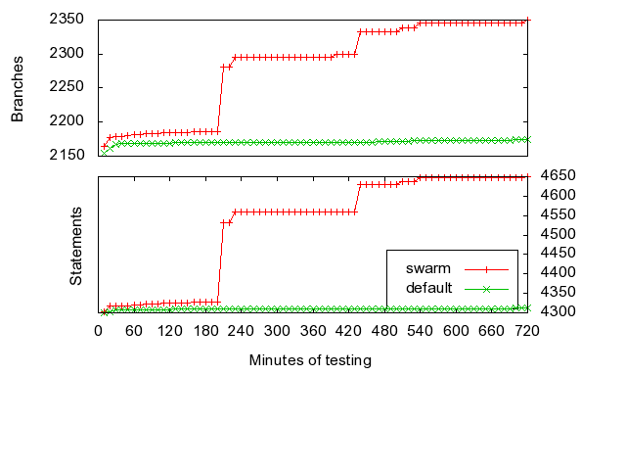
Swarming a File System
Ran 24 hours of tests on YAFFS2
12 hours of swarm
12 hours of default
Swarm covered hundreds more statements and branches
20+ more per 10 minute interval (with very high statistical significance)

Slide 13
Swarming C Compilers
Ran 2 weeks of tests
1 week of swarm (1,000 random configurations)
1 week of kitchen sink configuration testing
Swarm ran 66,699 tests, of which 15,851 crashed some compiler
Kitchen sink ran 47,477 tests, of which 22,691 crashed some compiler

Slide 14
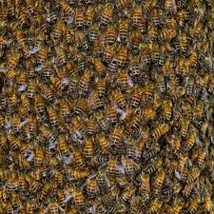
Swarming C Compilers
Swarm found 104 unique ways to crash compilers
Kitchen sink only found 73
Statistically significant result at 99.9+ level%
=

Slide 15
Swarming C Compilers
Swarm found (many) more bugs, but found fewer tests exposing each bug
That’s great! We don’t need more than one
Every bug has an ideal configuration; kitchen sink is only good for a few bugs; swarm can find the sweet spot for many more bugs
Each bug (or line of code for that matter) has its own ideal probability distribution
Now working on using that to test code changes

Slide 16
Swarming C Compilers
Swarm also improved coverage
About 500 more LOC covered on latest LLVM
About 1500 more LOC on latest GCC
Similar or better improvements in branches
Covered 50-100 more functions than kitchen sink!
Again, statistically significant at 99% level

Slide 17

Swarming JavaScript
Applied to Mozilla’s SpiderMonkey JavaScript engine (v 1.6, 1.7, 1.8.5), using jsfunfuzz base
Finds up to >1.5x as many distinct faults (e.g. 84 vs. 52) in 48 hours of testing vs. “kitchen sink”
Large statistically significant improvements in all coverage measures as well
Only method that found any bugs in Google’s JavaScript engine (ClusterFuzz is hard to beat)
Problem becomes mostly that of deciding which of thousands of failing test cases are the same bug

Slide 18
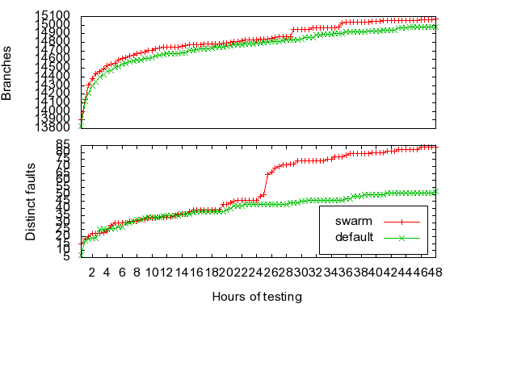
Swarming JavaScript

Slide 19
Why Swarm Works
Bugs obviously have features that trigger them
Can’t find a bug in write unless you first open a file
Can’t find a bug in arithmetic optimization in a C program that does no math
But features can also suppress bugs
If a bug requires writing to files, closing files makes it harder to do that
C compilers tend to turn off many optimizations in the presence of pointers

Slide 20
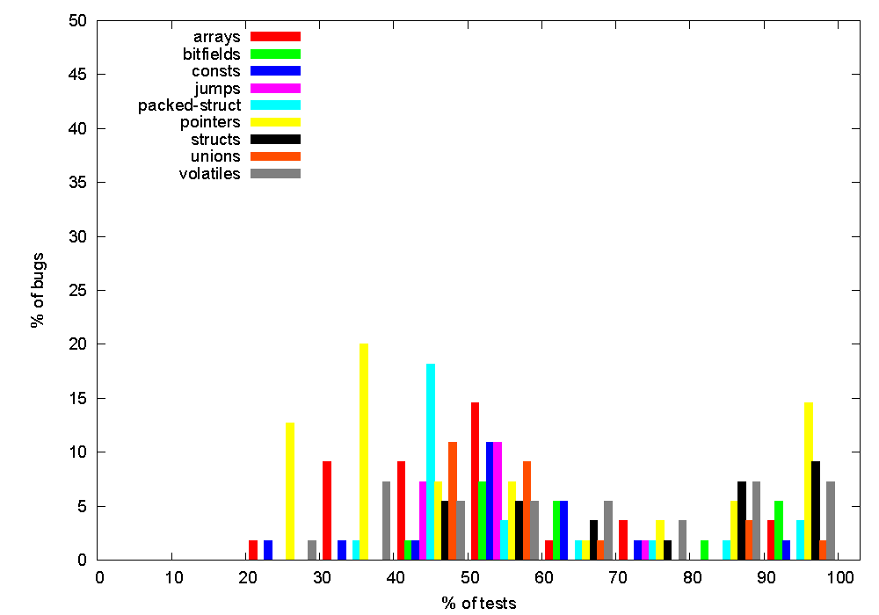
Some Feature Facts

Slide 21
More About Features
Suppression is key (ISSRE 13):
Over all subject programs (YAFFS2, C & JavaScript compilers, SGLIB C container library, Lobo HTML parser):
Most features are triggers for some bugs/lines of code/branches/etc.
Most features are also suppressors for some other bugs/lines of code/branches/etc.
Most bugs/lines of code/branches/etc. have both triggers and suppressors!
Number of suppressors/triggers is remarkably consistent, whether there are tens of features or hundreds of features (around 2-3)
Finding a single “good” configuration is not likely
A feature that helps you find one bug will hinder you in finding another bug!

Slide 22
Part II: Fuzzer Taming

Slide 23
Fuzzer Taming
compiler under test
fuzzer
test
cases
reducer
fuzzer user
output
reduced
bug-inducing test cases
oracle
bug-inducing test cases

Slide 24
“Future work Bug-hunting via random testing is a slow process: each reported bug must be fixed before continuing testing, otherwise with high probability the tool keeps on rediscovering the same bug.” [1]
[1] Compiler Testing via a Theory of Sound Optimisations in the C11/C++11 Memory Model, Robin Morisset, Pankaj Pawan, Francesco Zappa Nardelli, PLDI 2013

Slide 25
char a;
int b[];
void fn1 () {
a = 0;
for (; a < 7; a += 1)
b[7 + a] = 0;
}
struct S1
{
volatile int f2:1
};
static struct S1 a;
void main ()
{
printf ("%d\n", a.f2);
}
int a[][7];
char b;
void fn1 () {
b = 0;
for (; b < 7; b += 1)
a[1][b] = 0;
}
GCC 4.3.0 crashes at –O3
GCC 4.3.0 crashes at –O3

Slide 26
char a;
int b[];
void fn1 () {
a = 0;
for (; a < 7; a += 1)
b[7 + a] = 0;
}
char a;
int b[];
void fn1 () {
a = 0;
for (; a < 7; a += 1)
b[7 + a] = 0;
}
char a;
int b[];
void fn1 () {
a = 0;
for (; a < 7; a += 1)
b[7 + a] = 0;
}
char a;
int b[];
void fn1 () {
a = 0;
for (; a < 7; a += 1)
b[7 + a] = 0;
}
char a;
int b[];
void fn1 () {
a = 0;
for (; a < 7; a += 1)
b[7 + a] = 0;
}
char a;
int b[];
void fn1 () {
a = 0;
for (; a < 7; a += 1)
b[7 + a] = 0;
}
char a;
int b[];
void fn1 () {
a = 0;
for (; a < 7; a += 1)
b[7 + a] = 0;
}
char a;
int b[];
void fn1 () {
a = 0;
for (; a < 7; a += 1)
b[7 + a] = 0;
}
char a;
int b[];
void fn1 () {
a = 0;
for (; a < 7; a += 1)
b[7 + a] = 0;
}
char a;
int b[];
void fn1 () {
a = 0;
for (; a < 7; a += 1)
b[7 + a] = 0;
}
char a;
int b[];
void fn1 () {
a = 0;
for (; a < 7; a += 1)
b[7 + a] = 0;
}
char a;
int b[];
void fn1 () {
a = 0;
for (; a < 7; a += 1)
b[7 + a] = 0;
}
char a;
int b[];
void fn1 () {
a = 0;
for (; a < 7; a += 1)
b[7 + a] = 0;
}
char a;
int b[];
void fn1 () {
a = 0;
for (; a < 7; a += 1)
b[7 + a] = 0;
}
char a;
int b[];
void fn1 () {
a = 0;
for (; a < 7; a += 1)
b[7 + a] = 0;
}
char a;
int b[];
void fn1 () {
a = 0;
for (; a < 7; a += 1)
b[7 + a] = 0;
}
char a;
int b[];
void fn1 () {
a = 0;
for (; a < 7; a += 1)
b[7 + a] = 0;
}
char a;
int b[];
void fn1 () {
a = 0;
for (; a < 7; a += 1)
b[7 + a] = 0;
}
char a;
int b[];
void fn1 () {
a = 0;
for (; a < 7; a += 1)
b[7 + a] = 0;
}
char a;
int b[];
void fn1 () {
a = 0;
for (; a < 7; a += 1)
b[7 + a] = 0;
}
char a;
int b[];
void fn1 () {
a = 0;
for (; a < 7; a += 1)
b[7 + a] = 0;
}
char a;
int b[];
void fn1 () {
a = 0;
for (; a < 7; a += 1)
b[7 + a] = 0;
}
char a;
int b[];
void fn1 () {
a = 0;
for (; a < 7; a += 1)
b[7 + a] = 0;
}
char a;
int b[];
void fn1 () {
a = 0;
for (; a < 7; a += 1)
b[7 + a] = 0;
}
char a;
int b[];
void fn1 () {
a = 0;
for (; a < 7; a += 1)
b[7 + a] = 0;
}
char a;
int b[];
void fn1 () {
a = 0;
for (; a < 7; a += 1)
b[7 + a] = 0;
}
char a;
int b[];
void fn1 () {
a = 0;
for (; a < 7; a += 1)
b[7 + a] = 0;
}
char a;
int b[];
void fn1 () {
a = 0;
for (; a < 7; a += 1)
b[7 + a] = 0;
}
char a;
int b[];
void fn1 () {
a = 0;
for (; a < 7; a += 1)
b[7 + a] = 0;
}
char a;
int b[];
void fn1 () {
a = 0;
for (; a < 7; a += 1)
b[7 + a] = 0;
}
char a;
int b[];
void fn1 () {
a = 0;
for (; a < 7; a += 1)
b[7 + a] = 0;
}
char a;
int b[];
void fn1 () {
a = 0;
for (; a < 7; a += 1)
b[7 + a] = 0;
}
char a;
int b[];
void fn1 () {
a = 0;
for (; a < 7; a += 1)
b[7 + a] = 0;
}
char a;
int b[];
void fn1 () {
a = 0;
for (; a < 7; a += 1)
b[7 + a] = 0;
}
char a;
int b[];
void fn1 () {
a = 0;
for (; a < 7; a += 1)
b[7 + a] = 0;
}
char a;
int b[];
void fn1 () {
a = 0;
for (; a < 7; a += 1)
b[7 + a] = 0;
}
char a;
int b[];
void fn1 () {
a = 0;
for (; a < 7; a += 1)
b[7 + a] = 0;
}
char a;
int b[];
void fn1 () {
a = 0;
for (; a < 7; a += 1)
b[7 + a] = 0;
}
char a;
int b[];
void fn1 () {
a = 0;
for (; a < 7; a += 1)
b[7 + a] = 0;
}
char a;
int b[];
void fn1 () {
a = 0;
for (; a < 7; a += 1)
b[7 + a] = 0;
}
char a;
int b[];
void fn1 () {
a = 0;
for (; a < 7; a += 1)
b[7 + a] = 0;
}
char a;
int b[];
void fn1 () {
a = 0;
for (; a < 7; a += 1)
b[7 + a] = 0;
}
char a;
int b[];
void fn1 () {
a = 0;
for (; a < 7; a += 1)
b[7 + a] = 0;
}
char a;
int b[];
void fn1 () {
a = 0;
for (; a < 7; a += 1)
b[7 + a] = 0;
}
char a;
int b[];
void fn1 () {
a = 0;
for (; a < 7; a += 1)
b[7 + a] = 0;
}
char a;
int b[];
void fn1 () {
a = 0;
for (; a < 7; a += 1)
b[7 + a] = 0;
}
char a;
int b[];
void fn1 () {
a = 0;
for (; a < 7; a += 1)
b[7 + a] = 0;
}
char a;
int b[];
void fn1 () {
a = 0;
for (; a < 7; a += 1)
b[7 + a] = 0;
}
char a;
int b[];
void fn1 () {
a = 0;
for (; a < 7; a += 1)
b[7 + a] = 0;
}
char a;
int b[];
void fn1 () {
a = 0;
for (; a < 7; a += 1)
b[7 + a] = 0;
}
char a;
int b[];
void fn1 () {
a = 0;
for (; a < 7; a += 1)
b[7 + a] = 0;
}
char a;
int b[];
void fn1 () {
a = 0;
for (; a < 7; a += 1)
b[7 + a] = 0;
}
char a;
int b[];
void fn1 () {
a = 0;
for (; a < 7; a += 1)
b[7 + a] = 0;
}
char a;
int b[];
void fn1 () {
a = 0;
for (; a < 7; a += 1)
b[7 + a] = 0;
}
char a;
int b[];
void fn1 () {
a = 0;
for (; a < 7; a += 1)
b[7 + a] = 0;
}
char a;
int b[];
void fn1 () {
a = 0;
for (; a < 7; a += 1)
b[7 + a] = 0;
}
char a;
int b[];
void fn1 () {
a = 0;
for (; a < 7; a += 1)
b[7 + a] = 0;
}
char a;
int b[];
void fn1 () {
a = 0;
for (; a < 7; a += 1)
b[7 + a] = 0;
}
char a;
int b[];
void fn1 () {
a = 0;
for (; a < 7; a += 1)
b[7 + a] = 0;
}
char a;
int b[];
void fn1 () {
a = 0;
for (; a < 7; a += 1)
b[7 + a] = 0;
}
char a;
int b[];
void fn1 () {
a = 0;
for (; a < 7; a += 1)
b[7 + a] = 0;
}
char a;
int b[];
void fn1 () {
a = 0;
for (; a < 7; a += 1)
b[7 + a] = 0;
}
char a;
int b[];
void fn1 () {
a = 0;
for (; a < 7; a += 1)
b[7 + a] = 0;
}
char a;
int b[];
void fn1 () {
a = 0;
for (; a < 7; a += 1)
b[7 + a] = 0;
}
char a;
int b[];
void fn1 () {
a = 0;
for (; a < 7; a += 1)
b[7 + a] = 0;
}
char a;
int b[];
void fn1 () {
a = 0;
for (; a < 7; a += 1)
b[7 + a] = 0;
}
char a;
int b[];
void fn1 () {
a = 0;
for (; a < 7; a += 1)
b[7 + a] = 0;
}
char a;
int b[];
void fn1 () {
a = 0;
for (; a < 7; a += 1)
b[7 + a] = 0;
}
char a;
int b[];
void fn1 () {
a = 0;
for (; a < 7; a += 1)
b[7 + a] = 0;
}
char a;
int b[];
void fn1 () {
a = 0;
for (; a < 7; a += 1)
b[7 + a] = 0;
}
char a;
int b[];
void fn1 () {
a = 0;
for (; a < 7; a += 1)
b[7 + a] = 0;
}
char a;
int b[];
void fn1 () {
a = 0;
for (; a < 7; a += 1)
b[7 + a] = 0;
}
char a;
int b[];
void fn1 () {
a = 0;
for (; a < 7; a += 1)
b[7 + a] = 0;
}
char a;
int b[];
void fn1 () {
a = 0;
for (; a < 7; a += 1)
b[7 + a] = 0;
}
char a;
int b[];
void fn1 () {
a = 0;
for (; a < 7; a += 1)
b[7 + a] = 0;
}
char a;
int b[];
void fn1 () {
a = 0;
for (; a < 7; a += 1)
b[7 + a] = 0;
}
char a;
int b[];
void fn1 () {
a = 0;
for (; a < 7; a += 1)
b[7 + a] = 0;
}
char a;
int b[];
void fn1 () {
a = 0;
for (; a < 7; a += 1)
b[7 + a] = 0;
}
char a;
int b[];
void fn1 () {
a = 0;
for (; a < 7; a += 1)
b[7 + a] = 0;
}
char a;
int b[];
void fn1 () {
a = 0;
for (; a < 7; a += 1)
b[7 + a] = 0;
}
char a;
int b[];
void fn1 () {
a = 0;
for (; a < 7; a += 1)
b[7 + a] = 0;
}
char a;
int b[];
void fn1 () {
a = 0;
for (; a < 7; a += 1)
b[7 + a] = 0;
}
char a;
int b[];
void fn1 () {
a = 0;
for (; a < 7; a += 1)
b[7 + a] = 0;
}
char a;
int b[];
void fn1 () {
a = 0;
for (; a < 7; a += 1)
b[7 + a] = 0;
}
char a;
int b[];
void fn1 () {
a = 0;
for (; a < 7; a += 1)
b[7 + a] = 0;
}
char a;
int b[];
void fn1 () {
a = 0;
for (; a < 7; a += 1)
b[7 + a] = 0;
}
char a;
int b[];
void fn1 () {
a = 0;
for (; a < 7; a += 1)
b[7 + a] = 0;
}
char a;
int b[];
void fn1 () {
a = 0;
for (; a < 7; a += 1)
b[7 + a] = 0;
}

Slide 27
Problems
Large number of test cases
running Csmith with swarm a few days produced 3,000+ bug-inducing test cases for a compiler
Much smaller number of distinct bugs
fewer than 50 bugs triggered
Some bugs are triggered much more frequently than others

Slide 28
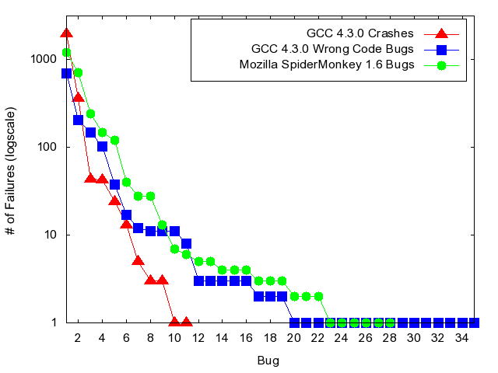

Slide 29
Solution #1
Report one bug
Then Wait…

Slide 30
Solution #1
Report one bug
Then Wait…
By yesterday, there were still 2,000+ open bugs in GCC’s database (P1, P2, P3, and at least “normal” severity)

Slide 31
Solution #2: Suppressing Duplicates Using Clustering
Find a way to measure similarity between test cases (distance function)
Use an off-the-shelf clustering algorithm
Choose a representative test from each cluster
We can do better

Slide 32
Observations
We don’t care about clusters
We just want a ranking that puts as many different bugs as possible in any prefix of the ranked list
Our approach:
Rank by dissimilarity
Like clustering, uses a distance function
Algorithm: furthest point first [Gonzalez 1985]

Slide 33
Naturally gives ranking
Parameter free
Gives better results

Slide 34
Test Cases
Distance
Ranked
Test Cases
Distance Function
Furthest Point First (FPF)
FPF: each ranked test case is the one that is furthest from the closest of all previously ranked test cases

Slide 35
Furthest Point First [Gonzalez 1985]
5
4
P2
P1
2
P3
3
6
P4
7

Slide 36
Furthest Point First [Gonzalez 1985]
5
4
P2
P1
2
P3
3
6
P4
7

Slide 37
Furthest Point First [Gonzalez 1985]
5
4
P2
P1
2
P3
3
6
7
P4

Slide 38
Furthest Point First [Gonzalez 1985]
5
4
P2
P1
2
P3
3
6
7
P4

Slide 39
Furthest Point First [Gonzalez 1985]
5
4
P2
2
P3
3
6
7
P4
P1

Slide 40
Furthest Point First [Gonzalez 1985]
5
4
P2
2
P3
3
6
7
P4
P1

Slide 41
Furthest Point First [Gonzalez 1985]
5
4
P2
2
P3
3
6
7
P4
P1

Slide 42
Furthest Point First [Gonzalez 1985]
5
4
P2
2
P3
3
6
7
P4
P1

Slide 43
Furthest Point First [Gonzalez 1985]
5
4
2
P3
3
6
7
P4
P1
P2

Slide 44
Furthest Point First [Gonzalez 1985]
5
4
2
3
6
7
P4
P1
P2
P3

Slide 45
Furthest Point First [Gonzalez 1985]
diverse test cases are early in the list
P4
P1
P2
P3

Slide 46
What is a good distance function?
Should put test cases triggering the same bug close to each other
No obvious best choice
Many sources of information
In machine learning a “multi-view” problem
Unusual in that these views may not be redundant

Slide 47
Compiler’s Failure Output
Segmentation fault (program cc1)
internal compiler error: in simplify_subreg, at simplify-rtx.c:4922

Slide 48
Compiler’s Failure Output
Segmentation fault (program cc1)
normalized edit distance
internal compiler error: in simplify_subreg, at simplify-rtx.c:4922

Slide 49
Compiler’s Failure Output
Segmentation fault (program cc1)
normalized edit distance
0.79
internal compiler error: in simplify_subreg, at simplify-rtx.c:4922

Slide 50
Stack Trace
at 0x5CCAD5: note_stores (rtlanal.c:1417)
normalized edit distance: 0.56
at 0x512684: fold_binary (fold-const.c:9486)

Slide 51
Wrong-code Bug
int printf (const char *, ...);
char a;
int main ()
{
char *b = &a;
*b = -(&a == b);
printf ("%d\n", a);
return 0;
}
int printf (const char *, ...);
int a, d, e;
int **b;
int *c = &a;
int main ()
{
int ***f = &b, ***g = &b;
e = 0 == 0 ? 4073709551612UL : 0;
d = 0 == 0 ? e : 0;
*c = d + (f != g);
printf ("%d\n", a);
return 0;
}

Slide 52
Wrong-code Bug
int printf (const char *, ...);
char a;
int main ()
{
char *b = &a;
*b = -(&a == b);
printf ("%d\n", a);
return 0;
}
int printf (const char *, ...);
int a, d, e;
int **b;
int *c = &a;
int main ()
{
int ***f = &b, ***g = &b;
e = 0 == 0 ? 4073709551612UL : 0;
d = 0 == 0 ? e : 0;
*c = d + (f != g);
printf ("%d\n", a);
return 0;
}
0.50

Slide 53
Experimental Setup
2,501 test cases that trigger 11 crash bugs in GCC 4.3.0
1,298 test cases that trigger 35 wrong-code bugs in GCC 4.3.0
2,603 test cases that trigger 28 bugs in SpiderMonkey 1.6

Slide 54
GCC 4.3.0 Wrong-code Bug Discovery Curves
Our Best Result
Base line
Best Clustering Result

Slide 55
GCC 4.3.0 Wrong-code Bug Discovery Curves
Our Best Result
Base line
Best Clustering Result

Slide 56
# bugs in highest ranked 15 test cases
 | Baseline | Best Clustering | Best FPF
SpiderMonkey | 5 | 6 | 12
GCC Crash | 6 | 7 | 11
GCC Wrong-code | 5 | 6 | 12
By the way, FPF is much faster than clustering, even with an expensive metric such as Levenshtein (string edit distance)

Slide 57
Workflow for Fuzzing
ranked
small
bug-inducing test cases
compiler under test
code coverage
fuzzer
test
cases
reducer
tamer
fuzzer user
output
small
bug-inducing test cases
oracle
bug-inducing test cases

Slide 58
GCC 4.3.0 Crash Bug Discovery Curves
FPF(Lev(Test)+Lev(Output))
Base line
Only need to examine 15 test cases to find all distinct bugs using our best metric: FPF(Lev(test)+Lev(output))

Slide 59
SpiderMonkey 1.6 Bug Discovery Curves
FPF(Lev(Test)+Lev(Output))
Best Clustering Result
Base line
By looking at the first 15 test cases, the user is able to find 13 distinct bugs

Slide 60
GCC 4.3.0 Wrong-code Bug Discovery Curves
FPF(linecov)
Best Clustering Result
Base line
By looking at the first 15 test cases, the user is able to find 12 distinct bugs

Slide 61
Part III: Reduction by Coverage

Slide 62
Random Tests in Regression
Two kinds of regression testing:
Regression for detection of known bugs
Random testing works just fine for this
Typically use delta-debugging to minimize to a small failing test case
“Regression” for quick coverage of code and detection of new faults
Random tests are typically not used for this
Highly redundant/inefficient
Why not just run new random tests?

Slide 63

Test Case Reduction
Variations on Hildebrandt and Zeller’s delta debugging algorithm
Uses a modified “binary search” to reduce failing test case to smaller (still failing) version
Test case

Slide 64
Two Advantages of Reduction
Much easier for humans to debug
Usually the full motivation for test case reduction
For many random testing settings size reduction > 10x
Test cases also execute much faster
Good for quick regression
But reduced failures are often useless for finding bugs other than the original bugs
Bad code coverage
Bad behavioral coverage
Test case

Slide 65
Reducing with Respect to Coverage
Apply delta debugging algorithm
But change criteria for successful reduction from “still fails” to “has the same statement coverage”
tryItOut("with((delete __proto__))
{export __parent__;true;}");
tryItOut("while((false for (constructor
in false))){}");
tryItOut("throw __noSuchMethod__;");
tryItOut("throw undefined;");
tryItOut("if(<><x><y/></x></>)
{null;}else{/x/;/x/g;}");
tryItOut("{yield;export __count__; }");
tryItOut("throw StopIteration;");
tryItOut("throw StopIteration;");
tryItOut(";yield;");
tryItOut("with((delete __proto__))
{export __parent__;true;}");
tryItOut("while((false for (constructor
in false))){}");
tryItOut("throw undefined;");
tryItOut("if(<><x><y/></x></>)
{null;}else{/x/;/x/g;}");
tryItOut("throw StopIteration;");
tryItOut(";yield;");
Same statement coverage on Mozilla SpiderMonkey 1.6
For larger tests the reduction is typically much larger.

Slide 66
Building a Quick Test
Generate random tests T₁…T_{n}
Reduce all tests T₁…T_{n} -> T’₁…T’_{n}
Select a time budget
Choose tests from T’₁…T’_{n} at random or prioritize by coverage

Slide 67
The Advantages of Quick Testing
After reduction with respect to coverage
Test cases execute 2x (file system) to 4x (JavaScript) faster
Test cases also preserve failure, branch coverage, other properties of interest
Allow for much more code coverage in very short test budgets (30 seconds to 5 minutes)
For SpiderMonkey 1.6 the reduced suite found more distinct faults than the original unreduced suite(!)
Advantages persist on new versions of the code
Test case

Slide 68
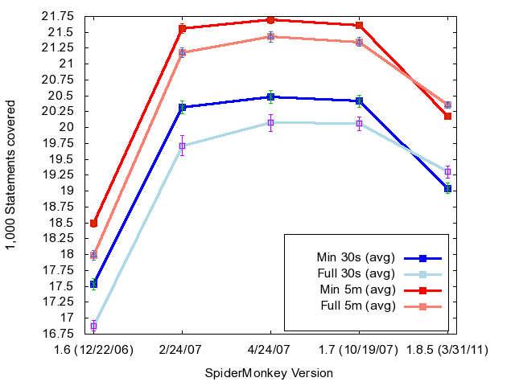
Quick Testing SpiderMonkey

Slide 69
More Advantages of Quick Testing
Symbolic execution scales badly
However, it scales badly for complex systems code
Recent popular response is to use existing tests as seed for symbolic execution (KLEE, BugRedux, SAGE)
ISSTA 14 submission – large improvement in symbolic execution effectiveness if base on already coverage-reduced tests
Test case

Slide 70
Summary
To generate better random tests
Vary the distribution radically for each test
To debug random tests
Use FPF + a distance measure to quickly see different underlying faults
To re-use random tests
Reduce tests with respect to code coverage first
For short budgets, much better than new tests
Can also make symbolic execution more effective

Slide 71
Questions?

