Slide 1
A Little Language for Testing
Alex Groce and Jervis Pinto
Oregon State University

Slide 2
Test Harnesses
Define (and usually tell how to generate) the set of valid tests for a program
Common task in software model checking and automated testing
SPIN, JPF, CBMC, KLEE, random testing, bounded exhaustive testing, etc.
I’ve spent a good part of my working life as a researcher writing “test harnesses” of some kind or other

Slide 3


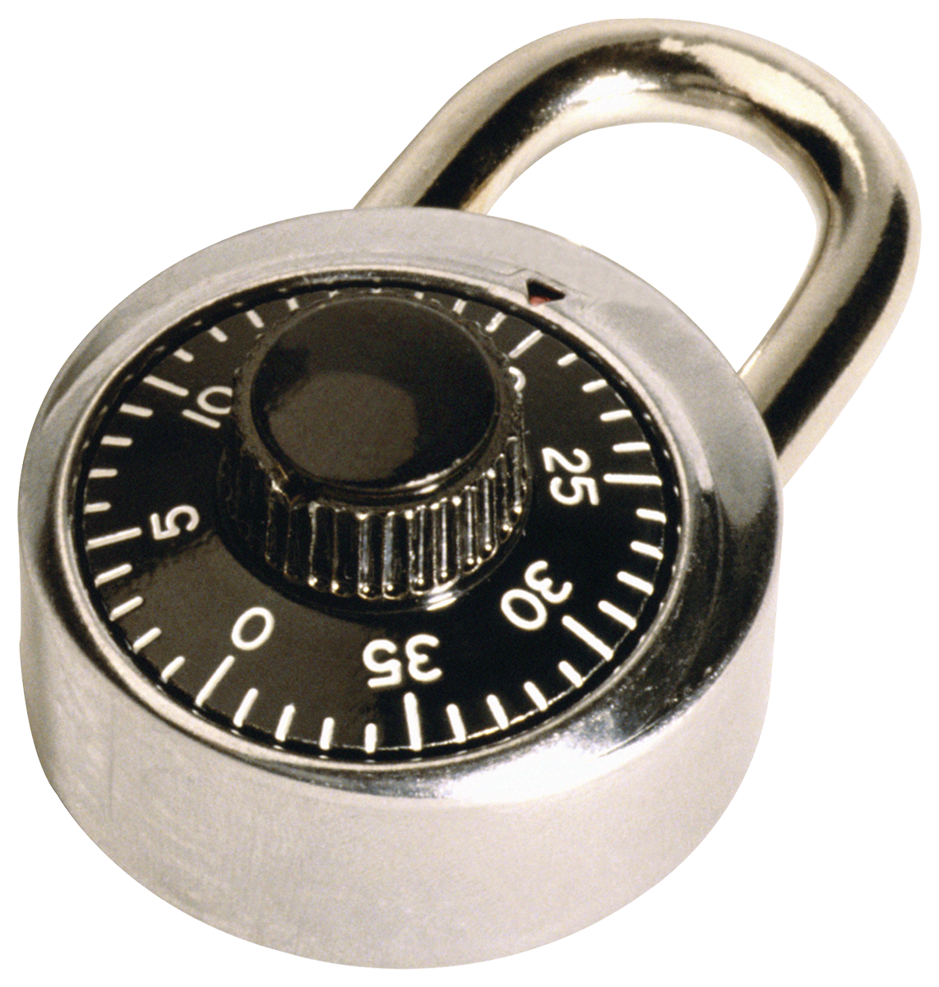
Test Harnesses
Writing test harnesses is time-consuming
Writing test harnesses is error-prone
Writing test harnesses involves lots of repetitive, semi-redundant code that is hard to refactor
Writing test harnesses tends to lock you in to a particular method for testing/verification

Slide 4
Proposal: A Little Language
Need a language for defining valid tests
Lightweight DSL targeting the things we do in test harnesses – making choices, calling functions, building up input values, checking properties
Separate test generation from test definition
Use different testing / model checking algorithms without redefining “valid tests”

Slide 5
Two Parts of the Talk
An overview of the idea of TSTL (the language introduced in this paper)
TSTL in action
Please ask questions as we go

Slide 6
Part I: The Template Scripting Testing Language

Slide 7
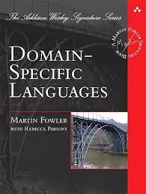
Domain-Specific Languages
Used for specialized tasks that involve certain common idioms
Make specialized kinds of programming easier – code is more concise, more reliable
Often declarative vs. imperative
Sounds like a good fit for test harness coding

Slide 8

Domain-Specific Languages
On the other hand:
Test harnesses usually need to compute a variety of things, sometimes complex
Who wants to learn a new language that’s only good for one thing?
Much of the harness is in the language of the SUT, in a typical case
Solution: embed normal language in the DSL
Inspired by SPIN’s relationship to C code

Slide 9
Template Scripting Testing Language
Template
TSTL compiles to code in the language of the SUT
So you can freely mix in “raw code”
Scripting
Expect the “host” language often will be a scripting language for concise, easy-to-read code
Testing Language
TSTL is only for defining valid test + properties

Slide 10
Basic Idea
TSTL harness describes structure of a test + properties (and perhaps logging)
TSTL compiles this into a class that satisfies an abstract interface that allows a test generator to interact with the SUT as a (possibly infinite) graph
Class allows reset, query of enabled transitions, performing actions, checking properties, setting logging levels, backtrack & replay, delta-debugging…

Slide 11
Trivial Example
TSTL harness definition:
pool: %INT% 1
pool: %LIST% 1
%INT% := %[1..2]%
%LIST% := []
%LIST%.append(%INT%)
property: len(%LIST%) <= 20
(,)
INT[0] = 1
INT[0] = 2
LIST[0] = []
(1,)
(2,)
(,[])
(,[])
INT[0] = 1
INT[0] = 2
(1,[])
(1,[])
(2,[])
LIST[0].append(INT[0])
Access via API:
sut.restart(), sut.actions(), sut.check()…
action =
<ID: str × guard: ()->true × act: ()->()>
(1,[1])

Slide 12
Status and Future Work
TSTL language has changed (improved, we hope) since this paper
Available as a package for Python, with example code and some documentation
Includes a few simple testing tools
In progress: Scala version, possibly versions for C and Java (yes, non-scripting)

Slide 13
Part II: TSTL in Action

