Slide 1
Mitigating (and Exploiting) Test Reduction Slippage
Josie Holmes, Alex Groce, Mohammad Amin Alipour

Slide 2

Test Reduction
Variations on Hildebrandt and Zeller’s delta debugging algorithm
Uses a modified “binary search” to reduce failing test case to smaller (still failing) version
Test case

Slide 3

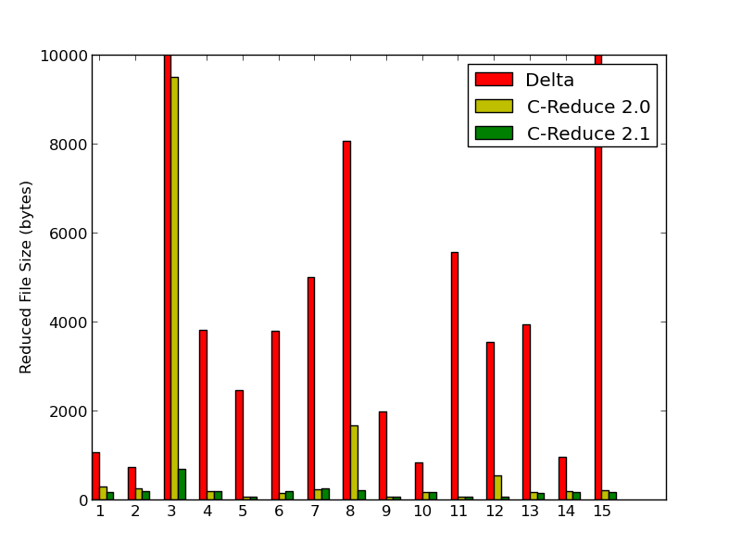

Test Reduction
Essential for random testing
Widely used in manual testing
Not just academic – widely used in real world
C-Reduce
Mozilla’s Lithium
Test case

Slide 4

Test Reduction Slippage
Input to test reduction algorithm: test t
Output of test reduction algorithm: test r
Both t and r fail, but:
t detects faults F
r detects faults F’
F ≠ F’
You found bug 1 but reduced to bug 2...
t
r
reduction
F
≠
F’

Slide 5

Test Reduction Slippage
The bad case is when you lose faults:
t detects faults F
r detects faults F’
F ≠ F’
t
r
F
≠
F’
f

Slide 6

Test Reduction Slippage
Other issues:
Likely that slippage is usually from low-probability / “combinatorial footprint” faults to easier-to-detect faults
Losing the needle, finding the haystack
t
r
F
≠
F’
f

Slide 7
Test Reduction Slippage
Is slippage always harmful?
No!
t detects faults F
r detects faults F’
F ≠ F’
t
r
F
≠
F’
f

Slide 8
Mitigating (and Exploiting!) Slippage
How can we use slippage without risking the “dark side” of slippage?
Answer: return more than one reduced test!
F’₂
t
r
F’₁
r₁
r₂
t
r₃
r₄
F
≠
F’
F’₃
F’₄

Slide 9
How do we do that?
Two algorithms for producing multiple reduced tests from a single test:
comb-block and multi-ddmin
F’₂
t
r
F’₁
r₁
r₂
t
r₃
r₄
F
≠
F’
F’₃
F’₄

Slide 10
comb-block
Basic idea:
First, run delta-debugging (or other reducer)
Then, take results and remove the components of reduced test r from the original test t to get t’
Reduce t’ to get r’
Should be a very different failing test than r
t
t-r
r
r’
then
reduction
reduction

Slide 11
comb-block Elaborated
t
Problem: it is likely r had some components that must be in any useful test (e.g. mount for file system tests)
Solution: try removing larger and larger combinations of components of r from t
So long as one component is removed from t, guaranteed to get a different r’
Combinations + something like “blocking clauses” from SAT solvers => comb-block
Can apply recursively, limit how many combinations to consider (see paper for details of the algorithm)
Potentially produces many reductions from one test, the reductions are constrained to be as different from each other as possible to maximize diversity, produce good slippage, avoid bad slippage
r
reduction
t-s₁
t-s₂
t-s₃ ...

Slide 12
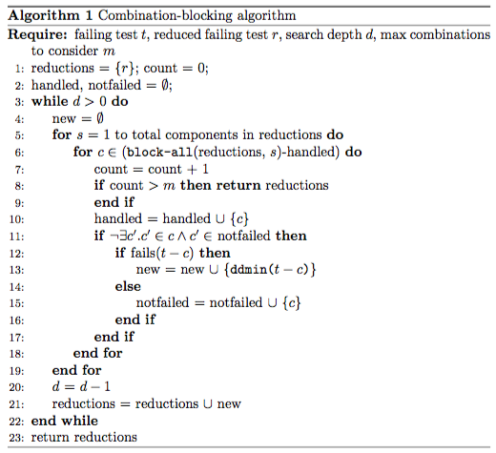
comb-block Algorithm

Slide 13
multi-ddmin
Extremely simple algorithm
Run delta debugging (which we call ddmin after original DD papers) multiple times, randomizing order in which candidate reductions of a test are considered
Result is the union of all the distinct reduced tests discovered
ddmin
ddmin
ddmin
ddmin
ddmin
ddmin

Slide 14
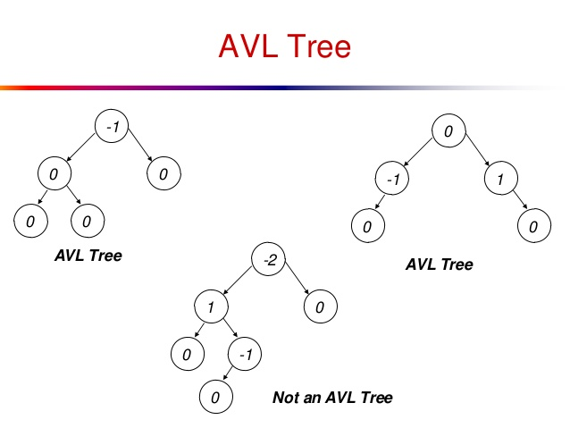
Results: AVL Tree
Analysis of 82 mutants of a Python AVL Tree:
Produce AVL trees with two faults by injecting two mutants, checking that both can be detected in isolation by random testing
Generated 7,500 tests (sampling 2,959/3,274 possible mutant pairs)
Ran all algorithms, comb-block with depth of 5 / 1,000 max combinations tried, multi-ddmin to generate 10 random reductions

Slide 15
Results: AVL Tree
Results (means over 7,500 tests)
Unreduced tests detected 1.08 faults
Reduced tests detected only 1.05 faults
Using comb-block detected 1.14 faults
Using multi-ddmin detected 1.11 faults
Runtime for comb-block 2.79s mean vs. 4.24s for multi-ddmin
All results highly (p < 1.6x10⁻⁹) significant

Slide 16
Results: AVL Tree
Fault-lossy slippage in about 8% of tests
We also tried 30 runs for each mutant pair (96K tests), only running slippage mitigation if there was actual lossy slippage
Many mutant pairs had slippage rates of up to 83%
comb-block mitigated the slippage 56% of the time averaged over mutant pairs
multi-ddmin mitigated 33% of the time
Difference significant at p<1x10⁻⁹⁵

Slide 17
Results: Mozilla SpiderMonkey
Real tests and faults
SpiderMonkey 1.6 (Mozilla’s JavaScript engine) faults, corpus of tests from 2013 PLDI paper on fault identification
Sample of 113 tests
Non-recursive comb-block vs. multi-ddmin with 10 reductions

Slide 18
Results: Mozilla SpiderMonkey
Non-recursive comb-block detected 1.34 distinct faults (mean) per test case
multi-ddmin detected only 1.09 (and was much slower)
On the other hand, detected more faults over all tests (total of 10 vs. 8 vs. 7 for pure reduction)
Normal reduction always detected exactly one fault
Good example of the value of positive slippage
Neither did well mitigating harmful slippage; but harmful slippage was rare (only 2.7% of tests)

Slide 19
Related Work
Chen et. al [PLDI 13] introduced term “slippage” and estimated some rates for SpiderMonkey and GCC tests
Hughes et al. [Workshop on Automation of Software Test 2016] propose an alternative search procedure for QuickCheck, with different requirements (user provides some abstraction of actions), that might help with slippage – not their primary purpose

Slide 20
Summary
Slippage is when test reduction causes a change in the fault(s) detected by the test
Usually seen as a bad thing but it can in fact be a benefit of reduction
Our proposal: produce multiple reductions to avoid harmful slippage, induce good slippage
One directed, complex algorithm and one very simple modification of delta debugging
Preliminary experiments show that both algorithms can mitigate/exploit slippage, at a reasonable cost

Slide 21
Future Work
More experiments over more subjects
How frequent and how problematic is slippage in the real world?
Is slippage exploitation a practical and efficient way to increase the effectiveness of testing efforts? Do tests exposing faults often lie “near” tests exposing other faults?

Slide 22
Questions?

