Slide 1

Coverage
… and Its Discontents
with apologies to
Alex Groce, Amin Alipour, Rahul Gopinath
Oregon State University

Slide 2
Coverage for Suite Evaluation: An Origin Story

Slide 3

Suite Evaluation
Basic question in software testing:
How good is this test suite?
Obvious way to answer:
How many bugs does it find?
(that’s what a test suite’s FOR, right?)
Why doesn’t this work?

Slide 4
Suite Evaluation
Counting bugs found doesn’t work
Different reasons for testers and researchers, but the same conclusion
“Something must be done.”
“This is something.”
“This must be done!”

Slide 5
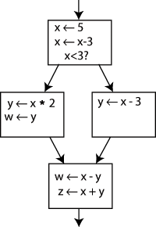
Thus: Coverage
There are lots of coverage measures
In this talk, I mostly mean traditional structural code coverage measures:
Statement coverage
Which lines of code in the program did the suite run?
Branch coverage
Which branches in the code did the suite take?
MC/DC, path coverage, and other exotic beasts exist too, but outside of avionics (and research, which doesn’t count), nobody much uses them

Slide 6
Coverage Isn’t Silly
There are good reasons to think coverage might help predict suite quality
If you never run a line of code, it’s awful hard to find any bugs in it
Branches are important, many bugs come down to control flow patterns that weren’t expected
Bad test suites seem to also often have really poor coverage
->

Slide 7



Sensible People Use Coverage
Good books that cover software testing by “real-world” people suggest using coverage
Code Complete, Lessons Learned in Software Testing, Beizer’s book, etc.
Governments require test coverage in some cases (MC/DC in avionics for example)

Slide 8
Coverage: Origins
The origin story is:
Coverage is plausible!
We really need to predict how good suites are

Slide 9
A Weak Story
That’s it
No radioactive spiders, no kite in a thunderstorm, no apple on the head, just a combination of
Pressing need
General plausibility
Lack of anything better

Slide 10

Testers & Developers Ask:
So, can I really (safely):
Use coverage to decide when to stop testing?
Use coverage to pick a testing tool?
Use coverage to guide my decisions in making new tests?

Slide 11
Researchers Ask:
So, can I really (responsibly and scientifically and without getting my papers rejected):
Use coverage to compare (automated) test generation methods?
Use coverage as the actual goal of my test generation algorithm?

Slide 12

The Good News
Smart testing researchers decided these were important questions to answer
A long time ago!
And many, many papers were published on the topic, over the years
They’re still being written
(I wrote some of them)

Slide 13
The Bad News
Answer still isn’t actually clear from these papers, for a few reasons
The papers don’t agree
There aren’t that many data points
The papers don’t all answer the actual questions

Slide 14
The Papers Don’t Agree
One (award winning) ICSE paper this year is titled “Coverage is not strongly correlated with test suite effectiveness”
Another ICSE paper (ours) finds that statement coverage does a good job of predicting suite quality for hundreds of Java projects on Github
Recent ISSTA, TOSEM, etc. papers on the topic with different results
In particular: is coverage just a predictor of size, which is good? Not clear!

Slide 15

Not Enough Data Points
Most of the papers consider a few programs, at most, and a few suites or suite generation methods
To get more suites, random sub-setting of suites is often used (not very realistic)
Even the studies with more programs don’t consider more than one language, and only a certain kind of open source project, etc.

Slide 16

What Is the Question?
What do we actually want to know, in order to answer those concerns from testers and researchers?
The papers answer a variety of slightly varying questions (e.g. researcher needs vs. testers)
What’s the actual core hypothesis here?

Slide 17
A Hypothesis to Test
The Strong Coverage Hypothesis (SCH):
For the population of realistic software systems, test suites produced by human efforts or automated testing methods, and realistic faults, there is at least a moderate statistical correlation between the level of coverage a suite achieves and its level of fault detection. Moreover, this correlation is not the result of some trivial confounding factor that could be used in place of coverage, such as suite size.

Slide 18
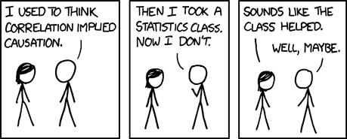
A Note on Causality
The SCH just claims correlation between coverage and fault detection, not causality
Is this a problem?

Slide 19
A Note on Causality
Not really a problem
We just want a tool for predicting suite effectiveness, in most cases, not a profound understanding of what makes suites good

Slide 20
The Good News (2)
Most “modern” papers on coverage roughly address the Strong Coverage Hypothesis
They aim to measure correlation, accounting for suite size and obvious confounding factors
They care about things like rank-order correlation vs. absolute prediction of fault detection, don’t assume linearity, etc.

Slide 21
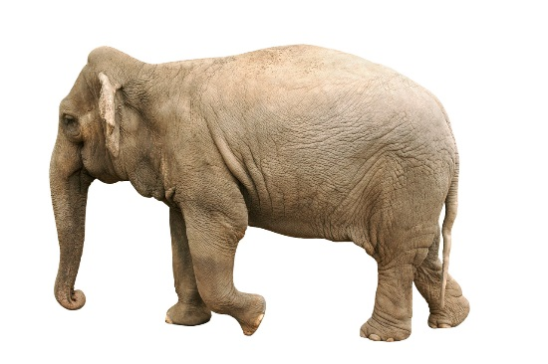
The Elephant in the Room
These papers generally don’t actually address the Strong Coverage Hypothesis
Measuring actual faults detected by test suites is really hard, and there are often too few real faults for good statistical evaluation
So the papers use mutation analysis

Slide 22

Mutation Analysis
Basic idea:
Make many small syntactic changes to a program’s source code—these are the mutants
Determine whether a test suite can detect the difference between these modified versions and the original program: count mutants killed
That is your measure of suite effectiveness!

Slide 23
The Problem
Mutation analysis is just another kind of coverage, so…
The assumption that mutants predict fault detection is an instance of the Strong Coverage Hypothesis
It turns out the data on mutants -> fault detection is as weak as the data on code coverage, for the most part
Sure, it’s highly plausible
So is coverage!

Slide 24
An Elephant Graveyard
We need to cut out the middle man
Get data directly on the Strong Coverage Hypothesis
Measure correlation of coverage to actual detection of real faults

Slide 25
Our Proposal
If you perform testing experiments in a setting where you can count faults report coverage and fault counts for all test suites you study
http://testcoverage.eecs.oregonstate.edu

Slide 26
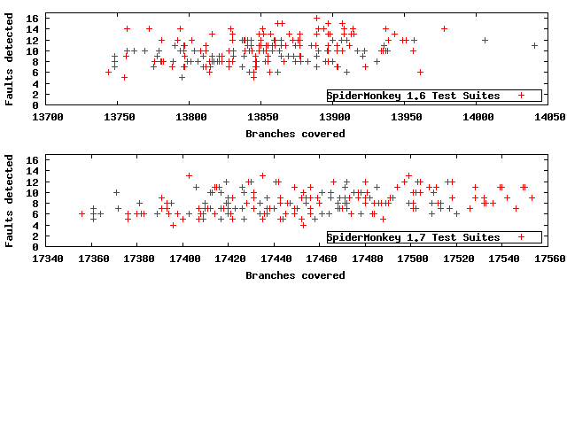
An Example of Relevant Data

Slide 27
Correlation Analysis
It doesn’t look great, but the correlations here are decent (0.23-0.27 for branch coverage), certainly enough to add some support for the Strong Coverage Hypothesis
Now, we just need more data sets!

Slide 28
Not So Fast
Those test suites were in fact generated by two methods for suite generation, as part of a paper comparing the methods
The graph and correlation aggregates these
Let’s see what happens when we examine the two data sets independently (there are still plenty of points for our statistics)

Slide 29
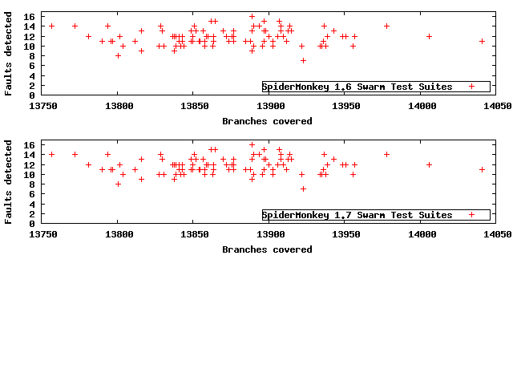
Swarm Testing Suites Only

Slide 30
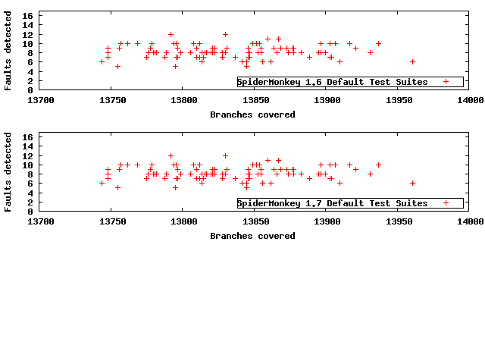
Non-Swarm Suites Only

Slide 31
Not So Fast
The correlations go away (-0.07-0.04), except for a modest (0.22) correlation in the default suites for SpiderMonkey 1.7, for both statement and branch coverage
If we pull back to the original data, it turns out that whether the suite is swarm or not is the best predictor of # of faults detected
(Shameless self promotional bit: if you do random testing, consider using swarm testing)

Slide 32
What if Coverage is Just a Side-Effect?
If coverage is a side-effect for something easily measured, like suite size, it’s useless
If it is a side-effect of something hard to produce (like good automated testing methods or good human testing practices) it is actually still useful for our purposes!
The question is just predictive power, not causality

Slide 33
A New Hypothesis
The Weak Coverage Hypothesis (WCH):
For the population of realistic software systems, test suites produced by different human efforts or different automated testing methods, and realistic faults, there is at least a moderate statistical correlation between the level of coverage a suite achieves and its level of fault detection. This may be the result of a non-trivial complex cause that produces both coverage and fault detection. No prediction for suites produced by the same method is guaranteed.

Slide 34
Switching to the WCH
We shouldn’t study coverage using random subsets of homogenous test suites any more
Size still matters: we don’t want coverage to just be a really expensive and painful way to measure the size (in computation budget) of a test suite
Need to either use regression or do lots of experiments over equal-time test suites
We’ve known that since at least a 2003 ICSE paper by Harder, Mellen, and Ernst

Slide 35
Putting Coverage on a Sound Footing
Collect data on coverage & real faults, in the context of the Weak Coverage Hypothesis
No shortcuts, we need real suites not subsets
Similar experiments with mutation analysis as the coverage method
If we get very good mutant -> fault detection correlation, the set of papers already written on coverage provides decent support for the WCH

Slide 36
In the Meantime?
Most books that discuss coverage warn against using it to stop testing, anyway
They just suggest that you should try to augment suites to get good coverage
Not very comforting to testing researchers, but most people aren’t testing researchers…

Slide 37
The Plural of Anecdote is Not Confidence
So, the core idea here is:
“There are all these bugs we miss because our test suites don’t cover things!”
How true is this?
Let’s consider some recent infamous bugs…

Slide 38
if ((err = SSLHashSHA1.update(&hashCtx, &serverRandom)) != 0)
goto fail;
if ((err = SSLHashSHA1.update(&hashCtx, &signedParams)) != 0)
goto fail;
goto fail;
if ((err = SSLHashSHA1.final(&hashCtx, &hashOut)) != 0)
goto fail;
err = sslRawVerify(ctx,
ctx->peerPubKey,
dataToSign, /* plaintext */
dataToSignLen, /* plaintext length */
signature,
signatureLen);
if(err) {
sslErrorLog("SSLDecodeSignedServerKeyExchange: sslRawVerify "
"returned %d\\n", (int)err);
goto fail;
}
fail:
SSLFreeBuffer(&signedHashes);
SSLFreeBuffer(&hashCtx);
return err;

Slide 39
2404 int
2405 tls1_process_heartbeat(SSL *s)
2406 {
2407 unsigned char *p = &s->s3->rrec.data[0], *pl;
2408 unsigned short hbtype;
2409 unsigned int payload;
2410 unsigned int padding = 16; /* Use minimum padding */
2411
2412 /* Read type and payload length first */
2413 hbtype = *p++;
2414 n2s(p, payload);
2415 pl = p;
2416
2417 if (s->msg_callback)
2418 s->msg_callback(0, s->version, TLS1_RT_HEARTBEAT,
2419 &s->s3->rrec.data[0], s->s3->rrec.length,
2420 s, s->msg_callback_arg);
2421
2422 if (hbtype == TLS1_HB_REQUEST)
2423 {
2424 unsigned char *buffer, *bp;
2425 int r;
2426
2427 /* Allocate memory for the response, size is 1 bytes
2428 * message type, plus 2 bytes payload length, plus
2429 * payload, plus padding
2430 */
2431 buffer = OPENSSL_malloc(1 + 2 + payload + padding);
2432 bp = buffer;
2433
2434 /* Enter response type, length and copy payload */
2435 *bp++ = TLS1_HB_RESPONSE;
2436 s2n(payload, bp);
2437 memcpy(bp, pl, payload);
2438
2439 r = ssl3_write_bytes(s, TLS1_RT_HEARTBEAT, buffer, 3 + payload + padding);

Slide 40
Advice for Researchers
Don’t evaluate only on the basis of coverage
Or even only using mutation analysis
No substitute for real live faults
Adding coverage to support an evaluation based on faults is fine
We have more reason to suspect coverage is correlated than not (I think)
We’re just not sure
Don’t omit worse coverage results!

Slide 41
Advice for Practitioners
Suite size alone isn’t that useful, you need something to measure…
“This is something!”
Obey the law, company policy
Aim at producing good tests; measure coverage to find holes, not as your end result

Slide 42
Advice for Practitioners
Writing tests just to get coverage (without other goals) is probably a bad idea even if the Weak Coverage Hypothesis holds…
Hypothesis developed over suites built for other purposes, primarily—aiming only at coverage could be a major confounding factor here!
Stay tuned for more updates from your friendly neighborhood software testing research community

Slide 43
Questions?

