Slide 1
Visual Summary Diagram
Andy Grogan-Kaylor

Slide 2
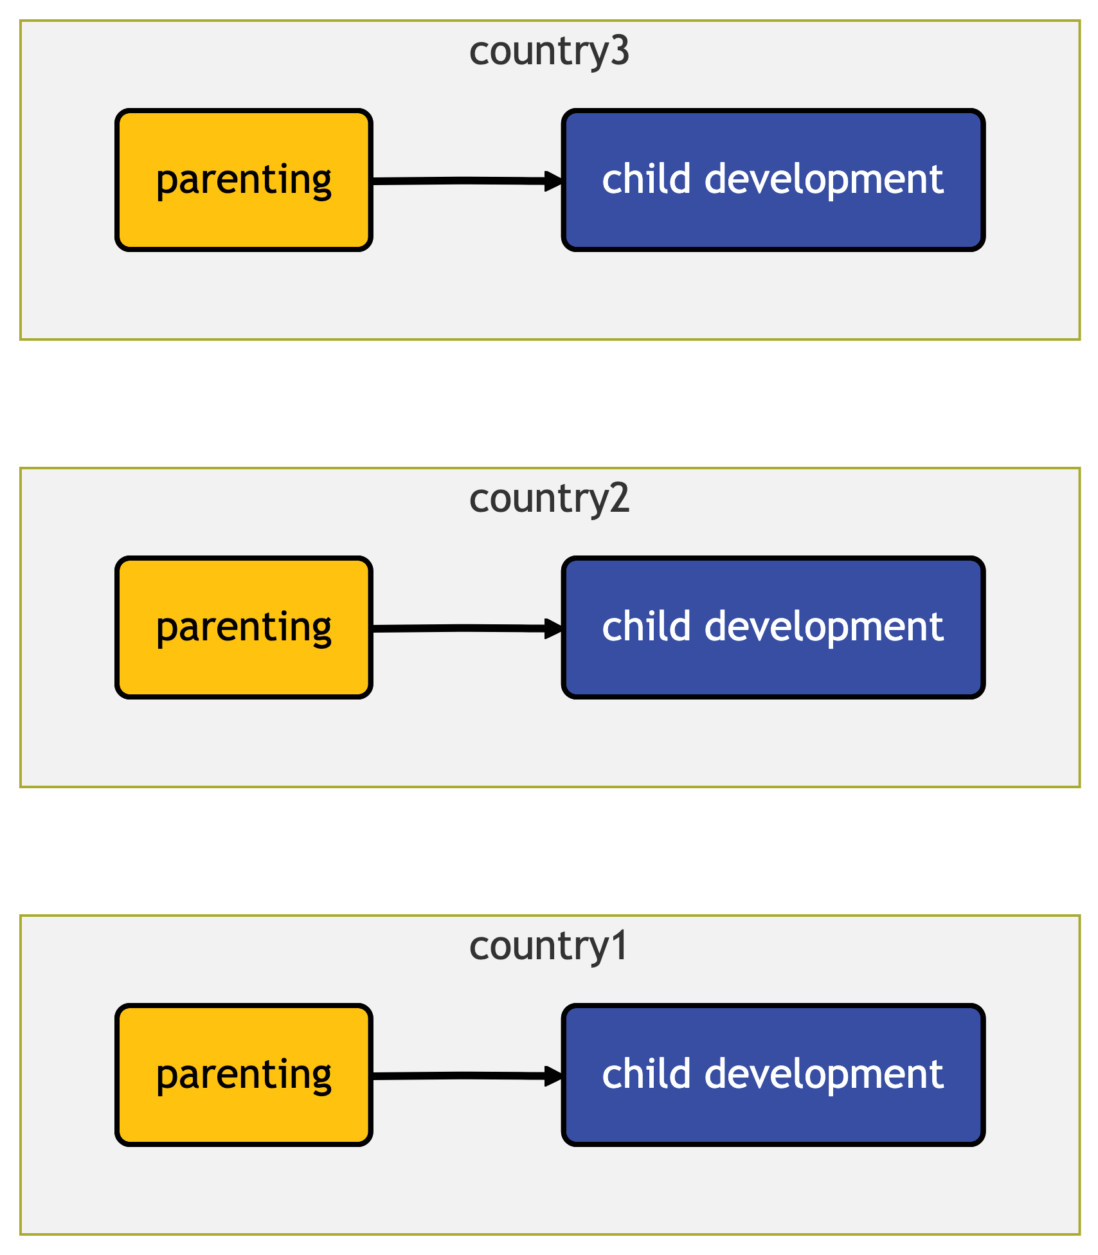
Research Question

Slide 3
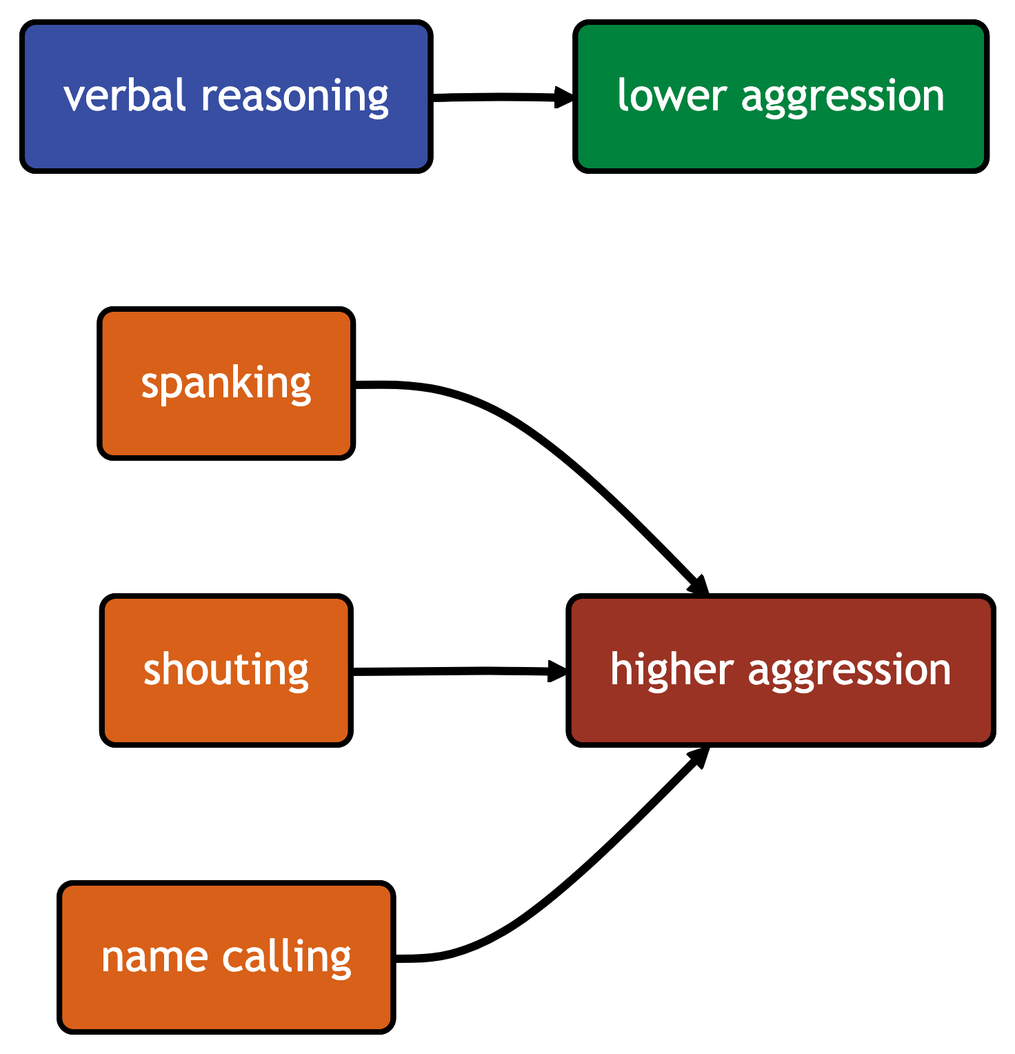
Results

