Slide 1

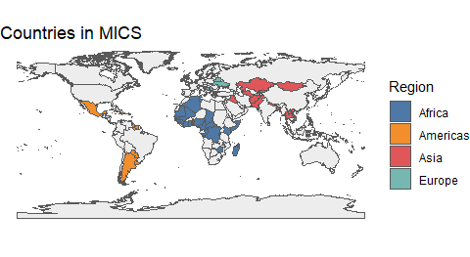
Interesting and Noteworthy Findings From MICS Analyses Implications For The Cross Cultural Study Of Parenting And Child Development
No Spanking
Spanking is associated with decreases in child socio-emotional development & with increases in child aggression.
No Insults
Name-calling & psychological aggression may have effects that are as harmful as those of physical punishment.
No Physical Or Psychological Punishments
Though common, these parenting behaviors are consistently associated with decreases in child socio-emotional development & with increases in child aggression.
Child Physical Abuse
Simulations with MICS data suggest that eliminating the use of physical punishment would be met with a large reduction in the amount of physical child abuse.
Positive Discipline
Positive discipline–in the form of verbal reasoning–is generally associated with improvements in child well-being across countries, and should therefore be recommended.
References
Grogan-Kaylor, Andrew, Berenice Castillo, Garrett T Pace, Kaitlin P Ward, Julie Ma, Shawna J Lee, and Heather Knauer. 2021. “Global perspectives on physical and nonphysical discipline: A Bayesian multilevel analysis.” International Journal of Behavioral Development, January. https://doi.org/10.1177/0165025420981642.
Ma, Julie, Andrew C. Grogan-Kaylor, Garrett T. Pace, Kaitlin P. Ward, and Shawna J. Lee. 2022. “The association between spanking and physical abuse of young children in 56 low- and middle-income countries.” Child Abuse & Neglect 129 (July): 105662. https://doi.org/10.1016/j.chiabu.2022.105662.
Pace, Garrett T., Shawna J. Lee, and Andrew Grogan-Kaylor. 2019. “Spanking and young children’s socioemotional development in low- and middle-income countries.” Child Abuse and Neglect 88: 84–95. https://doi.org/10.1016/j.chiabu.2018.11.003.
Ward, Kaitlin P., Andrew C. Grogan-Kaylor, Garrett T. Pace, Jorge Cuartas, and Shawna J. Lee. 2021a. “A Multilevel Ecological Analysis of the Predictors of Spanking Across 65 Countries.” BMJ Open 11 (e046075). https://doi.org/10.1136/bmjopen-2020-046075.
Ward, Kaitlin P, Andrew Grogan-Kaylor, Julie Ma, Garrett T Pace, and Shawna J Lee. 2021b. “Associations Between 11 Parental Discipline Behaviors and Child Outcomes Across 60 Countries.” PsyArXiv. https://doi.org/10.31234/osf.io/f5t8x.
Ward, Kaitlin P., Shawna J. Lee, Andrew C. Grogan-Kaylor, Julie Ma, and Garrett T. Pace. 2022. “Patterns of Caregiver Aggressive and Nonaggressive Discipline Toward Young Children in Low- and Middle-Income Countries: A Latent Class Approach.” Child Abuse & Neglect 128. https://doi.org/https://doi.org/10.1016/j.chiabu.2022.105606.

