Slide 1

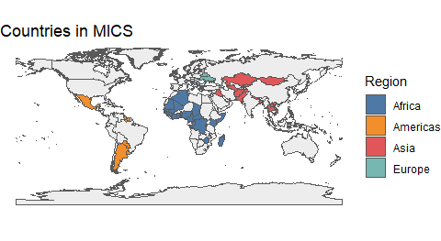
Interesting and Noteworthy Findings From MICS Analyses Implications for the Cross-Cultural Study of Parenting and Child Development
Spanking Hurts Children
Spanking is associated with decreased child socio-emotional development & increased child aggression.
Insults Contribute to Harm
Name-calling & psychological aggression may have effects that are as harmful as those of physical punishment.
Physical and Psychological Punishment Slow Child Development
Harsh punishment is consistently associated with decreased child socio-emotional development & more child aggression.
Eliminating Spanking Reduces Abuse
Simulations with MICS data suggest that eliminating spanking would result in a large reduction in global rates of physical child abuse.
Use Positive Discipline!
Positive discipline–in the form of verbal reasoning–is associated with improved child well-being across MICS countries.
Positive discipline benefits children.
References
Grogan-Kaylor, Andrew, Berenice Castillo, Garrett T Pace, Kaitlin P Ward, Julie Ma, Shawna J Lee, and Heather Knauer. 2021. “Global perspectives on physical and nonphysical discipline: A Bayesian multilevel analysis.” International Journal of Behavioral Development, January. https://doi.org/10.1177/0165025420981642.
Ma, Julie, Andrew C. Grogan-Kaylor, Garrett T. Pace, Kaitlin P. Ward, and Shawna J. Lee. 2022. “The association between spanking and physical abuse of young children in 56 low- and middle-income countries.” Child Abuse & Neglect 129 (July): 105662. https://doi.org/10.1016/j.chiabu.2022.105662.
Pace, Garrett T., Shawna J. Lee, and Andrew Grogan-Kaylor. 2019. “Spanking and young children’s socioemotional development in low- and middle-income countries.” Child Abuse and Neglect 88: 84–95. https://doi.org/10.1016/j.chiabu.2018.11.003.
Ward, Kaitlin P., Andrew C. Grogan-Kaylor, Garrett T. Pace, Jorge Cuartas, and Shawna J. Lee. 2021a. “A Multilevel Ecological Analysis of the Predictors of Spanking Across 65 Countries.” BMJ Open 11 (e046075). https://doi.org/10.1136/bmjopen-2020-046075.
Ward, Kaitlin P, Andrew Grogan-Kaylor, Julie Ma, Garrett T Pace, and Shawna J Lee. 2021b. “Associations Between 11 Parental Discipline Behaviors and Child Outcomes Across 60 Countries.” PsyArXiv. https://doi.org/10.31234/osf.io/f5t8x.
Ward, Kaitlin P., Shawna J. Lee, Andrew C. Grogan-Kaylor, Julie Ma, and Garrett T. Pace. 2022. “Patterns of Caregiver Aggressive and Nonaggressive Discipline Toward Young Children in Low- and Middle-Income Countries: A Latent Class Approach.” Child Abuse & Neglect 128. https://doi.org/https://doi.org/10.1016/j.chiabu.2022.105606.

