Slide 1
Writing The Empirical Section For The Social Work Prelim
Andy Grogan-Kaylor

Slide 2
Role Of Research In Social Work
Social work is a profession dedicated to social justice and the improvement of well-being.

Slide 3
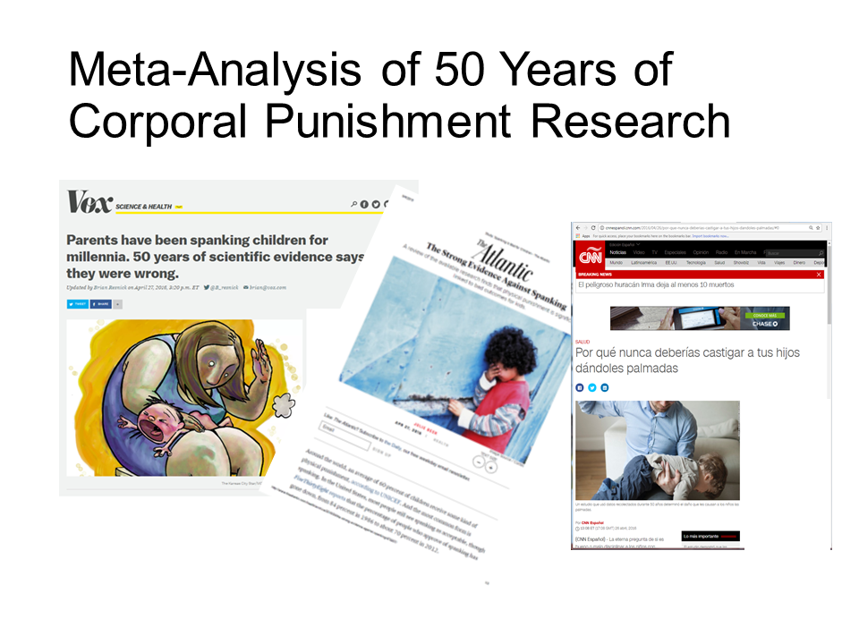
Evidence Drives Policy

Slide 4
Evidence Drives Policy(2)
Policy Statement by American Academy of Pediatrics (Sege et al. 2019)
Policy Statement by American Psychological Association (American Psychological Association 2019)

Slide 5
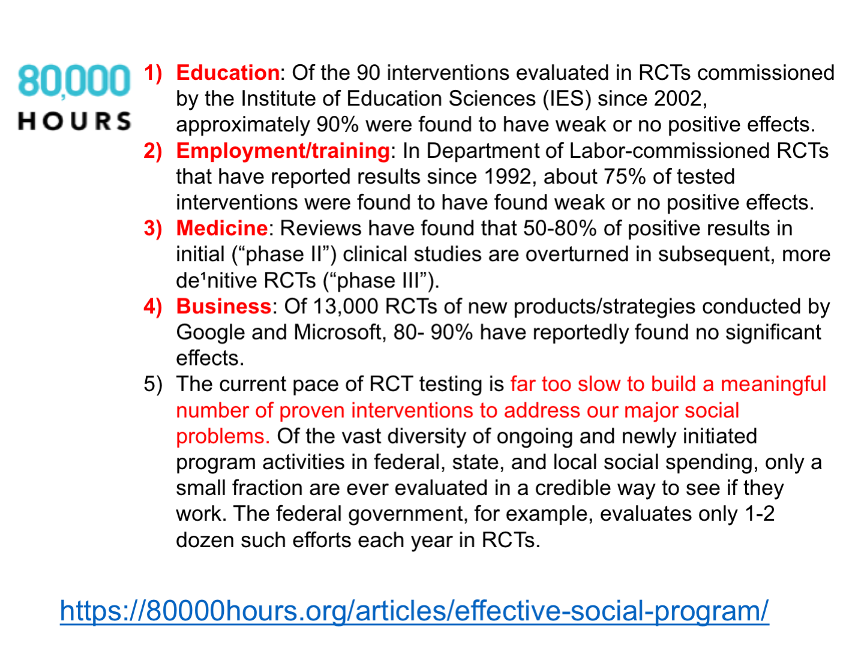
Concerns About The Research Base for Social Programs And Interventions

Slide 6
Savedoff, Levine, and Birdsall
“No physician would consider prescribing strong medications whose impact and potential side-effects have not been properly evaluated. Yet in social development programs, where huge sums can be spent to modify population behaviors, change economic livelihoods, and potentially alter cultures or family structure, no such standard has been adopted.
While it is widely recognized that withholding programs that are known to be beneficial would be unethical, the implicit corollary—that programs of unknown impact should not be widely replicated without proper evaluation—is frequently dismissed.”
— (Savedoff, Levine, and Birdsall 2006)

Slide 7

Concerns About Evidence More Generally

Slide 8
So… Why Do We Include Research In The Social Work Prelim
A profession that makes claims to address pain, suffering, and injustice needs to be able to back up its claims with strong high quality evidence.

Slide 9
Incorporating Empirical Evidence Within a Social Work Prelim: Writing The Empirical Section of the Social Work Prelim
Imposter Syndrome
Drawing The Circle Around Your Question
Finding The Right Literature
Writing

Slide 10
Imposter Syndrome
“Academic life is full of learning, excitement, and discovery. However, academics also experience professional challenges at various points in their career, including repeated rejection, impostor syndrome, and burnout. These negative experiences are rarely talked about publicly, creating a sense of loneliness and isolation for people who presume they are the only ones affected by such setbacks. However, nearly everyone has these experiences at one time or another, and thus talking about them should be a normal part of academic life.” (Jaremka et al. 2019)
Surface / Acknowledge the Feeling
Acknowledge the Feeling / Welcome It!
Fake It Until You Make It

Slide 11
Drawing The Circle Around Your Question & Finding The Right Literature
Remember the 80/20 rule: 80% of everything is of relatively low value; only 20% is gold.
There are many studies that “make conclusions.” Only a very limited set of them are methodologically rigorous, and are real contributions to the literature.
Start your literature search by reading a good review article, e.g. a recent review piece in Annual Review of Psychology. What do they cite? What authors do they think are important? Then search in a large database like PsychInfo or ProQuest

Slide 12
Finding The Right Literature (2)
More recent literature (last 5 years; last 10 years)
Higher impact journals (Thompson ISI) e.g.
Child Development
Child Psychology and Psychiatry
Developmental Psychology
Articles from important or longstanding ongoing studies or databases e.g.
FFCWS
ADD Health
ECLS
PSID-CDS
Seminal or Key Articles from any era or journal (the ones that everyone mentions)
I still think that the key articles in most literatures end up numbering somewhere between 20 and 50 articles.

Slide 13
Writing
Writing is Hard
Write Many Rough Drafts (Share Them! With your Advisor, or with other people who will read frequent drafts of your writing.)
Not All Sources Are Equally Good

Slide 14
Not All Sources Are Equally Good
(author, date) studied (sample) to examine (research question). (author, date) found that ______________. (author, date) also found that ______________. (author, date) also found that ______________. However, one (strength/limitation) of the study was that __________________________. These authors suggested (policy, program, intervention).

Slide 15
Questions?

Slide 16
References
American Psychological Association. 2019. “Resolution on Physical Discipline of Children By Parents.” https://www.apa.org/about/policy/physical-discipline.pdf.
Jaremka, Lisa M, Joshua M Ackerman, Bertram Gawronski, Nicholas O Rule, Kate Sweeny, Linda R. Tropp, Molly A Metz, Ludwin Molina, William S Ryan, and S Brooke Vick. 2019. “Common academic experiences no one talks about: Repeated rejection, impostor syndrome, and burnout.” Perspectives on Psychological Science.
Savedoff, William D, Ruth Levine, and Nancy Birdsall. 2006. When Will We ever learn ? Improving Lives through Impact evaluation. Report of the Evaluation Gap Working Group.
Sege, Robert D, Benjamin S Siegel, Council on Child Abuse and Neglect, and Committee on Psychosocial Aspects of Child and Family Health. 2019. “Effective Discipline to Raise Healthy Children.” Pediatrics 143 (2): e20183609. https://doi.org/10.1542/peds.2018-3609.

