Slide 1
Instruction of masking cloud and shadow in time series by ATSA
Xiaolin Zhu
Department of Land Surveying and Geo-Informatics The Hong Kong Polytechnic University
5/25/2018
zhuxiaolin55@gmail.com

Slide 2
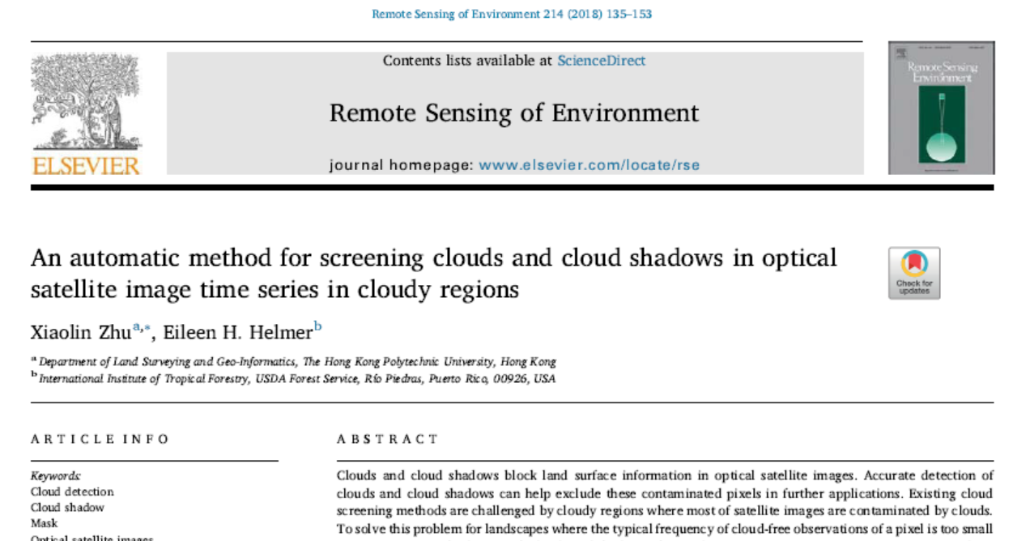
Reference
Download link: https://www.sciencedirect.com/science/article/pii/S0034425718302530

Slide 3
Input data prepare
Three data sets needed:
a time series: all images should be stacked together
Water mask: with same resolution and size of the time series images. Pixels with value 0 are water body
Sun angles: sun elevation (1st column) and azimuth (2st column) of each image in the time series

Slide 4
Input data prepare
Test data sets:
Landsat8_18images_2015_Hkisland: a time series with 18 images in 2015 covering Hong Kong Island. Each image has 5 bands: blue, green, red, nir and swir
Water_mask_Hkisland: water mask
sun angle.txt: sun elevation and azimuth angles of the 18 images
Image# | Day of year
1 | 19
2 | 35
3 | 51
4 | 67
5 | 99
6 | 115
7 | 131
8 | 163
9 | 179
10 | 195
11 | 211
12 | 227
13 | 243
14 | 275
15 | 291
16 | 307
17 | 323
18 | 339

Slide 5
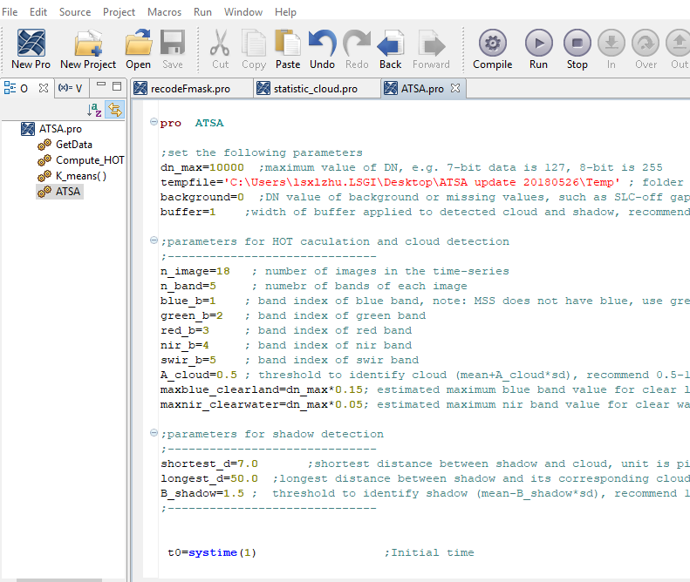
Step1
Open IDL and classic ENVI;
Open the ATSA code in IDL:

Slide 6
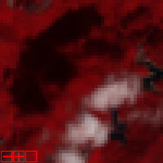
Step2: Set parameters
Follow the explanation in the code and refer to the RSE paper
There are three important parameters:
A_cloud=0.5 ; threshold to identify cloud (mean+A_cloud*sd), recommend 0.5-1.5, smaller values can detect thinner clouds
B_shadow=1.5 ; threshold to identify shadow (mean-B_shadow*sd), recommend 1-3, smaller values can detect lighter shadows
longest_d=50.0 ;longest distance between shadow and its corresponding cloud, unit is “pixel”, can be set empirically by inspecting images
Distance
The default parameters are used for the attached test dataset!

Slide 7
Step3: Compile and run
Input data according to pop-up window
Final mask is stored in the same folder of input time series, with “_cloud_mask_ATSA” as postfix.
Code: shadow 0, clear 1, cloud 2, background 3
All the intermediate results stored in the user-created temporal folder: including 4 files
hot_image, shadow_index, potential_shadow_zone, IDW_shadow_darkness

Slide 8
Manually edit
No method can get 100% perfect cloud/shadow mask
In RS software, such as ENVI, users can correct the mask manually

Slide 9
END

