Slide 1
Data extraction and annotation from pdf files
1st AgroHackathon, Hack 14
Montpellier, 2016

Slide 2
The goal
Extract textual information contained in pdf files of (agricultural) bibliographic resources.
Use extracted information against known endpoints for the semantic annotation.
Design a modular system easily configurable and extendable.
Have an intuitive way for end users to semantically annotate their pdf files.

Slide 3
The process – Key Features
We divided the system into 4 separate components:
API Endpoint, where all the calls are made, using as input the url of a pdf file.
TextExtractor, where the actual extraction of textual information takes place.
Controllers, where the extracted information is passed and then external endpoints are called.
Mapper, where the returned annotated result is presented back in a unifying manner.

Slide 4
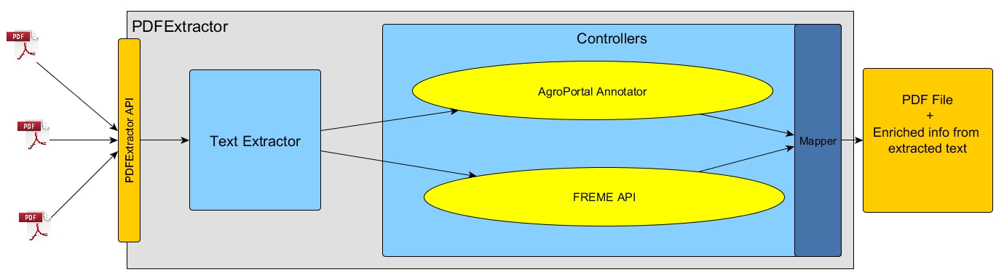
PDFExtractor Workflow

Slide 5
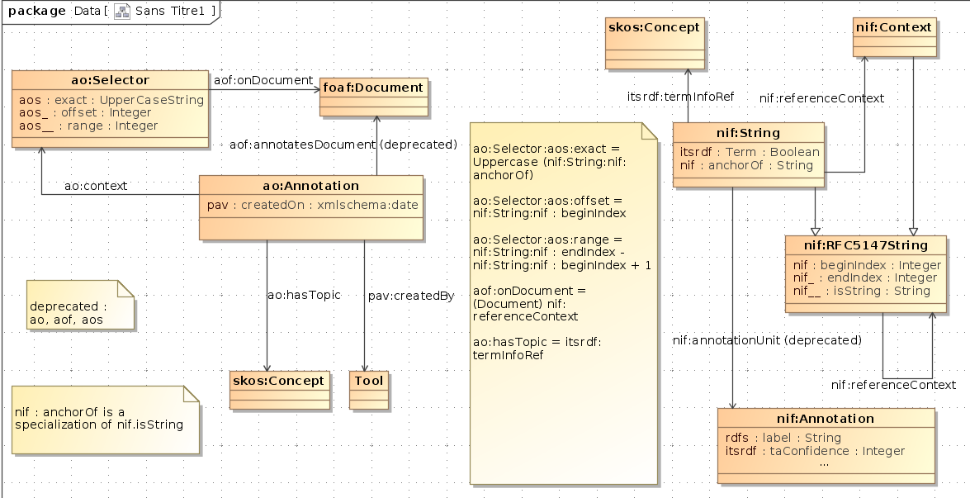
Mappings – AgroPortal with FREME

Slide 6
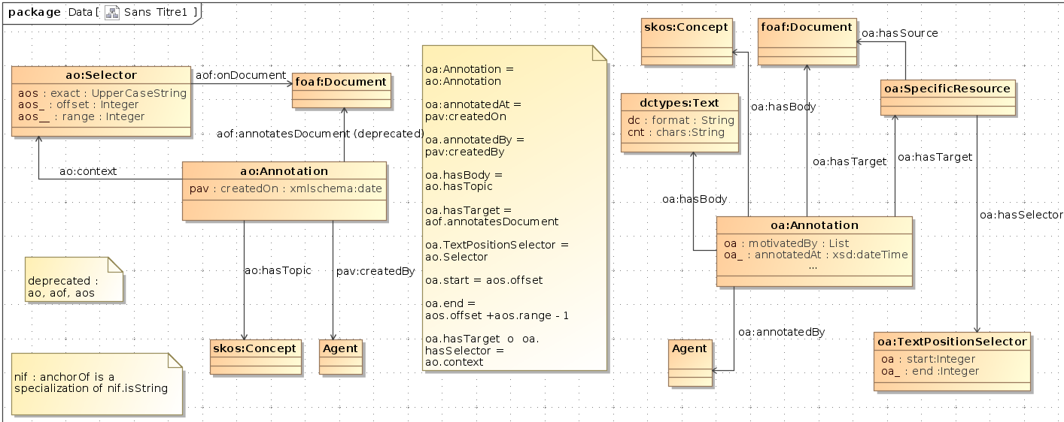
Mappings – AgroPortal with OA

Slide 7
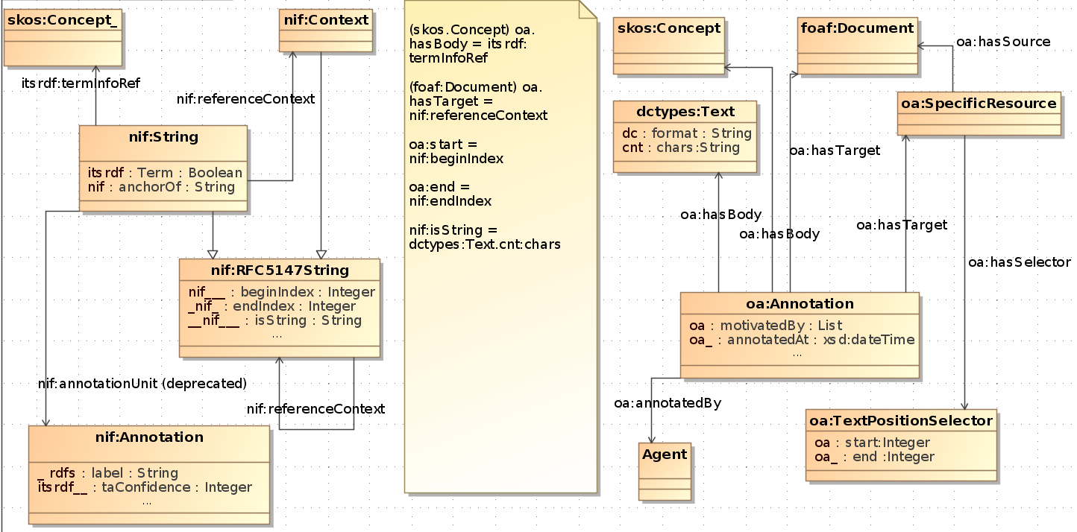
Mappings – FREME with OA

Slide 8
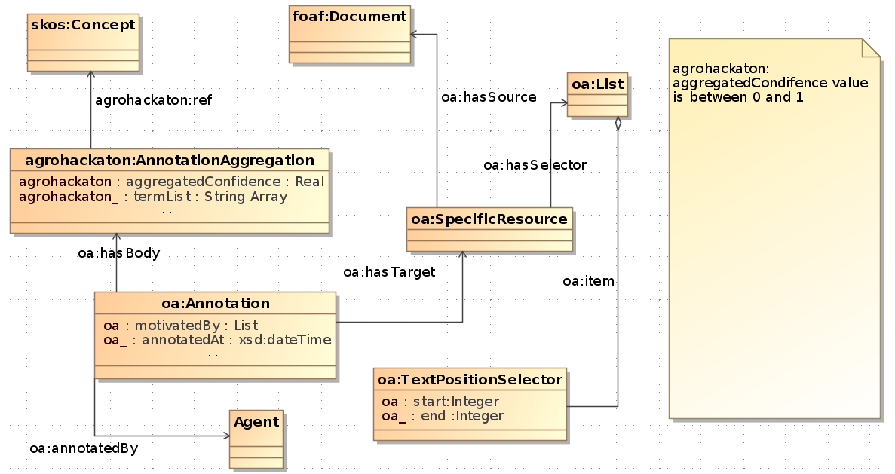
Proposed Evolution of OA based on FREME

Slide 9
Future Work
Integrate more controllers into the workflow.
Design a cleansing component clearing out redundant information.
Provide a richer API endpoint for the system.
Benchmark various endpoints called by the controllers.
Build a front-end web app on top to help end users.

