Slide 1
The Impact of Urban Road Closures on Public Transit
Case Study: Jerusalem
Course 71253 — Introduction to Data Science
Student names here
Notes:
Welcome the room. This is a data science EDA project on Jerusalem public bus data, focused on one practical question: when protests close Aza Street in Rehavia, which buses are actually affected, and is the detour worth worrying about? Introduce yourself and the course.

Slide 2
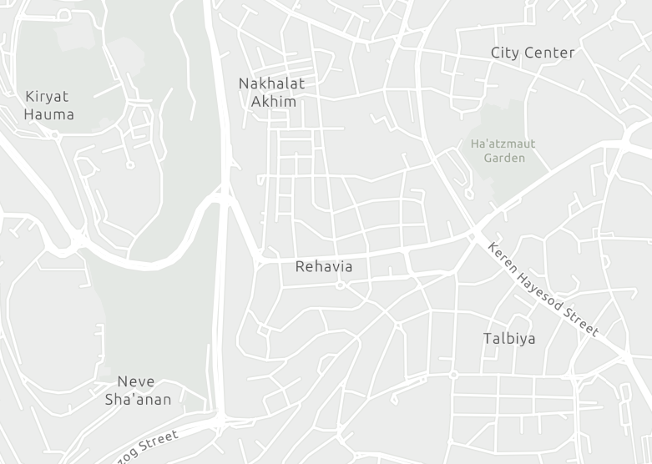
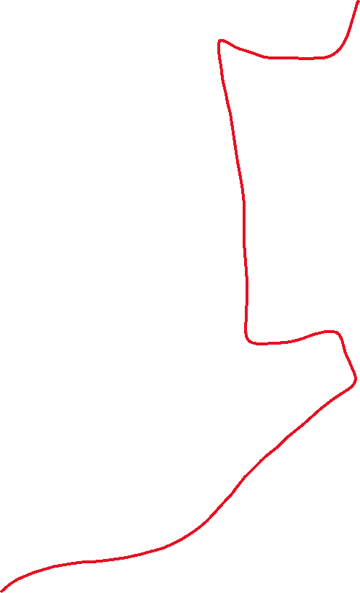
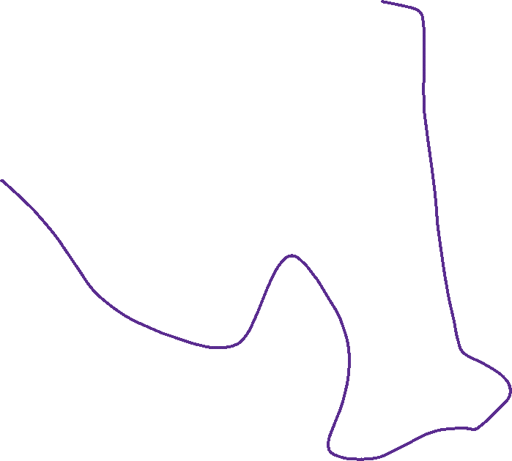

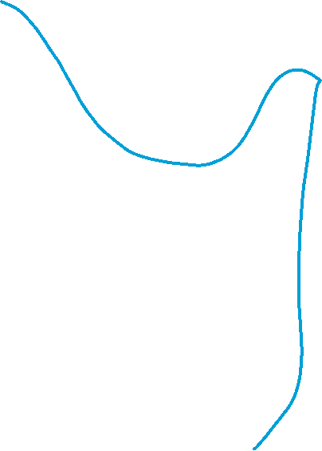
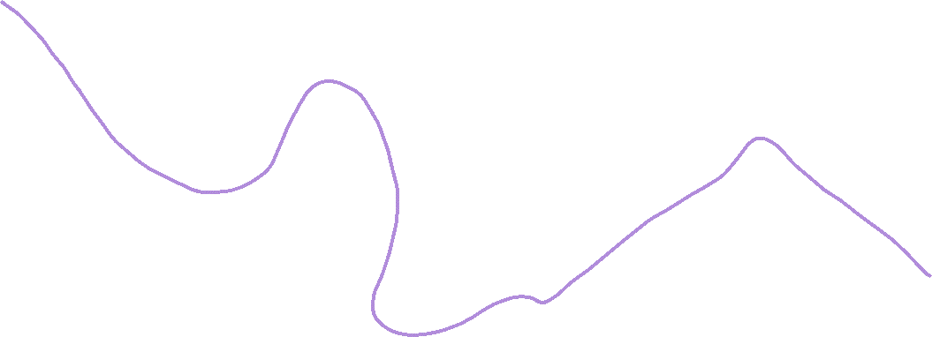
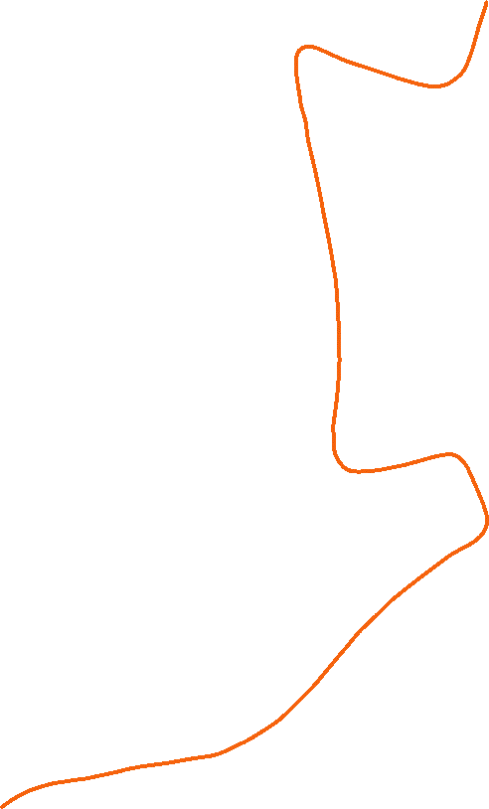

Aza Street closures make Rehavia's buses untrustable
A narrow, central main traffic artery
The Prime Minister lives on Aza Street.
Rehavia is a hub of ongoing protests.
Police repeatedly close the street to traffic.
We study lines that pass through this area, affected by closures
17
19
22
97
9
14
15
FIGURE 1 — MAP OF REHAVIA AND THE STUDIED BUS LINES
Notes:
Rehavia sits at the center of Jerusalem's protest activity, and the Prime Minister's residence is on Aza Street, right through the neighborhood. Police close the street repeatedly for security reasons, which disrupts the bus lines that run through it. This is the real-world motivation behind the whole analysis: a resident needs to know which lines are reliable and when.

Slide 3
One row = one stop on one trip
Ministry of Transport dataset, 2024. 7 bus lines.
Each row: one line, month, day, hour, stop.
A full trip ("block") is one sequence of rows.
Stop #
Stop code
Cum. time (min)
Cum. distance (m)
1
2314
0.66
0
2
2323
1.16
457
3
5592
3.80
1,973
4
972
5.45
2,901
5
938
6.31
3,219
TABLE 1 — EXAMPLE BLOCK, LINE 19 (SUNDAY, 5AM DEPARTURE)
Notes:
Explain the source: Israel's Ministry of Transport open dataset, 'Arrival to station, day and hours' — a pipe-delimited export aggregating average ride behavior per (route, month, day-of-week, hour, stop). The project covers 7 commercial lines across 16 underlying route_ids. Walk through the example table: this is one block — one full trip on line 19, departing at 5am on a Sunday in January — shown stop by stop, with cumulative travel time and distance growing down the rows.

Slide 4
Cleaning cut duplicates, not real data
708,642 → 603,662
records after removing duplicates
6.3%
of rows flagged low-confidence, not deleted
25/26 → 1/2
hours remapped to midnight–2am
Note: raw data has no blockage flag — closures must be inferred from route variants.
Notes:
708,642 raw rows (filtered to the 16 target route_ids) contained a structural export artifact: about 3 overlapping batches produced duplicate keys. A block-aware majority-vote dedup resolved these down to 603,662 rows. Separately, 6.3% of rows have fewer than 8 underlying observations and are flagged low-confidence rather than dropped, since they're often legitimate low-traffic late-night slots. Hours 25/26 in the raw 26-hour clock are remapped to display as 1am/2am for readability — no rows are dropped by this remap.

Slide 5
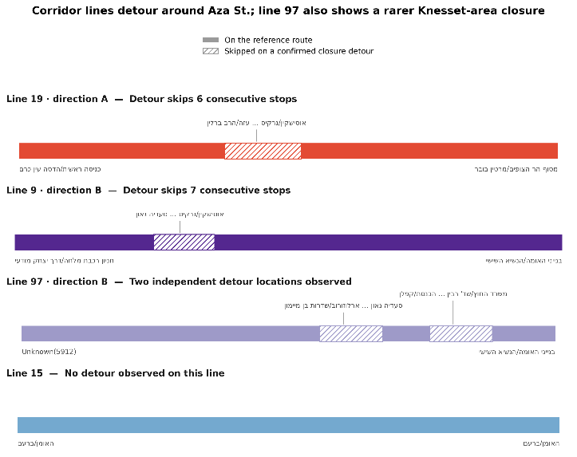
stop_sequence | stop_name | n_observations | cumulative_time (min) | cumulative_distance (m)
16 | Herzog/Tchernichovsky | 7 | 21.11 | 8,249
23 | Ussishkin/Bezalel | 7 | 25.94 | 8,453
A minority of trips skip stops on Aza St.
Each line has a reference route — its most common path.
A minority of trips skip a segment of stops.
These are the line's route "variants."
FIGURE 2 — SKIPPED STOPS ON THE AZA ST. DETOUR
Line 22B always completes the full route — excluded from this analysis.
Notes:
Every line has a reference route: its single most common stop sequence. A minority of trips skip a contiguous segment of stops instead — these are the line's route variants. Figure 2 shows exactly which stops each corridor line skips on its detour, and confirms all three shared-corridor lines (17, 19, 22) skip the same physical Aza Street segment, while control line 15 never detours at all.

Slide 6
How can a resident know the safest way out?
Main question: the most reliable way to leave by bus, given road blockages.
1
When and how often do blockages occur on Aza Street?
2
Does the detour make the trip longer or shorter?
3
Do blockages also affect lines that skip Aza Street?
Notes:
Frame the project's central research question and the three sub-questions that structure the rest of the deck. Sub-question 1 is answered by phases 06 and 13 (frequency and timing of blockages). Sub-question 2 is answered by phases 05, 09, and 12 (does the detour cost or save time, with statistical backing). Sub-question 3 is answered by phase 08, using control lines 14 and 15 that never pass through Aza Street.

Slide 7
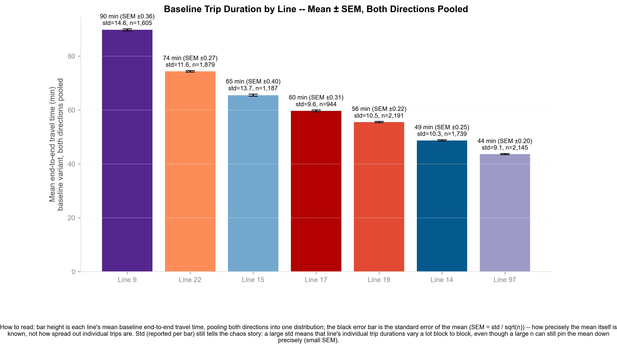
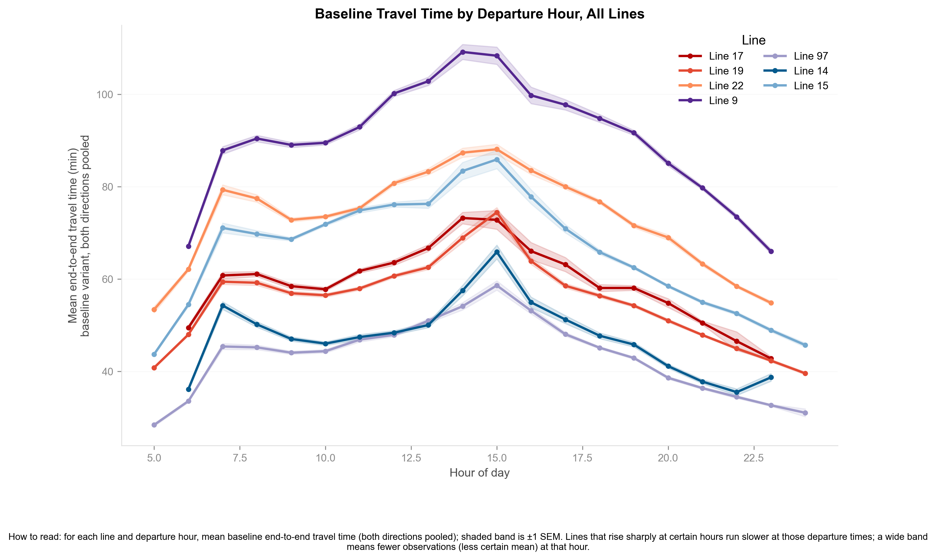
Route length and time of day both shape travel time
Longer routes take longer: Line 9 ~20 km/90 min, Line 97 ~10 km/44 min.
All seven lines share one daily rhythm — rising, peaking at midday, dropping by evening.
FIGURE 3A — BASELINE TRIP DURATION BY LINE
FIGURE 3B — BASELINE TRAVEL TIME BY DEPARTURE HOUR
Notes:
There's a strong, near-mechanical correlation between how long a route physically is and how long the trip takes end-to-end. Line 9 is the longest studied line at roughly 20 km and 90 minutes average baseline travel time. Line 97 is the shortest, roughly 10 km and 44 minutes. This ranking matters later — it's the backdrop against which we measure detour costs and savings per line.
Beyond ranking, every one of the 7 lines follows the same daily shape: travel time is lowest at dawn, climbs through the morning rush, peaks around midday to early afternoon (traffic congestion, not distance), and drops back down toward evening and night. This shared rhythm is the 'normal' baseline we compare blockage windows against.

Slide 8
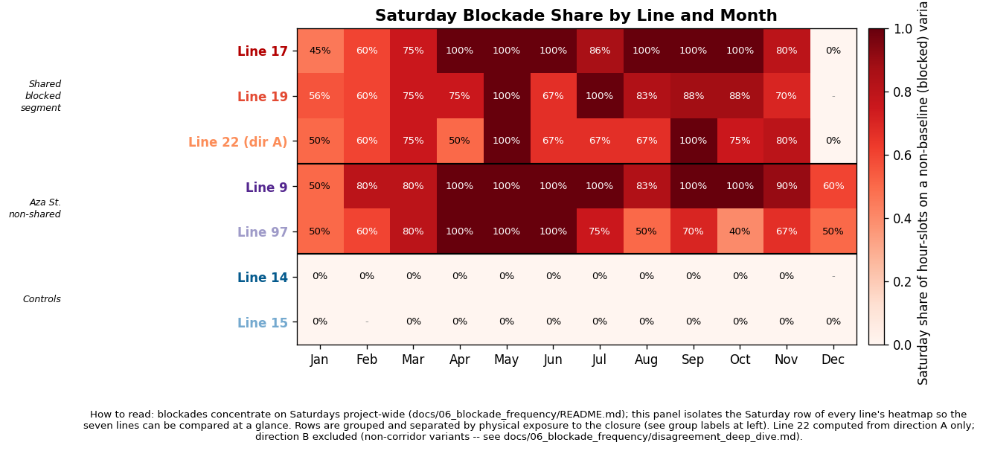
Blockages spike hard on Saturday nights
5%–12% of corridor trips detour on an average weekday.
Saturday nights jump to 66%–84%.
Control lines 14/15 stay near 0%.
TABLE 3 / FIGURE 5 — SATURDAY BLOCKADE SHARE BY LINE AND MONTH
Notes:
Under the project's variant-detection rule, 5-12% of trips on the three shared-corridor lines (17, 19, 22) use the detour on an average weekday. That share jumps sharply on Saturday nights, to 66-84% depending on the line and month. The two control lines, 14 and 15, sit at essentially 0% year-round — they never detour, because they don't share the blocked segment. Figure 5 isolates just the Saturday row of each line's monthly heatmap so all seven can be compared side by side.

Slide 9
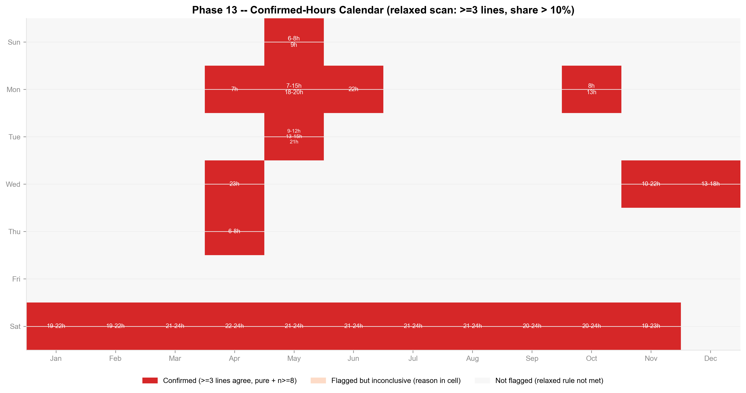
21 confirmed blockage events, mostly Saturdays
11 of 21 events are Saturday nights, 7pm–midnight.
The rest cluster on weekdays.
Weekday events track Knesset session days.
FIGURE 6 — CONFIRMED BLOCKAGE HOURS BY MONTH AND DAY
Notes:
Zooming from monthly shares down to the exact day-of-week/hour level, the full-year calendar scan confirms 21 distinct blockage events. 11 of the 21 are Saturday nights, 7pm to midnight — the dominant, expected pattern. The remaining 10 are weekday events, clustered on specific months and days that line up with Knesset session days, suggesting parliamentary security closures as a secondary driver.

Slide 10
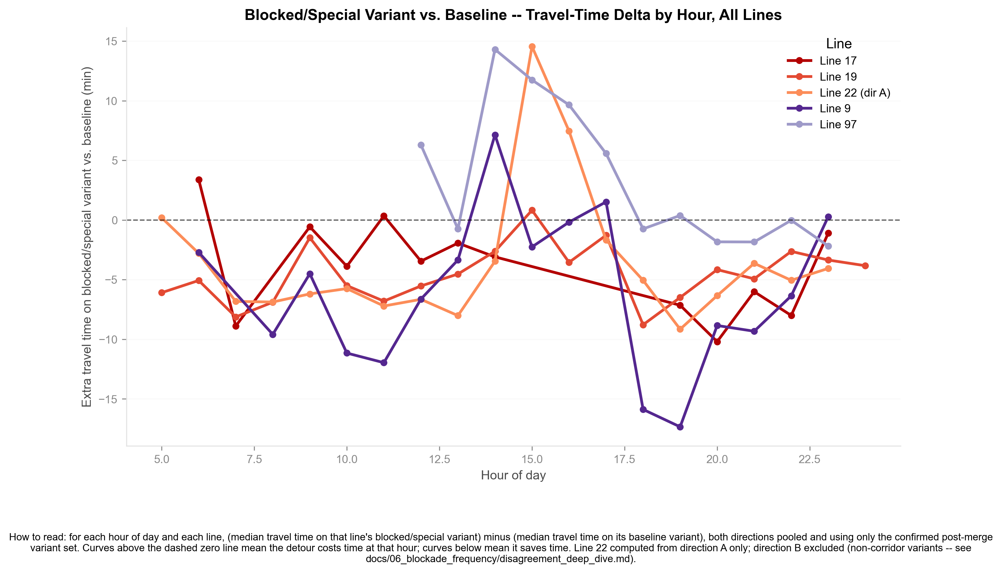
The detour is usually faster, not slower
On average, detours save 8 to 16 minutes.
Statistically significant for all 5 detouring lines.
During rush hour, the advantage disappears.
FIGURE 7 — MEDIAN TRAVEL-TIME DELTA BY HOUR
Notes:
This is the key practical finding: on average, the detour route is faster than the regular route, not slower. Savings run 8 to 16 minutes depending on the line, and permutation tests confirm the effect is statistically significant for all 5 lines that detour. The one caveat is rush hour — during the busiest daytime hours, the time advantage shrinks or disappears, since congestion on the detour road eats into the shorter distance.

Slide 11
Blockages don't leak to other lines
Lines 14/15 don't pass through Aza Street.
Mann-Whitney and permutation tests: no significant difference.
Their travel times are unaffected by the closures.
Line | Stratum | n blockage | n normal | Median blockage (min) | Median normal (min) | Δ (min) | p Mann-Whitney | p t Welch's
15 | Saturday | 33 | 12 | 52.9 | 52 | 0.9 | 0.376 | 0.353
15 | Weekday | 153 | 746 | 64.8 | 66.6 | −1.8 | 0.941 | 0.543
14 | Saturday | 40 | 7 | 37.8 | 36.6 | 1.2 | 0.317 | 0.256
14 | Weekday | 198 | 1,108 | 48 | 47.1 | 0.9 | 0.156 | 0.064
TABLE 4 — CONTROL LINES' TRAVEL TIME, BLOCKADE VS. NORMAL
Notes:
Lines 14 and 15 never pass through Aza Street, so they serve as a control group. Comparing their travel time during confirmed blockade windows against matched normal times, using both Mann-Whitney U and a day/hour-stratified permutation test, shows no statistically significant difference. Effects that looked significant in an earlier pass do not hold up once the more complete blockage-window definition and stratified test are applied — the blockage's impact stays local to the corridor lines.

Slide 12
There's no line to avoid leaving Rehavia
Blockages cluster on Saturday nights.
The detour is faster on average.
Control lines are unaffected.
Notes:
Pull the three sub-questions together into one answer. Blockages are frequent but predictable — they cluster overwhelmingly on Saturday nights, with a secondary weekday pattern tied to Knesset sessions. When they happen, the detour is faster on average, not slower, except right at rush hour. And the effect stays contained to the corridor lines — control lines are statistically unaffected. Bottom line for a Rehavia resident: there's no single line that's riskier to take, just a predictable time window to plan around.

Slide 13
Thank you
Questions?
Notes:
Thank the instructor and students, and open the floor for questions.

