Slide 1
The Impact of Urban Road Closures on Public Transit
Case Study: Jerusalem
Course 71253 — Introduction to Data Science
Avishag Schwartz , Rony Schwartz
Notes:
Welcome the room. This is a data science EDA project on Jerusalem public bus data, focused on one practical question: when protests close Aza Street in Rehavia, which buses are actually affected, and is the detour worth worrying about? Introduce yourself and the course.

Slide 2
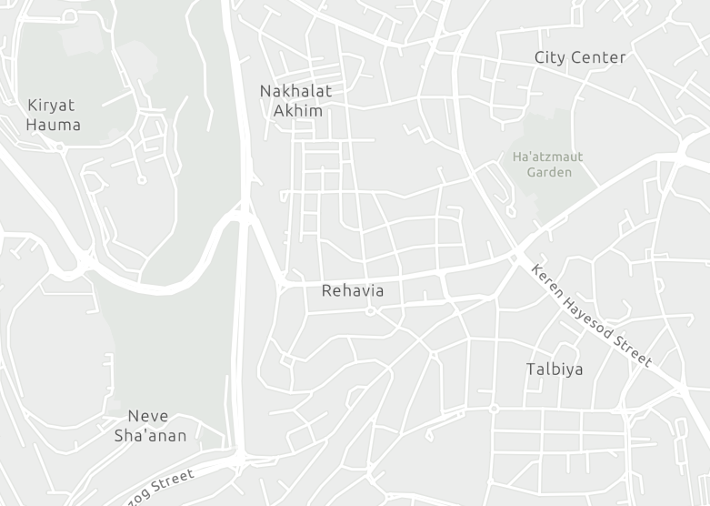
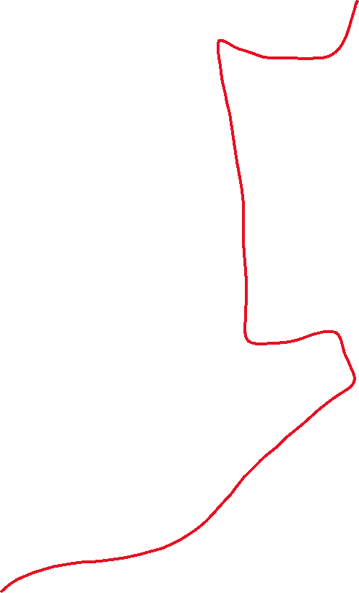
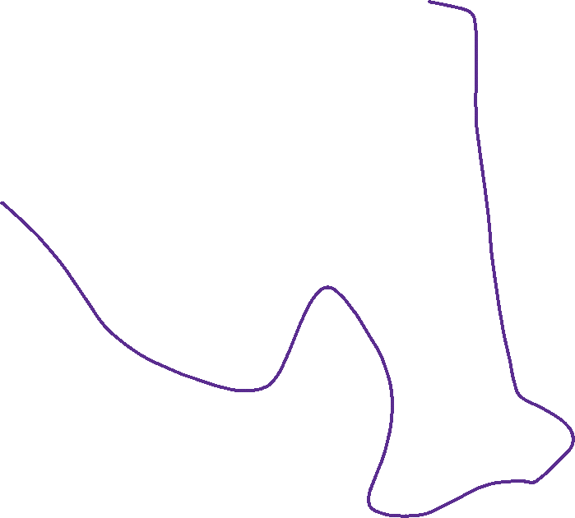

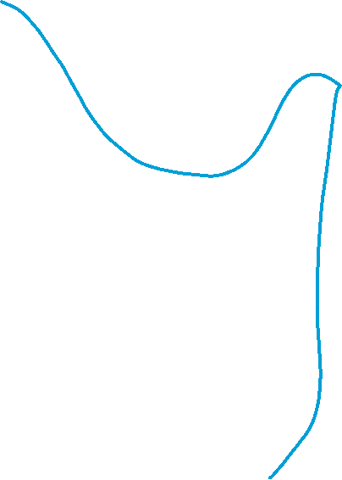
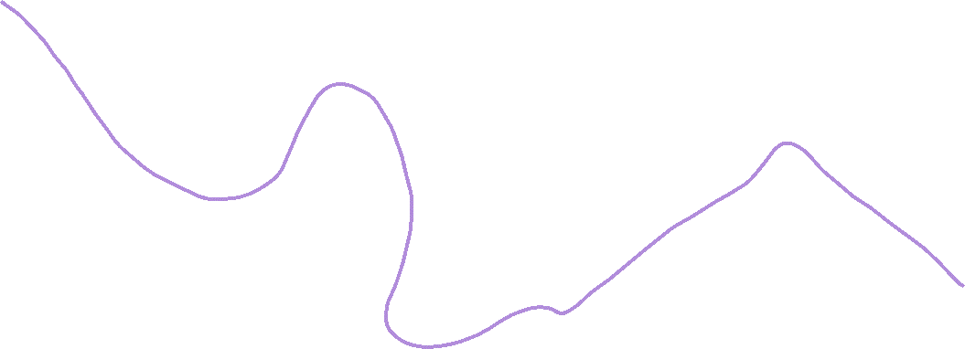
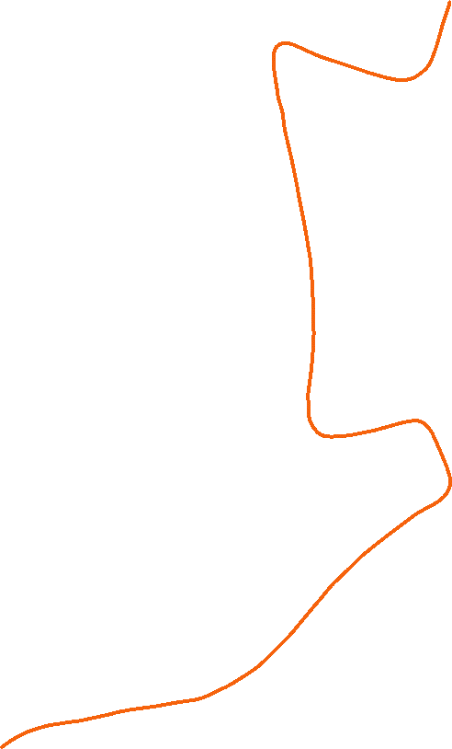

Aza Street closures make Rehavia's buses untrustable
Aza is a narrow, central traffic artery
The Prime Minister lives on Aza Street.
Therefore ,Rehavia is a hub of ongoing protests.
Police repeatedly close the street to traffic.
We study lines that pass through this area, affected by closures
מקטע מלא ברחוב עזה | 17
 | 19
 | 22
מקטע חלקי ברחוב עזה | 9
 | 97
קווי ביקורת | 14
 | 15
FIGURE 1 — MAP OF REHAVIA AND THE STUDIED BUS LINES
Notes:
Rehavia sits at the center of Jerusalem's protest activity, and the Prime Minister's residence is on Aza Street, right through the neighborhood. Police close the street repeatedly for security reasons, which disrupts the bus lines that run through it. This is the real-world motivation behind the whole analysis: a resident needs to know which lines are reliable and when.

Slide 3
stop_sequence | Stop name | n_observations | cumulative_time (min) | cumulative_distance (m)
1 | דולצ'ין/קוליץ | 10 | 1.46 | 0
2 | הכפר השוודי/סולד | 10 | 4.96 | 1,926
3 | מרכז פיליפ ליאון/סולד | 10 | 6.28 | 2,244
Exploratory analysis
Ministry of Transport dataset, 2024. 7 bus lines.
Each row: one line, month, day of the week , hour, stop.
A full trip ("block") is one sequence of rows.
TABLE 1 — EXAMPLE BLOCK, LINE 19 (SUNDAY, 5AM DEPARTURE)
Cleaning cut duplicates, not real data
708,642 → 603,662
records after removing duplicates
6.3%
of rows flagged low-confidence, not deleted
25/26 → 1/2
hours remapped to midnight–2am
Notes:
Explain the source: Israel's Ministry of Transport open dataset, 'Arrival to station, day and hours' — a pipe-delimited export aggregating average ride behavior per (route, month, day-of-week, hour, stop). The project covers 7 commercial lines across 16 underlying route_ids. Walk through the example table: this is one block — one full trip on line 19, departing at 5am on a Sunday in January — shown stop by stop, with cumulative travel time and distance growing down the rows.

Slide 4
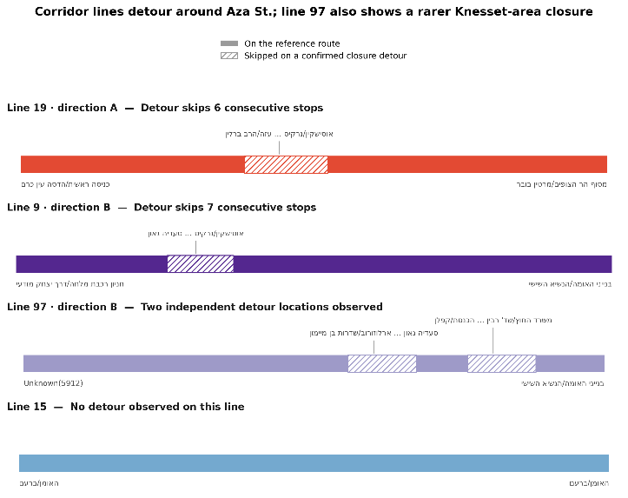
A minority of trips skip stops on Aza St.
Each line has a reference route — its most common path.
A minority of trips skip a segment of stops.
These are the line's route "variants."
stop_sequence | stop_name | n_observations | cumulative_time (min) | cumulative_distance (m)
16 | Herzog/Tchernichovsky | 7 | 21.11 | 8,249
23 | Ussishkin/Bezalel | 7 | 25.94 | 8,453
TableE 2 — SKIPPED STOPS ON THE AZA ST. DETOUR- example data
FIGURE 2 — SKIPPED STOPS ON THE AZA ST. DETOUR
Line 22B always completes the full route — excluded from this analysis.
Notes:
Every line has a reference route: its single most common stop sequence. A minority of trips skip a contiguous segment of stops instead — these are the line's route variants. Figure 2 shows exactly which stops each corridor line skips on its detour, and confirms all three shared-corridor lines (17, 19, 22) skip the same physical Aza Street segment, while control line 15 never detours at all.

Slide 5
How can a resident know the most reliable way out?
1
When and how often do blockages occur on Aza Street?
2
Does the detour make the trip longer or shorter?
3
Do blockages also affect lines that skip Aza Street?
Notes:
Frame the project's central research question and the three sub-questions that structure the rest of the deck. Sub-question 1 is answered by phases 06 and 13 (frequency and timing of blockages). Sub-question 2 is answered by phases 05, 09, and 12 (does the detour cost or save time, with statistical backing). Sub-question 3 is answered by phase 08, using control lines 14 and 15 that never pass through Aza Street.

Slide 6
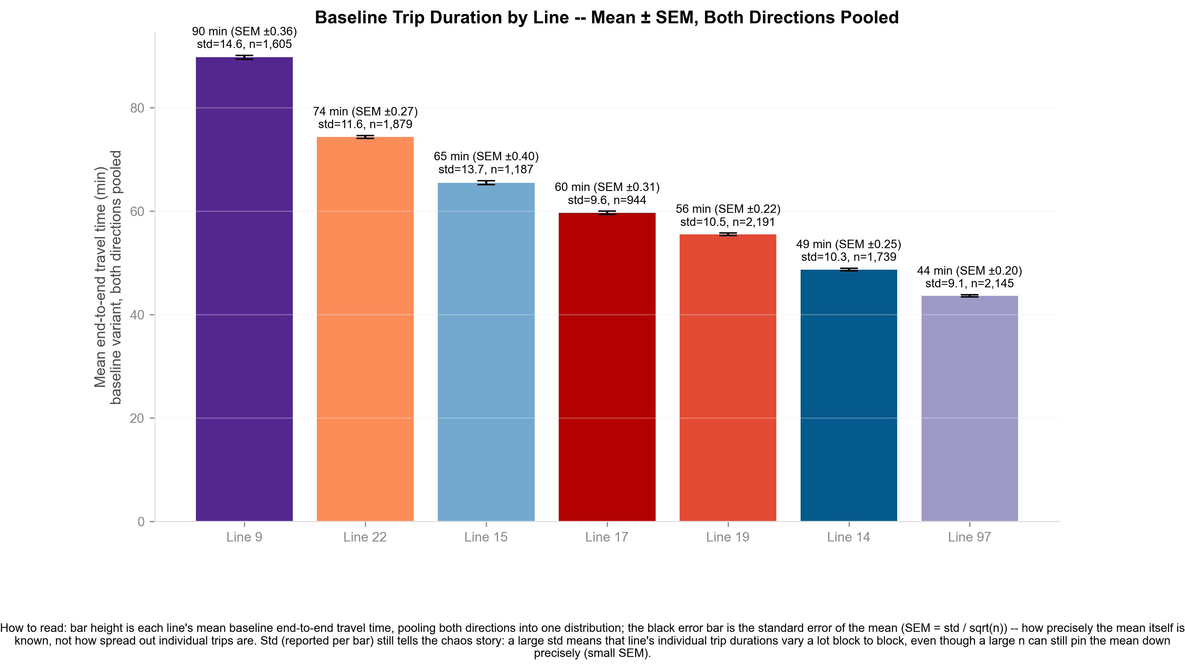
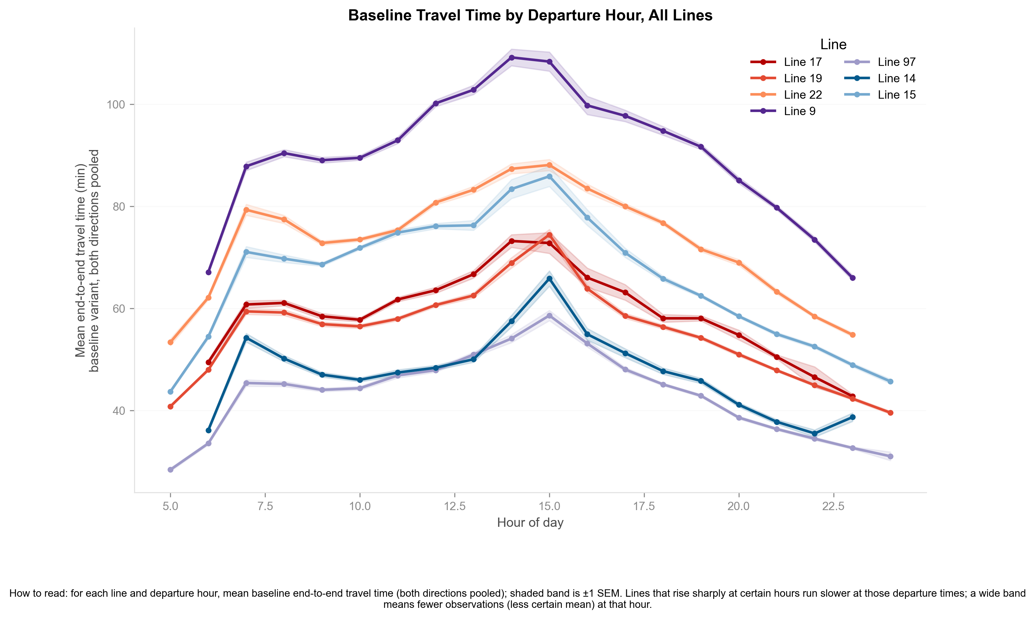
travel time of reference routes
Longer routes take longer: Line 9 ~20 km/90 min, Line 97 ~10 km/44 min.
All seven lines share one daily rhythm — rising, peaking at midday, dropping by evening.
FIGURE 3A — BASELINE TRIP DURATION BY LINE
FIGURE 3B — BASELINE TRAVEL TIME BY DEPARTURE HOUR
Notes:
There's a strong, near-mechanical correlation between how long a route physically is and how long the trip takes end-to-end. Line 9 is the longest studied line at roughly 20 km and 90 minutes average baseline travel time. Line 97 is the shortest, roughly 10 km and 44 minutes. This ranking matters later — it's the backdrop against which we measure detour costs and savings per line.
Beyond ranking, every one of the 7 lines follows the same daily shape: travel time is lowest at dawn, climbs through the morning rush, peaks around midday to early afternoon (traffic congestion, not distance), and drops back down toward evening and night. This shared rhythm is the 'normal' baseline we compare blockage windows against.

Slide 7
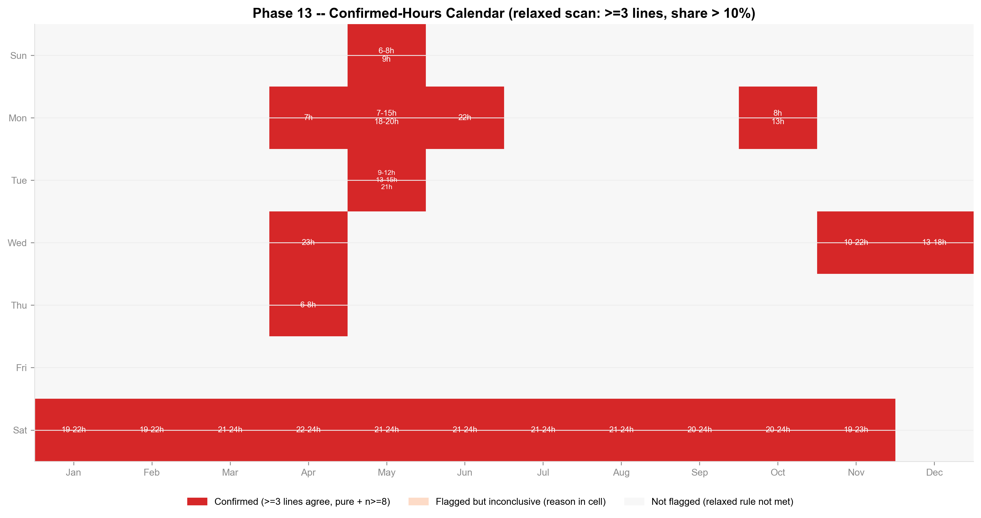
When does Blockages occur
5%–12% of corridor trips detour on an average weekday.- at least 3 lines run on blockadge variants , same time
Saturday nights jump to 66%–84%.
Control lines 14/15 stay near 0%.
21 confirmed blockage events, mostly Saturdays
11 of 21 events are Saturday nights, 7pm–midnight.
The rest cluster on weekdays.
On confirmed events, the data indicates that the duration of the blockages differ between lines
FIGURE 6 — CONFIRMED BLOCKAGE HOURS BY MONTH AND DAY
Notes:
Zooming from monthly shares down to the exact day-of-week/hour level, the full-year calendar scan confirms 21 distinct blockage events. 11 of the 21 are Saturday nights, 7pm to midnight — the dominant, expected pattern. The remaining 10 are weekday events, clustered on specific months and days that line up with Knesset session days, suggesting parliamentary security closures as a secondary driver.

Slide 8
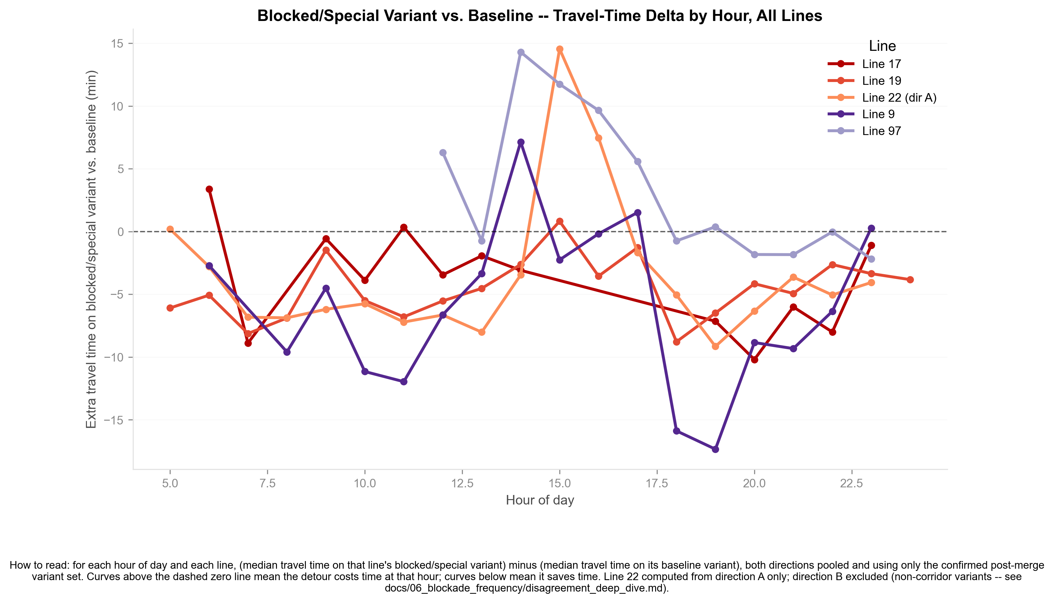
Treval time of The detour varient
On average, detours save 8 to 16 minutes.
Statistically significant for all 5 detouring lines.
During rush hour, the advantage disappears.
FIGURE 7 — MEDIAN TRAVEL-TIME DELTA BY HOUR
Notes:
This is the key practical finding: on average, the detour route is faster than the regular route, not slower. Savings run 8 to 16 minutes depending on the line, and permutation tests confirm the effect is statistically significant for all 5 lines that detour. The one caveat is rush hour — during the busiest daytime hours, the time advantage shrinks or disappears, since congestion on the detour road eats into the shorter distance.

Slide 9
Effect of Blockages on the control lines 14/15
Bolcadge – only 1 line is using the blocked variant
Mann-Whitney and permutation tests: no significant difference.
Their travel times are unaffected by the closures.
Line | Stratum | n blockage | n normal | Median blockage (min) | Median normal (min) | Δ (min) | p Mann-Whitney | p t Welch's
15 | Saturday | 33 | 12 | 52.9 | 52 | 0.9 | 0.376 | 0.353
15 | Weekday | 153 | 746 | 64.8 | 66.6 | −1.8 | 0.941 | 0.543
14 | Saturday | 40 | 7 | 37.8 | 36.6 | 1.2 | 0.317 | 0.256
14 | Weekday | 198 | 1,108 | 48 | 47.1 | 0.9 | 0.156 | 0.064
TABLE 4 — CONTROL LINES' TRAVEL TIME, BLOCKADE VS. NORMAL
Notes:
Lines 14 and 15 never pass through Aza Street, so they serve as a control group. Comparing their travel time during confirmed blockade windows against matched normal times, using both Mann-Whitney U and a day/hour-stratified permutation test, shows no statistically significant difference. Effects that looked significant in an earlier pass do not hold up once the more complete blockage-window definition and stratified test are applied — the blockage's impact stays local to the corridor lines.

Slide 10
Summery
לא מצאנו הבדלים לרעה על התחבורה הציבורית בירושלים בזמן חסימות
אפשר לומר שחסימת רחוב ראשי לא בהכרח גורמת לעומס מיוחד על הכבישין נסביב
הנתונים מעידים על כאוס , אין סדר , אין לדעת מה המסלול בו השתמשו האוטובסים.
כאשר יש חסימה אמנם האוטובוס מהיר יות ראבל האזרח צריך ללכת יותצר , וכדי להשלים מידע על זה צריך להשיג מידע על משתמשי אוטובוס שהוא אינו זמין . או לא מצאנו אותו
ותכלס זה בעיקר מה שחסר לנו כדי להשלים את התמונה

