Slide 1
Introduction to Genome Wide Association Studies
Saharon Rosset
Tel Aviv University

Slide 2
Genome wide association studies
Goal: find connections between:
  A phenotype: height, type-I diabetes, etc., known to be heritable
  Whole-genome genotype
Specific goals are distinct:
  Identify statistical connections between points (or areas) in the genome and the phenotype
    Drive hypotheses for biological studies of specific genes/regions in specific context
  Generate insights on genetic architecture of phenotype
    Many small genetic effects dispersed across the genome?
    Few large effects concentrated in one area (MHC?)
  Build statistical models to predict phenotype from genotype
    “Show me your genome and I will tell you what diseases you will get”

Slide 3
Methodology
Collect n subjects with known phenotype (usually n in range 10³-10⁴)
Measure each one in m genomic locations (“representing common variation in the whole genome”)
  Usually SNPs: Single Nucleotide Polymorphisms
  Typically m in range 10⁵-10⁶
  Recently moving to whole genome sequencing (m = 3*10⁹ but realistically same information)
Now we can think of our data as X_{n*m} matrix with subjects as rows, SNPs as columns,
  X_{ij} is in {0,1,2} (genotype at single locus)
  Also given extra vector Y_{n} of phenotypes
Our first task: association testing
  Find SNPs (columns in X) that are statistically associated with Y
  Can be thought of as m separate statistical tests run on this matrix

Slide 4
AGAGCAGTCGACAGGTATAGCCTACATGAGATCGACATGAGATCGGTAGAGCCGTGAGATCGACATGATAGCC
AGAGCCGTCGACATGTATAGTCTACATGAGATCGACATGAGATCGGTAGAGCAGTGAGATCGACATGATAGTC
AGAGCAGTCGACAGGTATAGTCTACATGAGATCGACATGAGATCGGTAGAGCCGTGAGATCGACATGATAGCC
AGAGCAGTCGACAGGTATAGCCTACATGAGATCAACATGAGATCGGTAGAGCAGTGAGATCGACATGATAGCC
AGAGCCGTCGACATGTATAGCCTACATGAGATCGACATGAGATCGGTAGAGCCGTGAGATCAACATGATAGCC
AGAGCCGTCGACATGTATAGCCTACATGAGATCGACATGAGATCGGTAGAGCAGTGAGATCAACATGATAGCC
AGAGCCGTCGACAGGTATAGCCTACATGAGATCGACATGAGATCGGTAGAGCAGTGAGATCAACATGATAGTC
AGAGCAGTCGACAGGTATAGCCTACATGAGATCGACATGAGATCTGTAGAGCCGTGAGATCGACATGATAGCC
Genoma Enfermos:
> 0.1% SNP asociado
AGAGCAGTCGACATGTATAGTCTACATGAGATCGACATGAGATCGGTAGAGCAGTGAGATCAACATGATAGCC
AGAGCAGTCGACATGTATAGTCTACATGAGATCAACATGAGATCTGTAGAGCCGTGAGATCGACATGATAGCC
AGAGCAGTCGACATGTATAGCCTACATGAGATCGACATGAGATCTGTAGAGCCGTGAGATCAACATGATAGCC
AGAGCCGTCGACAGGTATAGCCTACATGAGATCGACATGAGATCTGTAGAGCCGTGAGATCGACATGATAGTC
AGAGCCGTCGACAGGTATAGTCTACATGAGATCGACATGAGATCTGTAGAGCCGTGAGATCAACATGATAGCC
AGAGCAGTCGACAGGTATAGTCTACATGAGATCGACATGAGATCTGTAGAGCAGTGAGATCGACATGATAGCC
AGAGCCGTCGACAGGTATAGCCTACATGAGATCGACATGAGATCTGTAGAGCCGTGAGATCGACATGATAGCC
AGAGCCGTCGACAGGTATAGTCTACATGAGATCAACATGAGATCTGTAGAGCAGTGAGATCGACATGATAGTC
Genoma Sanos:

Slide 5
Disease association analysis of a single SNP
 | Genotype 0 | Genotype 1 | Genotype 2 | Total
Y=0 (healthy) | N₀₀ | N₀₁ | N₀₂ | N₀
Y=1 (sick) | N₁₀ | N₁₁ | N₁₂ | N₁
Total | M₀ | M₁ | M₂ | n
Now our problem is one of testing:
H₀: No connection between disease and SNP ⬄ the rows and columns of the table are independent
Obvious approach: χ² test for 3x2 table (2-df)
Other alternatives: logistic regression, trend test,… (dealing with genotype as numeric)
This approach generates m (≈10⁶) total hypotheses tests and p values

Slide 6
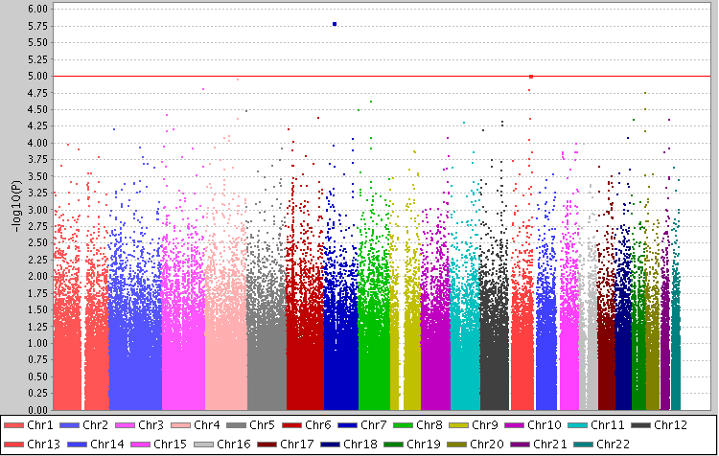
“Manhattan plot” of GWAS results
What happens if we use a p-value threshold of α=0.05 (black line) to declare results as significant?
We would get about 10⁶x0.05 = 50K false discoveries
Solution: be very selective in what results we declare as significant. In this plot the threshold is the orange line at α=10⁻⁵
⇒ Declaring only one association in Chr7

Slide 7
The multiplicity problem in GWAS
What is a statistically sound choice of a threshold for declaring an association?
Family wise error rate (FWER): the probability of making even one false discovery out of our m tests
Controlling FWER: the well known Bonferroni correction, perform each test at level α = 0.05/m
  For m = 10⁶ this gives α = 5 x 10⁻⁸
Leading journals (Nature Genetics) require a p value smaller than 5 x 10⁻⁸ to publish GWAS results
  Implicitly require Bonferroni for 10⁶ – super conservative!
  Lesson learned in blood, from findings that did not replicate and were eventually deemed false!

Slide 8
GWAS promise and history
We know of many highly heritable traits and diseases including
  Height
  Heart Disease
  Many cancers
The GWAS promise: we will identify the genetic basis for this heritability
First GWAS in 2005, since then:
Thousands of studies, hundreds of thousands of individuals, hundreds of billions of SNPs genotyped, many billions of $$$ invested
Was the promise fulfilled?

Slide 9

Was the promise fulfilled? Yes and no!

Slide 10
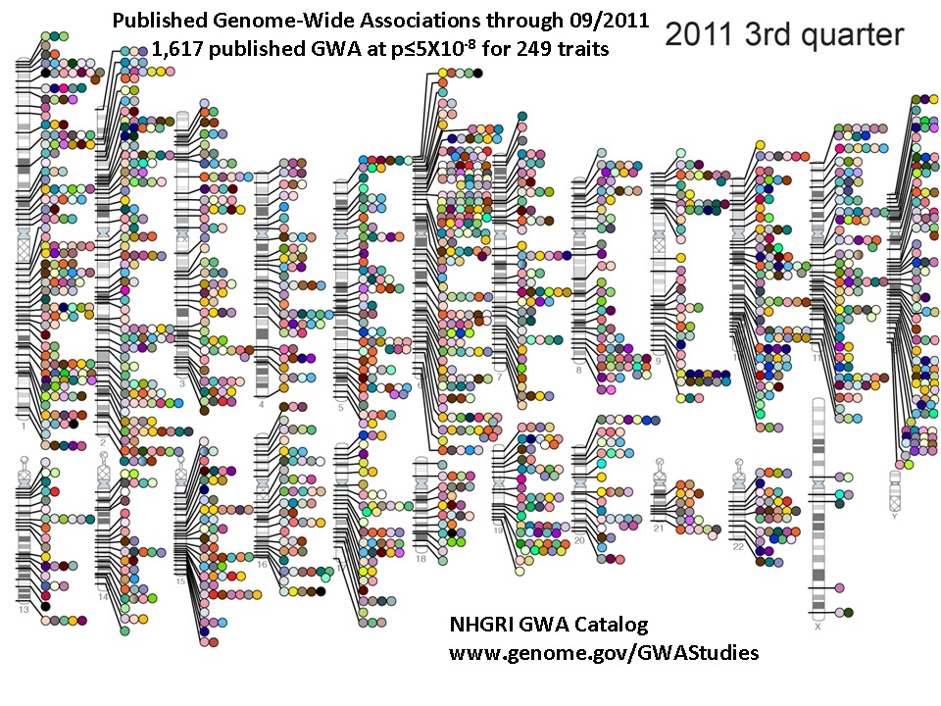
Yes: we found a lot of associations, learned some biology
Lessons learned:
A few of strongest associations are in coding regions
Most associations are in regulatory elements
Some are in gene deserts

Slide 11
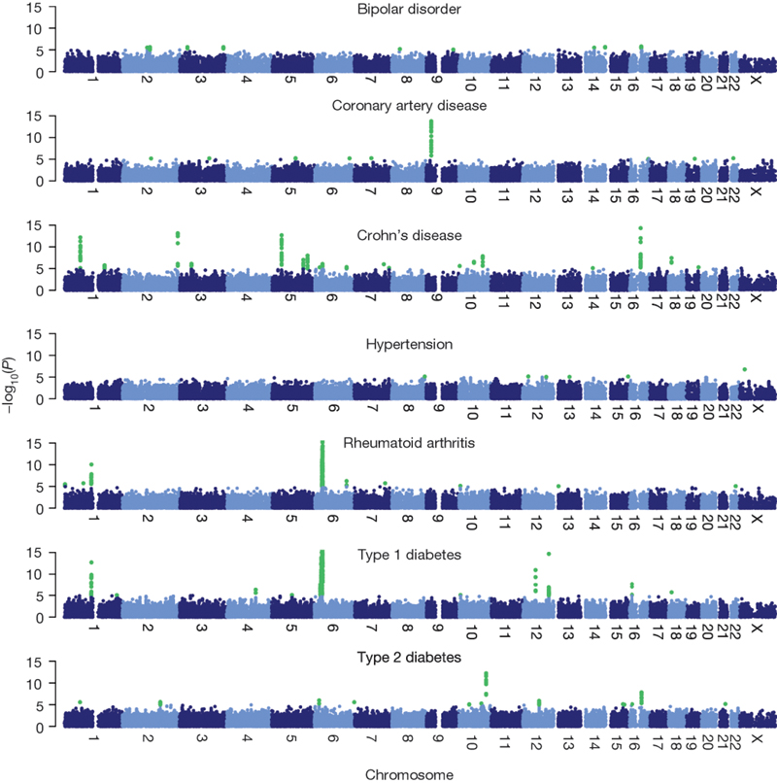
Results of famous WTCCC study of seven diseases on 14,000 cases and 3,000 shared controls
(Nature, 2007)
Total found: 13 significant findings at level 5*10⁻⁸

Slide 12

Not al all: where is all the heritability?

Slide 13
Our GWAS findings do not explain heritability
Height:
  From twins and family study, about 80% of height variability is heritable
  Huge height GWAS (n>40K ) found SNPs explaining ~10% of height variability
Diseases: Schizophrenia, heart disease, cancers,…
  Heritability: 30%-80%
  For none of these, GWAS gives more than 5%-10%
Basically, for all complex traits investigated a major gap remains!

Slide 14
Results of famous WTCCC study of seven diseases on 14,000 cases and 3000 shared controls
(Nature, 2007)
Total found: 13 significant findings at level 5*10⁻⁸
Heritability explained: small for all except T1D

Slide 15
Where is the missing heritability? Theories:
Rare variants not covered by GWAS : Every family has its own mutation
  We know some examples in cancer (BRCA)
Complex associations/epistasis: combinations of SNPs
  Problem: 10⁶ SNPs is 10¹² pairs
Lack of power: the effects are weak, we need much more data
  Or statistical approaches that aggregate more smartly
Epigenetic effects: heritability is not in the genome at all
To some extent, all these theories have been tested, some have provided interesting answers (still hotly debated)

Slide 16
The importance of genetic structure
Genetic structure: not everyone in the population is from same genetic background
  Some people are more genetically similar than others
  Israel: Ashkenazi Jews, Mizachi Jews, Arabs,…
  US: Caucasian, Black, Hispanic
Particularly interesting: admixed populations
  African/Hispanic Americans: mixture of African, European and Native American ancestry
  Proportions may vary significantly between “African American” individuals
Many SNPs in the genome have different distribution between Africans and Europeans
  Most not due to selection/adaptation but due to random drift

Slide 17
Genetic structure and GWAS
Many traits have strong population association
  In the US, diabetes much more common among blacks
  In Israel, Crohn’s disease is much more common among Ashkenazi Jews
Now, say that we sampled diabetes cases in some hospitals in US + controls in the same hospitals, performed GWAS
  % of blacks in cases will be higher than in controls (because of high prevalence)
  What will our GWAS show?
Every SNP which differs in distribution between Europeans and Africans will be statistically associated with the disease
  Only because of structure/stratification in our sample!

Slide 18
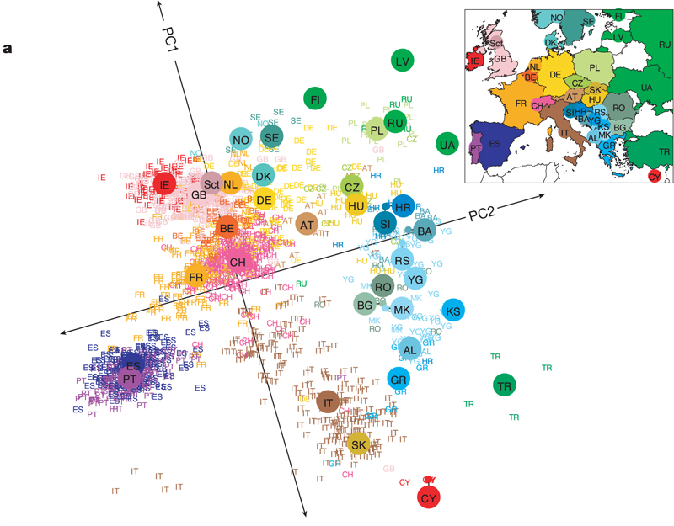

Even homogeneous population has some structure:
Genes mirror geography within Europe
J Novembre et al. Nature 000, 1-4 (2008) doi:10.1038/nature07331

Slide 19
GWAS: controlling for structure, using structure
We are seeking associations that are not “due to structure”
  How can we eliminate ones that are due to it?
If we know who is white and who is black, we can do an analysis that controls for the “race” variable
  For example, logistic regression with both the race and the SNP as predictors
What happens if we don’t know?
  We just saw that structure can be automatically extracted even from “homogeneous” data
  We can extract it, then control for it
  This is what modern GWAS analyses do

Slide 20
Using structure in a cool way: Admixture mapping
Assume we have:
  A disease that is more common in Africans than Europeans, say: early onset kidney disease (<40)
  A population that is an admixture of European and African, like African Americans
Suggestion: find the genetic cause by examining genomes of sick admixed individuals
  The area of the genome where the genetic cause resides will be more “African” in the cases than the rest of their genome
  We don’t necessarily need controls for this analysis

Slide 21
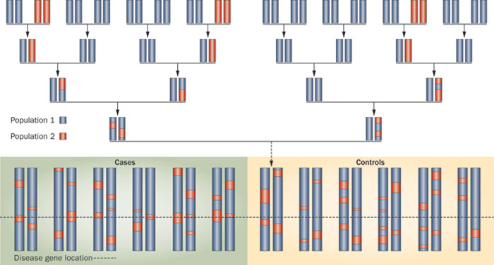

Figure 2 Discovering associations with a disease through admixture mapping
Permission obtained from Nature Publishing Group.
Darvasi, A. & Shifman, S. Nat. Genet. 37, 118–119 (2005)
Rosset, S. et al. (2011)
The population genetics of chronic kidney disease: insights from the MYH9–APOL1 locus
Nat. Rev. Nephrol. doi:10.1038/nrneph.2011.52

Slide 22
Genetic risk prediction from GWAS
The vision, the doctor will have a “desktop predictor”
  Input: patient’s genome
  Output: risk for one (or many) diseases
Building prediction models is a very different use of GWAS information
  Non-genetic risk factors that are correlated with the genome (like diet) are also legitimate for prediction
  Don’t need to name the SNPs that are responsible for risk ( ⇒ can use structure)
  Don’t necessarily need a biologist in the loop
We have accumulating evidence that we may be able to do much better prediction than our identified significant associations only can offer
  Advanced methods can take advantage of weaker associations, signal from rare variants, environmental effects, etc.

Slide 23
Summary
GWAS is a modern “Big Data” challenge
Proper analysis is a major statistical/methodological challenge, e.g.:
  Controlling and using structure
  Finding complex associations
We have learned a lot – but not as much as we hoped
We are still improving on both major fronts:
  Size and extent of data available
  Advanced statistical methods

Slide 24
Thank you!
saharon@post.tau.ac.il

