Slide 1
Beyond GWAS
Erik Fransen

Slide 2
Missing heritability
Rare variants
Common variants of smaller effect
Structural variants
Gene-gene interactions
Inflated heritability

Slide 3
Missing heritability
Rare variants
Common variants of smaller effect
Structural variants
Gene-gene interactions
Inflated heritability

Slide 4
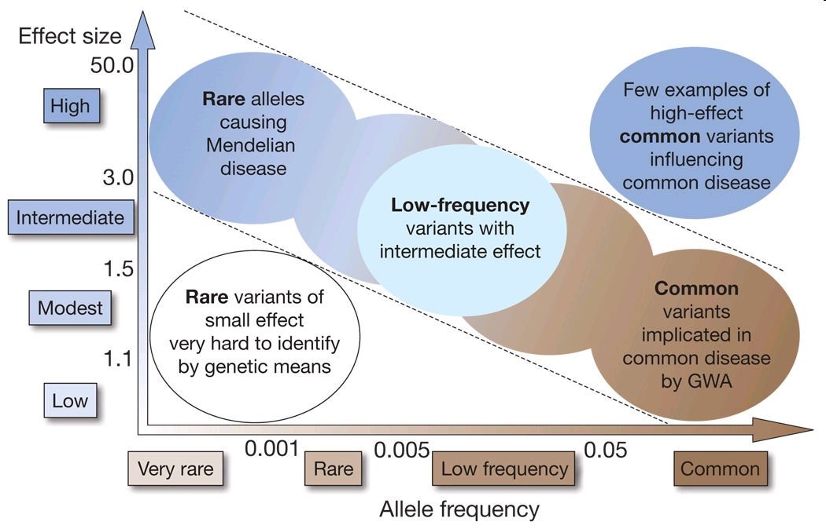

Slide 5
Common and rare variants
Traditional GWAS identify common variants
MAF > 0.05
Low-frequency (LF) variants :
poorly covered on chip
Low LD with SNPs on chip
Next-generation sequencing (NGS) techniques to identify LF variants in large cohorts

Slide 6
Testing LF variants
Do LF variants contribute to complex traits?
LF variants with large effect?
Multiple rare variants in 1 gene?
Missing heritability?
Testing association
Classic testing
Gene-based testing

Slide 7
Classic association test
Test association between single variant and disease
Chisquare test
 | AA | Aa | aa | Total
Case |  |  |  | 1000
Control |  |  |  | 1000

Slide 8
Classic association test
Test association between single variant and disease
Chisquare test : common variant
 | AA | Aa | aa | Total
Case | 560 | 380 | 60 | 1000
Control | 640 | 320 | 40 | 1000

Slide 9
Classic association test
Test association between single variant and disease
Chisquare test : rare variant
Test not valid, or low power, unless high N
GWAS : MAF<0.05 = problem
 | AA | Aa | aa | Total
Case | 987 | 12 | 1 | 1000
Control | 991 | 9 | 0 | 1000

Slide 10
Collapsing rare variants
Collapsed genotype :
Gene-by-gene recoding genotype
Any rare variant present or not (yes/no)
Associate collapsed GT with phenotype
 | No rare variant | At least 1 rare variant | Total
Case | 850 | 150 | 1000
Control | 889 | 111 | 1000

Slide 11
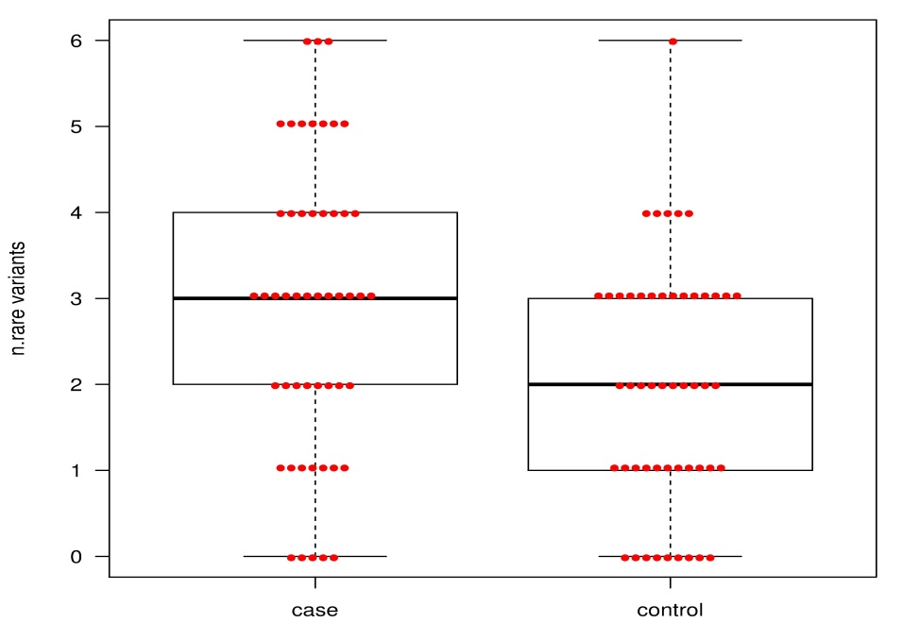
Burden test
Test the burden of rare variants:
Count #rare variants within each gene
Associate #variants with phenotype

Slide 12
Problem with burden tests
Collapsing & burden test assume all rare alleles act in one direction
Assume deleterious effect
Ignore neutral/beneficial alleles
Controls may be enriched in beneficial variants

Slide 13
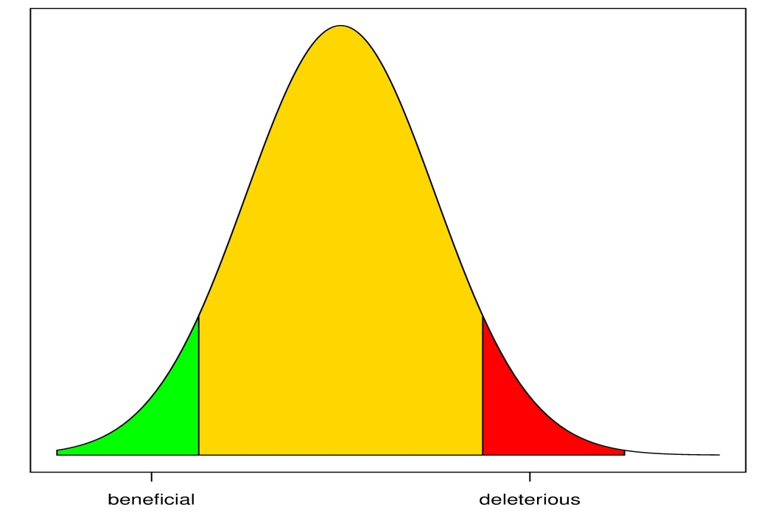
Non-burden test
Effects of rare alleles represent a distribution
Beneficial and deleterious alleles

Slide 14

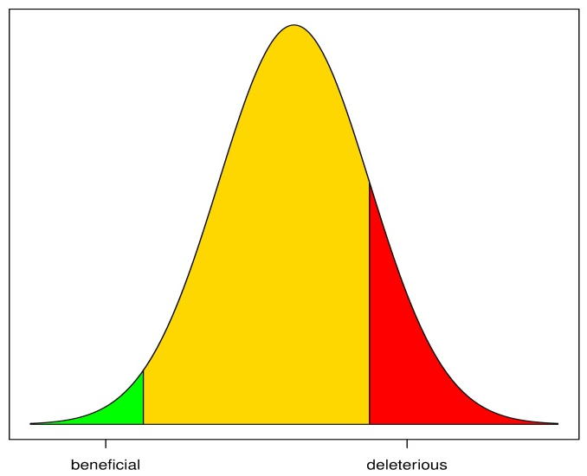
Non-burden test
Sequence Kernel Association Test (SKAT)
Estimate allelic effect sizes for all SNPs
Compare distribution of effects between cases and controls
Collective effect of all SNPs per gene

Slide 15
Recent results on rare variants
Require combination of :
GWAS data
Whole exome/targeted resequencing/whole genome sequencing
Often
Exome sequencing form GWAS cohorts
Targeted resequencing of previous GWAS hits
N : 5,000 – 10,000

Slide 16
Study1 : Amino acid levels
9 phenotypes = levels of 9 AA
Risk factors for (ao.) T2D, Alzheimers)
Exome sequencing on 8,800 ID + GWAS data
Single-marker test:
17 associations G-W significant at 12 loci
3 novel loci

Slide 17
Study1 : Amino acid levels
9 phenotypes = levels of 9 AA
Risk factors for (ao.) T2D, Alzheimers)
Exome sequencing on 8,800 ID + GWAS data
Single-marker test
Gene-based (SKAT) test
1 additional gene
p=9E-8 on aggregated effect of all variants
most sig. single SNP:10E-5

Slide 18
Study1 : Amino acid levels
9 phenotypes = levels of 9 AA
Risk factors for (ao.) T2D, Alzheimers)
Exome sequencing on 8,800 ID + GWAS data
Single-marker test
Gene-based (SKAT) test
Missing heritability?
Common variants (GWAS) : 6%
Plus rare variants (exome) : 15-20%

Slide 19
Study 2 : Type2 diabetes
Meta-analysis of 23k cases and 40k controls
Combine:
(old) GWAS data
Whole exome resequencing (50x depth)
Whole genome resequencing (4x depth)

Slide 20
Study 2 : Type2 diabetes
Meta-analysis of 23k cases and 40k controls
Combine:
Results:
175K LF variants identified
No LF variants were genome-wide significant
Only one highly sig. LF variants in previously unidentified gene
SKAT (of LF variants): no genome-wide sig. genes
→ no LF variants with high effect in T2D

Slide 21
Study 2 : Type2 diabetes
Meta-analysis of 23k cases and 40k controls
Combine:
Results:
no LF variants with high effect in T2D
LF variants in previously known loci
LF variants underly old GWAS signal
Old GWAS hit often due to >1 LF variant
→ better pinpointing causal variant

Slide 22
Conclusion LF variants
Most, but not all, LF analyses point to loci/genes previously identified by GWAS
LF variants with large effect size : not found (yet?)
LF variants may explain part of missing heritability, but not all

Slide 23
Missing heritability
Rare variants
Common variants of smaller effect
Structural variants
Gene-gene interactions
Inflated heritability

Slide 24
Heritability in common variants
GWAS results on human adult height
N = 34,000 → 20 loci associated
N = 180,000 → 180 loci associated
All associated SNPs account for 10% of phenotypic variation

Slide 25
Heritability in common variants
GWAS results on human adult height
N = 34,000 → 20 loci associated
N = 180,000 → 180 loci associated
All associated SNPs account for 10% of phenotypic variation
SNPs with p<5.0E-8

Slide 26
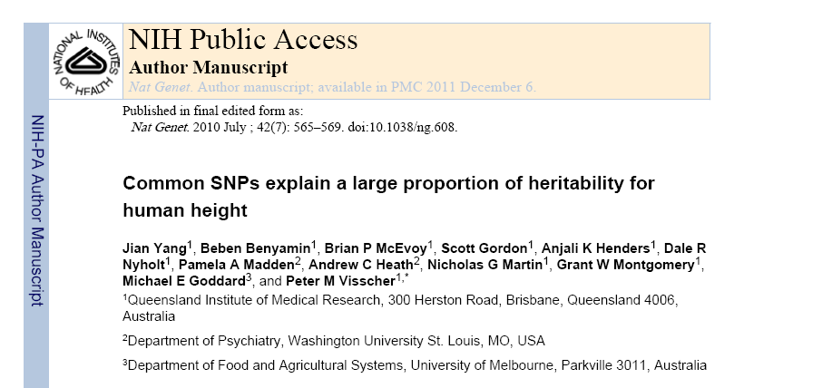
Common SNPs for height

Slide 27
Common SNPs for height
Missing heritability in common SNPs ?
SNPs not reaching genome-wide significance
Causal variants not in complete LD with typed SNPs

Slide 28
Common SNPs for height
Missing heritability in common SNPs ?
SNPs not reaching genome-wide significance
Causal variants not in complete LD with typed SNPs
Effect of all SNPs together:
No individual SNPs pinpointed
Aggregated effect of all SNPs
45% < H²

Slide 29
Common SNPs for height
Missing heritability in common SNPs ?
SNPs not reaching genome-wide significance
Causal variants not in complete LD with typed SNPs
Correct for incomplete LD :
Correction depends on MAF of causal SNPs
MAF ~ typed SNPs : 54%
MAF lower : 80%

Slide 30
Conclusion
Typed SNPs can explain over 50% of H²
Remainder : incomplete LD and (compatible with) lower MAF
Larger GWAS can identify more SNPs
P lowers as N increases
Deep resequencing will identify more causal variants

Slide 31
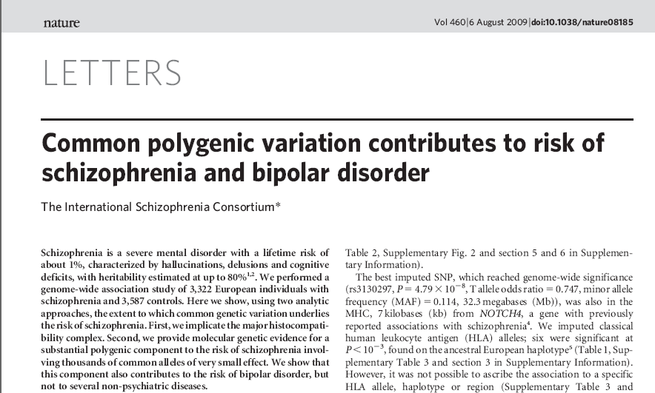
Psychiatric disorders

Slide 32
Psychiatric disorders
(Almost) no major genes identified
How much variance is explained by non-significant SNPs ?
GWAS in schizophrenia
Select SNPs using varying cutoff
p<0.1 ; p<0.2 ; p<0.3 ; p<0.4 ; p<0.5
Build regression model using included SNPs
Use regression model to predict disease status in independent populations

Slide 33
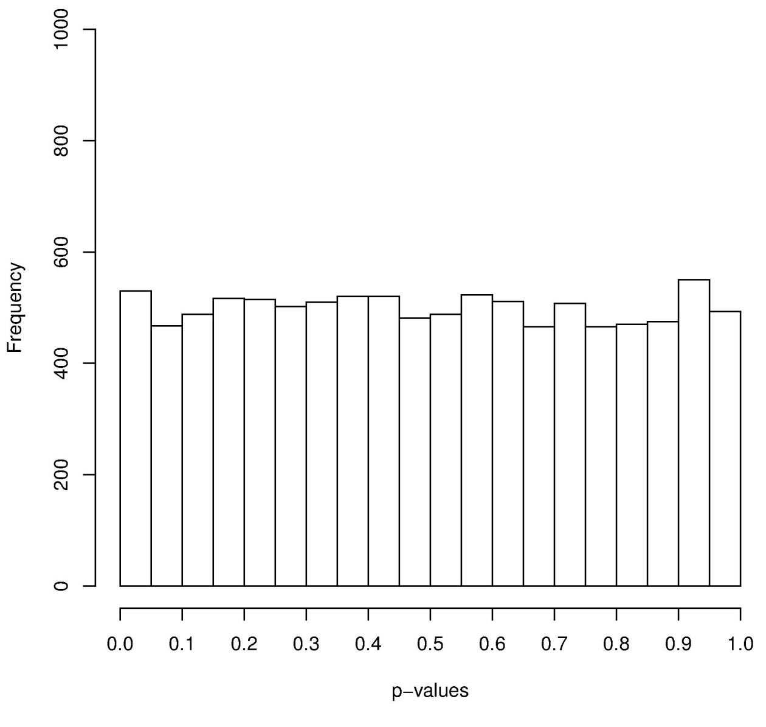
P-value distribution

Slide 34
P-value distribution

Slide 35
P-value distribution

Slide 36
P-value distribution

Slide 37
P-value distribution

Slide 38
P-value distribution

Slide 39
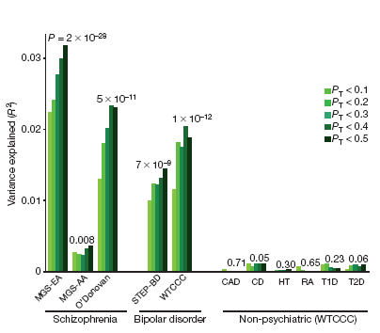
Prediction of phenotype

Slide 40
Conclusion
Low-significant SNPs enriched for causal alleles
SNPs (for schizophrenia) with low significance can predict disease status (for schizophrenia) in independent population
Schizophrenia SNPs also predicting bipolar disorder

Slide 41
Future prospect
Prediction model built using SNPs from GWAS
Higher sample size :
SNPs with p<< more enriched of truly causative SNPs
Prediction model becomes more accurate
Polygenic risk score may become diagnostic tool to predict phenotype (even in absence of individually pinpointed SNPs)

