Slide 1



Genome-wide Association
David Evans
University of Queensland

Slide 2

Queensland
View from Evans’ Laboratory*
*Presenter makes no guarantees wrt veracity of
statements made in the course of this presentation

Slide 3
This Session
Tests of association in unrelated individuals
Population Stratification
Assessing significance in genome-wide association
Replication
Population Stratification Practical

Slide 4
Tests of Association in Unrelated Individuals

Slide 5
Simple Additive Regression Model of
Association (Unrelated individuals)
Y_{i} = α + βX_{i} + e_{i}
where
Y_{i} = trait value for individual i
X_{i} = number of ‘A’ alleles an individual has
1.2
1
0.8
Y
0.6
0.4
0.2
0
X
0
1
2
Association test is whether β > 0

Slide 6
Linear Regression Including Dominance
Y_{i} = α + β_{x}X_{i} + β_{z}Zi + e_{i}
where
Y_{i} = trait value for individual i
X_{i} = 1 if individual i has genotype ‘AA’ Z_{i}= 0 for ‘AA’
0 if individual i has genotype ‘Aa’ 1 for ‘Aa’
-1 if individual i has genotype ‘aa‘ 0 for ‘aa’
1.2
1
d
a
0.8
Y
0.6
-a
0.4
0.2
0
0
1
X
2

Slide 7
Genetic Case Control Study
Controls
Cases
G/T
G/G
T/T
T/T
T/T
T/G
T/G
T/T
T/G
T/G
G/G
T/G
T/G
T/T
Allele G is ‘associated’ with disease

Slide 8
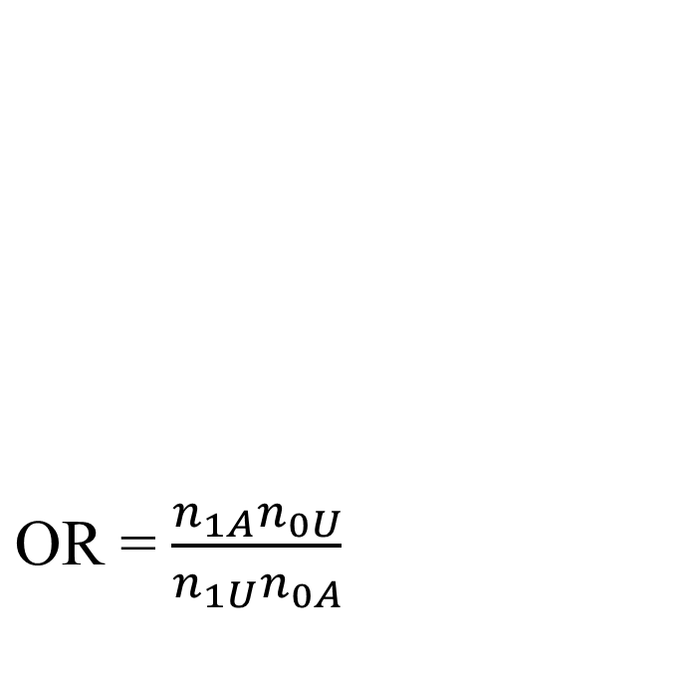
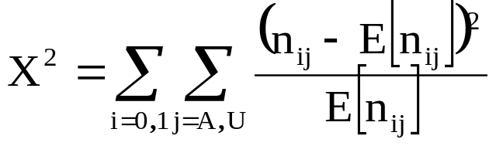
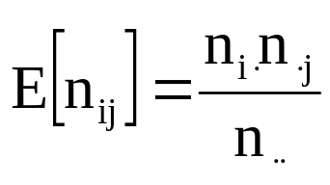
Allele-based tests
Each individual contributes two counts to 2x2 table.
Test of association
where
X² has χ² distribution with 1 degrees of freedom under null hypothesis.
 | Cases | Controls | Total
G | n_{1A} | n_{1U} | n_{1·}
T | n_{0A} | n_{0U} | n_{0·}
Total | n_{·A} | n_{·U} | n··

Slide 9
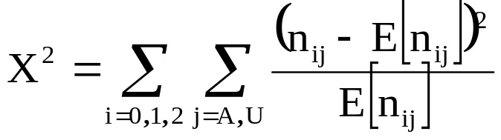
Genotypic tests
SNP marker data can be represented in 2x3 table.
Test of association
where
X² has χ² distribution with 2 degrees of freedom under null hypothesis.
 | Cases | Controls | Total
GG | n_{2A} | n_{2U} | n_{2·}
GT | n_{1A} | n_{1U} | n_{1·}
TT | n_{0A} | n_{0U} | n_{0·}
Total | n_{·A} | n_{·U} | n··

Slide 10
Dominance Model
Each individual contributes two counts to 2x2 table.
Test of association
where
X² has χ² distribution with 1 degrees of freedom under null hypothesis.
 | Cases | Controls | Total
GG/GT | n_{1A} | n_{1U} | n_{1·}
TT | n_{0A} | n_{0U} | n_{0·}
Total | n_{·A} | n_{·U} | n··

Slide 11
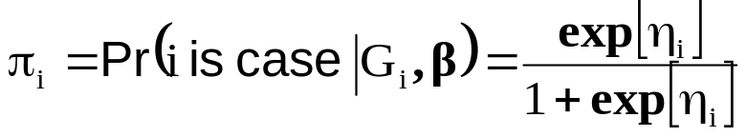
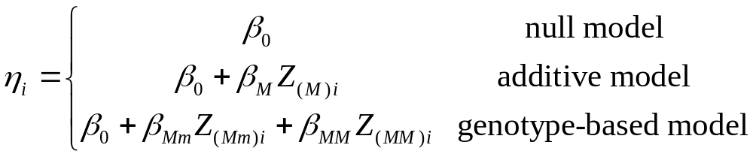
Logistic regression framework
Model case/control status within a logistic regression framework.
Let π_{i} denote the probability that individual i is a case, given their genotype G_{i}.
Logit link function
where

Slide 12
Indicator variables
Represent genotypes of each individual by indicator variables:
 |  | Additive model |  | Genotype model
Genotype |  | Z_{(M)i} |  | Z_{(Mm)i} | Z_{(MM)i}
mm |  | 0 |  | -1 | 0
Mm |  | 1 |  | 0 | 1
MM |  | 2 |  | 1 | 0

Slide 13
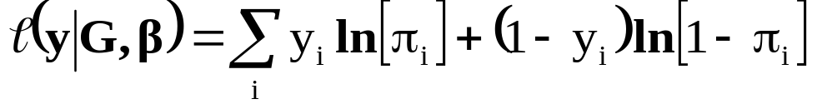
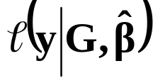
Likelihood calculations
Log-likelihood of case-control data given marker genotypes
where y_{i} = 1 if individual i is a case, and y_{i} = 0 if individual i is a control.
Maximise log-likelihood over β parameters, denoted .
Models fitted using PLINK.

Slide 14
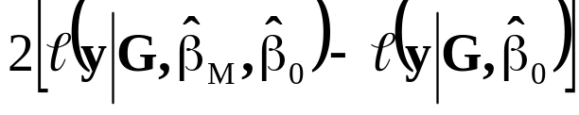
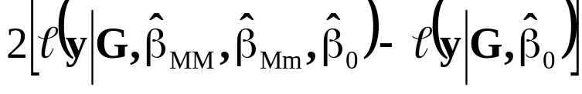
Model comparison
Compare models via deviance, having a χ² distribution with degrees of freedom given by the difference in the number of model parameters.
Models | Deviance | df
Additive vs null |  | 1
Genotype vs null |  | 2

Slide 15
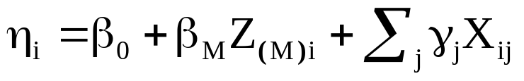
Covariates
It is straightforward to incorporate covariates in the logistic regression model:
  age, gender, and other environmental risk factors.
Generalisation of link function, e.g. for additive model:
where X_{ij} is the response of individual i to the jth covariate, and γ_{j} is the corresponding covariate regression coefficient.

Slide 16
Caution with Covariates!
Covariates useful for:
  Controlling for confounding
  Increasing power
Should be used with caution!
Lung
Cancer
SNP
Smoking

Slide 17

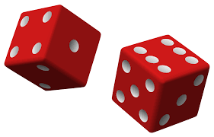
Collider Bias Intuition

Slide 18
Caution with Covariates!
SNP
SNP
“Collider” Bias
BMI
CHD
G, E (-SNP)
SNP
“Collider” Bias
Outcome
Covariate

Slide 19
Caution with Covariates!
Intuition is different for binary traits!
  Case control studies only
  Can increase or decrease power
  Depends on prevalence of disease (<20%)
  Most apparent for strongly associated covariates

Slide 20
Population Stratification

Slide 21
Definitions: Stratification and Admixture
Stratification / Sub-structure
  Refers to the situation where a sample of individuals consists of
  several discrete subgroups which do not interbreed as a single
  randomly mating unit
Admixture
  Implies that subgroups also interbreed. Therefore individuals may be
  a mixture of different ancestries.

Slide 22
My Samples
 | Sample 1 Americans
 | χ²=0 | p=1
 | Use of Chopsticks
A | Yes | No | Total
A₁ | 320 | 320 | 640
A₂ | 80 | 80 | 160
Total | 400 | 400 | 800

Slide 23
My Samples
 | Sample 2 Chinese
 | χ²=0 | p=1
 | Use of Chopsticks
A | Yes | No | Total
A₁ | 320 | 20 | 340
A₂ | 320 | 20 | 340
Total | 640 | 40 | 680

Slide 24
My Samples
 | Sample 3 Americans + Chinese
 | χ²=34.2 | p=4.9x10⁻⁹
 | Use of Chopsticks
A | Yes | No | Total
A₁ | 640 | 340 | 980
A₂ | 400 | 100 | 500
Total | 1040 | 440 | 1480

Slide 25
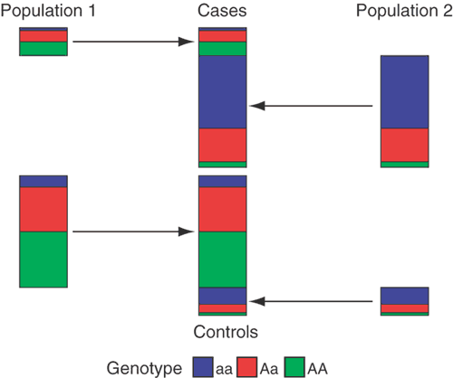
Population structure
Marchini, Nat Genet (2004)

Slide 26
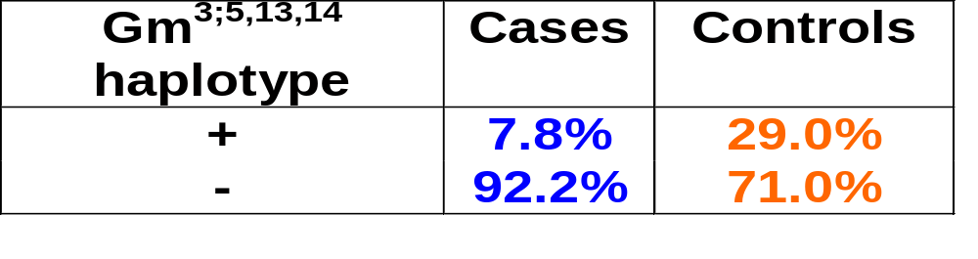
ADMIXTURE: (DIABETES IN AMERICAN INDIANS)
Full heritage American Indian Population
+ -
Gm^{3;5,13,14} ~1% ~99%
(NIDDM Prevalence ≈ 40%)
Caucasian Population
+ -
Gm^{3;5,13,14} ~66% ~34%
(NIDDM Prevalence ≈ 15%)
Study without knowledge of genetic background:
OR=0.27
95%CI = 0.18 - 0.40

Slide 27
ADMIXTURE: (DIABETES IN AMERICAN INDIANS)
Index of Indian Heritage
Gm^{3;5,13,14}
+
-
0
17.8%
19.9%
4
28.3%
28.8%
8
35.9%
39.3%
Gm haplotype serves as a marker for Caucasian admixture

Slide 28
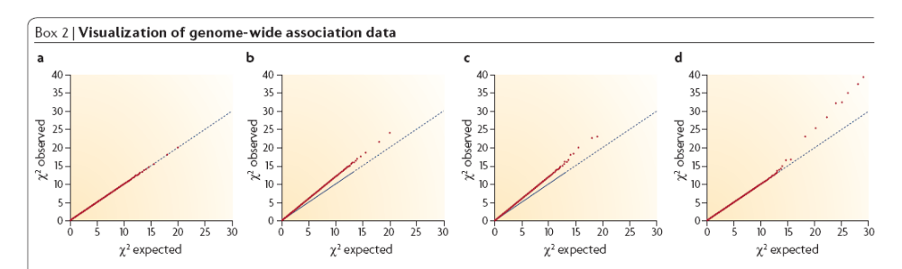
QQ plots
McCarthy et al. (2008) Nature Genetics

Slide 29
Solutions (common variants)
Family-based Analysis
Stratified Analysis
  Analyze Chinese and American samples separately then combine statistically
Model the confounder
  Include a term for Chinese or American ancestry in a logistic regression model
  Principal Components
Genomic Control
Linear Mixed Models
LD score regression

Slide 30
Transmission Disequilibrium Test
Rationale: Related individuals have to be from the same population
Compare number of times heterozygous parents transmit “A” vs “C” allele to affected offspring
Many variations
AC
AA
AC

Slide 31
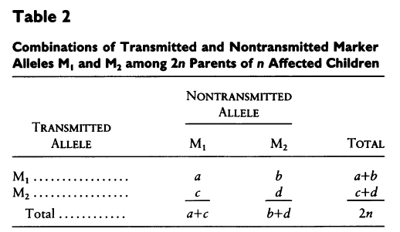

TDT
Spielman et al 1993 AJHG

Slide 32
TDT Advantages
Robust to stratification
Identification of Mendelian Inconsistencies
Parent of Origin Effects
More accurate haplotyping
AC
AA
AC

Slide 33
TDT Disadvantages
Difficult to gather families
Difficult to get parents for late onset / psychiatric conditions
Genotyping error produces bias
Inefficient for genotyping (particularly GWA)
AC
AA
AC

Slide 34
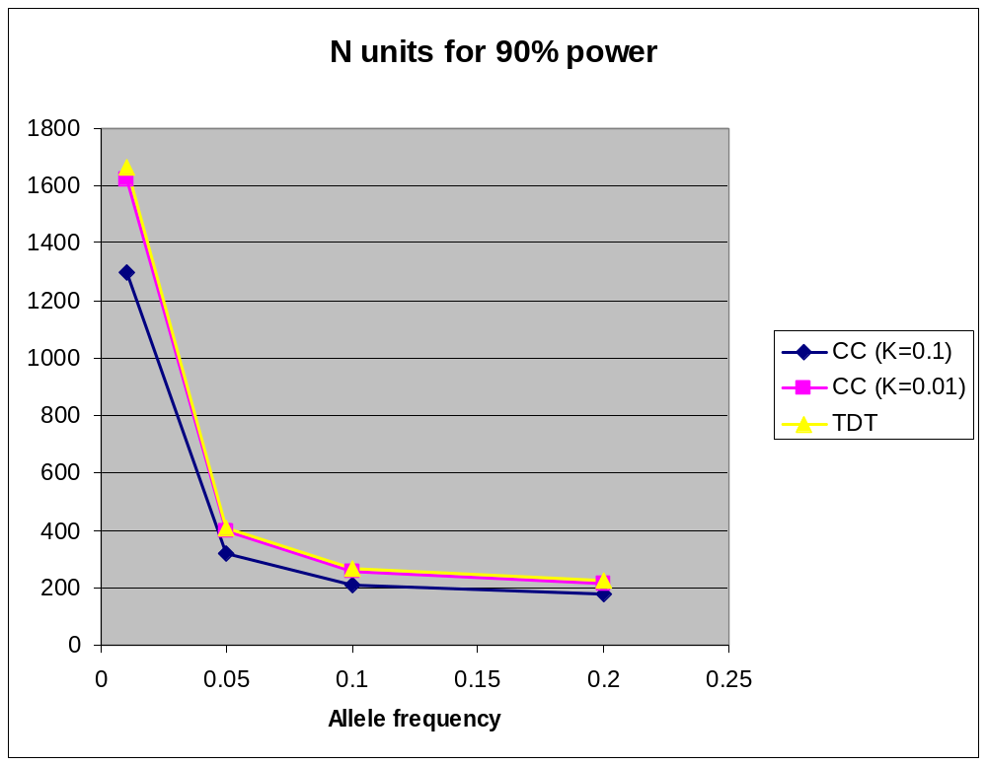
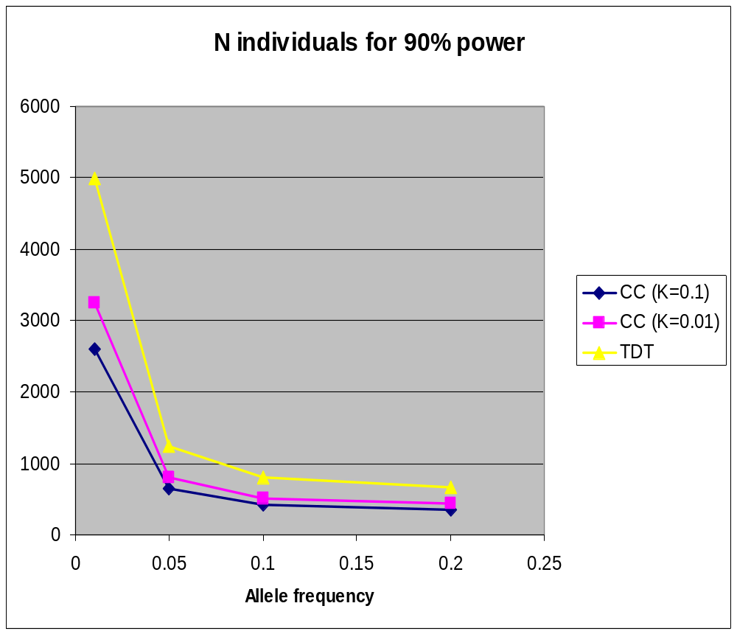
Case-control versus TDT
α = 0.05; RAA = RAa = 2

Slide 35
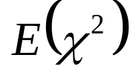
Genomic control
χ²
No stratification
Test locus
Unlinked ‘null’ markers
χ²
Stratification → adjust test statistic

Slide 36
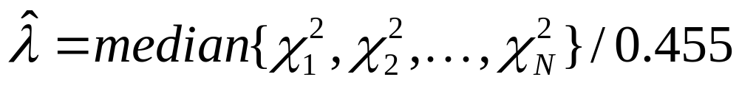
Genomic control
“λ” is Genome-wide inflation factor
Test statistic is distributed under the null:
T_{N} / λ ~ χ²₁
Problems…

Slide 37
Principal Components Analysis
Principal Components Analysis is applied to genotype data to infer continuous axes of genetic variation
Each axis explains as much of the genetic variance in the data as possible with the constraint that each component is orthogonal to the preceding components
  The top principal Components tend to describe population ancestry
Include principal components in regression analysis => correct for the effects of stratification
EIGENSTRAT, SHELLFISH

Slide 38
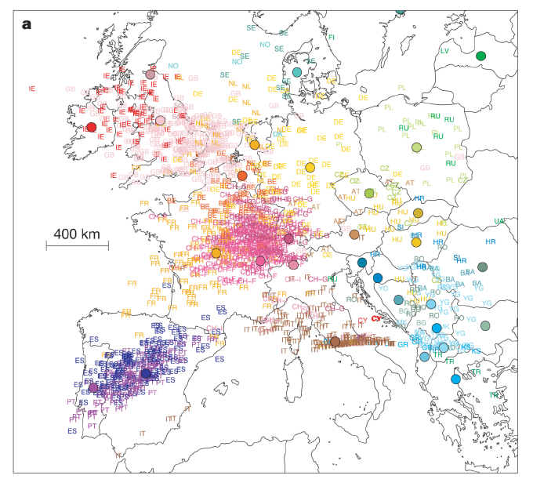
Novembre et al, Nature (2008)
Principal Component Two
Principal Component One

Slide 39

Wellcome Trust Case Control Consortium

Slide 40
Population structure - λ
Disease
1 | 1.15
2 | 1.08
3 | 1.09
4 | 1.26
5 | 1.06
6 | 1.07
7 | 1.10
Genomic control - λ
genome-wide inflation of median test statistic

Slide 41
Disease collection center
Center 1 | No. of samples 524
2 | 271
3 | 439
4 | 465
5 | 301
Center 3: λ = 1.77
All others: λ = 1.09

Slide 42
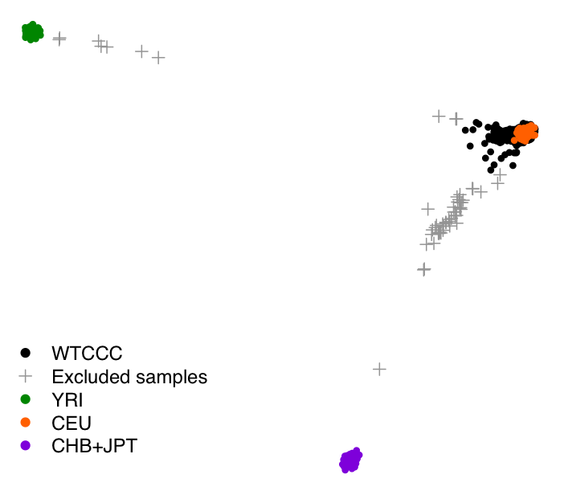
Multi-dimensional Scaling

Slide 43
Linear Mixed Models
The test of association is performed in the fixed effects part of the model (“model for the means”)
“Relatedness” between individuals (due to both population structure and cryptic relatedness) is captured in the modelling of the covariance between individuals
Can increase power by implicitly conditioning on associated loci other than the candidate locus (quantitative traits)
Variety of software packages (e.g. GCTA, GEMMA, LMM-BOLT)

Slide 44
Linear Mixed Models
y = Xβ + g + ε
y is N x 1 vector of observed phenotypes
X is N x k vector of observed covariates
β is k x 1 vector of fixed effects coefficients
g is N x 1 vector of total genetic effects per individual g ~(0, Aσ_{g}²)
A is the GRM between different individuals
V = Aσ_{g}² + Iσ_{ε}²

Slide 45
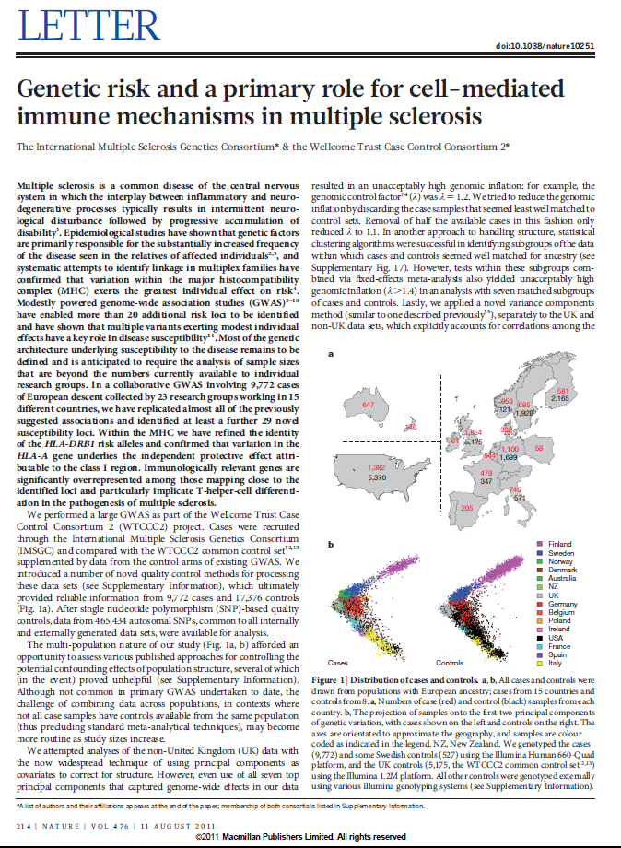
Example
Sawcer et al, Nature (2011)

Slide 46
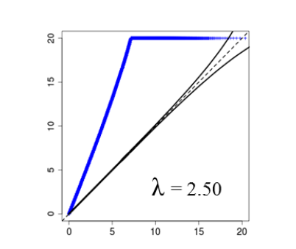
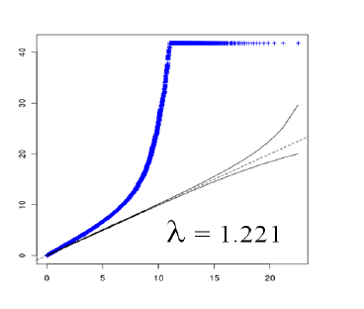
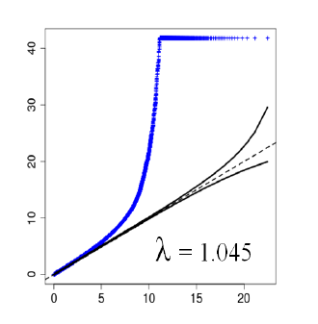
Comparison of Approaches in Sawcer et al.
No correction
PCA correction
(top 100 PCs)
Mixed-model
correction

Slide 47
Linear Mixed Models - Complexities
Many markers required for proper control of stratification
Inclusion of the causal variant in the GRM will decrease power to detect association (GCTA-LOCO)
Case-control analyses are a different story and these sorts of models can involve a substantial decrease in power

Slide 48
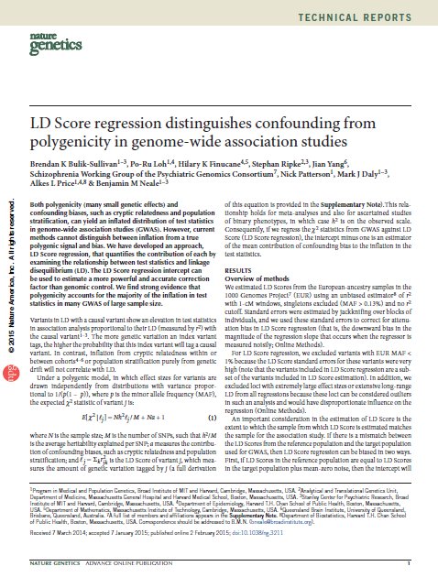
LD Score Regression

Slide 49
LD Score Regression- Key Points
A key issue in GWAS is how to distinguish inflation by polygenicity from bias
This is increasingly important as the size of GWAS (meta-analyses) increases
LD score regression quantifies the contribution of each by examining the relationship between the test statistics and LD
Estimates a more accurate measure of test score inflation than genomic control

Slide 50
LD Score Regression- Basic Idea
The basic idea is that the more genetic variation a marker tags, the higher the probability that it will tag a causal variant
In contrast, variation from population stratification/cryptic relatedness shouldn’t correlate with LD
Regress test statistics from GWAS against LD score. The intercept minus one from this regression is an estimator of the mean contribution of confounding to the inflation of the test statistics

Slide 51
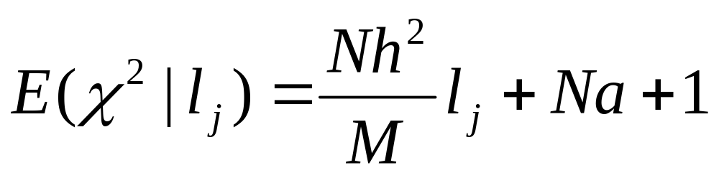
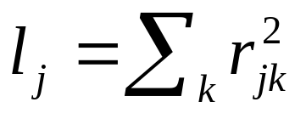
LD Score Regression
(LD Score)
N = sample size
M = number of SNPs
h² / M = average heritability per SNP
a = Population structure / cryptic relatedness

Slide 52

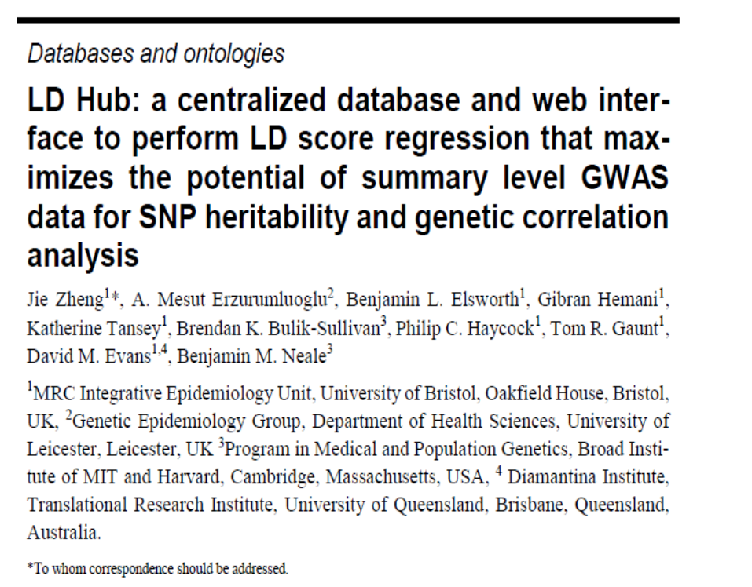
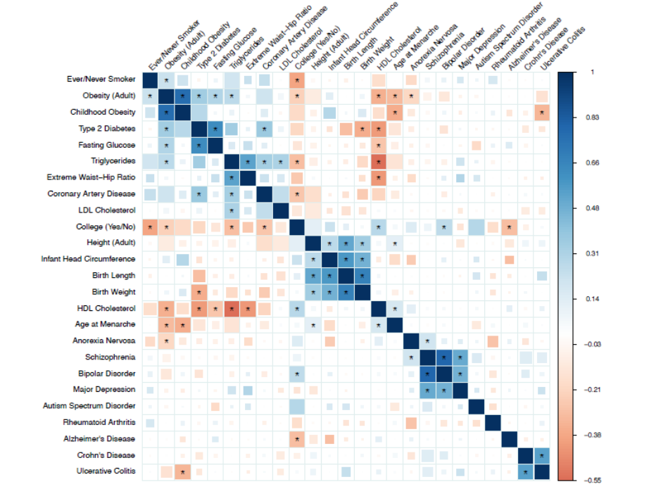
LDHub

Slide 53
Imputation
(Sarah Medland)

Slide 54
Meta-analysis
(Meike Bartels)

Slide 55
Assessing “Significance” in Genome-wide Association Studies

Slide 56
Multiple Testing
Multiple Testing Problem: The probability of observing a “significant” result purely by chance increases with the number of statistical tests performed
For testing 500,000 SNPs
5,000 expected to be significant at α < .01
500 expected to be significant at α < .001
…
0.05 expected to be significant at α < 10⁻⁷
One solution is to maintain α_{FWER} = .05
Bonferroni correction for m tests
Set significance level to α = .05/m
“Effective number of statistical tests
“Genome-wide Significance” suggested at around α = 5 x 10⁻⁸ for European populations

Slide 57
Asymptotic P values
“The probability of observing the test result or a more extreme value than the test result under the null hypothesis”
The p value is NOT the probability that the null hypothesis is true
The probability that the null/alternate hypothesis is true is a function of the evidence contained in the data (p value), the power of the test, and the prior probability that the association is true/false
The p value is a fluid measure of the strength of evidence against the null hypothesis that was designed to be interpreted in conjunction with other (pre-existing) evidence

Slide 58
Interpreting p values
STRONGER EVIDENCE | WEAKER EVIDENCE
Genotyping error unlikely | “Suspicious” SNP
Stratification unlikely | Stratification possible
Low p value | Borderline p value
Powerful Study | Weak Study
High MAF | Low MAF
Candidate Gene | Intergenic region
Previous Association | No previous evidence

Slide 59
Permutation Testing
The distribution of the test statistic under the null hypothesis can be derived by shuffling case-control status relative to the genotypes, and performing the test of association many times
Permutation breaks down the relationship between genotype and phenotype but maintains the pattern of linkage disequilibrium in the data
Appropriate for rare genotypes, small studies, non-normal phenotypes etc.

Slide 60
Replication

Slide 61
Replication
Replicating the genotype-phenotype association is the “gold standard” for “proving” an association is genuine
Most loci underlying complex diseases will not be of large effect
It is unlikely that a single study will unequivocally establish an association without the need for replication

Slide 62
Guidelines for Replication
Replication studies should be of sufficient size to demonstrate the effect
The same SNP should be tested
The replicated signal should be in the same direction
Replication studies should conducted in independent datasets
Joint analysis should lead to a lower p value than the original report
Replication should involve the same phenotype
Replication should be conducted in a similar population
Well designed negative studies are valuable

Slide 63
Practical
(Jeff and Hillary)

