Slide 1


SMART INDIA HACKATHON 2026
TITLE PAGE
Problem Statement ID: SIH1645 (Smart Agriculture & Farm Connect)
Problem Statement Title: AI Mandi Price Intelligence, Quality Grading & Farm Logistics
Theme: Agriculture, FoodTech & Rural Development
PS Category: Software
Team ID: SIH2026-TEAM-AGRO
Team Name: Agro-Sphere Innovators
Project / Idea: Agro-Sphere (Multilingual Farmer Intelligence Platform)
GitHub Repo: https://github.com/agrosphere06-ui/Agro.sphere.git
Live Web App: https://agrosphere06-ui.github.io/Agro.sphere/

Slide 2
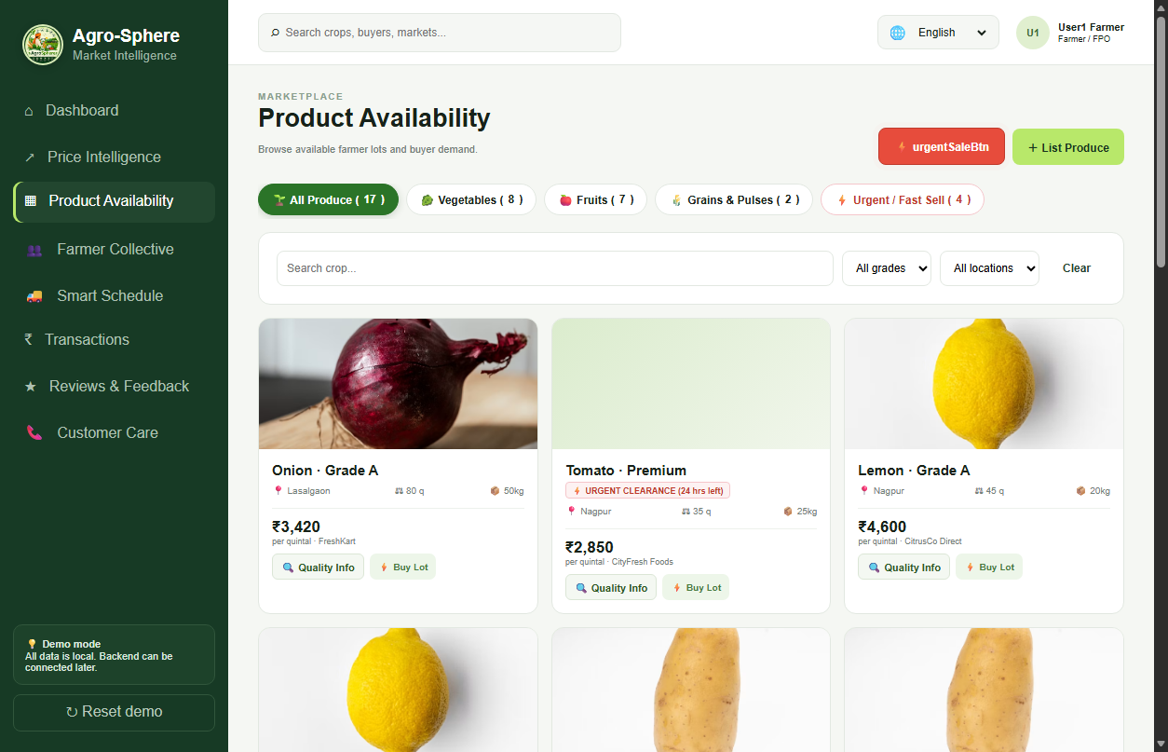
IDEA TITLE
Agro-Sphere Innovators
Agro-Sphere: Unified Farm Intelligence & Direct Market Ecosystem
• Transparent Mandi Discovery: Live modal rates across APMC mandis (Lasalgaon, Nashik, Pune) with predictive 7-day selling recommendations.
• Verified Quality Grading & Inspection: Standardized lot specs (moisture %, size 45-55mm, zero residue test, defect <2%) for Grade A, B & Premium produce.
• Zero-Waste Fast Clearance: Emergency fast-sale channel for perishable surplus fruits/vegetables to eliminate post-harvest crop rotting.
• FPO Collective Pooling: Aggregates small farmer harvests into 100q+ bulk lots to secure institutional buyer pricing & reduce freight.
• End-to-End Live Logistics: Real-time truck tracking (MH-15), driver contact dispatch, weighbridge slot booking, and digital calendar milestones.
• Multilingual Voice AI Sahayak: Voice-operated in Hindi, Marathi & English for non-literate farmers with 24x7 Toll-Free Helpline (1800-889-2476).

Slide 3
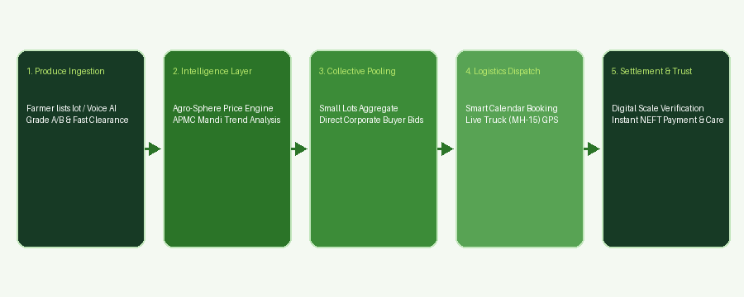
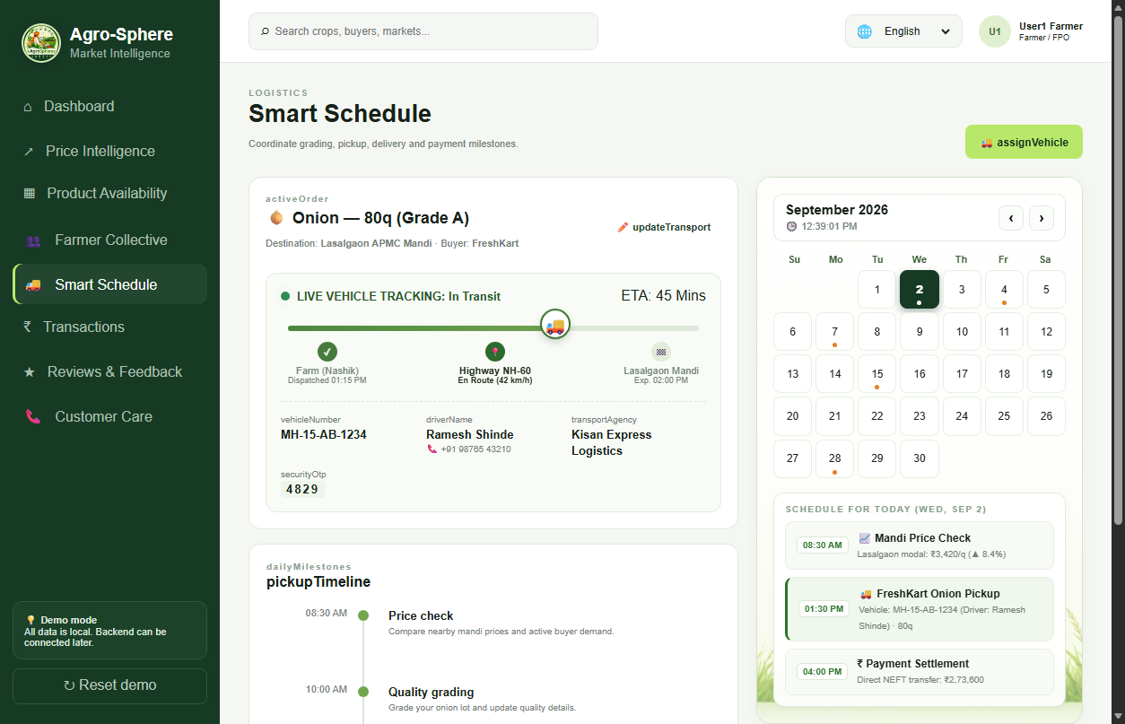
TECHNICAL APPROACH
Agro-Sphere Innovators
Technical Architecture & Execution Methodology
• Modern Web & Mobile Stack: Responsive Glassmorphism architecture, CSS Grid/Flexbox, dynamic modular section routing.
• Voice AI Engine: Web Speech API (STT & TTS) + Vapi.ai Telephony Integration supporting Hindi, Marathi, and Indian English.
• Logistics & Scheduling Engine: Real-time route progression, live GPS coordinate simulator, and dynamic monthly milestone calendar.
• Multilingual I18n System: Real-time DOM dictionary translation across 12 Indian regional languages.
• Security & Settlement: PIN-verified weighbridge authorization and instant ledger balance tracking.

Slide 4
FEASIBILITY AND VIABILITY
Agro-Sphere Innovators
Feasibility, Risk Analysis & Mitigation Strategies
• Technical Feasibility: Lightweight client architecture works on low-bandwidth 2G/3G rural networks with offline resilience.
• Operational Feasibility: Multi-channel support (24x7 Toll-Free 1800-889-2476, WhatsApp Photo Grading +91 98200 45678, on-ground APMC officers).
• Financial Viability: Disintermediates exploitative middlemen (saving 15-20% margin for farmers); self-sustainable via minimal 0.5% buyer transaction fee.
• Challenge: Low Digital Literacy among elderly farmers.
↳ Mitigation: Multilingual AI Voice Sahayak with one-touch voice chips and natural speech queries.
• Challenge: Weight & Quality Disputes at Mandi Yard.
↳ Mitigation: Digital weighbridge PIN verification receipt and local field officer dispute desk.
• Challenge: Spoilage of Perishable Produce.
↳ Mitigation: Priority Zero-Waste Fast Clearance tag and instant buyer flash-sale notifications.

Slide 5
IMPACT AND BENEFITS
Agro-Sphere Innovators
📈 DIRECT & MEASURABLE BENEFITS
Direct financial gains & operational savings delivered directly to farmers & FPOs
• +18% to +25% Farmer Realized Profit: Disintermediates middleman cartels & commission fees (saving 12%–18% margins), putting an extra ₹350–₹550 per quintal directly into farmer bank accounts.
• -30% Logistics & Freight Cost Savings: FPO collective pooling aggregates small 10–20q harvests into 100q+ bulk truckloads, eliminating dead-freight trips with scheduled return-load dispatch.
• -35% Post-Harvest Perishable Loss: Emergency Zero-Waste fast-clearance channel liquidates perishable surpluses (tomatoes, onions) to bulk food processing buyers in <12 hours before rotting.
• 100% Escrow Security & 15-Min Payouts: Replaces traditional 15–30 day delayed informal credit default risks with automated bank settlement upon digital weighbridge PIN clearance.
• -85% Mandi Yard Congestion & Wait Times: Digital gate-pass scheduling and weighbridge queue slots compress farmer waiting time from 36 hours down to under 4 hours.
• Predictive Price Discovery & Selling Windows: Multi-mandi 30-day continuous price tracking alerts farmers to peak selling days, avoiding distress offloading during localized market crashes.
💡 Tangible Impact Example: A smallholder farmer selling 50 quintals of Grade A onion earns an extra ~₹22,500 net profit and saves ~₹4,200 in pooled transport costs.
🌍 BROADER & LASTING SOCIETAL IMPACT
Long-term systemic transformation and societal value created by accumulated benefits over time
• Rural Poverty Alleviation & De-leveraging: Sustained profit breaks village moneylender debt traps, fostering inter-generational farm wealth and arresting distress rural migration.
• Smallholder & FPO Institutional Leverage: Organizes 86% marginal farmers into bankable collective enterprises with corporate-level bargaining power.
• National Food Security & Price Stability: Eliminating supply friction and crop spoilage tempers urban food inflation while guaranteeing farmer floor realization.
• Digital & Financial Inclusion for Kisans: Multilingual Voice AI (Hindi/Marathi/English) empowers non-literate farmers with direct digital commerce & UPI banking.
💼 HOW WE GENERATE INCOME (REVENUE MODEL)
100% Free for Farmers — Sustainable monetization via institutional buyers & B2B ecosystem
• 0.5% – 1.0% Buyer Platform Escrow Fee: Charged to wholesale buyers, food processors & modern retailers on settled escrow orders for digital compliance & lot provenance.
• 2% – 3% Logistics Fleet Aggregation Margin: Commission earned from partnered logistics & trucking fleet operators for guaranteed round-trip load dispatch and route optimization.
• Enterprise Market Intelligence SaaS: Subscription fees from FMCG brands, exporters, and agri-lenders for multi-mandi predictive price forecasting, crop yield estimates & audit reports.
• Digital Weighbridge & Assaying Fee: Nominal revenue-sharing margin with APMC yards on automated digital weighbridge slip generation and BIS/AGMARK quality verification.

Slide 6
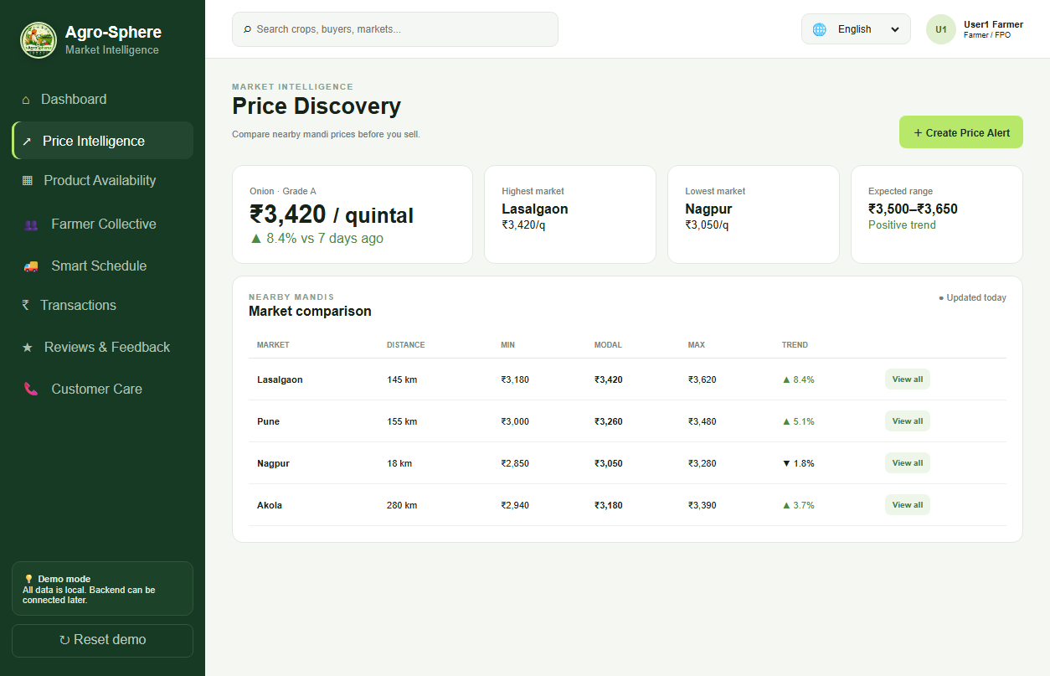
RESEARCH AND REFERENCES
Agro-Sphere Innovators
Research Grounding, Live Deployment & References
• Live Web Platform: https://agrosphere06-ui.github.io/Agro.sphere/
• Official GitHub Codebase: https://github.com/agrosphere06-ui/Agro.sphere.git
• Government Data Reference: Agmarknet (Directorate of Marketing & Inspection, Ministry of Agriculture & Farmers Welfare).
• Post-Harvest Loss Research: NITI Aayog Strategy for Doubling Farmers Income & Central Institute of Post-Harvest Engineering (CIPHET).
• Quality & Grading Standards: Bureau of Indian Standards (BIS) & APEDA Export Produce Specifications for Fruits & Vegetables.
• Voice AI Technology: Deepgram Multilingual Speech Recognition & Vapi.ai Telephony Voice Pipelines.

