Slide 1

SMART INDIA HACKATHON 2026
TITLE PAGE
Problem Statement ID: SIH1645 (Smart Agriculture & Farm Connect)
Problem Statement Title: AI Mandi Price Intelligence, Quality Grading & Farm Logistics
Theme: Agriculture, FoodTech & Rural Development
PS Category: Software
Team ID: SIH2026-TEAM-AGRO
Team Name: Agro-Sphere Innovators
Project / Idea: Agro-Sphere (Multilingual Farmer Intelligence Platform)
Live Prototype: https://diveshchinchavalkar45.github.io/Agro.sphere/

Slide 2
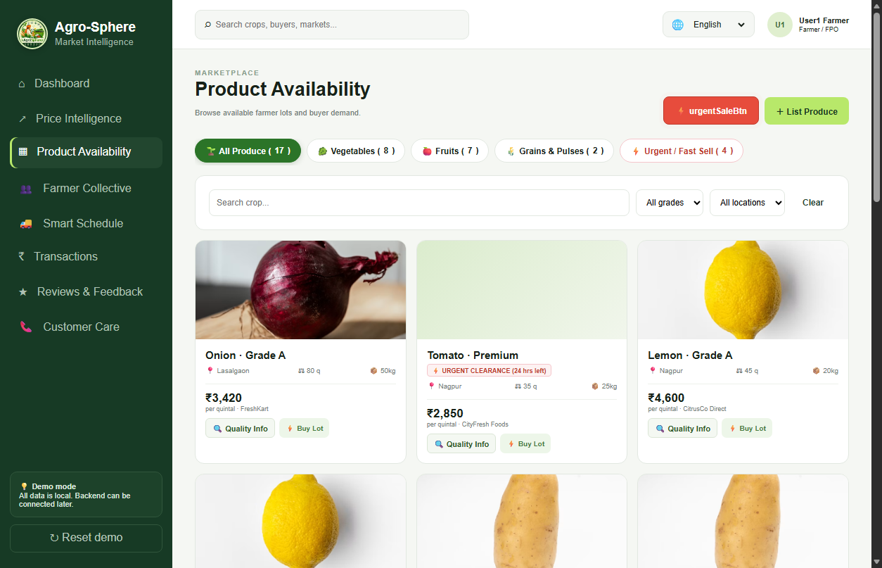
IDEA TITLE
Agro-Sphere Innovators
Agro-Sphere: Unified Farm-to-Market Solution Flow
STEP 01
🎙️ Voice AI & Rates
───────────────
• Voice input in Hindi, Marathi & English for non-literate farmers
• Live APMC rates & 7-day predictive selling alerts
STEP 02
⚖️ Digital Grading
───────────────
• Standardized Grade A/B, size & moisture specs
• Emergency Zero-Waste clearance for perishables
STEP 03
🤝 FPO Bulk Pooling
───────────────
• Aggregates smallholder lots into 100q+ volume
• Direct contracts with institutional buyers (Reliance, etc.)
STEP 04
🚚 Smart Logistics
───────────────
• Real-time GPS reefer truck tracking (MH-15)
• Weighbridge digital slot booking & driver dispatch
STEP 05
🛡️ Escrow Payout
───────────────
• PIN-verified weighbridge receipt & audit slip
• Instant digital bank credit (+18% to +25% net income)
🎯 Outcome: Zero Middlemen Cartels • >30% Spoilage Cut • +18% to +25% Net Income Realization

Slide 3
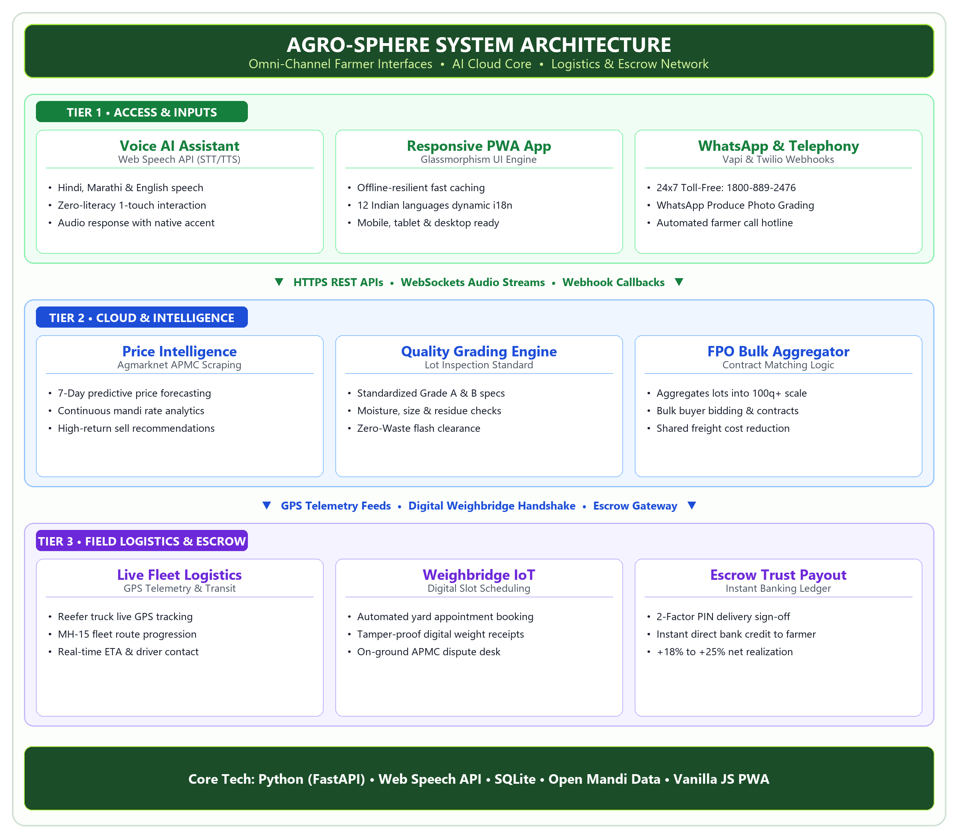
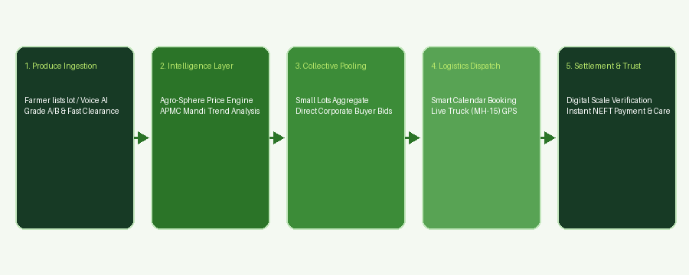
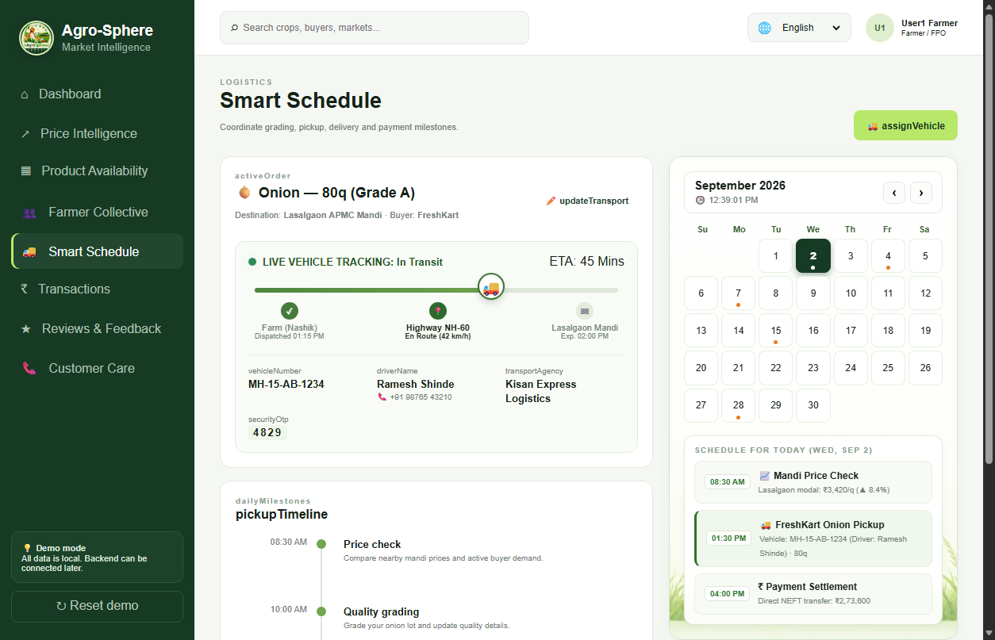
TECHNICAL APPROACH
Agro-Sphere Innovators
Modular 4-Tier Technical Pipeline & System Execution
01 | Voice AI & Client Interface [FRONTEND & ACCESS]
• Web Speech API (STT/TTS) in Hindi, Marathi & English
• Responsive Glassmorphism PWA with 12 Indian languages
02 | AI Price & Grading Engine [INTELLIGENCE LAYER]
• 7-Day predictive price forecasting with Agmarknet data
• Standardized Grade A/B specs & Zero-Waste fast clearance
03 | FPO Aggregation & Fleet GPS [LOGISTICS & SCALE]
• Automated lot pooling into 100q+ institutional bulk volume
• Real-time GPS reefer truck route progression (MH-15 fleet)
04 | Escrow & Dispute-Free Payout [TRUST & SETTLEMENT]
• PIN-verified digital weighbridge receipts & slot booking
• Instant bank ledger transfer (+18% to +25% net realization)
⚙️ Tech Stack: Python (FastAPI) • Web Speech API • SQLite • Open Agmarknet Data • Vanilla JS PWA

Slide 4
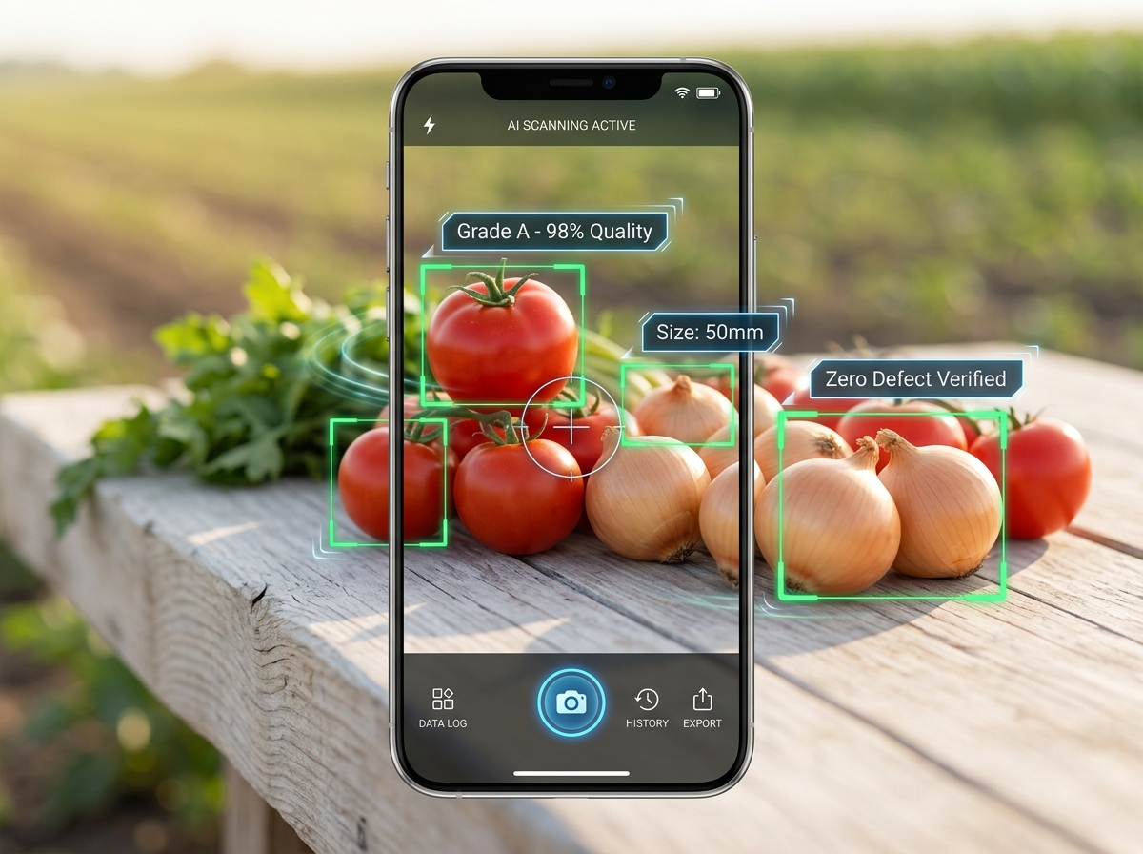
FEASIBILITY AND VIABILITY
Agro-Sphere Innovators
Future Scope, Scaling Roadmap & 1st-Year Engineering Mentorship
🎓 1st-Year Engineering Student Innovation & Faculty Mentorship
As passionate 1st-year engineering students, we built this working prototype as our core foundation. To take it to production scale, we are actively taking technical guidance and advice from our College Professors, Senior Engineering Students & APMC Mandi Field Officers.
🌳 AGRO-SPHERE FUTURE ENHANCEMENT TREE
What Better Can We Do? • Estimated Timelines • Academic Collaboration
🌿 Branch 1: On-Device Computer Vision AI [⏱️ Estimated Time: 3 – 4 Months]
• Smartphone camera scanning for automated crop defect & rot detection
• Real-time sizing (mm), moisture estimation & Grade A/B scoring
• Lightweight Edge-ML models that run offline in low-connectivity fields
🌿 Branch 2: IoT Cold-Chain & Weighbridge Automation [⏱️ Estimated Time: 2 – 3 Months]
• IoT wireless sensors inside reefer trucks (temperature/humidity tracking)
• Automated RFID electronic weighbridge integration for instant gross-tare weighing
• Eliminates mandi weighbridge queues and prevents weight dispute fraud
🌿 Branch 3: Mentorship, Pilot Trials & Scaled Ecosystem [⏱️ Estimated Time: 4 – 6 Months]
• Weekly advisory with Professors & Seniors on model tuning & database scaling
• Live on-ground farmer pilots at Lasalgaon APMC with local FPO leaders
• Integration with e-NAM (National Agriculture Market) and UPI 2.0 Escrow
📸 Upcoming Feature: Mobile Vision AI (YOLOv8)
Instant phone camera grading: 98% quality check, size (50mm) & zero defect verification

Slide 5
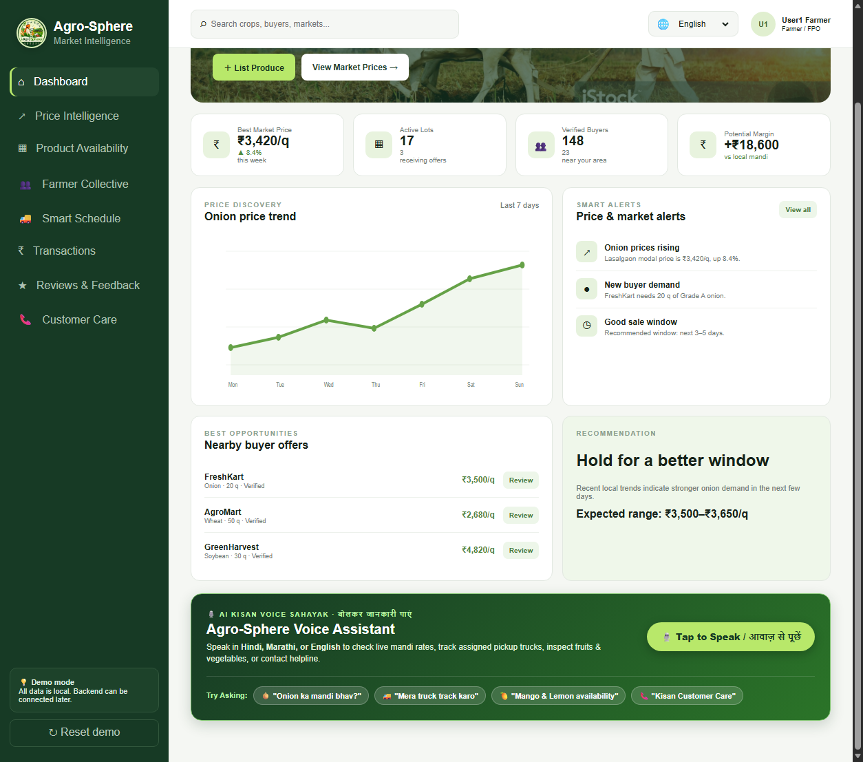
IMPACT AND BENEFITS
Agro-Sphere Innovators
Quantifiable Direct Gains, Macro Societal Value & Sustainable Revenue Model
📊 1. MEASURABLE BENEFITS (Direct Project Gains)
Direct, positive & quantifiable results delivered to farmers & buyers:
• 💰 +18% to +25% Higher Net Income Realization
↳ Bypasses 15–20% middleman cartel commissions with direct modal rate discovery.
• 📉 >30% Cut in Perishable Post-Harvest Spoilage
↳ Emergency Zero-Waste fast-clearance channel offloads ripe lots before rotting.
• 🚚 35% Freight & Logistics Cost Reduction
↳ FPO bulk pooling consolidates smallholder lots into full 100q+ truckloads.
• ⏱️ 60% Reduction in Mandi Yard Waiting Time
↳ Automated digital weighbridge slot reservation eliminates 2-3 day vehicle queues.
• 🛡️ 100% Escrow Payment Security
↳ Instant digital bank credit upon verified weighbridge receipt; zero payment default.
🌍 2. BROADER IMPACT (Lasting Societal Value)
Long-term macroeconomic, community & sustainable transformation:
• 🌾 Smallholder Economic Empowerment & De-Risking
↳ Elevates marginalized kisans (86% of Indian agriculture) & curbs distress rural debt.
• 🤝 Institutional Scale for Farmer Collectives (FPOs)
↳ Transforms fragmented farmers into organized rural enterprises with bulk market power.
• 🥗 National Food Security & Reduced Landfill Waste
↳ Diverts thousands of tons of high-nutrition fruits & vegetables into the retail food chain.
• 🌐 Digital Inclusion for Non-Literate Farmers
↳ Voice-first vernacular AI (Hindi/Marathi) democratizes technology for elderly kisans.
• 📈 Transparent Market Governance & Policy Audits
↳ Provides verified trade data trails for government MSP tracking and fair crop insurance.
💼 REVENUE MODEL: HOW AGRO-SPHERE GENERATES SUSTAINABLE INCOME
• 1. 100% Free for Farmers (0% Commission): Kisans keep 100% of their earnings — zero fee to maximize grassroots trust and rapid village adoption.
• 2. 0.5% – 1.0% Institutional Buyer Fee: Charged to corporate buyers (Reliance, BigBasket, ITC) per closed bulk contract (far lower than traditional 6–8% APMC agent cuts).
• 3. Logistics Micro-Margin & Mandi SaaS: Value-added margin on partnered reefer freight dispatch + premium enterprise supply forecasting dashboards for export aggregators.

Slide 6
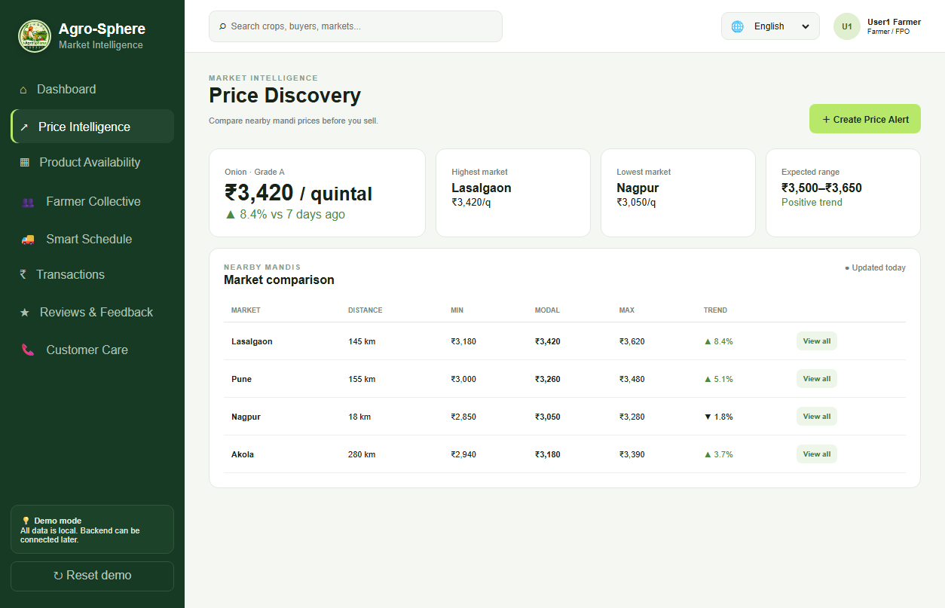
RESEARCH, REFERENCES & TECH CITATIONS
Agro-Sphere Innovators
Scientific Grounding, Generative AI & API Foundations, Live Prototype & Q&A
🏛️ 1. GOVERNMENT DATA & POLICY GROUNDING
• Agmarknet (Ministry of Agriculture)
↳ Real-time modal price feeds, APMC trading data & mandi volume benchmarks for Lasalgaon, Nashik & Pune.
• APEDA & Bureau of Indian Standards (BIS)
↳ Standardized export quality grading specs for onion, tomato & citrus (Grade A/B, size mm, zero chemical residue).
• NITI Aayog & CIPHET Research
↳ Grounded in Strategy for Doubling Farmers' Income & studies on 15–20% post-harvest cold chain wastage reduction.
🤖 2. AI RESEARCH, LLMS & API INTEGRATIONS
• Google Gemini API Integration
↳ Powers our intelligent Kisan AI backend: context-aware farm advisory, vernacular query understanding & intent routing.
• Google Search & OpenAI ChatGPT (GPT-4)
↳ Extensively utilized for agricultural literature research, APMC pricing schema exploration & multi-lingual prompt engineering.
• Web Speech API & Vapi.ai Telephony
↳ W3C-standard Speech Recognition/Synthesis + Vapi telephony pipelines for 24x7 automated toll-free voice hotline.
🌐 3. LIVE PROTOTYPE & CODE REPOSITORY
• Live Deployed Web Application:
🔗 https://diveshchinchavalkar45.github.io/Agro.sphere/
↳ Instant PWA: Live interactive mandi charts, harvest pooling, voice assistant & GPS schedule.
• Open-Source Code Repository:
🔗 https://github.com/diveshchinchavalkar45/Agro.sphere
↳ Full open-source codebase, modular FastAPI server, SQLite schema & multilingual i18n dictionaries.
• 24x7 Helpline & WhatsApp Demo:
🔗 Toll-Free: 1800-889-2476 | WhatsApp: +91 98200 45678
↳ Working multi-channel touchpoints for illiterate & elderly farmers in rural areas.
🌾 THANK YOU, RESPECTED JURY & EVALUATORS!
Ready for Questions & Live Interactive Demonstration
─────────────────────────────────────────
Team: Agro-Sphere Innovators • Team ID: SIH2026-TEAM-AGRO
Problem Statement: SIH1645 (Smart Agriculture & Farm Connect)
💡 "Empowering India's Annadata with Transparent AI, Collective Scale & Direct Market Access."
🌐 LIVE WORKING WEB PROTOTYPE: https://diveshchinchavalkar45.github.io/Agro.sphere/ [ ↗ CLICK TO LAUNCH LIVE APP ]

