Slide 1
Basic Electronics & analog data
Not just theory……

Slide 2
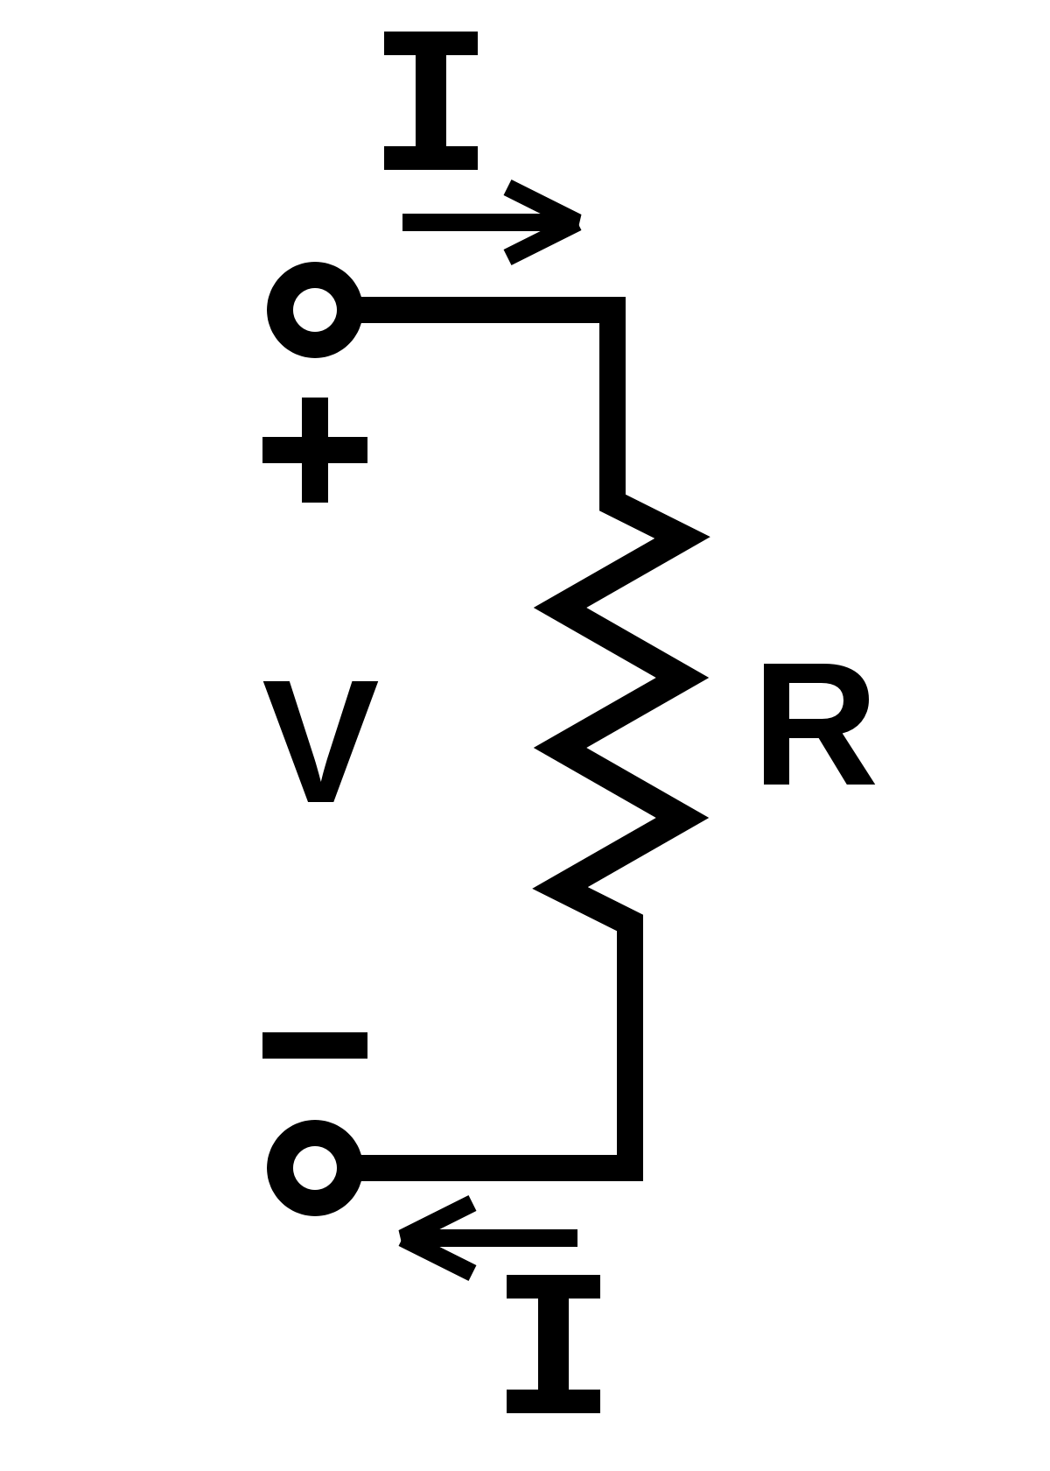
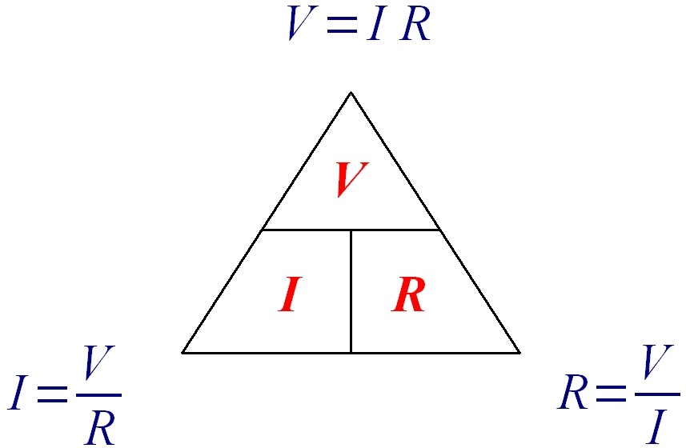
Ohms Law

Slide 3
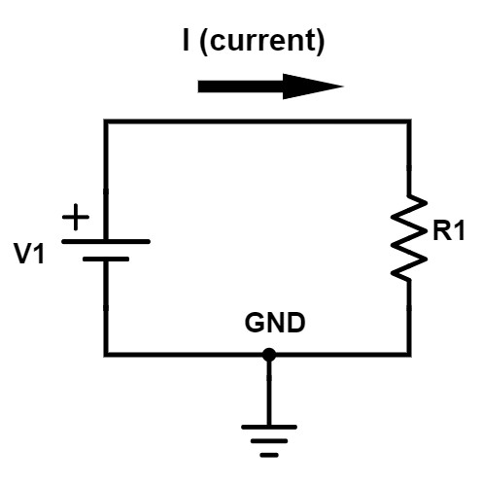
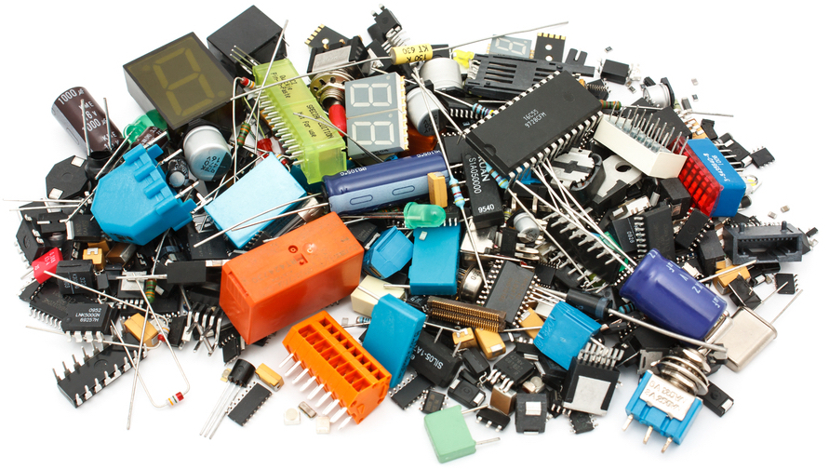
Moving from theory and schematics to actual circuits

Slide 4
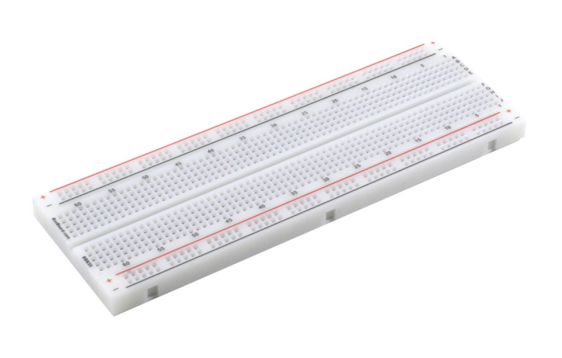
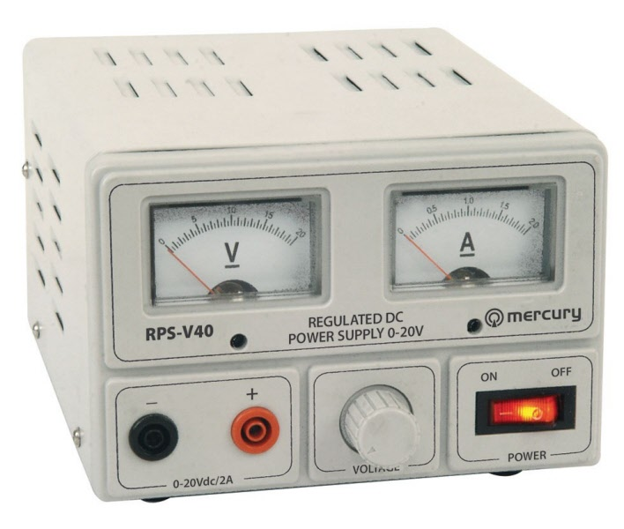
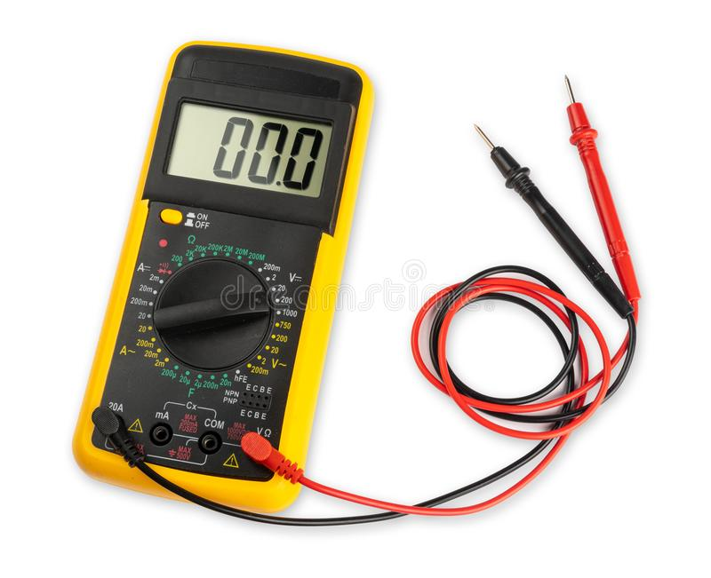
Some basic components

Slide 5
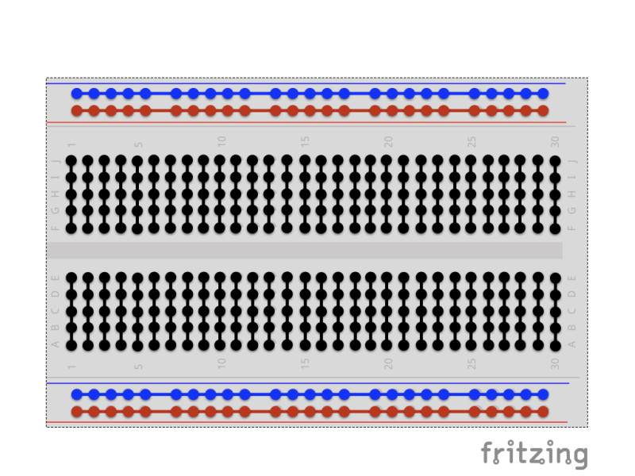
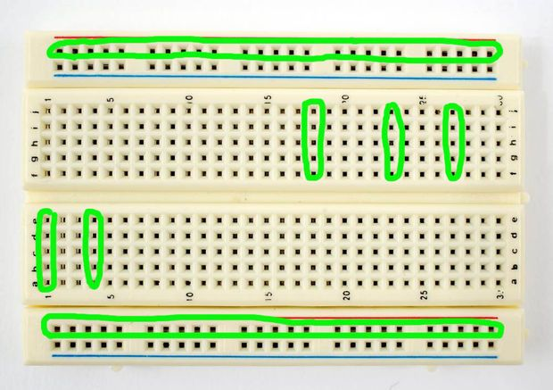
Bread board

Slide 6
Power supply

Slide 7
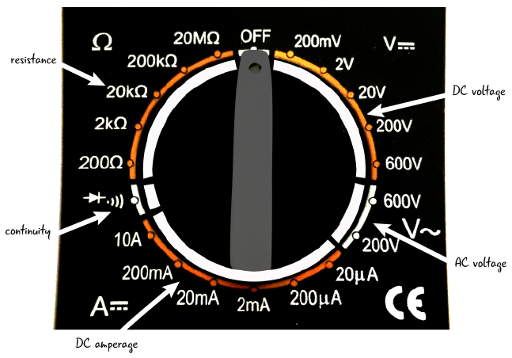
Multimeter

Slide 8
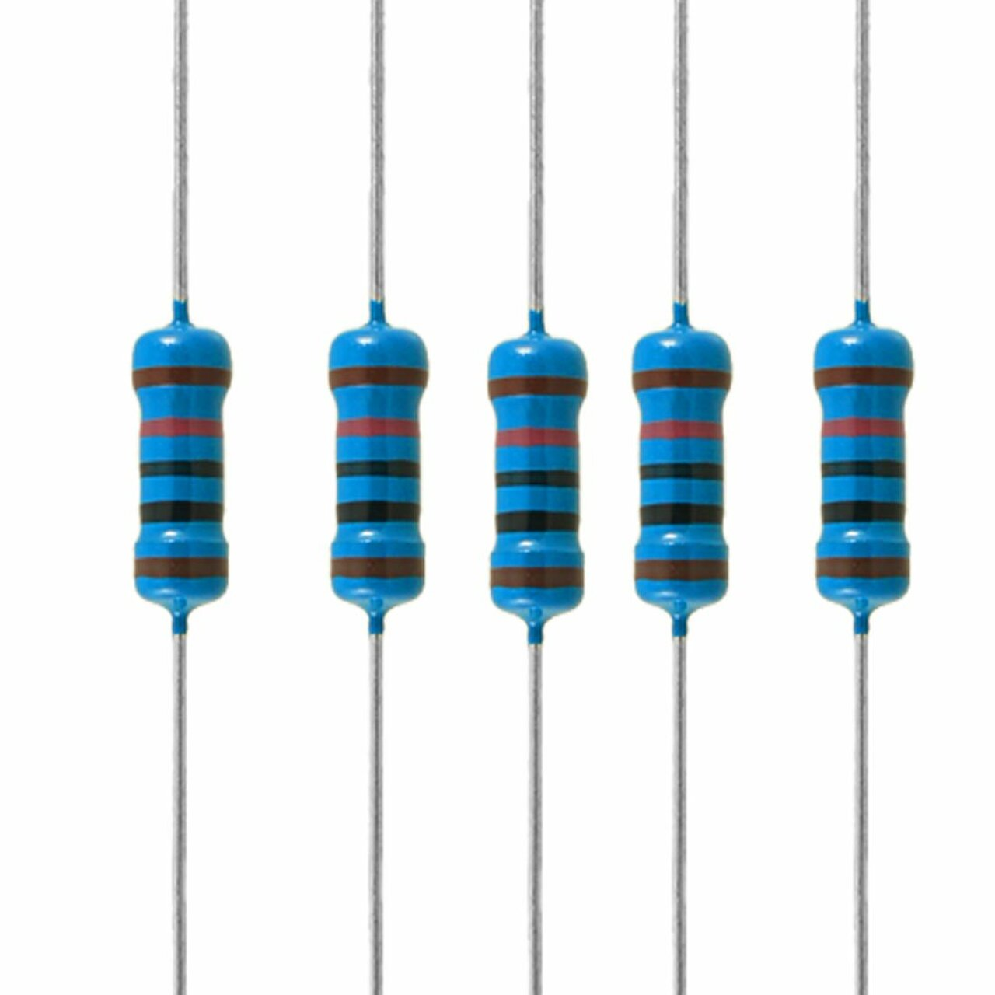
Resistance & resistors
Each resistor has markings on it stating its resistance but the best way to know is to check with the multimeter.
Test the random resistor you got.
What is the resistance?
Calculate the current at 5V.
Now let's build a circuit and measure it.

Slide 9
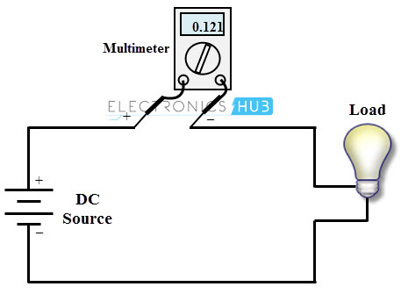
Let’s build this simple circuit
Things to consider:
Max current in multimeter → don’t burn it
Resistors are rated 0.25W (reminder W=V*A) → don’t burn them

Slide 10
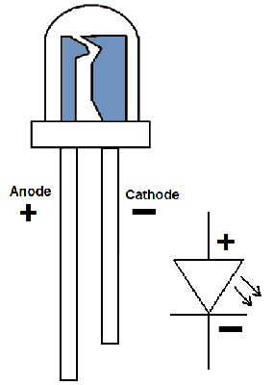
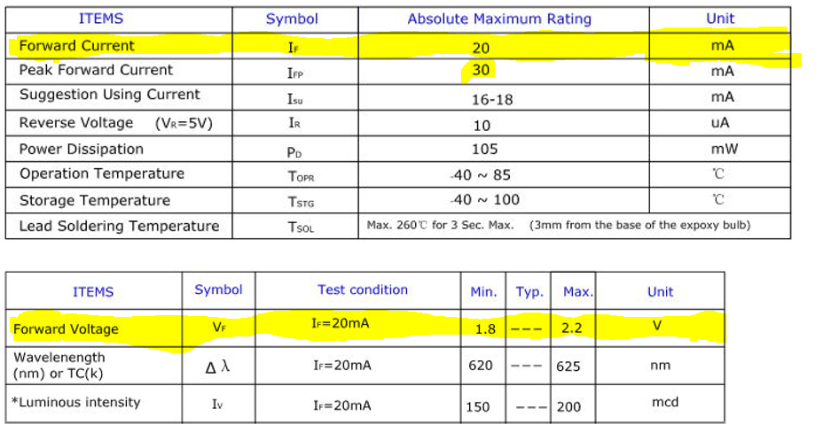
LED – Light Emitting Diode
From the datasheet of a standard 5mm LED
Good LED tutorials:
https://www.electronics-tutorials.ws/diode/diode_8.html
https://learn.sparkfun.com/tutorials/light-emitting-diodes-leds/all

Slide 11
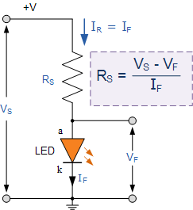

Example
What resistor will you use for a 12V power supply?
Try it…

Slide 12
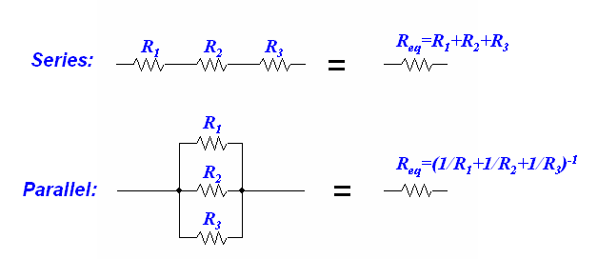
Exercises:
Plan and create a circuit with 50uA current
Play with resistors in series and in parallel to create unique resistance values
Reminder:
LED
Test and see if its true……

Slide 13
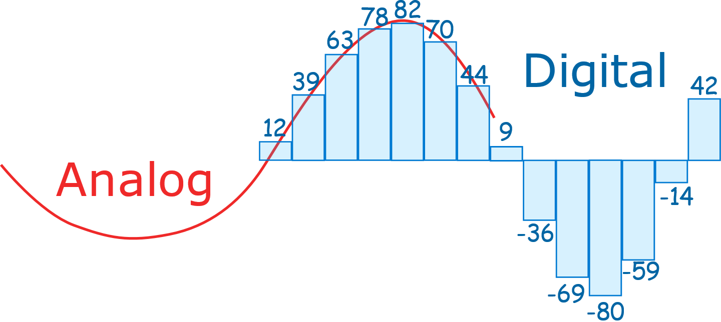
Analog signal, sensors and measurement
ESP32/Arduino measures voltage using an ADC

Slide 14
Sensors
A sensor is a device that responds to any change in physical phenomena or environmental variables like heat, pressure, humidity, movement etc. This change affects the physical, chemical or electromagnetic properties of the sensors which is further processed to a more usable and readable form. Sensor is the heart of a measurement system. It is the first element that comes in contact with environmental variables to generate an output.
For us we will be working mostly with sensors that change in their electromagnetic properties:
Change in voltage
Example: thermocouple / radiation sensors
Change in resistance
Example: Thermistors / photoresistor / potentiometer
Change in current
Example: Some light sensors
Change in capacitance
Example: Humidity and Soil moisture
Open/close electrical circuit – Pulse
Exsample: wind sensor (anemometer), switches
ESP32/Arduino measures only voltage and it does so using an Analog to Digital Converter (ADC)

Slide 15
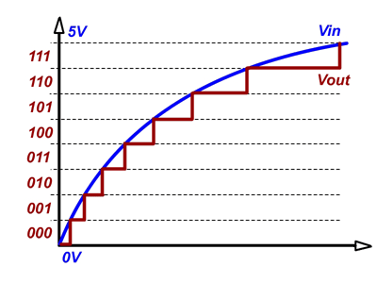
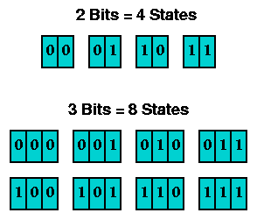
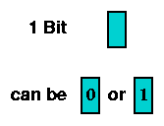

ADC – Analog to Digital Converter
$$Number of states=2^{bit}$$

Slide 16
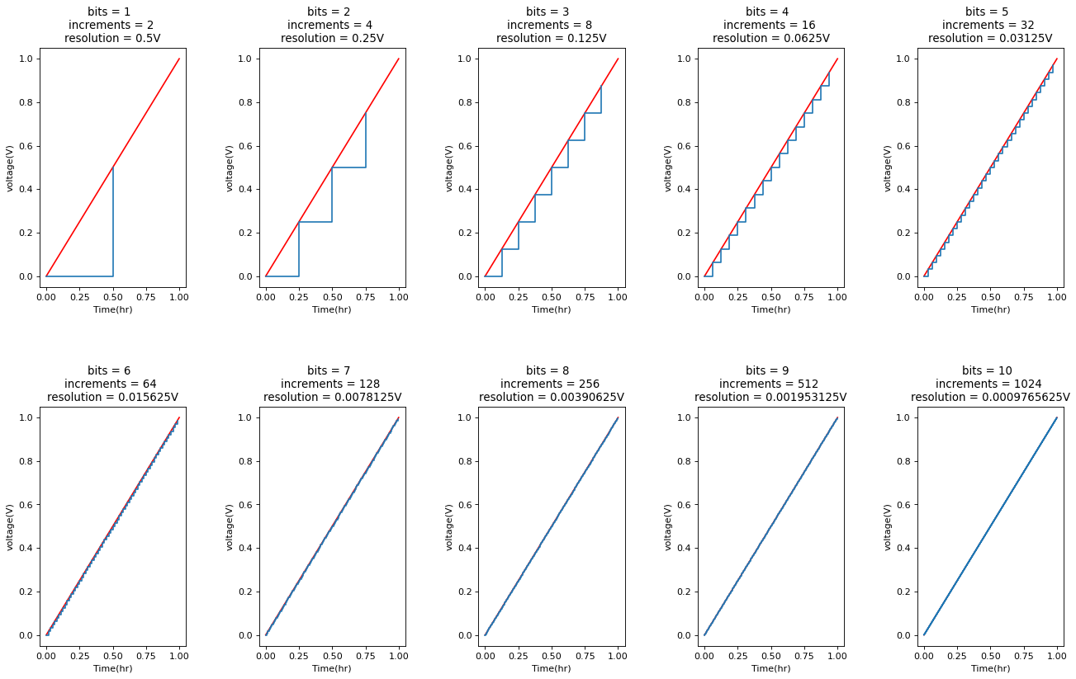

Slide 17
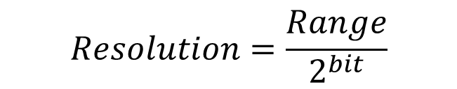
What ADCs we have
Module: | Arduino | ESP32 | ADS1115
ADC bits | 10 | 12 | 16
Range (V) | 0-5 0-1.1 0-reference (<5) | 0-3.3 | +/- 6.144V +/- 4.096V +/- 2.048V +/- 1.024V +/- 0.512V +/- 0.256V
Accuracy | Good | Bad (noisy & no- linear) | excelent
Max resolution?
Try calculating the max resolution
$$Resolution=\frac{Range}{2^{bit}}$$

Slide 18
What ADCs we have
Module: | Arduino | ESP32 | ADS1115
ADC bits | 10 | 12 | 16
Range (V) | 0-5 0-1.1 0-reference (<5) | 0-3.3 | +/- 6.144V +/- 4.096V +/- 2.048V +/- 1.024V +/- 0.512V +/- 0.256V
Accuracy | Good | Bad (noisy & no- linear) | excellent
Max resolution | 1.07mV | 0.805mV | 0.0078125mV

Slide 19
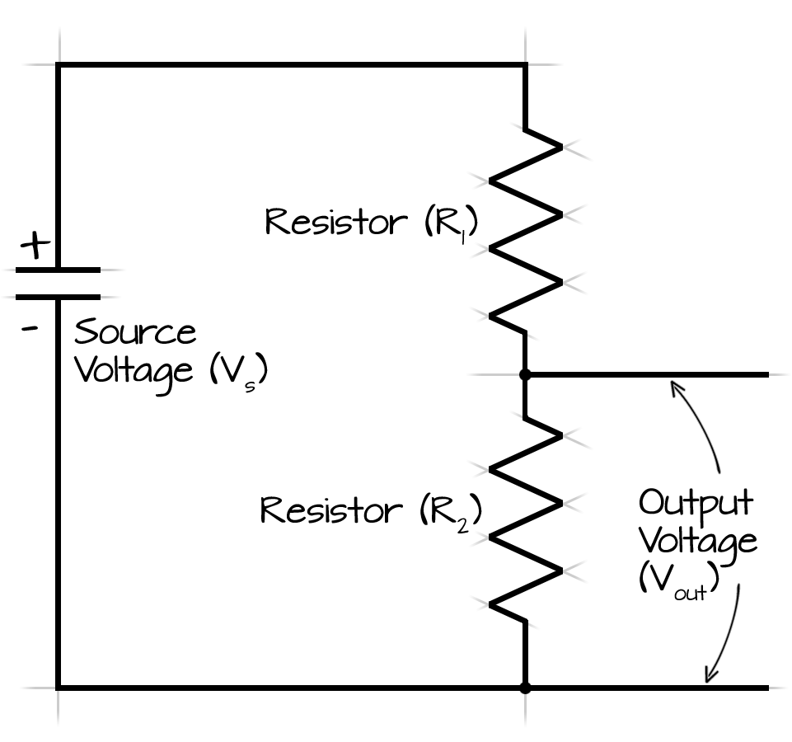
Devices only measure voltage, so how do we convert to voltage?
Change in voltage
Change in current
Change in resistance
Voltage divider
No problem
Add resistor with
known value
V = I * R
What is the relation between R2 and Vout?

Slide 20
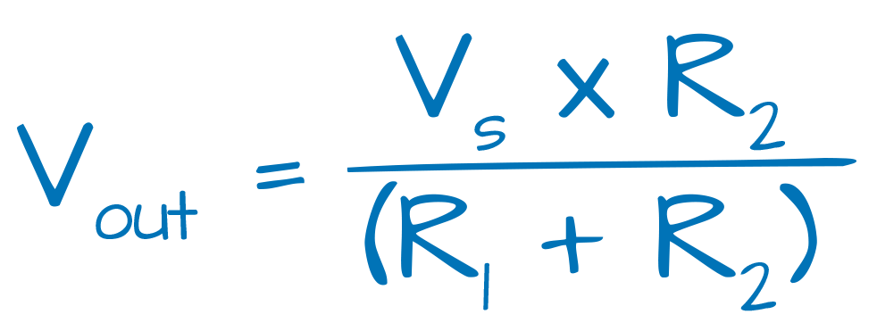



Voltage divider

Slide 21
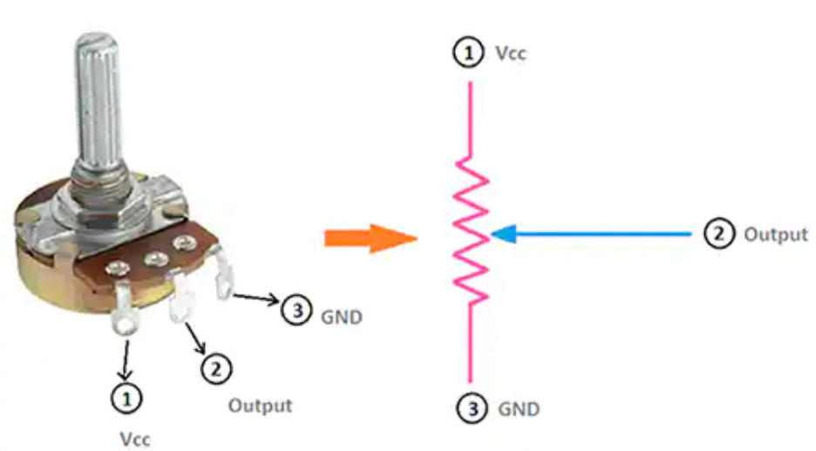
Potentiometer
Has “built in” variable voltage divider

Slide 22
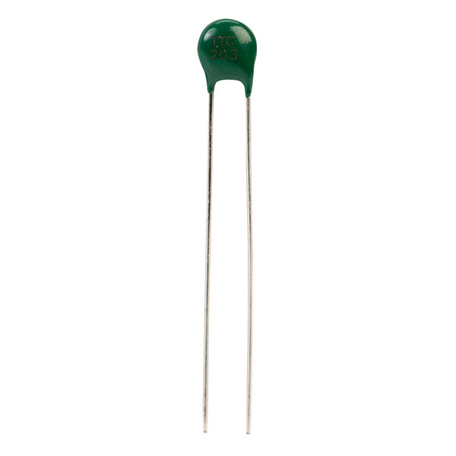
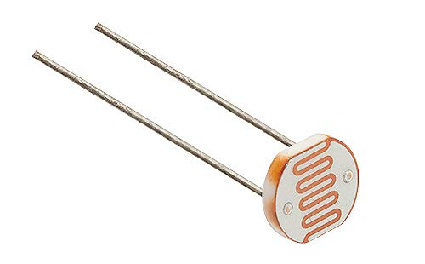
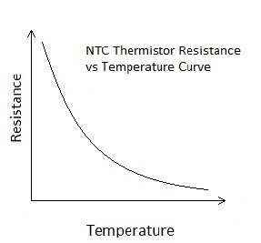
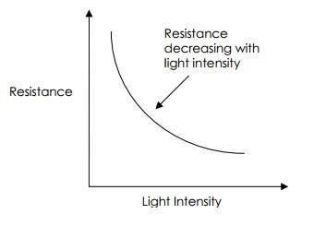
Photoresistor
Thermistor

Slide 23
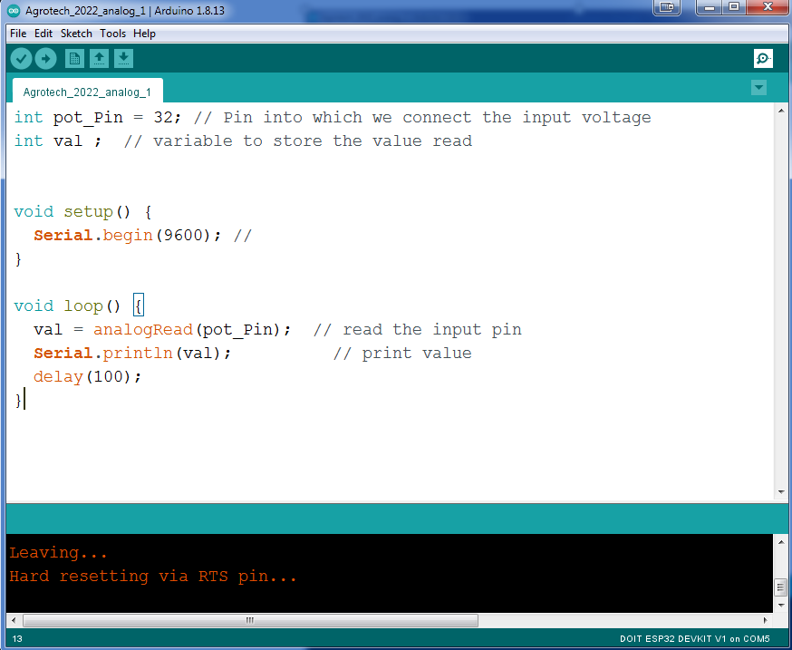
Class work
Upload the code and connect:
Potentiometer
Photoresistor
Thermistor
Turn ADC value into:
Voltage (V2)
R2 value
bonus - convert resistance to Temperature

Slide 24
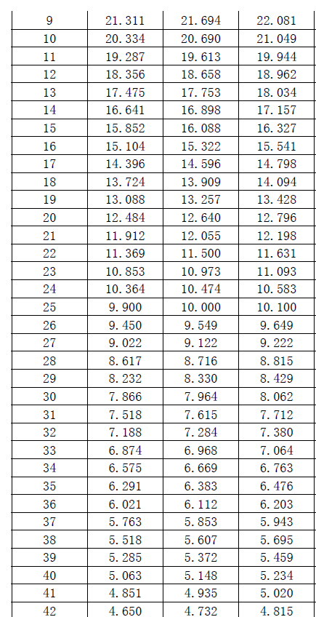
From resistance to temperature
Temp(C) min(Ω) center(Ω) max(Ω)
Our B value = 4150
Model equations and calculator of constants for thermistors:
https://www.thinksrs.com/downloads/programs/therm%20calc/ntccalibrator/ntccalculator.html
Thermistor tutorial:
https://learn.adafruit.com/thermistor/using-a-thermistor?gclid=CjwKCAjw8sCRBhA6EiwA6_IF4aVJKhNGZ1uXLi9KoB-jvnO2kBAEfc7wec8Rc3JcZuQGs_f4GHzYKRoCxxoQAvD_BwE

