Slide 1
Incorporation of Global Phasing workflows in MXCuBE
Rasmus Fogh MXCuBE / ISPyB joint meeting Trieste, September 2018

Slide 2
Contents
Introduction
Workflows and examples
DEMO
Status
GΦL

Slide 3
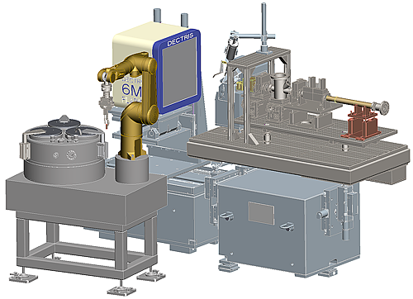
Driving a beamline as a third party
GΦL
Integration
MXCuBE
Abstract Beamline Interface messages
Workflow Application
MXCuBE
Image Collection
Strategy Calculation
Tracking and data management
Self-contained: no site-specific components or resources
Data Processing
GΦL

Slide 4
Data collection workflow
Optimal data collection strategy While U Wait
Strategy determined in the workflow outside MXCuBE
Requires multi-axis goniostat
Requires precise translational and rotational calibrations
Calibration workflows provided
Uses normal MXCuBE machinery, with additions

Slide 5
Integration architecture
MX
UI tab: starts GΦL workflow
Java
GΦL HardwareObjects
GΦL Workflow Data persistence
GΦL Controller
Message handling
Execution
GΦL Connection
Java
Python
ABI messages
Transcription
Fortran
XDS
TransCal
StratCal
…
MXCuBE Queue
Execution User interface
Generic I/O Popups
Parameter queries
Display and review

Slide 6
Contents
Introduction
Workflows and examples
DEMO
Status
GΦL

Slide 7
Data collection strategies
Calculate strategy after characterisation step
Strategy based on indexing space group
Alignment based on known crystal orientation
Multiple sweeps for completeness (e.g. for avoidance of empty cusps)
Automatic re-centring after change of orientation
Allowance for shadowing and collision avoidance

Slide 8
Phasing data
Align symmetry axis for optimal anomalous differences
One or more wavelengths
Automatic inverse-beam and wavelength interleaving (configurable)
Tested and working

Slide 9
Native data
One or more sweeps, with alignment for completeness and balanced redundancy
Now executes in mock mode
Upcoming test at ESRF ID30B
last ever in Qt3 branch

Slide 10
Translational calibration
Optical calibration using fine-tip fibre
30 centring points, in two stages
Automatic re-centring after first stage
ca. 5μm re-centring precision
Keep sample centred between successive reorientations
Manual sample centring under maximum zoom
See example

Slide 11
Re-centring example

Slide 12
Diffractometer calibration
Uses images from high-symmetry crystal
Produces
accurate goniostat axis orientations
accurate detector origin, position and offsets for individual segments
One multi-orientation data collection, slow processing (hours)

Slide 13
Data collection example
Crystal: Thaumatin, P4₁2₁2
0.1˚ per image
Strategy:
A: 45˚ sweep, aligned with fourfold axis
B: 90˚ sweep, orthogonal to fourfold axis
C: 90˚ sweep, orthogonal to fourfold axis B,C inverse-beam, interleaved in 9˚ wedges

Slide 14
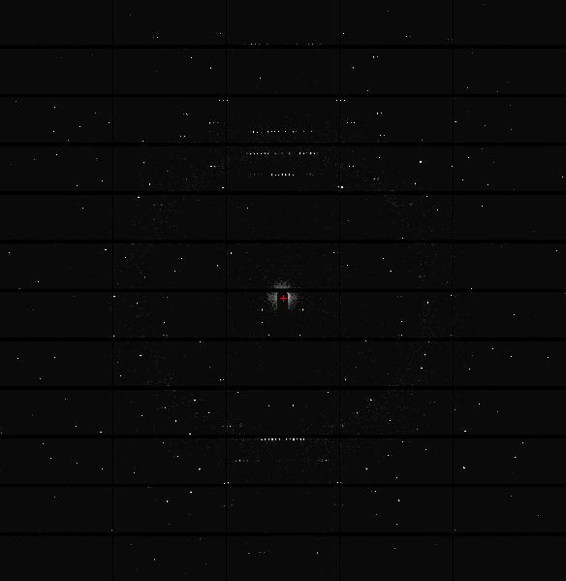
Axis-aligned image

Slide 15
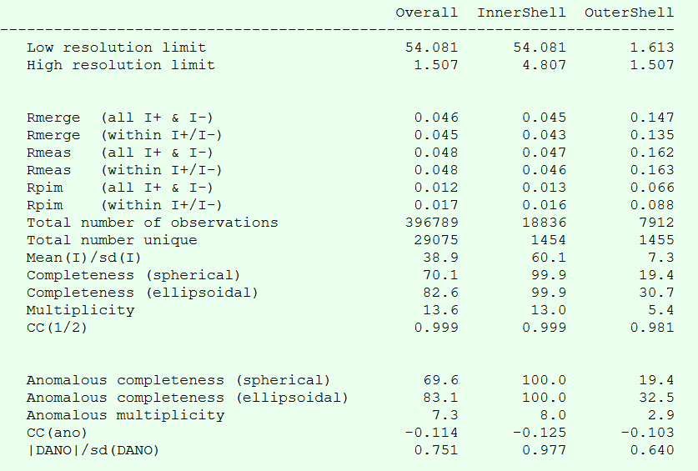
Thaumatin data

Slide 16
Contents
Introduction
Workflows and examples
DEMO
Status
GΦL

Slide 17
Contents
Introduction
Workflows and examples
DEMO
Status
GΦL

Slide 18
Testing over past year
Two visits and five remote test sessions at ESRF ID30B
Completed debugging and improved Qt3 version
Successful execution of
Translational calibration
Diffractometer calibration
Single-wavelength, two-orientation data collection workflow
Ported to master (Qt4) and further improved
Newer MXCuBE version much easier to work with

Slide 19
Plans for coming year
Test and install Qt4 version at multiple beamlines (ALBA, SOLEIL, more welcome)
Make phasing strategy workflow available for use by early adopters
Test native data strategies
Extend integration to MXCuBE v3 interface Some help may be required

Slide 20
Thanks to
Andrew McCarthy, Antonia Beteva and Marcus Oscarsson for testing and assistance at the ESRF
All the MXCuBE developers for help and collaboration
also for dockers, mock objects, and structured repositories
My colleagues at Global Phasing.

Slide 21
END
GΦL

