Slide 1
Flex robotics: a versatile sample changer for macromolecular crystallography applications
Control software and MxCube integration

Slide 2
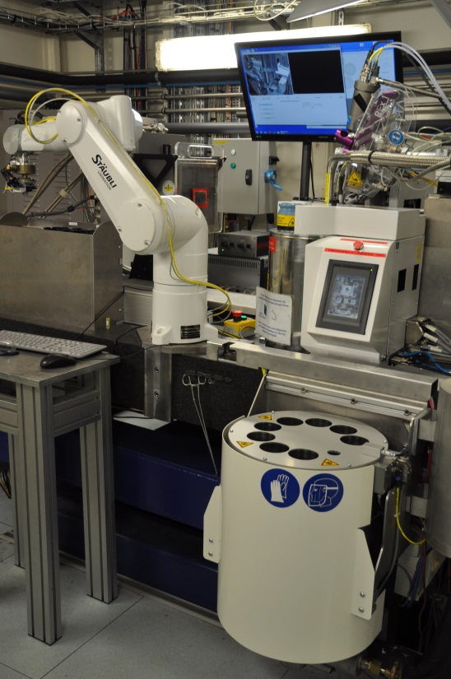
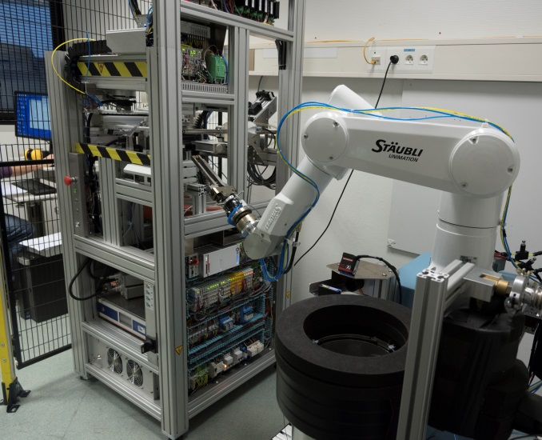
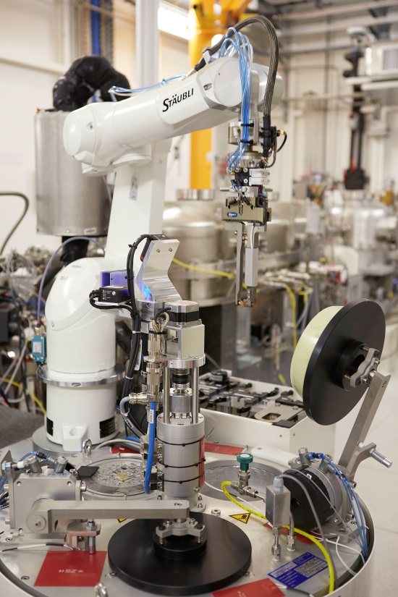
Flex robotics variants
FlexED8
FlexED3
FlexHCD
ED3 : EdgeDewar3
ED8 : EdgeDewar8
HCD : High Capacity Dewar

Slide 3
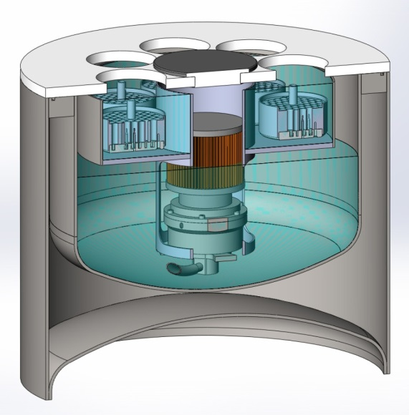
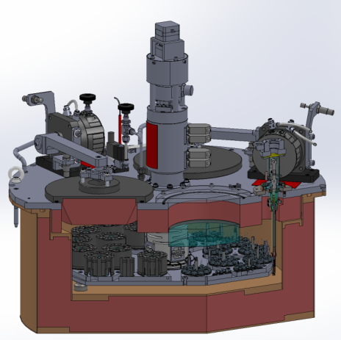

Dewars
ED8: EdgeDewar8
Patented EMBL design
Open (no ports)
Self cleaning
Permits short dewar access
Eight uni-puck footprint slots
ProxiSens puck detection system
HCD: High Capacity Dewar
Modified ESRF design
12 SC3 puck footprint & 12 uni-puck puck footprint
ProxiSens puck detection system

Slide 4




Control software architectures
Two ≠ software architecture with same StaubCom device server
MxCube
Java high level control software
StaubCom
low level server
Exporter
protocol
StaubCom
protocol
Python client
StaubCom protocol

Slide 5

StaubCom generic device server and API for Staubli robots
Socket based Ethernet communication with clients
Core Features:
Keep-alive messages
Update and log messages about robot status
Dynamic loading of custom movement sequences and custom PLCs
The API permits to implement custom:
Movement sequences
PLCs
Variable and IO state notification to the client
Initialization and termination scripts
Log and error messages
software.embl-em.de

Slide 6
Control software architecture
MxCube
Java high level control software
StaubCom
low level server
Exporter
protocol
StaubCom
protocol
Python client
StaubCom protocol

Slide 7
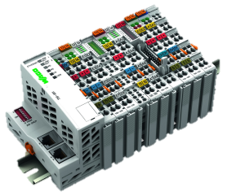
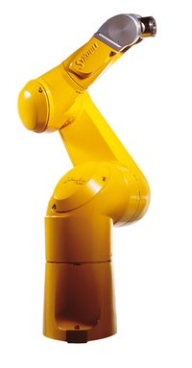
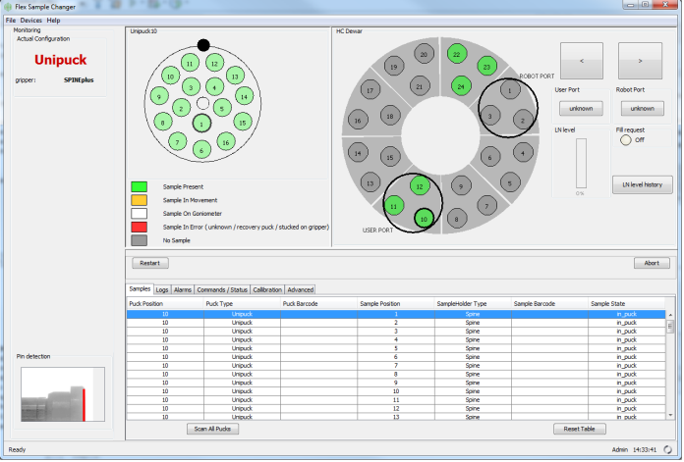
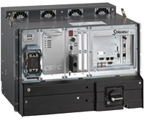
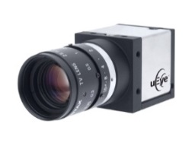
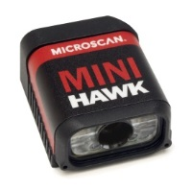
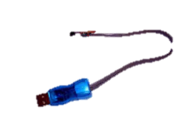
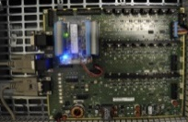

Flex robotics control architecture with Java
beamline control software (e.g.: MxCube)
VAL3 StaubCom server
Tango, Tine, Exporter, WebServices, Epics, …
IO management
Modbus
(Ethernet)
StaubCom
Protocol
Socket
(Ethernet)
VAL3
PLCs for low level regulation tasks
movement sequences:
Loading
Unloading
…
Camera + image processing:
Gripper calibration
Pin detection
DM reader
OneWire:
Gripper identification
ProxiSense Card:
Puck presence & type detection

Slide 8
Control software architecture
MxCube
Java high level control software
StaubCom
low level server
Exporter
protocol
StaubCom
protocol
Python client
StaubCom protocol

Slide 9
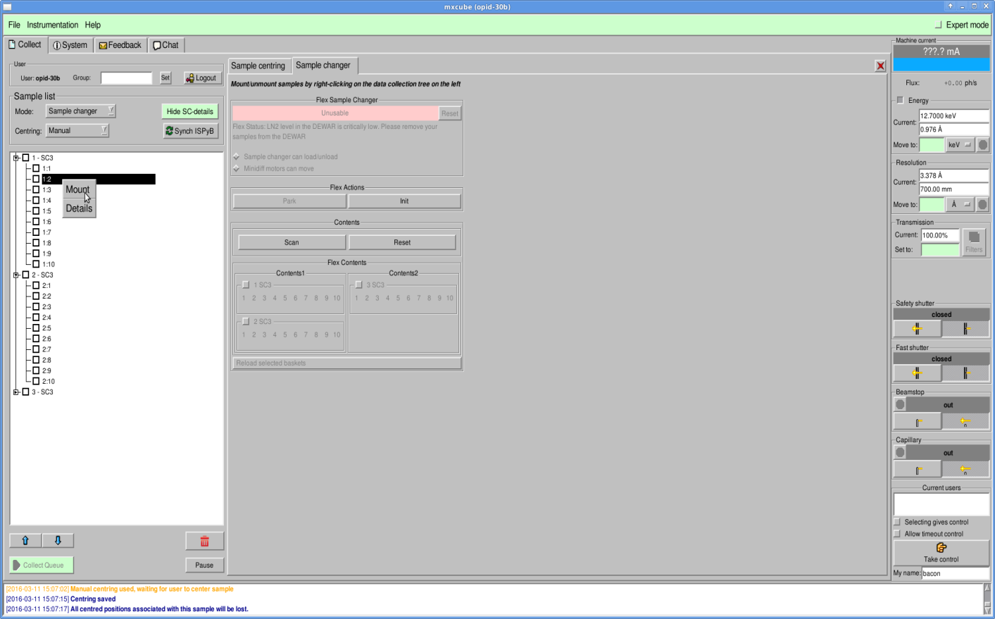
Flex robots MxCube integration
Based on the GenericSampleChanger class (Alaxandre Gobbo)
Development done by Akim Khadrouche (former BM14 technician)
Communication using Exporter protocol (JLib)
Supports events
Error and log messages
Robot status

Slide 10
Sample changers with Java control software & StaubCom device server / API
Flex robots
FlexHCD : ID30B - ESRF
FlexED8 : BM14 (dismanteled) - ESRF
FlexED3 : HTXLab – EMBL
Other sample changers
RoboDiff : Massif 1 - ESRF
NSLS-II Sample Changer: 17.ID.1 & 17.ID.2 - BROOKHAVEN

Slide 11
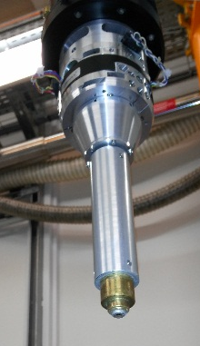
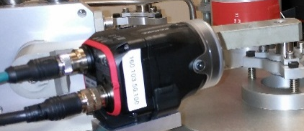
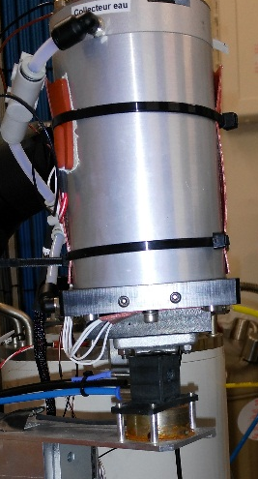
RoboDiff and ESRF-Flex-HCD
RoboDiff (Massif-1)
SPINE Sample Changer
Diffractometer
VAL3 integration of external devices
ESRF-FlexHCD
Versatile sample changer
External devices helping the sample handling

Slide 12

ESRF-FlexHCD Control software architecture
StaubCom device server
Python client integrated in a Bliss device server
MxCube
Java high level control software
StaubCom
low level server
Exporter
protocol
StaubCom
protocol
Python client
StaubCom protocol

Slide 13
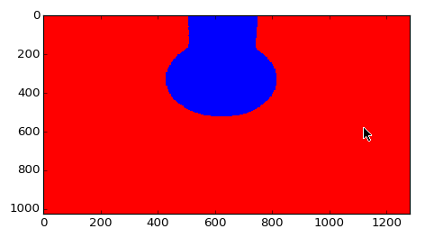
ESRF-FlexHCD Control software architecture
StaubCom device server
Python client integrated in PyFlex BLISS controller :
Trajectories handling :
Ueye camera image analysis (Lima library)
Microscan Data matrix reading (Ethernet socket)
Cached variable updates
External device :
1-wire memory reading (pyowfs)
Proxisense card (serial line socket)
Logging of StaubCom and PyFlex + Command line debugging option
No GUI
automatically exported as a generic TANGO server

Slide 14
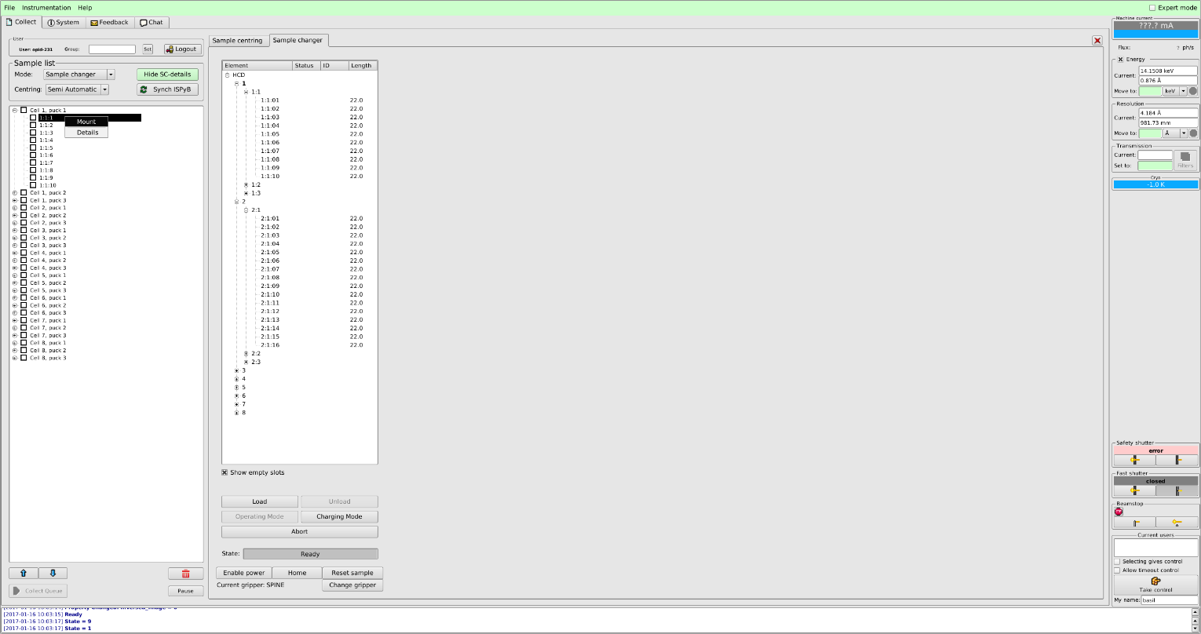
ESRF-FlexHCD integrated in MX-CuBE2
Sample Changer Tab using the generic sample changer Class :
Sample position list
Basic commands:
Loading / unloading
change gripper
Sample reset
Abort
Data collection list:
Chained loading
Automatic processing

Slide 15
Acknowledgements
EMBL:
Gergely PAPP
Marcos LOPEZ-MARRERO
Christopher ROSSI
Robert JANOCHA
Franck FELISAZ
Clement SOREZ
Florent Cipriani
Andrew MC CARTHY
Hassan BELRHALI
Akim KHADROUCHE
Babu MANJASETTY
Stephen CUSACK
ESRF:
Didier Nurizzo
Matias Guijarro
Antonia Beteva
Fabien Dobias
Hugo Caserotto
Thierry Giraud
Pascal Theveneau
Gordon Leonard

