Slide 1

ESRF Status report

Slide 2
ESRF STATUS
Since last meeting….
Completed installation of ID23-2 with MD3up and FlexHCD exclusively with Unipucks
Fast meshes available on all MD equipped stations and in a different fashion on MASSIF 1
All MX stations (but one) on bliss control system
Migration to v2.2 ready for MXCuBE3
New control PCs running Debian8 being installed to prepare transition to MXCuBE3

Slide 3
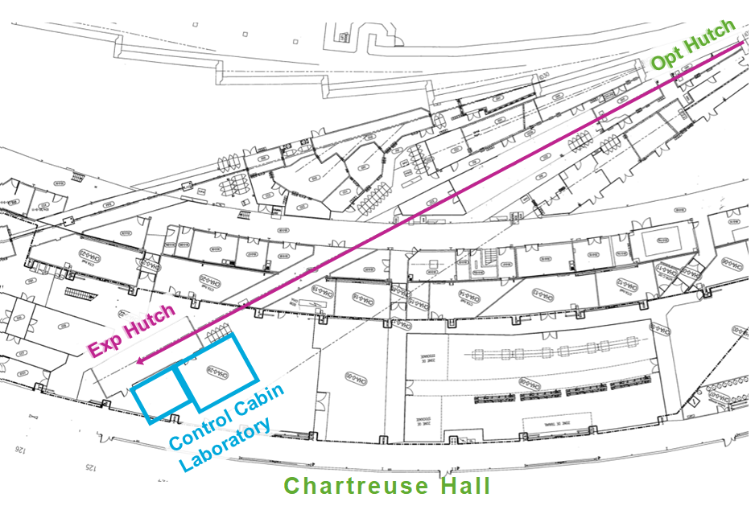
June 2017 Council endorses the upgrade of ID29
Technical Design Review (TDR) is in preparation
ID29 to become a (long) SSX beamline with extremely high flux density - up to 10¹⁶ ph/s in a submicron beam spot
The development of MXCuBE3 to include novel data collection methods and protocols, the data analysis pipeline and the evolution of LIMS will be included in the TDR

