Slide 1
SmarGon on Proxima 1
AT for MXteam@ Synchrotron SOLEIL
MXCuBE Meeting, Diamond Light Source, UK

Slide 2
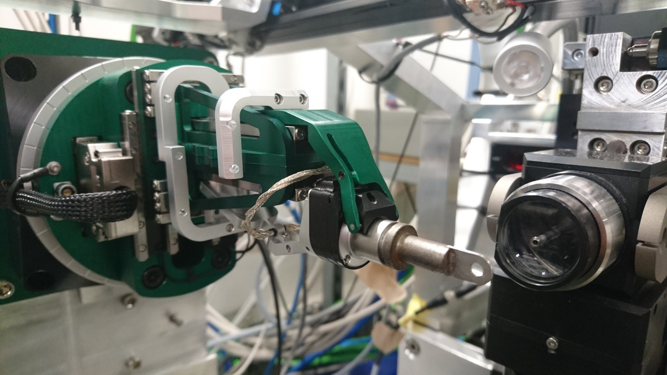
Implementation - time line

Slide 3
Implementation - time line
~2007
2016
2017
Crystal Logic
kappa
08
09
10
11
12
01
02
03
04
05
…
today
First delivery
Second delivery
In use
off-line tests
off-line tests
First installation
Second installation
Removal
back to SmarAct

Slide 4
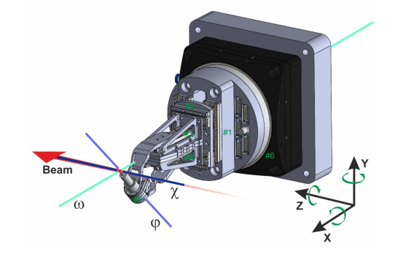
Reminder - Coordinate system
Omega - #6
Phi - #5
Chi - #3 & #4
X - #3 & #4
Y - #1
Z - #2

Slide 5
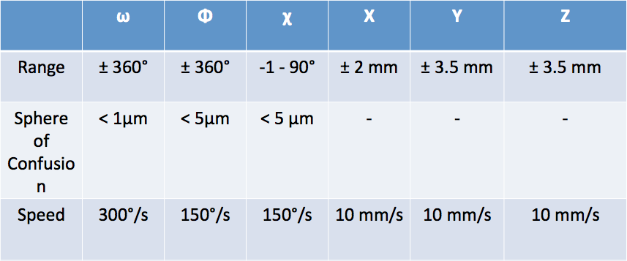
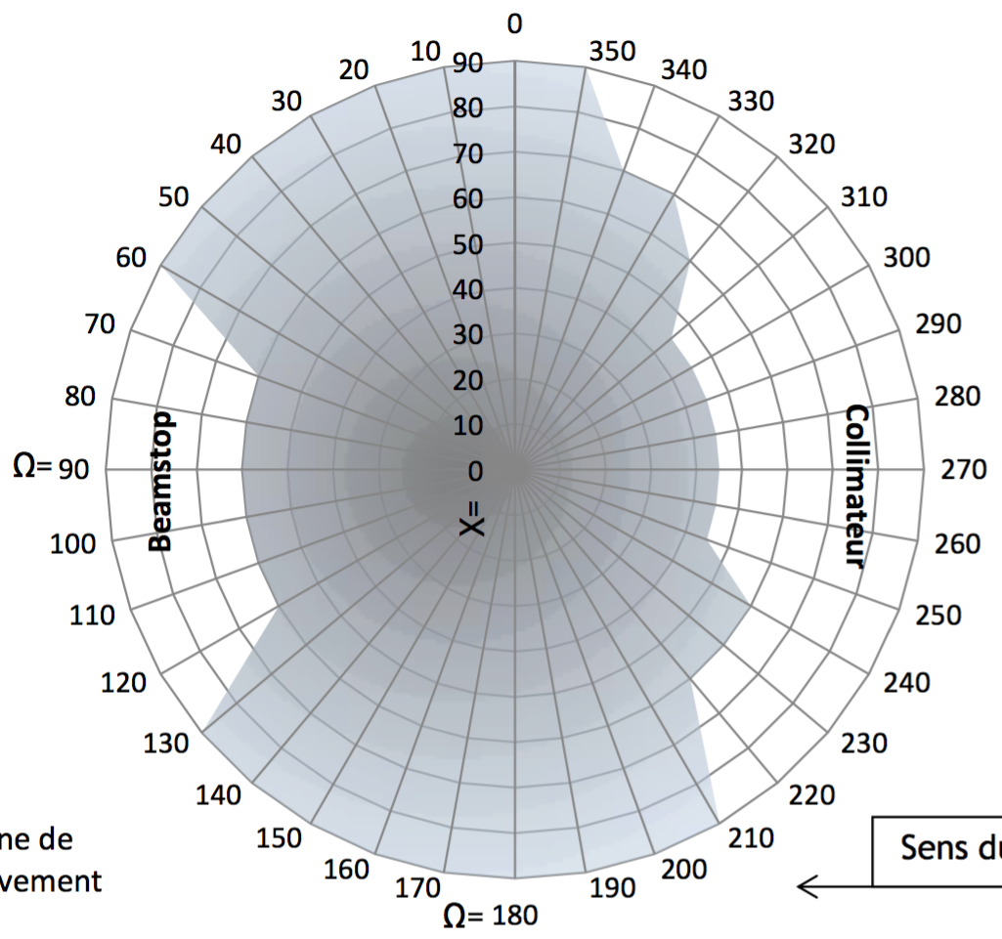
Goniometer range and measured S-O-C
For now, the Chi angle has been limited to < 50º to avoid any collision while turning Omega by 360º
Beam direction

Slide 6
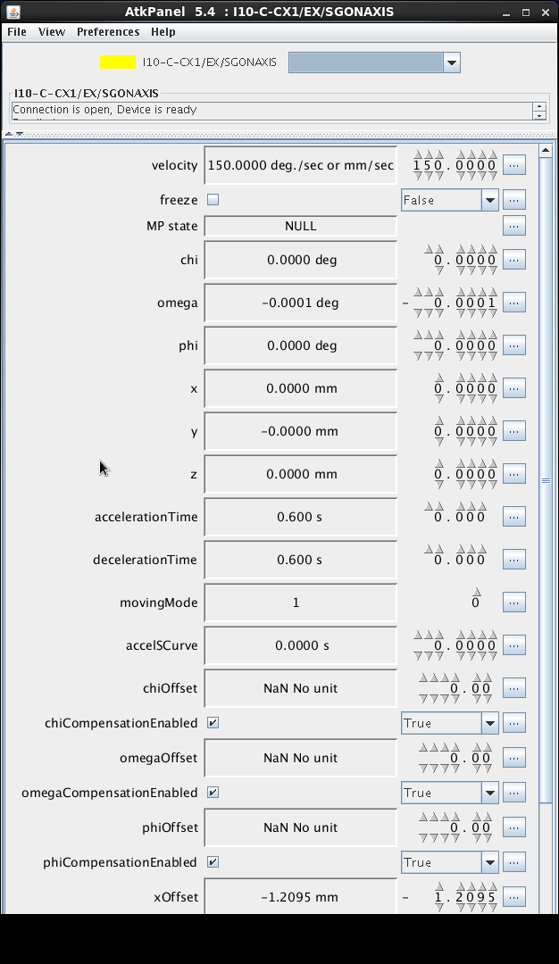
IT Environment
Environment at SOLEIL PROXIMA-1:
Tango communication protocol
specific C++ Tango device server (ds_SGonPPMAC, SGONAXIS)
Python-based clients (MXCuBE)
SmarAct-made GUI only used during the calibration processes

Slide 7
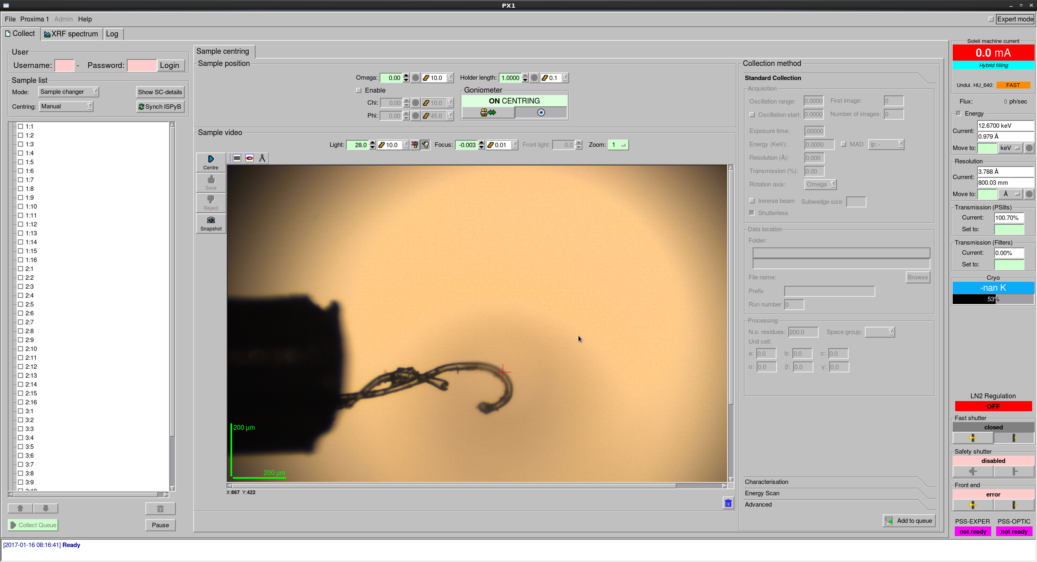
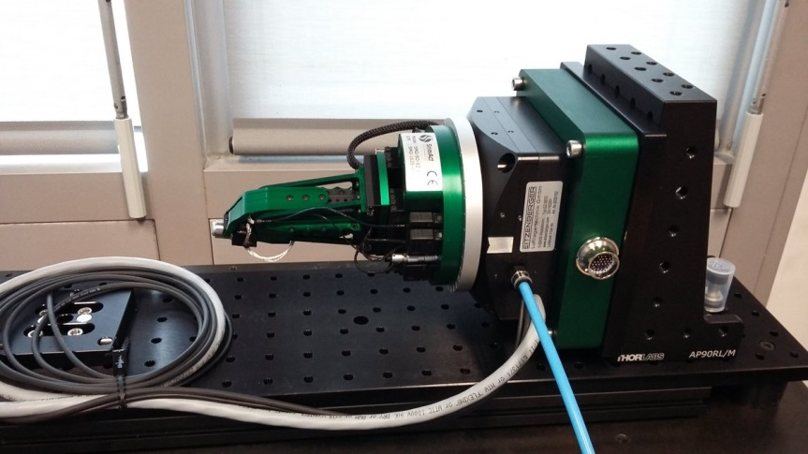
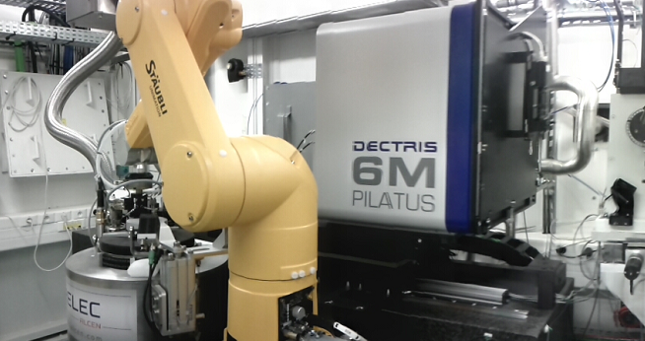
Implementation – control
C++ Tango Device Servers
SGonAxis : Implements control functions
SGonBox : Status of controller
SGonBoxData: Readback of data from controller.
Python
PX1Environment.py : Robot status, detector position, beamstop, collimator, Cryocooler, Keyence lasers and lighting positions
Collect.py : Data collection (Goniometer speed, angular range, shutter, detector mode)
CATSCryoTong.py (Robot trajectory, approach, synchronisation with Smart magnet)

Slide 8
Implementation – some details
SGonAxis : Called by - Collect server, individual axes move, PX1Environment... Much work, overseen by Bixente, to make MXCUBE interface fluid (cache requests in device server).
Use SmarGon calibration routines, offset mode to keep reference to beam position.
Still use Keyence laser for pin detection (SmarGon pin detection doesn’t work well for all types of pins)
Future : Implement helical scans once Qt4 tested on PX1 (well advanced) – needs modification of Collect server and implementation in MXCUBE

Slide 9
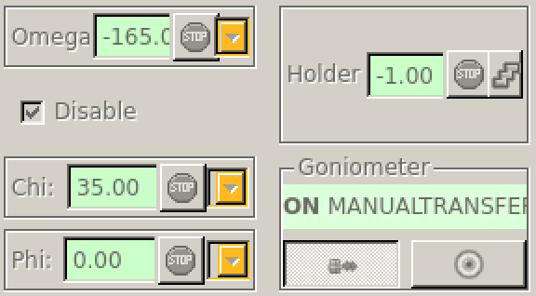
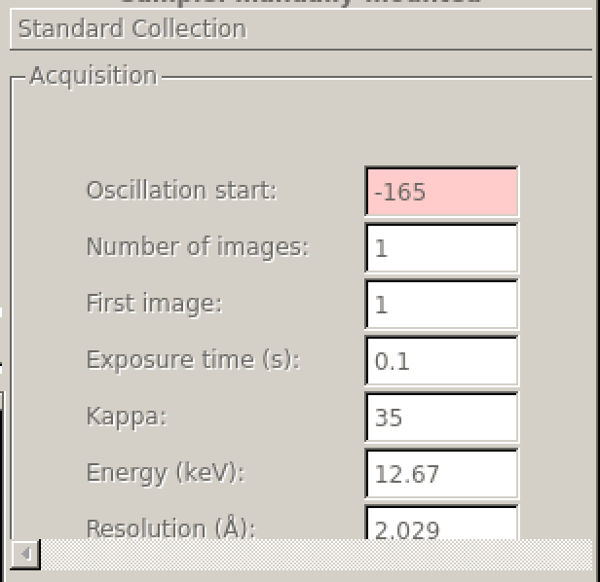
SmarGon in MXCuBE
v. Qt3
v. Qt4

Slide 10
SmarGon vs Crystal Logic
SmarGon (+)
More precise and faster. Better 3D accessibility, less shadowing.
SmarGon (-)
More fragile, ω stage less precise , less therla inertia.

Slide 11
Implementation – connection to CATS
Synchronisation with robot critical :
Smart magnet « shape not optimal » and CATS « collision sensing » too coarse : modified diameter to give more margin at transfer and used trajectory « slow down » prior to placing a sample.
« Timeout» 20 s after every robot sample mount, during which further transfer is disabled (avoid freeze-thaw).
Current record 1219 succesful transfers between failures : statistics being monitored.

Slide 12
Conclusions
After initial problems, SmarGon has been working reliably on PX1 since May 2017.
TANGO device servers are shareable (not many sites use TANGO….)
Collect and PX1Environment servers are very specific to PX1 – not easily shareable. Experience in them is.
Future : Qt4 soon, then Helical scans, sample centring with χ non zero, consider replacing ω axis with Crystal Logic ω, EIGER on PX1 from Summer 2018.

Slide 13
SmarGon in MXCuBE
v. Qt3
v. Qt4

Slide 14
Differences with previous gonio
overall, better sphere of confusion, faster centring
hardware more compact, allowing to decrease the minimum detector distance from the sample to 140 mm (previously 190 mm), shadowing, better collision map
less robust, limiting sample manual mounting to experienced users
control of the Omega rotation axis (used for data collection) less accurate
dead-time of 20sec in between samples before new loading
Planned implementations
Sample centring with a Chi angle different than 0º
Implementation of the HelicalScan data collection
Finding ways to easily build shadowing maps

