Slide 1
New interactive graphical features
in Qt4 MxCuBE
Notes:
1
1

Slide 2
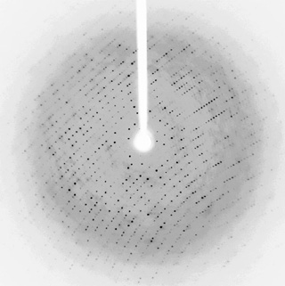

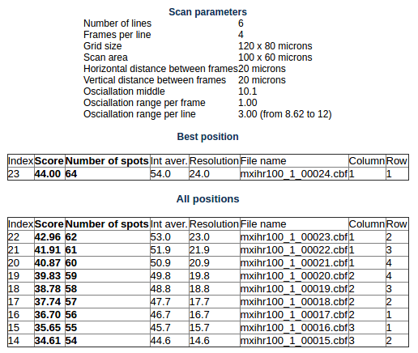
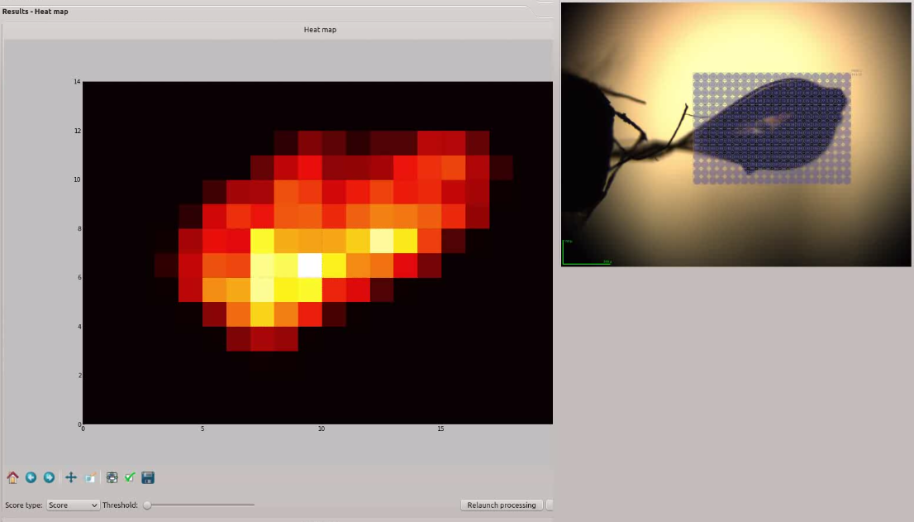
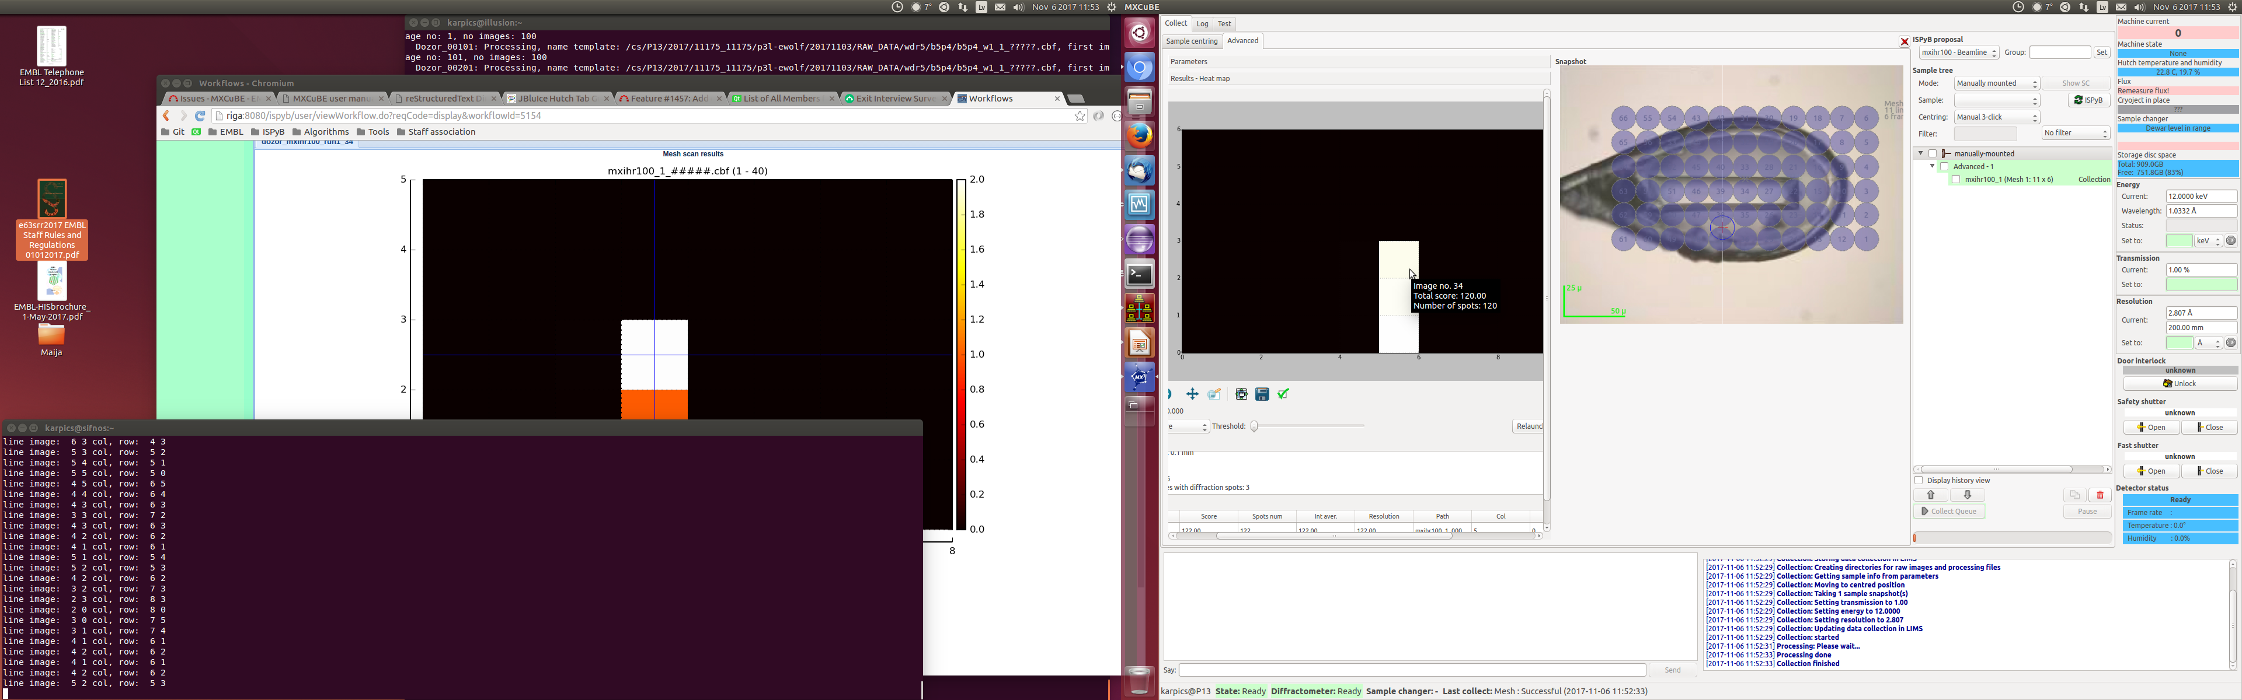
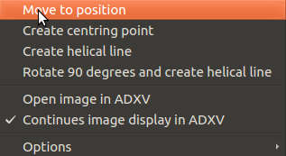
Interactive controls for mesh scans
Continuous image display in ADXV. Moving a mouse over a heatmap updates the ADXV viewer.
Hover over a heatmap opens a popup with information about the diffraction image.
Tools to perform manual xray centering.
More information stored in the ISPyB. Representation in EXI is missing.
Joint MXCuBE/ISPyB meeting
Notes:
2

Slide 3
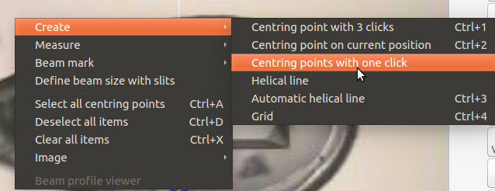
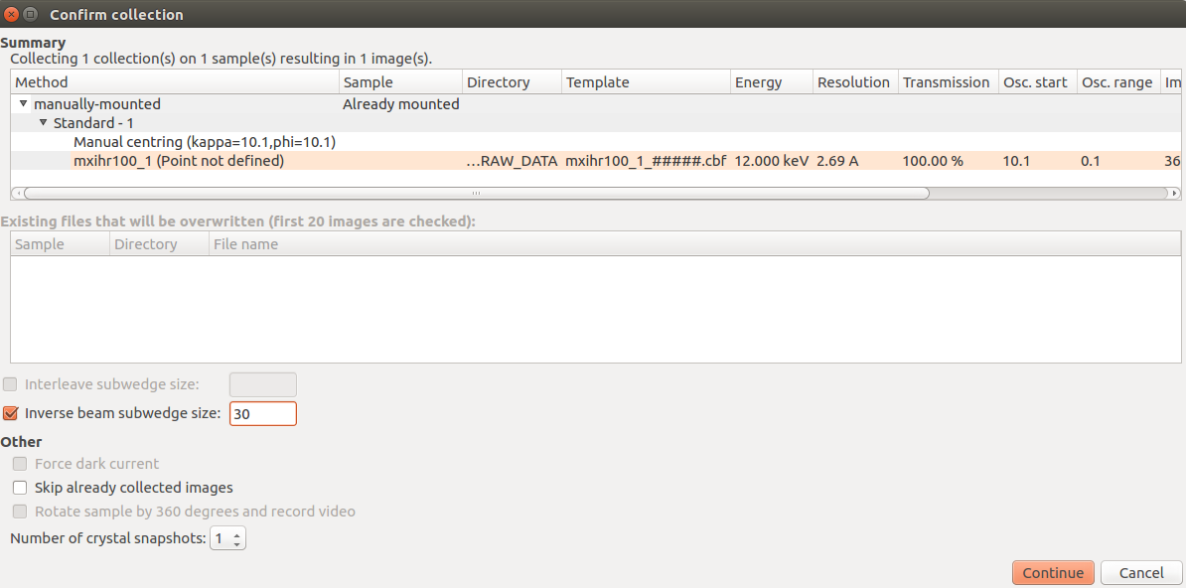

New features
One click centering for fast crystal screening.
Inverse beam data collection. Add a single data collection item and define wedge size in the confirmation dialog. Execution done via queue and in the ISPyB a single “Collect-Multiwedge” item is stored.
Joint MXCuBE/ISPyB meeting
Notes:
3

Slide 4
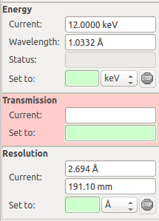
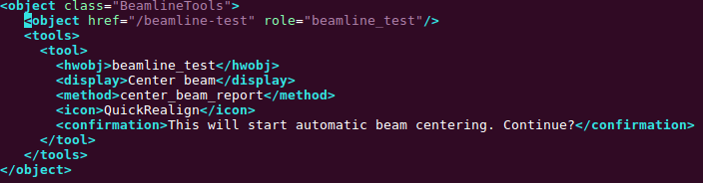

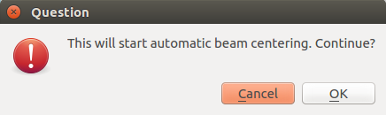
New features
Log about initialized and not initialized hardware objects.
Brick is painted red if the loading of the corresponding hardware object fails.
A generic way how to define procedure call from the toolbox. It is possible to define procedures in the xml adding icon, hint and confirmation dialog.
Progress dialog to block GUI during important procedures.
Joint MXCuBE/ISPyB meeting
Notes:
4

Slide 5
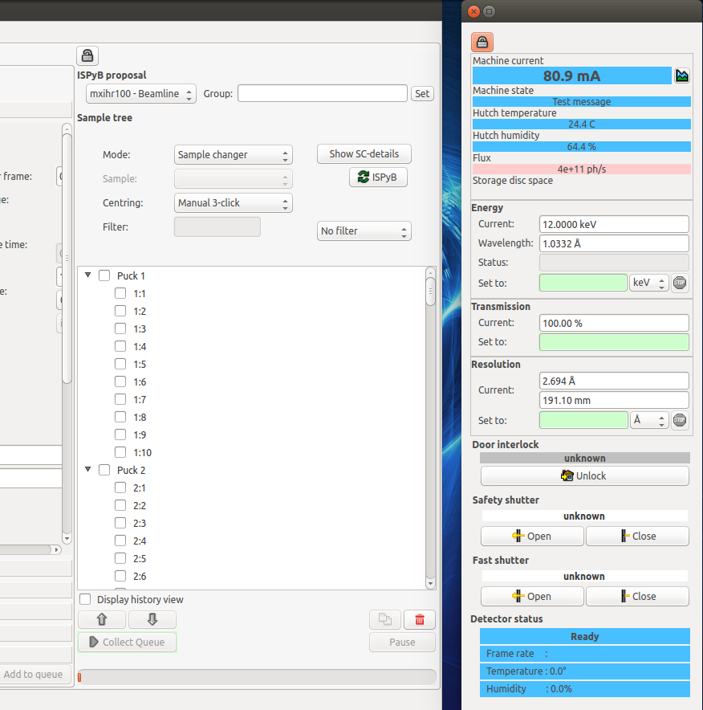
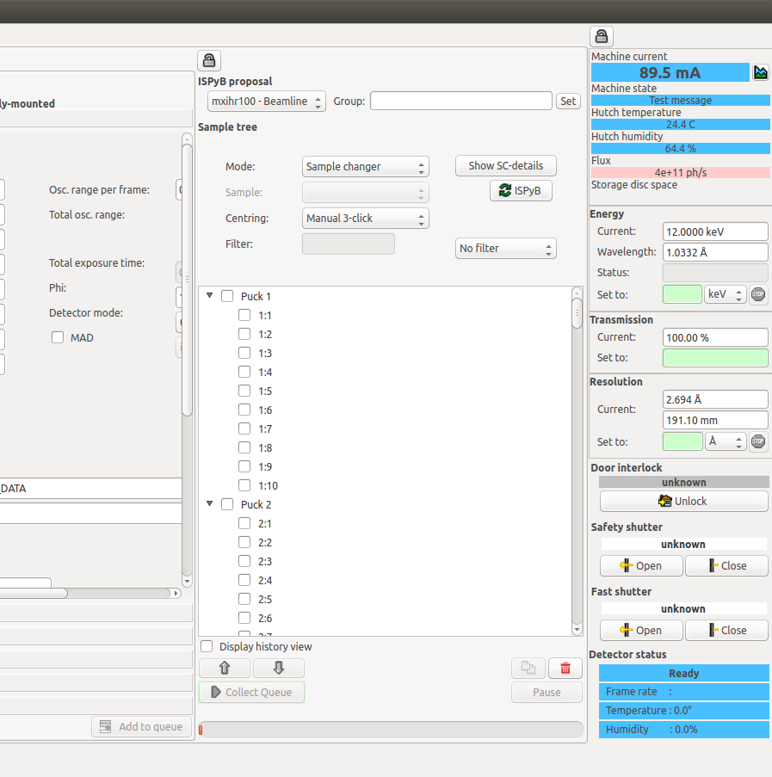
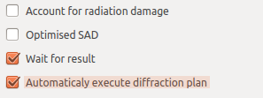
New features
Added “Wait for results” and “Automatically execute diffraction plan” to the characterization widget. User can choose execution scenario.
In the expert mode it is possible to move a widget to a new window.
Joint MXCuBE/ISPyB meeting
Notes:
5

Slide 6
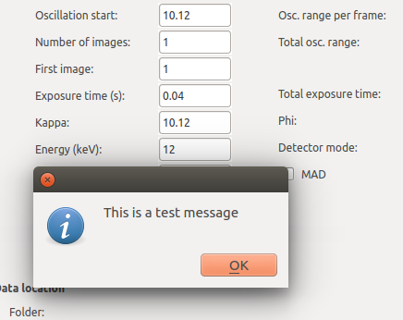
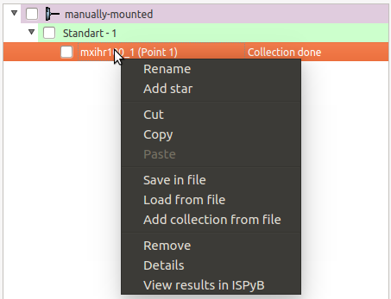
New features
A script to send a message via XMLRPC to MXCuBE. Used to communicate with remote users.
Executed items in the queue linked to the ISPyB. “View results in ISPyB” opens a new page in the web browser describing the data collection.
Joint MXCuBE/ISPyB meeting
Notes:
6

Slide 7
Thank you for you attention!
Notes:
7

