Slide 1

MXCuBE status @ ALBA
XALOC Beamline
Roeland Boer, Beamline Responsible XALO @ ALBA
MXCuBE meeting, Feb 2018, Diamond Light Source

Slide 2
Overview
MXCuBE2 @ ALBA
Highlights @ BL13-XALOC beamline
MXCuBE Current Status
MXCuBE Next steps

Slide 3
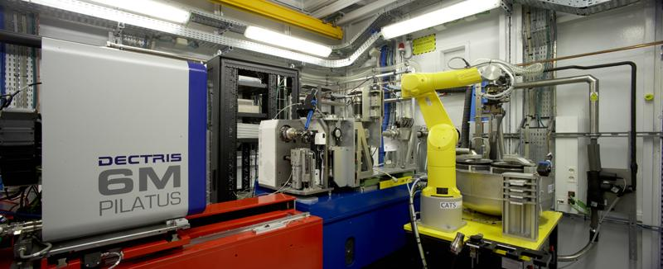
Integration of MXCuBE 2 (Qt4) @ ALBA
Xaloc Beamline (BL-13)
Beamline control based on SARDANA + TAURUS + TANGO

Slide 4
MXCuBE 2 implementation @ ALBA
Over Tango and Sardana/Taurus control layer
Graphical User Interface
Bliss Framework
python 2.x and Qt4
Control Layer
Hardware Repository
Bliss Framework Common
Hardware Objects
ALBA + MXCuBE specifics
Tango DS
Sardana/Taurus
Beamline Hardware and Data

Slide 5
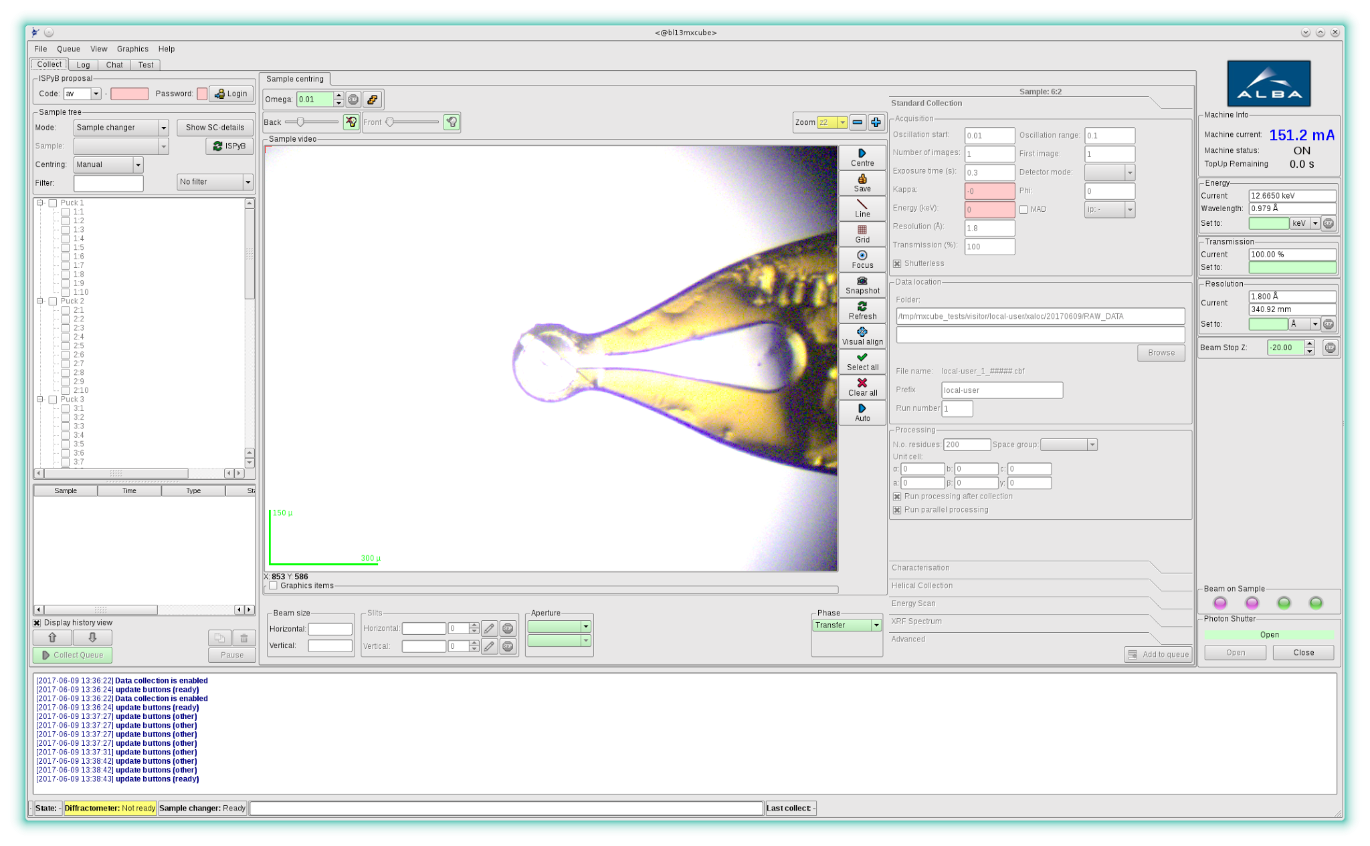
MXCuBE 2 @ ALBA
Current Status @ BL13-XALOC

Slide 6
MXCuBE 2 @ ALBA
Current Status @ BL13-XALOC
Working on Qt4/master branch.
Bixente Rey collaboration.
MXCuBE interface for all individual beamline elements.
Sample mounting (mxCATS) and centering commissioned and tested on users
Testing basic collection method implementation.
ISPyB testing stage (Daniel Salvat)
Two new Tango DS implemented XALOC:
Diffractometer
Beamline Supervisor

Slide 7
Integration of MXCuBE 2 @ ALBA
XalocDiffractometer TANGO DS
XALOC Diffractometer
Goniometer
omega, omegax,
omegay, omegaz,
centx, centy,
kappa.
Detector Table
diftabx,
diftabz.
DUSP
yagy,
yagz.
Aperture
aperx,
aperz.
Beamstop
bsx,bsy,bsz,
bstopx,
bstopz.
EPS signals
KappaPresence,
Ln2coverOpen,
SampleOnMagnet,
...
Parameters
Beamstoptype,
MountingPosition,
PinLenght,
SampleMode,
...
Phase transitions
GoBeamViewPhase,
GoCollectPhase,
GoSampleVisuPhase,
GoTransferPhase
Any HwObj from MXCuBE will always operate the equipment through this Tango DS.

Slide 8
Integration of MXCuBE 2 @ ALBA
XalocBeamlineSupervisor TANGO DS
XALOC Beamline Supervisor
Devices
Diffractometer,
SampleChanger,
Cryostream,
Shutters
EPS signals
DetDistanceSafe,
DetCoverOpen,
CryoPosition,
FastShutterCollectPosition.
Phase transitions
GoBeamViewPhase,
GoCollectPhase,
GoSampleVisuPhase,
GoTransferPhase
Function: Coordinate devices’s operation and configuration for phase transitions

Slide 9
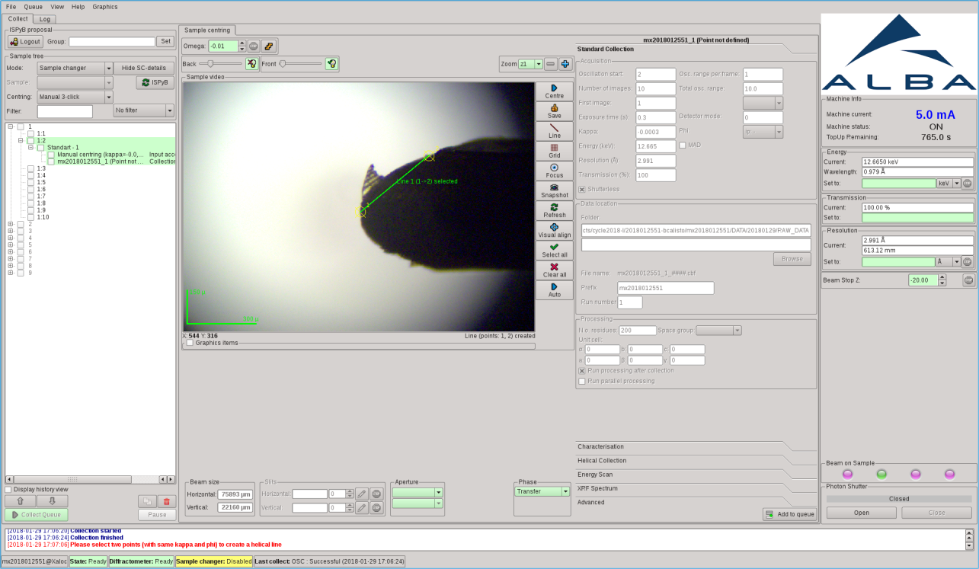
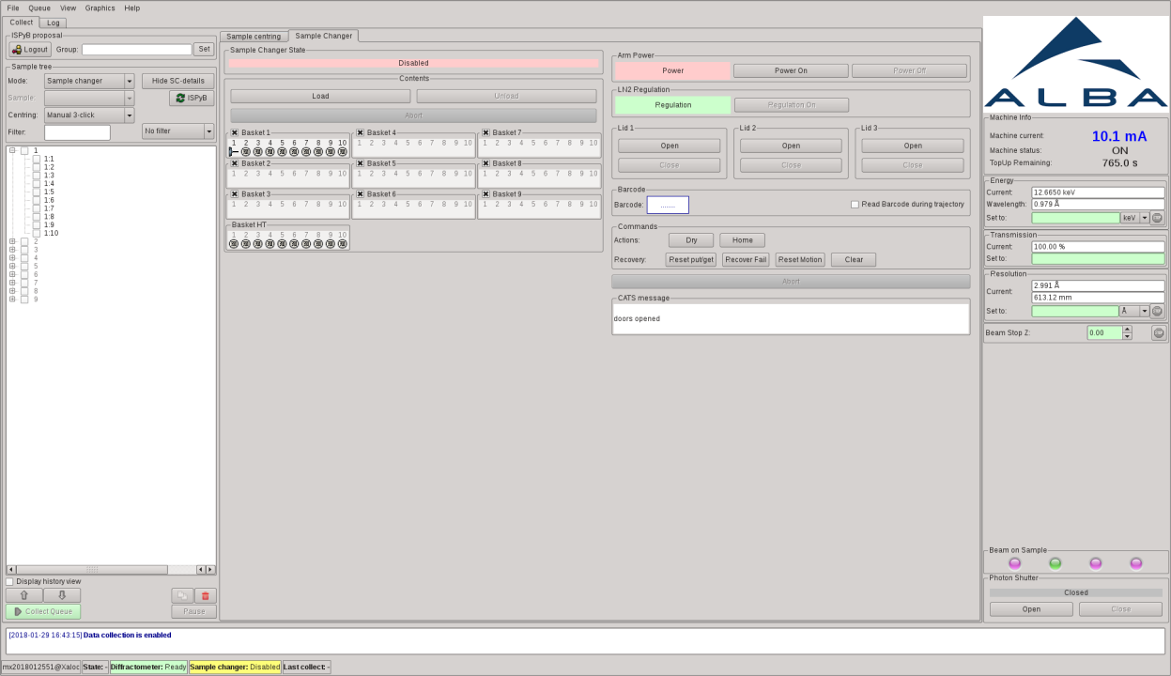
Screenshots of MXCuBE 2 @ ALBA

Slide 10

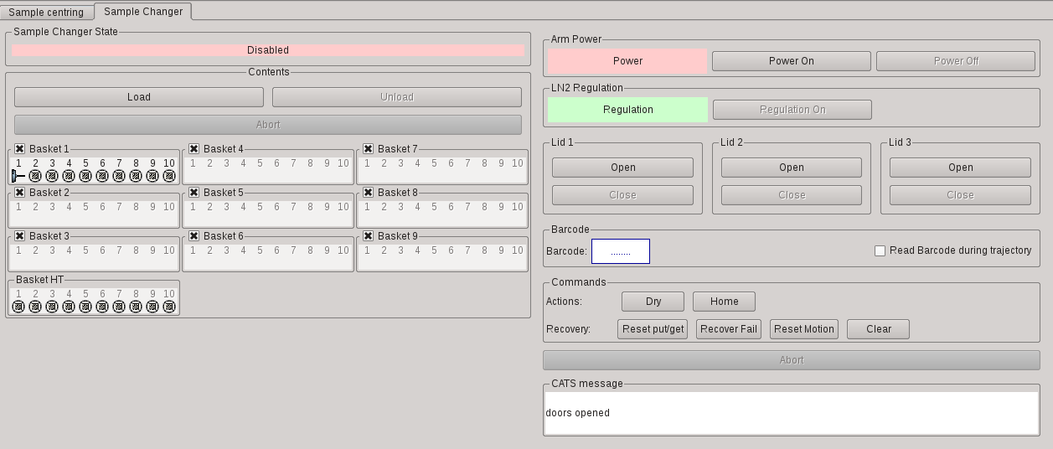
Screenshots of MXCuBE 2 @ ALBA

Slide 11
MXCuBE 2 @ ALBA
Final throes
Collection being commissioned
Data processing needs full implementation
Testing on friendly users soon

Slide 12
Acknowledgements
The people
BL13-XALOC
Roeland Boer
Judith Juanhuix
Fernando Gil
Barbara Machado
Xavi Carpena
IT-Systems
Sergi Puso
Ramon Escriba
MIS
Daniel Salvat
Alfonso Burgos
Controls
Guifre Cuni
Jordi Andreu
Externals
Bixente Rey
Thank you for your attention

Slide 13
Thank you for your attention

