Slide 1
Dual gripper sample changer implementation in MxCube
Roeland Boer
ISpyB/MxCube meeting

Slide 2
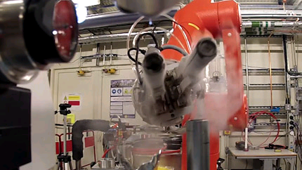
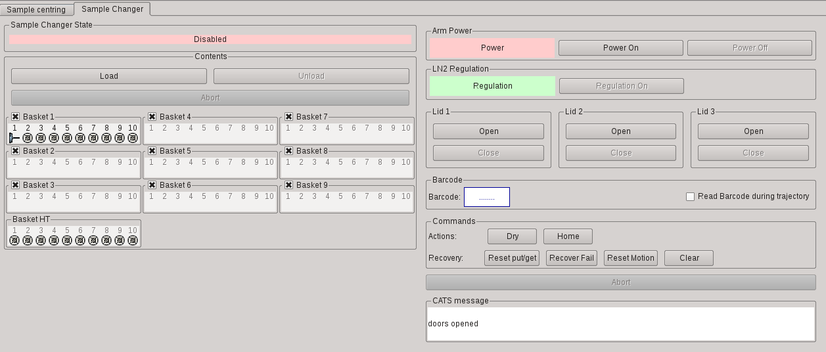
Dual gripper
Upgrade of the CATS robot to Unipuck system
Double gripper will be installed
Allows preloading samples for faster transfers

Slide 3
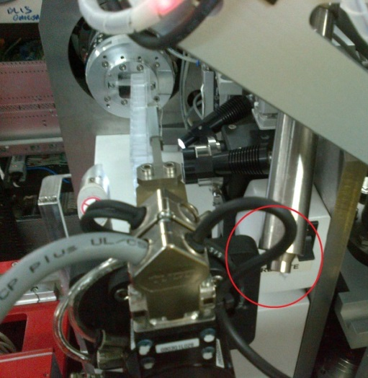
CATS grid scans
Cats x, y, z movements implemented as motors in sardana
Grid scans then implemented using these motors

Slide 4
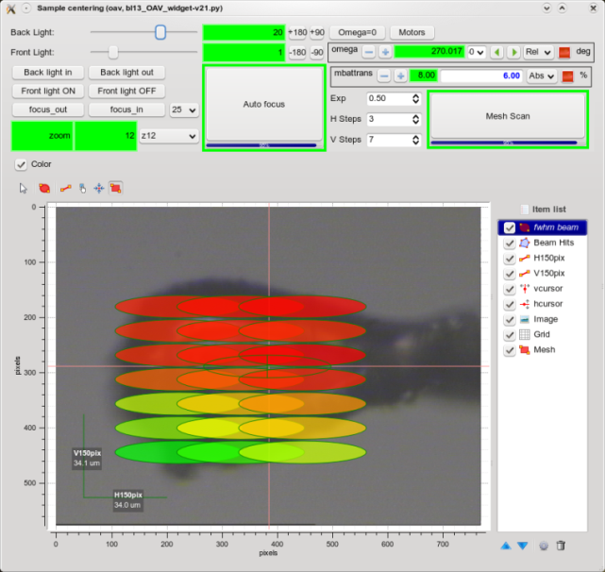
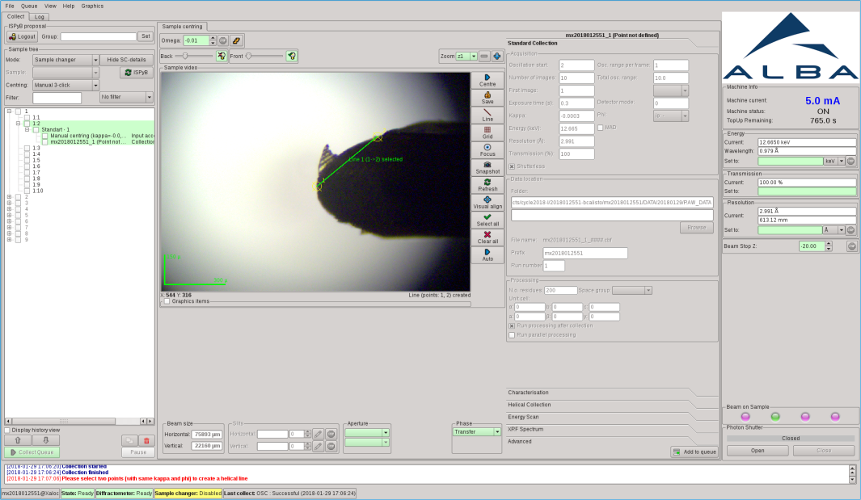
CATS grids to be implemented in MxCube
Selecting a grid in MxCube will have different behaviour depending on the state of the beamlin
The supervisor DS checks the state and decides which motors to move
Beamline Supervisor phases
GoBeamViewPhase,
GoCollectPhase,
GoSampleVisuPhase,
GoTransferPhase

