Slide 1

The BLISS Framework 4

Slide 2
The Framework v2
Is used to build complex GUI to control beamlines
By assembling complex widgets known as bricks
Each brick is connected to beamline components through “hardware objects”
A “hardware object” is an interface to our control systems (spec, Taco, Tango)
… but over time it got adapted to abstract other kind of things

Slide 3
Current limitations
100% based on Qt3
Each GUI connects to the hardware
Stored state is not shared amongst these instances
Configuration (XML files) of hardware objects is neither standardized nor assisted
Clumsy way to do connections between Bricks, and between Bricks and Hardware Objects

Slide 4
FWK4
Hardware Objects are renamed Control Objects
Still control system-agnostic
Uses Qt4, only for the GUI part
New client/server model for Control Objects
New tools to ease Control Objects configuration
New system to connect bricks together, and bricks between control objects
New GUI Builder

Slide 5
An overview of the new architecture

Slide 6
Client
Hardware
GUI
(bricks)
Hardware
objects
Hardware
GUI
(bricks)
Hardware
objects
GUI
(bricks)
Hardware
objects

Slide 7
Client
Server
GUI
(bricks)
Control
Objects
GUI
(bricks)
GUI
(bricks)
Hardware

Slide 8
Events facility: signals
Signals work like in Qt
Control Objects emit them
It let them tell the world something happened
They are connected to one or several callbacks in bricks

Slide 9
Accessing Control Objects from the GUI
Uses PYRO (PYthon Remote Objects)
Bricks access Control Objects through proxies
Concurrency is handled by Pyro

Slide 10
Connections
Connectable base class
Bricks and Control Objects are Connectables
Signals and slots:
Control objects: available signals and slots
Bricks: connection definitions containing a list of expected signals/slots
Connections are established using the Connections Editor

Slide 11
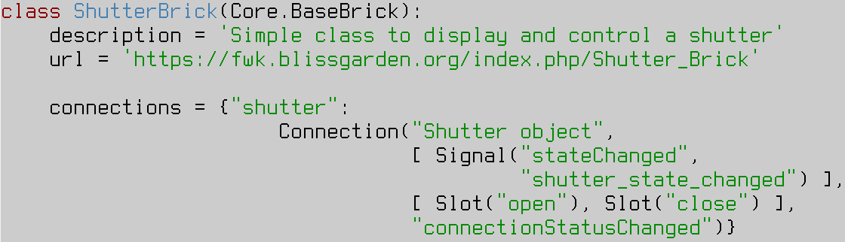
A declarative approach

Slide 12
A declarative approach

Slide 13
Why is the new architecture better
Proxys in GUI apps
Real Control Objects stay on the server
Less connections to hardware
Objects signal changes to their state
No core dependency on Qt

Slide 14
Beacon, the BEAmline CONfigurator
Allows to manage configuration files (XML) for Control Objects
Templates describe the config files
Later on, could be used to configure other beamline systems

Slide 15
Beacon: template and result
<template>
<channel name="status"/>
<channel name="state"/>
<command name="open"/>
<command name="close"/>
</template>
<object class="Shutter" username="Safety Shutter">
<channel name="status" uri="//basil/id23/bsh/1" type="taco" call="DevStatus" />
<channel name="state" uri="//basil/id23/bsh/1" type="taco" call="DevState" />
<command name="open" uri="//basil/id23/bsh/1" type="taco" call="DevOpen" />
<command name="close" uri="//basil/id23/bsh/1" type="taco" call="DevClose" />
</object>

Slide 16
GUI Builder
Tree-based GUI editor
New Application item : to set properties for the Application level
New Connection items: attached to the Application or to particular items in the tree
Other new features : Undo/Redo, sole item preview, ...

Slide 17
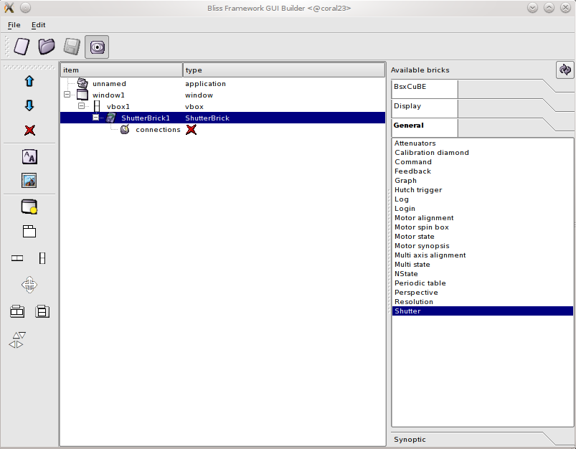
GUI Builder

Slide 18
GUI Builder: loading/saving
No more single .gui file : now a whole directory is used for each GUI application
Layout is completely separated from properties, connections
Everything is stored in a human-readable XML format
Resources (images, icons) can be copied into the directory to stay with the GUI application

Slide 19
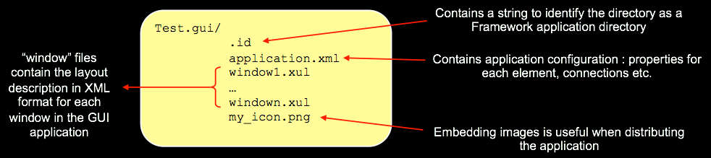
Loading/saving, cont.

Slide 20
GUI Builder: properties
Property Groups : several properties can be grouped, they are displayed in a sub-tree in the Property Editor
New Image property : any image file can be selected, otherwise provides access to the icons library

Slide 21
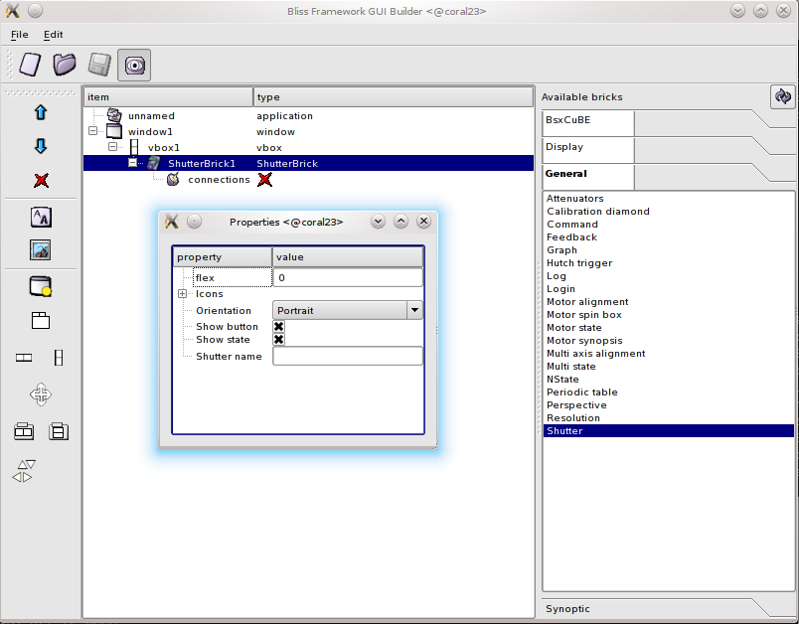
Editing properties

Slide 22
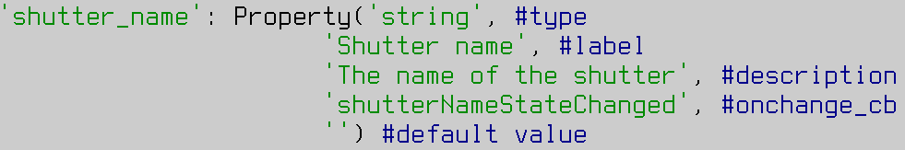
Declaring properties

Slide 23
The Framework's home
Managed using git
One submodule (repository) per brick/CO
git://git.epn-campus.eu
http://forge.epn-campus.eu
http://fwk.blissgarden.org

