Slide 1
ML Black Belt Program
Alex Graves Principal Data Architect
1Strategy

Slide 2
Problem
Using Amazon Review data for products sold on amazon.com, build a topic model that can categorize input reviews.
Pole | Title | Review
1 | Terrible product | I hated this thing from the moment I saw it. I don’t know why I bought it. What was I thinking, now I have to buy a time machine and go back to prevent myself from paying for this.
1 | Worst gift ever | My wife bought these shoes as a gift for me, but there were two left shoes in the box! I couldn’t get ahold of anyone to return them, so now I’m stuck with shoes that match my dancing ability.
2 | I love this thing!!! | This thing is amazing. Everyone should own one, or two, or three. An. Essential. Must. Buy

Slide 3














NTM State Machine
Application
Product Review Data Bucket
S3 Event Trigger
Ingestion Job
Job Code
Bucket
Preparation Job
Crawler
processing-job
Image
Processing Job
processing-job
registry
NTM Model
Notebook
Training Job
Training Instances
ntm-model
Model Storage
Bucket
Batch Transformation

Slide 4
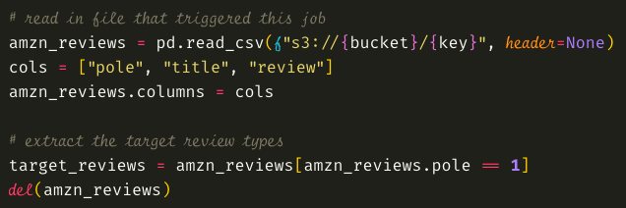
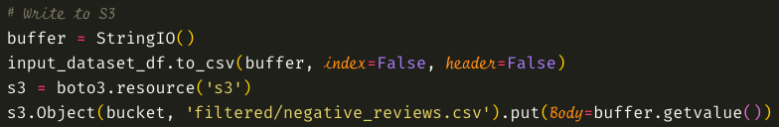
Ingestion Job
Read in data and filter out negative reviews
Write output to S3

Slide 5
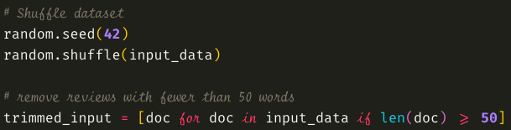
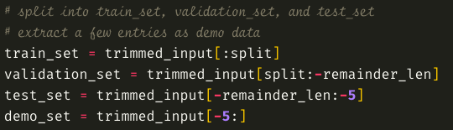
Preparation Job
Shuffle dataset and remove potentially
unhelpful samples
Split into necessary datasets for training

Slide 6
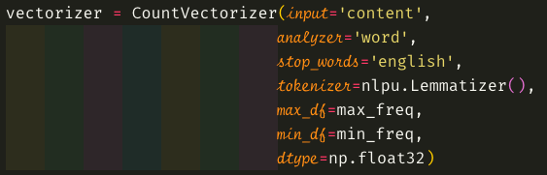
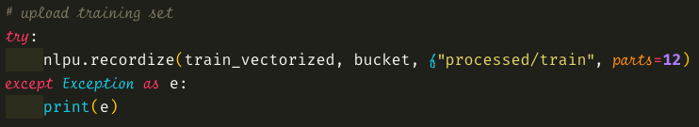
Processing Job
Vectorize each dataset using the CountVectorizer
class from sklearn. Use English stop words, analyze
only individual words from each document, limit
word frequency (here max_/min_ freq are set to
90% and 1% respectively). Use Lemmatization as the
tokenizer strategy.
Convert to RecordIO Protobuf format and upload to S3.

Slide 7
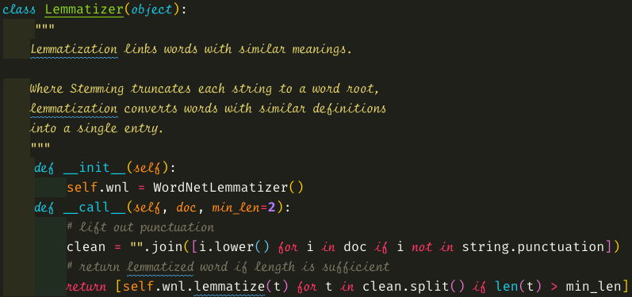
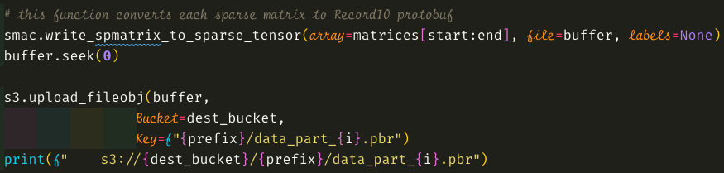
Processing Job Cont.
Lemmatizer class tokenizes on lowercase words
that are not punctuation marks. It also enforces
a minimum length for each word tokenized (in
this case 2 characters long)
The recordize() function uses the
write_spmatrix_to_sparse_tensor() method
within the SageMaker SDK to convert each
document into RecordIO Protobuf and uploads
them to S3.

Slide 8
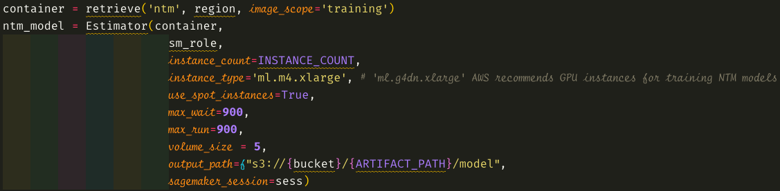
Training Job
Use the ‘ntm’ container to build a training job. Instantiate the Estimator class with an instance_count that matches the number of training files output by the Processing Job. The training job would run best on GPU instances, but there weren’t enough available in my account under its service quota. Lastly, train using spot instances for a lower cost.

Slide 9
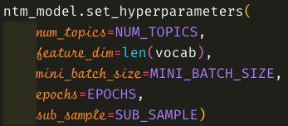
Training Job Cont.
Set all hyperparameters for the model. Here are the
Settings used in the recording:
NUM_TOPICS = 10
len(vocab) = 425
MINI_BATCH_SIZE = 300
EPOCHS = 70
SUB_SAMPLE = 0.7
The feature dimensions have to be the same as the length of the vocabulary file. I chose 10 topics because it
gave the most reasonable results during my various training scenarios. Originally, I set the mini_batch_size to
600, but this proved to be too large for the model to converge. There were many topics with similar main words
so the final value is much smaller. I set the epochs to 70 because larger values resulted in much longer
training times. I was balancing training time to model accuracy. I didn’t seem to hit a clear ”early ending” epoch,
so I’d like to retrain on GPU instances with a larger epoch value.

Slide 10
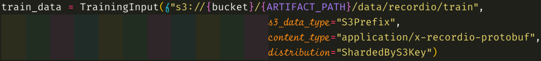

Training Job Cont.
Set input channels with proper location and data format.
The training_data channel should be “ShardedByS3Key” to
ensure the most efficient parallelized training job.
Submit training job

Slide 11
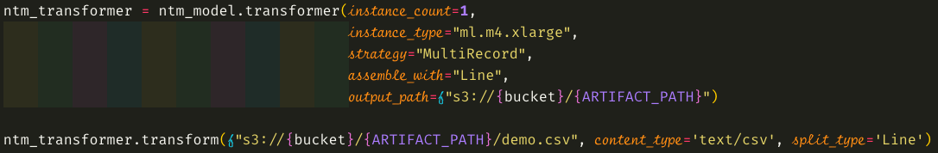
Conduct Batch Inference
Create Batch transformer object and submit transformation job.

Slide 12
Thanks for Watching!

