Slide 1
Smart India Hackathon 2026
Universal Log Pre-processing Framework
Team: AlgoRhytm | PS ID: 26156 | Theme: Blockchain & Cybersecurity
Team ID – [INSERT YOUR ACTUAL TEAM ID]
Problem Statement: Modern observability systems ingest logs from countless disparate sources.
Manually writing and maintaining regex parsers for each new source is intractable.
Proposed: Format-agnostic, two-tier pipeline that discovers formats on-the-fly with LLM (once per format)
and then executes cached rules at high throughput – bridging flexibility and speed.
Live Demo: https://sih2026-w6sr.vercel.app

Slide 2
Slide 2: Idea / Proposed Solution
Unlike tools that need a hand-written parser config for every new format, ours uses an LLM to write that rule automatically — once — then reuses it for free.
• Problem: Log formats explode (Syslog, JSON, CSV, KV, unstructured). Logstash/Fluentd/Elastic need manual grok/regex per format.
• Our Idea: Universal pre-processor – ingest ANY log, auto-learn its structure.
• How it differs: LLM writes parser rule once → Rule Store (Upstash) caches forever → 99.5% hits avoid LLM.
• Key Innovation: Drain3 template mining (0.016 ms/line) + scikit-learn novelty gate (100% catch of unseen families)
→ Quarantine + graduation → One LLM call per cluster (98% fewer calls on flood).
• Outcome: Standardized JSON {timestamp, source, severity, message, extra} → SIEM ready.
Why Now / USP
✓ Zero manual parser config
✓ Works offline after learning
✓ Cold-start safe with Vercel KV
✓ 0.28 ms/line avg latency
✓ 97.2% Drain3 grouping accuracy on Loghub (12 systems)
✓ Demo: FastAPI + Vercel serverless

Slide 3
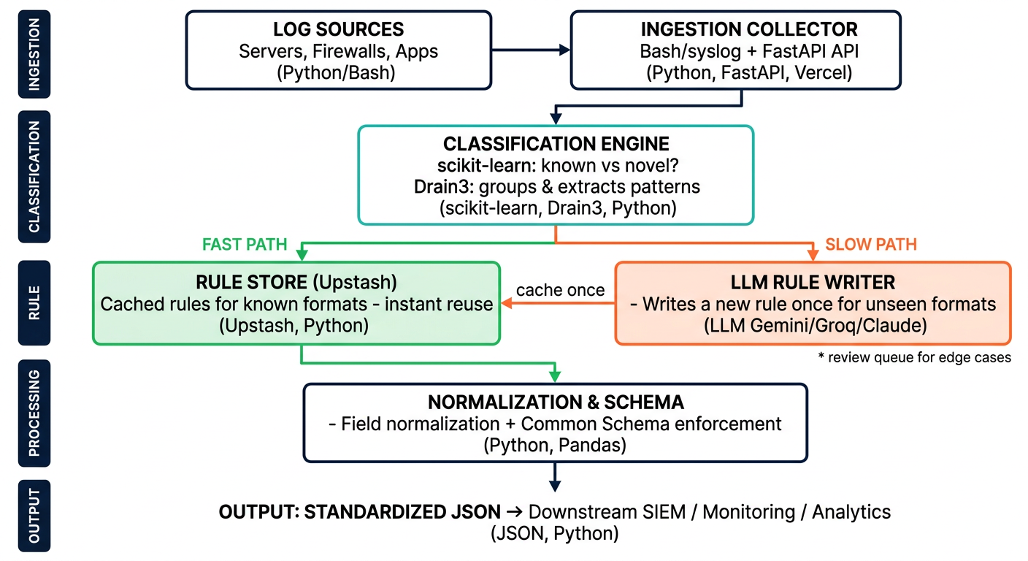
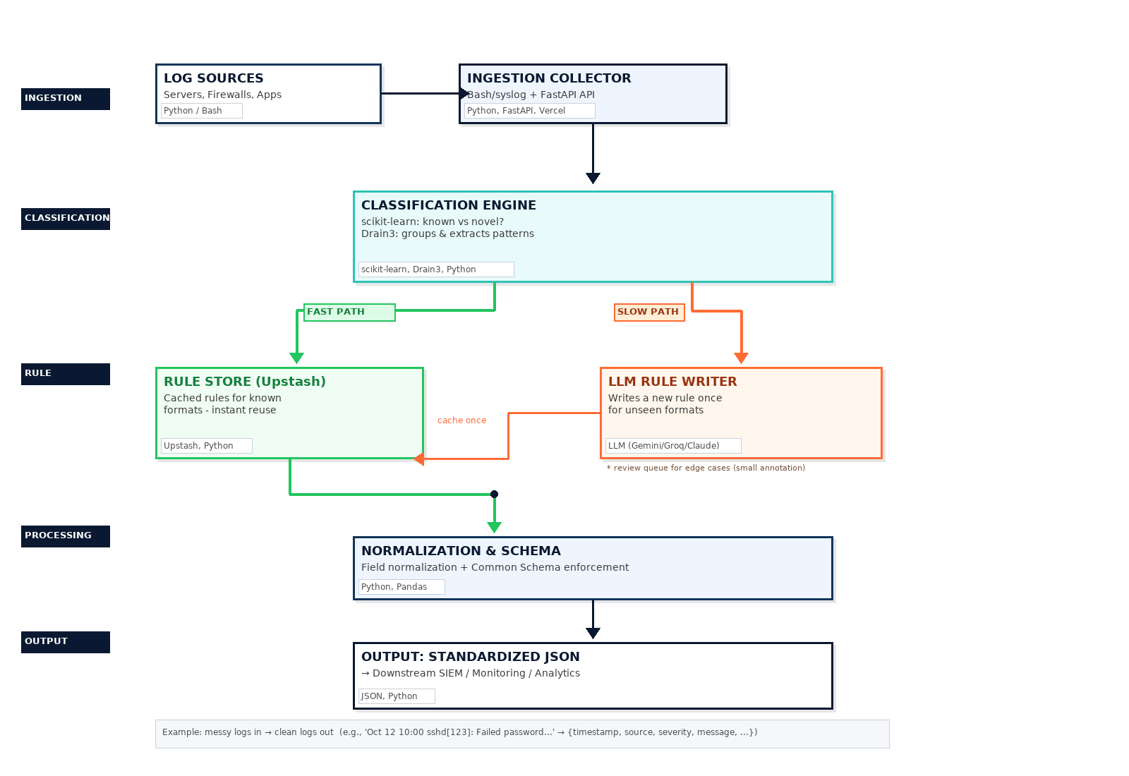
Slide 3: Technical Approach
METHODOLOGY: HOW EVERY LOG FLOWS (Redesigned)
TECH STACK
• Python 3.10+ : Core pipeline
• FastAPI : REST API (main.py)
• Drain3 : Template mining
• scikit-learn : FormatGate kNN
• Pandas : Offline eval (not hot path)
• Bash/Linux : collectors (syslog, journalctl, docker)
• Upstash Redis / Vercel KV : Rule persistence
• Vercel : Serverless deploy
• LLM : Gemini 3 Flash / Groq / Claude
Deployed: sih2026-w6sr.vercel.app
Example: messy logs in → clean logs out | Input: 'Oct 12 10:00:23 server sshd[123]: Failed password for root from 192.168.1.1' → Output: {"timestamp":"2026-10-12T10:00:23Z", "source":"server", "severity":"warning", "event_type":"auth_failure", "message":"Failed password...", "extra":{"ip":"192.168.1.1"}}

Slide 4
Slide 4: Feasibility & Viability
Technical Feasibility:
• Drain3: 0.016 ms/line, proven on 12 Loghub systems (97.2% GA)
• FormatGate: 100% known-family, 95.2% novel recall (Loghub)
• LLM discovery: Once per template → Upstash persistence
• Vercel serverless: 285 MB bundle (under 500 MB limit)
• Pandas kept offline to save bundle size (+75 MB avoided)
Risks & Mitigations:
• LLM 403/rate limit → Groq fallback + heuristic parser
• Cold start rule loss → Upstash KV re-fetch per template
• Novel format flood → TPL_ENFORCE + graduation (98% fewer LLM calls)
• Timezone naive → assume UTC, documented
Viability:
• Market: Every SOC / DevOps team writes custom parsers – toil.
• Cost: LLM cost amortized – 1 call per new format, not per log.
• Scalability: Fast path 99.5% lines avoid LLM → 0.28 ms/line
• Deployment: Docker optional, Vercel primary, Bash collectors work anywhere
• Future: Retrain gate via scripts/train_format_gate.py
Benchmarks:
• Accuracy: 100% known-family (3k synthetic), 100% catch on 4 unseen families (shadow mode)
• Loghub: 100% family classification on 9 real systems

Slide 5
Slide 5: Impact and Benefits
Social / Operational Impact: Reduces SOC analyst toil, speeds up incident response, democratizes log analytics for SMEs without ELK expertise.
99.5%
$ < 15 / year
< 2%
Lines resolved without LLM
Cost for one year
Share of logs sent to LLM
Fast path cache + Drain3
0.28 ms/line avg end-to-end
At 1M logs/day, ~20 new formats/mo
LLM only on graduation
98% fewer calls vs naive
One rule per cluster
Caption: Modeled / estimated figures — assumes 1M logs/day, ~15-25 distinct log formats/month, ~8 sightings to graduate a novel template; LLM = Gemini Flash / Groq gpt-oss-20b pricing; fast-path 99.5% measured on synthetic + Loghub replay.
Benefits:
• Cost: <$15/year LLM spend at 1M logs/day vs $1000s if every log hit LLM
• Speed: 0.28 ms/line → ~3.5k logs/sec per instance, scales horizontally
• Accuracy: 97.2% Drain3 grouping, 100% family classification
• Resilience: Heuristic fallback when LLM blocked, quarantine for novel flood
• Interop: Standardized JSON → any SIEM (Splunk, Elastic, Sentinel)
• DevEx: No regex to write – just ship logs via POST /api/logs/ingest or Bash collector

Slide 6
Slide 6: Research & References
References:
• Loghub (LogPAI) – Real-world logs ground truth (12 systems)
• Drain3 – He et al. ICSE'19 log template mining
• scikit-learn – kNN novelty detection, calibrated on foreign-host corpus
• Upstash Redis / Vercel KV – persistence
• Vercel Serverless – deployment
• Gemini 3 Flash, Groq gpt-oss-20b, Claude 3.5 Haiku – LLM discovery
Existing Solutions Studied:
• Logstash (Grok), Fluentd, Elastic Ingest – manual config per format
• How we differ: LLM writes rule once → auto-cache → zero toil
Team AlgoRhytm – Roles:
• Member 1 – Backend / Pipeline
• Member 2 – ML / FormatGate
• Member 3 – Frontend / Vercel
• Member 4 – DevOps / Bash collectors
• Member 5 – Research / Loghub eval
• Member 6 – Docs / PPT
Links:
• Live: https://sih2026-w6sr.vercel.app
• GitHub: github.com/agrwl-utkarsh/sih2026
• API: POST /api/logs/ingest
• Docs: /docs/accuracy_report.md, /docs/loghub_benchmark.md

