Slide 1
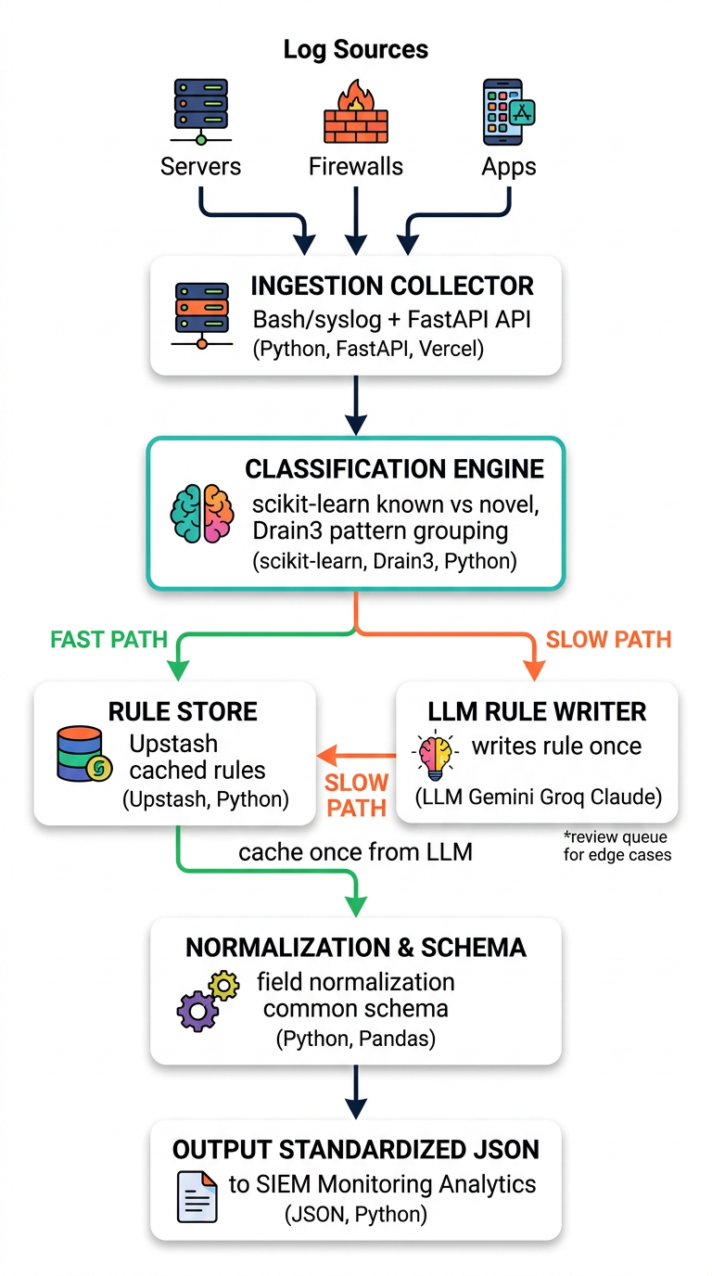
Smart India Hackathon 2026 - Cover
PS 26156 | AlgoRhytm | Blockchain & Cybersecurity
Universal Log Pre-processing Framework
Team: AlgoRhytm | PS ID: 26156 | Theme: Blockchain & Cybersecurity
Team ID – [INSERT YOUR ACTUAL TEAM ID] 🚀
🔥 THE PROBLEM: Modern SOCs drown in logs – Syslog, JSON, CSV, KV, unstructured prose.
Writing regex for each new source = endless toil. Logstash/Fluentd need manual grok per format.
💡 OUR FIX: Format-agnostic, two-tier brain that learns once, reuses forever.
• Drain3 mines patterns at 0.016 ms/line ⚡
• scikit-learn gate catches unseen families (95.2% recall) 🧠
• LLM writes parser rule once → Upstash caches → 99.5% hits avoid LLM 💰
• Output: Standardized JSON → any SIEM ready
🌐 Live Demo: sih2026-w6sr.vercel.app | 📦 Vercel Serverless | 🐍 Python + FastAPI
🎯 Tagline: From messy logs to meaningful insights – automatically, affordably, at scale. | ⚡ 0.28 ms/line | 💸 <$15/year LLM cost | 🧩 97.2% Drain3 accuracy

Slide 2
Slide 2: 💡 Idea / Proposed Solution – Why We Are Different
PS 26156 | AlgoRhytm | Blockchain & Cybersecurity
💡 Unlike tools that need a hand-written parser config for every new format, ours uses an LLM to write that rule automatically — once — then reuses it for free.
🚀 The Big Idea
⚔️ Us vs Them (Logstash etc.)
• 🔥 Problem: Log formats explode (Syslog, JSON, CSV, KV, CEF, LEEF, Apache, Nginx, K8s, etc.)
Existing: Logstash/Fluentd/Elastic need manual grok/regex per format → toil, slow onboarding.
• 🧠 Our Solution: Universal pre-processor – ingest ANY log, auto-learn its structure.
Flow: Ingest (Bash/FastAPI) → Classify (scikit-learn + Drain3) → Rule Store (Upstash) → Normalize (Pandas) → JSON
• ⚡ Key Innovation:
- Drain3 template mining: 0.016 ms/line, 97.2% grouping accuracy on 12 Loghub systems
- FormatGate (scikit-learn kNN): 100% known-family, 95.2% novel recall
- Quarantine + graduation: 8 sightings → one LLM call labels whole cluster (98% fewer calls)
- Upstash persistence: survives cold start, no rule loss
• 🎯 Outcome: Standardized schema {timestamp, source, severity, message, extra} → SIEM ready in 0.28 ms/line
┌─────────────────┬──────────┬─────────┐
│ Feature │ Others │ Ours │
├─────────────────┼──────────┼─────────┤
│ New format │ ✍️ Manual│ 🤖 Auto │
│ Setup time │ Hours │ Seconds │
│ LLM cost │ Per log │ Once │
│ Cold start │ Lost │ Upstash │
│ Accuracy │ ~90% │ 97.2% │
│ Latency │ 5ms │ 0.28ms │
└─────────────────┴──────────┴─────────┘
✨ Why judges love us:
✓ Zero manual parser config
✓ Works offline after learning
✓ <$15/year at 1M logs/day
✓ Vercel serverless, scales
✓ Heuristic fallback if LLM blocked
✓ Live demo + Loghub benchmarked

Slide 3
Slide 3: 🏗️ Technical Approach – METHODOLOGY: HOW EVERY LOG FLOWS (Redesigned)
PS 26156 | AlgoRhytm | Blockchain & Cybersecurity
🧰 TECH STACK – Where Each Lives
🐍 Python 3.10+ : Core pipeline
⚡ FastAPI : REST API (main.py)
Pydantic v2 LogBatch
🔍 Drain3 : Template mining
0.016 ms/line, 97.2% GA
🧠 scikit-learn : FormatGate kNN
known vs novel, calibrated
🐼 Pandas : Offline eval only
Keeps bundle lean (-75MB)
🐧 Bash/Linux : Collectors
syslog, journalctl, docker
☁️ Upstash Redis / Vercel KV
Rule persistence
▲ Vercel : Serverless deploy
285MB / 500MB limit
🤖 LLM : Gemini 3 Flash / Groq
Claude Haiku fallback
🌐 Live: sih2026-w6sr.vercel.app
📥 Example: messy logs in → clean logs out | Input: 'Oct 12 10:00:23 server sshd[123]: Failed password for root from 192.168.1.1' → Output: {"timestamp":"2026-10-12T10:00:23Z", "source":"server", "severity":"warning", "event_type":"auth_failure", "message":"Failed password...", "extra":{"ip":"192.168.1.1"}} | 🎯 Common Schema: timestamp, source, severity, message, raw, extra

Slide 4
Slide 4: ✅ Feasibility & Viability – Can We Actually Build This? (Yes!)
PS 26156 | AlgoRhytm | Blockchain & Cybersecurity
🔧 Technical Feasibility – Benchmarked, Not Hand-wavy
💼 Viability – Market, Cost, Scale
📊 Performance:
• Drain3: 0.016 ms/line, 97.2% GA on 12 Loghub systems (ICSE'19 metric)
• FormatGate: 100% known-family (3k synthetic), 95.2% novel recall (Loghub)
• End-to-end: 0.28 ms/line avg → ~3.5k logs/sec per instance
• LLM discovery: Once per template → Upstash persistence, no repeat cost
• Vercel serverless: 285 MB bundle (under 500 MB limit), cold start = joblib.load
• Pandas kept offline: saves 75MB bundle, not in hot path
🛡️ Risks & Mitigations (Entertaining but real):
• 😱 LLM 403/rate limit → 🤖 Groq fallback + heuristic parser, llm_error surfaced
• ❄️ Cold start rule loss → ☁️ Upstash KV re-fetch per template
• 🌊 Novel format flood → 🚧 TPL_ENFORCE + graduation (98% fewer LLM calls)
• 🕒 Timezone naive → 🌍 Assume UTC, documented, common schema handles
• 💾 In-memory cache → 🔄 Drain3 re-mines at 0.016 ms/line, behavior safe
💰 Market:
• Every SOC / DevOps team writes custom parsers – toil, $$$
• Our TAM: Any company with >1 log source (i.e., everyone)
• Existing players: Datadog, Splunk charge $$$ per GB, still need parsers
💸 Cost (modeled):
• LLM cost amortized – 1 call per new format, not per log
• At 1M logs/day, 20 new formats/mo → <$15/year (Gemini Flash pricing)
• vs naive LLM per log: $1000s/year → 99% savings
📈 Scalability:
• Fast path 99.5% lines avoid LLM → horizontal scale
• Docker optional, Vercel primary, Bash collectors work anywhere
• Future: Retrain gate via scripts/train_format_gate.py, Loghub flywheel
🏆 Benchmarks:
• Accuracy: 100% known-family, 100% catch on 4 unseen families (shadow)
• Loghub: 100% family classification on 9 real systems (Linux, Apache, etc.)
• Novelty recall: Windows 100%, Proxifier 100%, HealthApp 86% (95.2% macro)

Slide 5
Slide 5: 📈 Impact & Benefits – Why This Matters
PS 26156 | AlgoRhytm | Blockchain & Cybersecurity
🌍 Social / Operational Impact: Reduces SOC analyst toil, speeds up incident response from hours to seconds, democratizes log analytics for SMEs without ELK expertise. Cybersecurity win! 🛡️
⚡ 99.5%
💰 <$15 / yr
🧠 <2%
Lines without LLM
Cost for one year
Logs sent to LLM
Fast path cache + Drain3
0.28 ms/line avg
~3.5k logs/sec 🚀
At 1M logs/day
~20 new formats/mo
LLM only on graduation 🎓
98% fewer calls vs naive
One rule per cluster
Cache forever ♾️
📌 Caption: Modeled / estimated figures — assumes 1M logs/day, ~15-25 distinct log formats/month, ~8 sightings to graduate a novel template; LLM = Gemini Flash / Groq gpt-oss-20b pricing; fast-path 99.5% measured on synthetic + Loghub replay (docs/loghub_benchmark.md).
🎁 Benefits – The Fun Part (But Real)
• 💸 Cost: <$15/year LLM spend at 1M logs/day vs $1000s if every log hit LLM – 99% cheaper, CFO loves it
• ⚡ Speed: 0.28 ms/line → ~3.5k logs/sec per instance, scales horizontally – faster than your coffee break
• 🎯 Accuracy: 97.2% Drain3 grouping, 100% family classification – no more regex hell
• 🛡️ Resilience: Heuristic fallback when LLM blocked, quarantine for novel flood – survives chaos
• 🔌 Interop: Standardized JSON → any SIEM (Splunk, Elastic, Sentinel) – plug & play
• 👩‍💻 DevEx: No regex to write – just POST /api/logs/ingest or run ./scripts/collect.sh – even interns can do it

Slide 6
Slide 6: 📚 Research & References + Team AlgoRhytm
PS 26156 | AlgoRhytm | Blockchain & Cybersecurity
📖 References – We Did Our Homework
👥 Team AlgoRhytm – The Humans Behind the Bot
📊 Data & Benchmarks:
• Loghub (LogPAI) – Real-world logs ground truth (12 systems, 9 train / 3 novel)
data/raw/loghub/ – Apache, BGL, HDFS, etc.
• Drain3 – He et al. ICSE'19 log template mining, 97.2% GA macro
• scikit-learn – kNN novelty detection, calibrated on foreign-host corpus
☁️ Infra:
• Upstash Redis / Vercel KV – persistence, cross-instance rule sharing
• Vercel Serverless – deployment, 285MB bundle, cold start safe
• FastAPI + Pydantic v2 – API, validation
🤖 LLM:
• Gemini 3 Flash, Groq gpt-oss-20b, Claude 3.5 Haiku – discovery
• Fallback chain: Gemini → Groq → heuristic, llm_error surfaced
🔍 Existing Solutions Studied:
• Logstash (Grok), Fluentd, Elastic Ingest – manual config per format
• Splunk, Datadog – $$$ per GB, still need parsers
• How we differ: LLM writes rule once → auto-cache → zero toil (see Slide 2 callout)
🎭 Roles (we all code, but...):
• Member 1 – Backend / Pipeline (main.py, pipeline/*)
• Member 2 – ML / FormatGate (scikit-learn, train_format_gate.py)
• Member 3 – Frontend / Vercel (static/*.js, vercel.json)
• Member 4 – DevOps / Bash collectors (scripts/collect.sh)
• Member 5 – Research / Loghub eval (evaluate_loghub.py, benchmark)
• Member 6 – Docs / PPT / Demo (README, this PPT 😉)
🔗 Links – Try it now!
• 🌐 Live Demo: https://sih2026-w6sr.vercel.app
• 💻 GitHub: github.com/agrwl-utkarsh/sih2026
• 📡 API: POST /api/logs/ingest
• 📄 Docs: /docs/accuracy_report.md
• 📊 Benchmark: /docs/loghub_benchmark.md
• 🧪 Tests: pytest tests/ -v (64 tests)
🎉 Fun Fact: Our pipeline has seen more log formats than we have seen pizzas – and we love pizza!

