Slide 1
Slide 1: Title – Universal Log Pre-processing Framework
PS 26156 | AlgoRhytm | Blockchain & Cybersecurity
Universal Log Pre-processing Framework
Team: AlgoRhytm | PS ID: 26156 | Theme: Blockchain & Cybersecurity | Software
Team ID – [INSERT YOUR ACTUAL TEAM ID]
Problem: Modern observability ingests countless disparate log sources. Manual regex per source is intractable.
Solution: Format-agnostic, two-tier pipeline that discovers formats on-the-fly with LLM (once per format) and executes cached rules at high throughput.
Live Demo: https://sih2026-w6sr.vercel.app
Team: 6 members – Backend, ML, Frontend, DevOps, Research, Docs

Slide 2
Slide 2: Idea & Proposed Solution – Problem First
PS 26156 | AlgoRhytm | Blockchain & Cybersecurity
🚨 PROBLEM: Security and IT teams today must hand-write a custom parser for every different log format (syslog, JSON, CSV, proprietary formats); this doesn't scale, breaks whenever a new system or format appears, and creates blind spots that attackers can exploit.
⚖️ REAL-WORLD STAKES: CERT-In requires every organization to keep 180 days of logs and report incidents within 6 hours. Manual parsing can't meet this deadline.
👥 WHO IT AFFECTS: Security teams at organizations like NTRO, NCIIPC, banks, telecom operators, and power utilities – all critical infrastructure where log blind spots = national risk.
📂 VISUAL PROOF – Same event, three different languages (why parsers break):
SYSLOG (Linux / sshd)
JSON (App / Cloud)
WEB / NCSA (Apache / Nginx)
Oct 12 10:00:23 server sshd[123]:
Failed password for root
from 192.168.1.1 port 22
{"ts":"2026-10-12T10:00:23Z",
"event":"auth_failure",
"user":"root","ip":"192.168.1.1"}
192.168.1.1 - - [12/Oct:10:00:23]
"POST /login 401"
"Failed password for root"
💡 Tagline: "Every log speaks a different language. We make them speak one."
Unlike tools that need a hand-written parser config for every new format, ours uses an LLM to write that rule automatically — once — then reuses it for free.
① COLLECT & IDENTIFY
② UNDERSTAND & MAP
③ CLEAN & DELIVER
• Ingestion: Bash/syslog collector + FastAPI API (Python, FastAPI, Vercel)
• Classification: scikit-learn checks known vs novel, Drain3 groups patterns
• Tools: Python, Bash, FastAPI
• FAST PATH (green): Rule Store Upstash – cached rules, instant reuse
• SLOW PATH (orange): LLM Rule Writer – writes rule once for unseen format
• Review queue for edge cases (annotation)
• Tools: Upstash, LLM Gemini/Groq/Claude
• Normalization: Field normalization + Common Schema (Python, Pandas)
• Output: Standardized JSON → SIEM / Monitoring / Analytics
• 0.28 ms/line, 99.5% fast path, <$15/yr

Slide 3
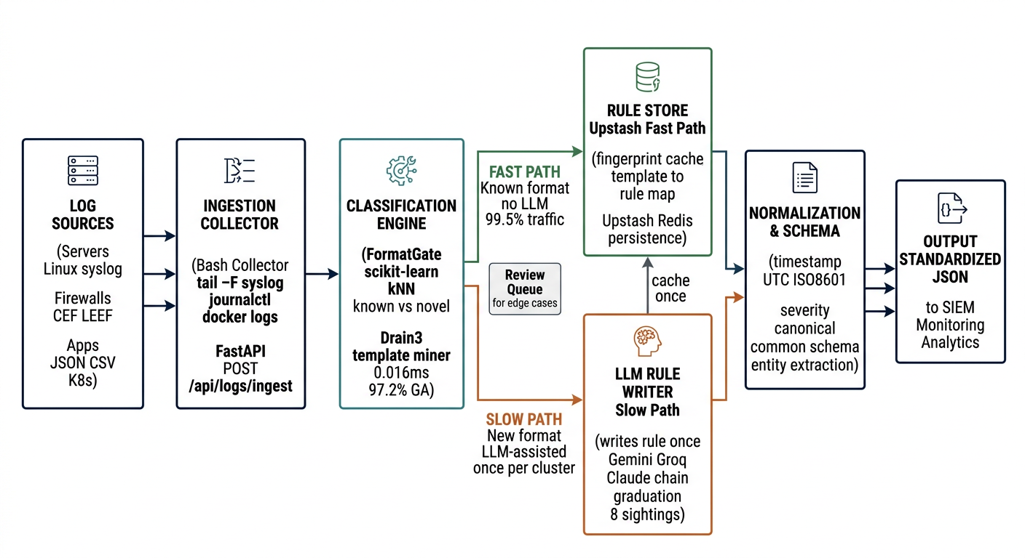
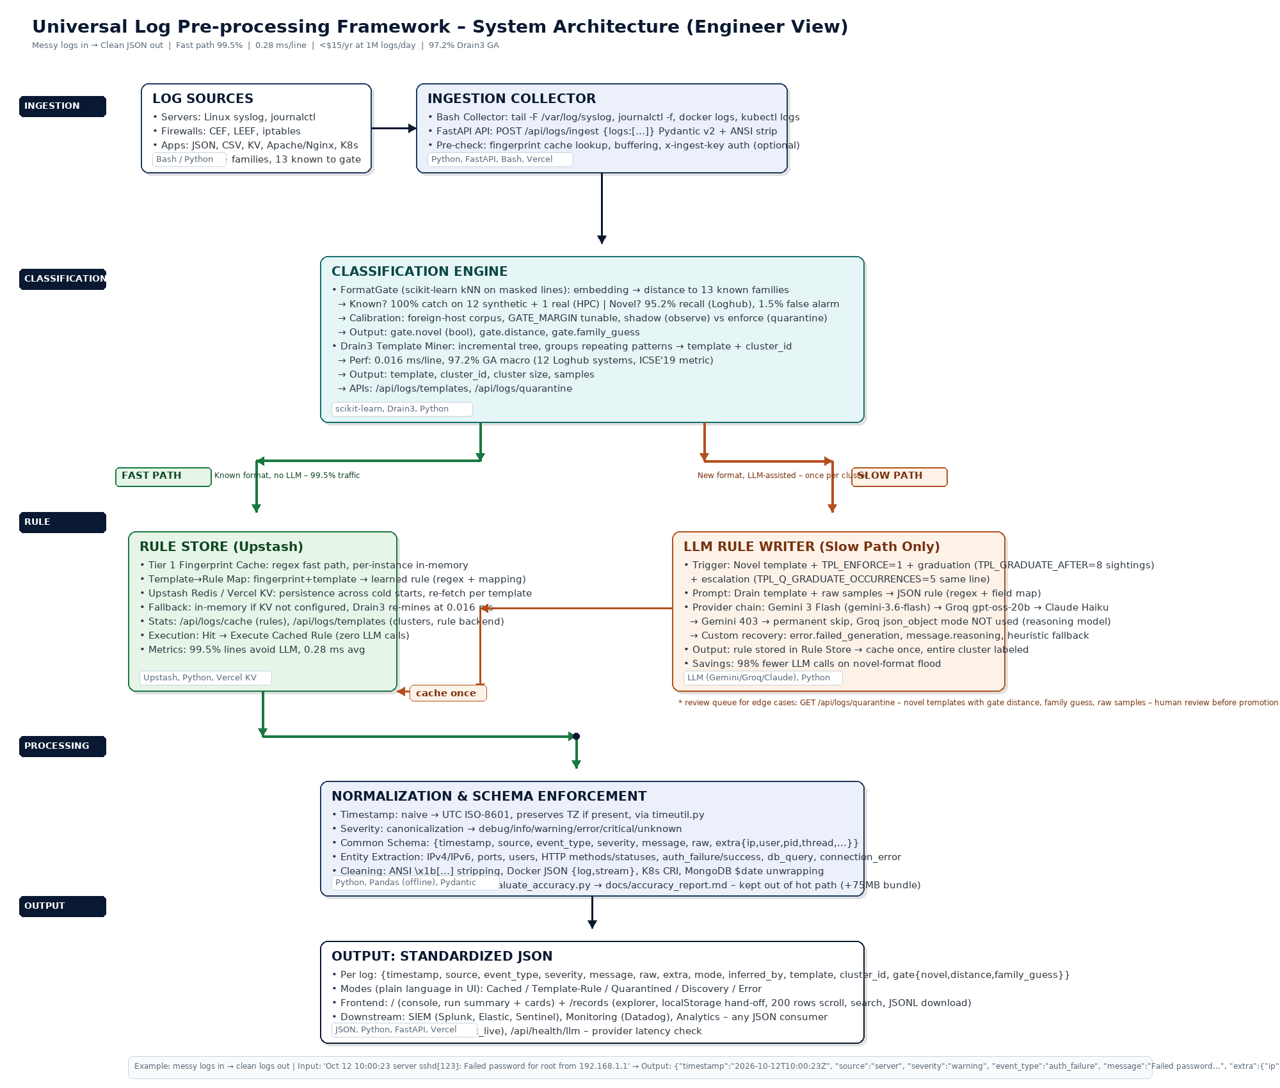
Slide 3: Technical Approach – System Architecture (Professional)
PS 26156 | AlgoRhytm | Blockchain & Cybersecurity
TECH STACK – Engineer View
🐍 Python 3.10+ : Core pipeline
⚡ FastAPI : REST API (main.py)
Pydantic v2 LogBatch
🔍 Drain3 : Template mining
0.016 ms/line, 97.2% GA
🧠 scikit-learn : FormatGate kNN
13 families, 95.2% novel recall
🐼 Pandas : Offline eval only
Saves 75MB bundle
🐧 Bash : Collectors
syslog, journalctl, docker
☁️ Upstash / Vercel KV
Rule persistence
▲ Vercel : Serverless
285MB / 500MB limit
🤖 LLM : Gemini 3 Flash / Groq
Claude Haiku fallback
Chain + heuristic fallback
Fast path green = no LLM
Slow path orange = LLM once
Review queue = /quarantine
✅ HOW WE SOLVE IT – Same messy logs from Slide 2 → clean JSON: {timestamp:2026-10-12T10:00:23Z, source:server, severity:warning, event_type:auth_failure, message:Failed password..., extra:{ip:192.168.1.1}} → Common schema for SIEM

Slide 4
Slide 4: Feasibility and Viability
PS 26156 | AlgoRhytm | Blockchain & Cybersecurity
🔧 Feasibility
💼 Viability (Real need moved to Slide 2)
• Drain3: 0.016 ms/line, 97.2% GA on 12 Loghub systems
• FormatGate: 100% known-family, 95.2% novel recall (Loghub real)
• LLM discovery: Once per template → Upstash persistence
• Vercel serverless: 285 MB bundle (<500 MB), cold start = joblib.load
• Pandas offline: saves 75MB, not in hot path
• 0.28 ms/line, 99.5% fast path
Challenges → Our Fix:
┌────────────────────┬────────────────────┐
│ Challenge │ Our Fix │
├────────────────────┼────────────────────┤
│ LLM 403/rate limit │ Groq fallback + │
│ │ heuristic parser │
│ Cold start loss │ Upstash KV re-fetch│
│ Novel flood │ TPL_ENFORCE + │
│ │ graduation 98% ↓ │
│ Timezone naive │ Assume UTC, doc'd │
└────────────────────┴────────────────────┘
• Can stay in India: Open-source (Python, FastAPI, Drain3, sklearn) + Vercel KV/Upstash, no foreign dependency
• Business model: Freemium SMEs, enterprise for NTRO/NCIIPC/banks/telecom/power – <$15/yr vs $1000s
• Grows easily: Horizontal scale – FastAPI stateless, Vercel serverless, Bash collectors anywhere, 3.5k logs/sec/instance
• Wide market: Every org with >1 log source – banks, telecom, power, govt (NTRO, NCIIPC), healthcare, e-commerce
Note: CERT-In 180 days / 6 hrs now on Slide 2 as stakes – removed here to avoid repetition.

Slide 5
Slide 5: Impact and Benefits
PS 26156 | AlgoRhytm | Blockchain & Cybersecurity
🌍 Impact: Security teams at NTRO, NCIIPC, banks, telecom operators, power utilities get faster incident response, reduced toil.
⚡ 99.5%
💰 <$15 / yr
🧠 <2%
Lines without LLM
Cost for one year
Logs sent to LLM
Fast path cache + Drain3
0.28 ms/line
At 1M logs/day
~20 new formats/mo
98% fewer calls vs naive
📌 Caption: Modeled / estimated figures — assumes 1M logs/day, ~15-25 distinct log formats/month, ~8 sightings to graduate a novel template; LLM = Gemini Flash / Groq pricing; fast-path 99.5% measured.
Benefits:
• Cost: <$15/year vs $1000s if every log hit LLM
• Speed: 0.28 ms/line → ~3.5k logs/sec, scales horizontally
• Accuracy: 97.2% Drain3 grouping, 100% family classification
• Resilience: Heuristic fallback, quarantine for novel flood
• Interop: Standardized JSON → Splunk, Elastic, Sentinel
• DevEx: No regex – POST /api/logs/ingest or Bash collector

Slide 6
Slide 6: Research & References
PS 26156 | AlgoRhytm | Blockchain & Cybersecurity
References:
• Loghub (LogPAI) – 12 systems ground truth
• Drain3 – ICSE'19 log template mining
• scikit-learn – kNN novelty detection
• Upstash / Vercel KV – persistence
• Gemini 3 Flash, Groq, Claude – LLM discovery
Existing Solutions Studied:
• Logstash, Fluentd, Elastic – manual config
• How we differ: LLM writes rule once → cache
Team AlgoRhytm – Roles:
• Member 1 – Backend / Pipeline
• Member 2 – ML / FormatGate
• Member 3 – Frontend / Vercel
• Member 4 – DevOps / Bash collectors
• Member 5 – Research / Loghub eval
• Member 6 – Docs / PPT
Links:
• Live: https://sih2026-w6sr.vercel.app
• GitHub: github.com/agrwl-utkarsh/sih2026

