Slide 1
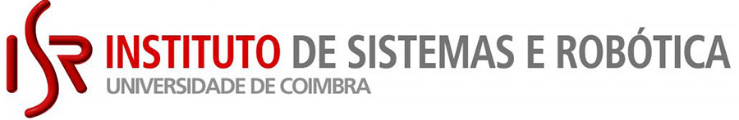
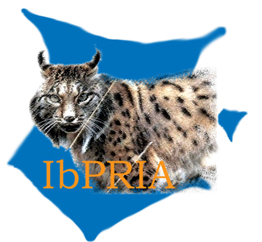


Pseudo-MOS Learning:
A Full-to-No-Reference FIQA Framework
IbPRIA 2025: 12th Iberian Conference on Pattern Recognition and Image Analysis
André Neto, Nuno Gonçalves
andre.neto@isr.uc.pt, nungon@deec.uc.pt
Coimbra, 01-07-2025
ISR – VisTeam
IbPRIA
Notes:
Good morning, my name is André Neto. I'm presenting work done with Nuno Gonçalves at the University of Coimbra, where we propose a new framework for facial image quality assessment using Pseudo-MOS learning, a method that bridges the gap between full-reference and no-reference evaluation.

Slide 2
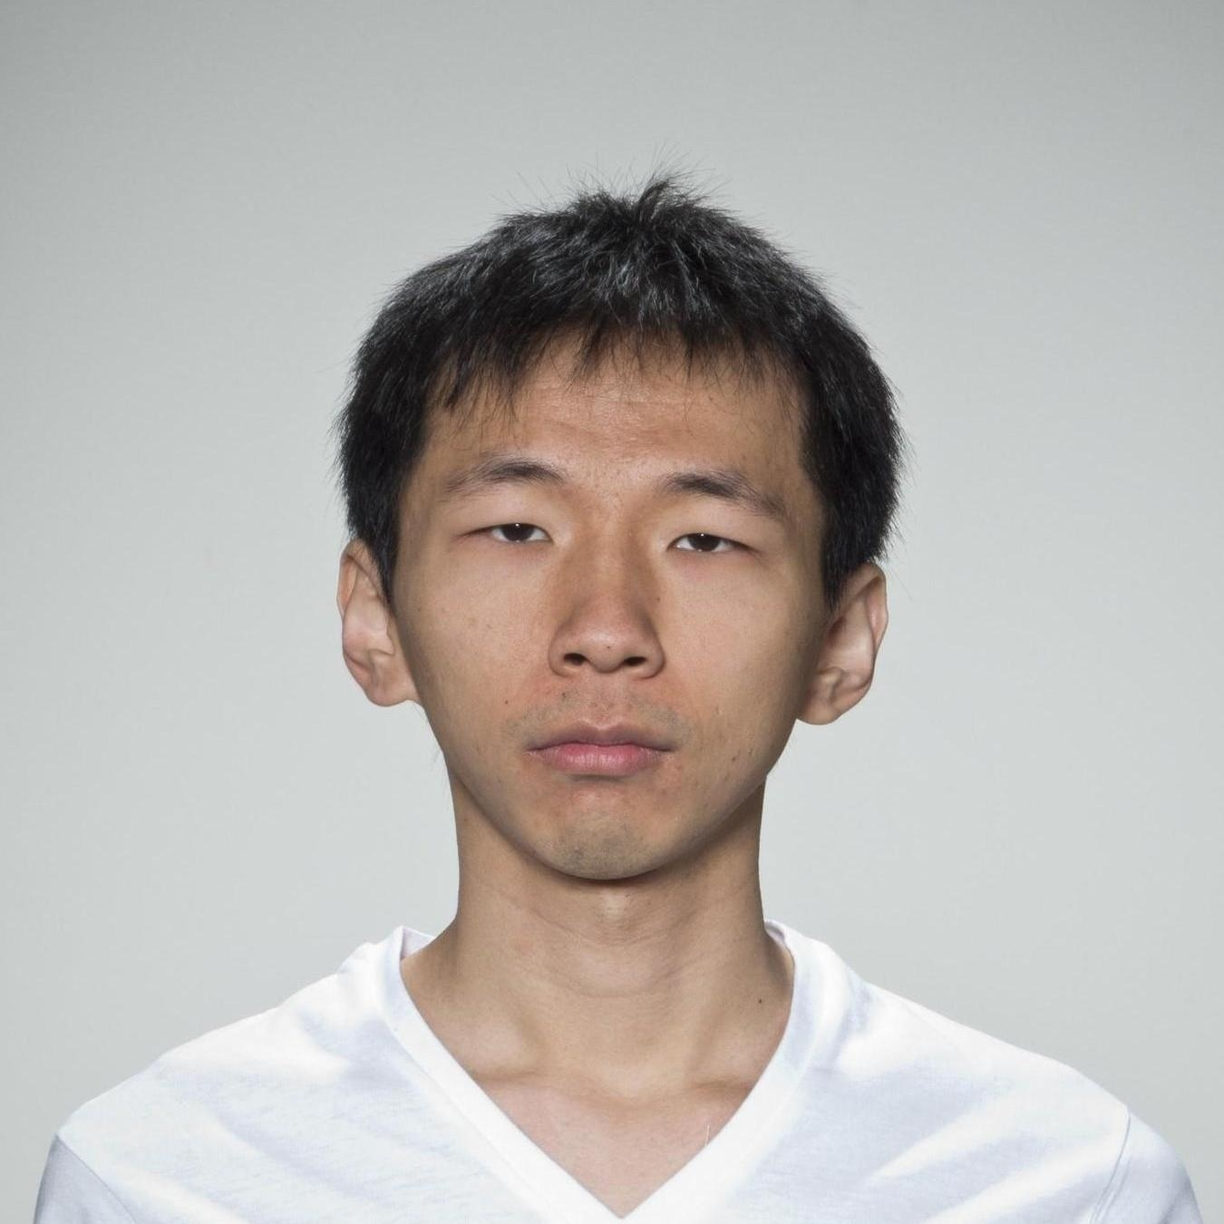
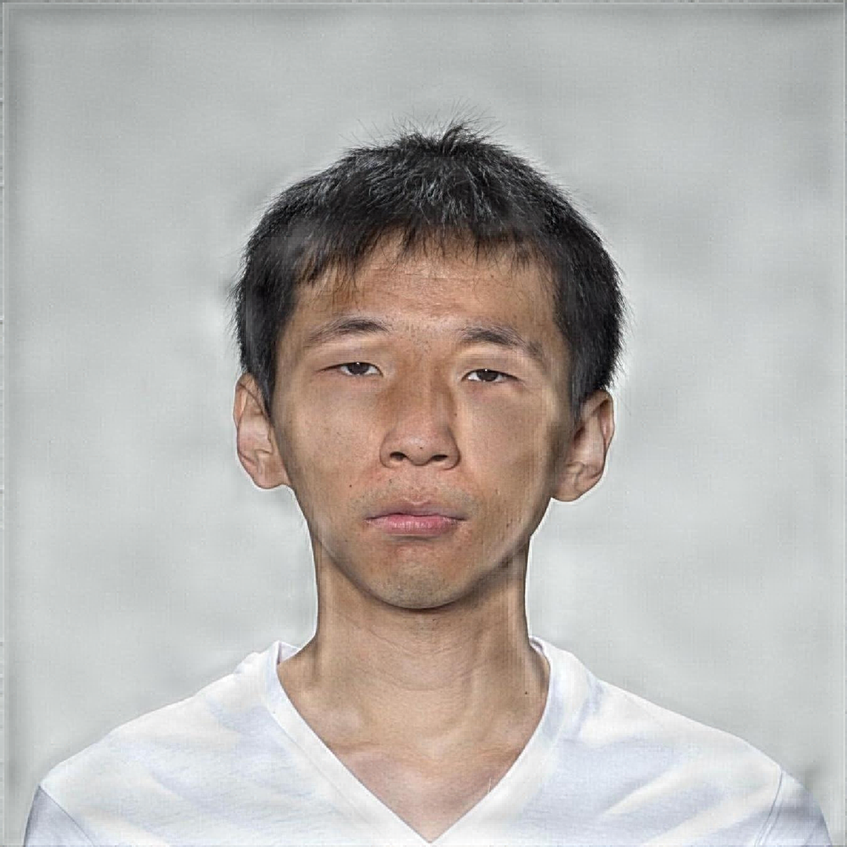
Why Face Image Quality Assessment Matters
Face Image Quality Assessment (FIQA):
Estimates the overall quality of a facial image
Used to filter low-quality inputs or weight matching scores
Types of FIQA:
FR-FIQA: gives reliable scores, but impractical in most real life scenarios
NR-FIQA: is often misaligned with human subjective perception, collected as Mean Opinion Score (MOS)
FR-FIQA
NR-FIQA
✔️
Score = 0.34
Score = 0.87
❌
MOS (ground truth) = 0.40
ISR – VisTeam
IbPRIA
Notes:
Face Image Quality Assessment, or FIQA, is a tool used to estimate how suitable a facial image is for any automatic processing task.
This includes not only face recognition, but also face verification, expression analysis, demographic estimation, face synthesis or editing, and even when encoding Machine-readable travel documents like passports or ID cards, where image quality must meet strict standards.
On the left, we see two versions of the same person. The original image is clear and well-lit. The second has visible artifacts.
In this example, a Full-Reference FIQA (FR-FIQA) model gives a score of 0.38, aligned with the human-perceived quality or Mean Opinion Score (MOS) of 0.40.
In contrast, the No-Reference FIQA (NR-FIQA) model gives a misleadingly high score of 0.87, despite the distortions.
So we know FR-IQA is more reliable than NR-IQA, but realistically, there aren’t a lot of real life application for it, you rarely have the reference image laying around.
The main problem of the NR-IQA, is that you need

Slide 3
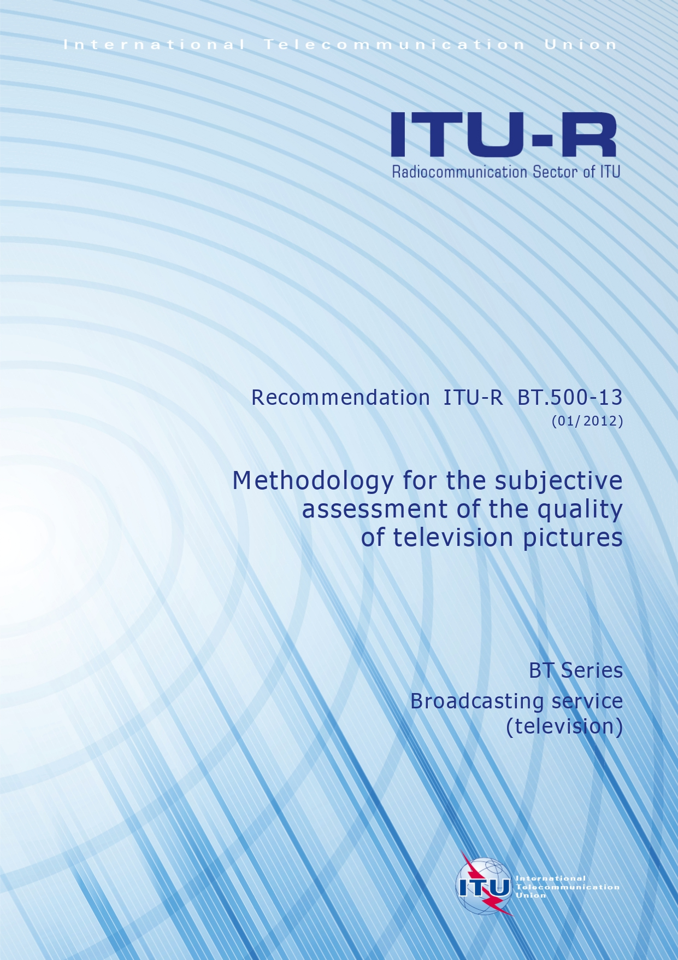
Current NR-FIQA Limitations
Human ratings are biased (ethnicity, gender, age).
By International Telecommunication Union - Radiocommunication Sector (ITU-R) Recommendations standards, each image needs ~30 evaluations.
Gathering sufficient, reliable MOS is time-consuming and costly.
... What if we could replicate MOS from a small annotated subset?
ISR – VisTeam
IbPRIA

Slide 4
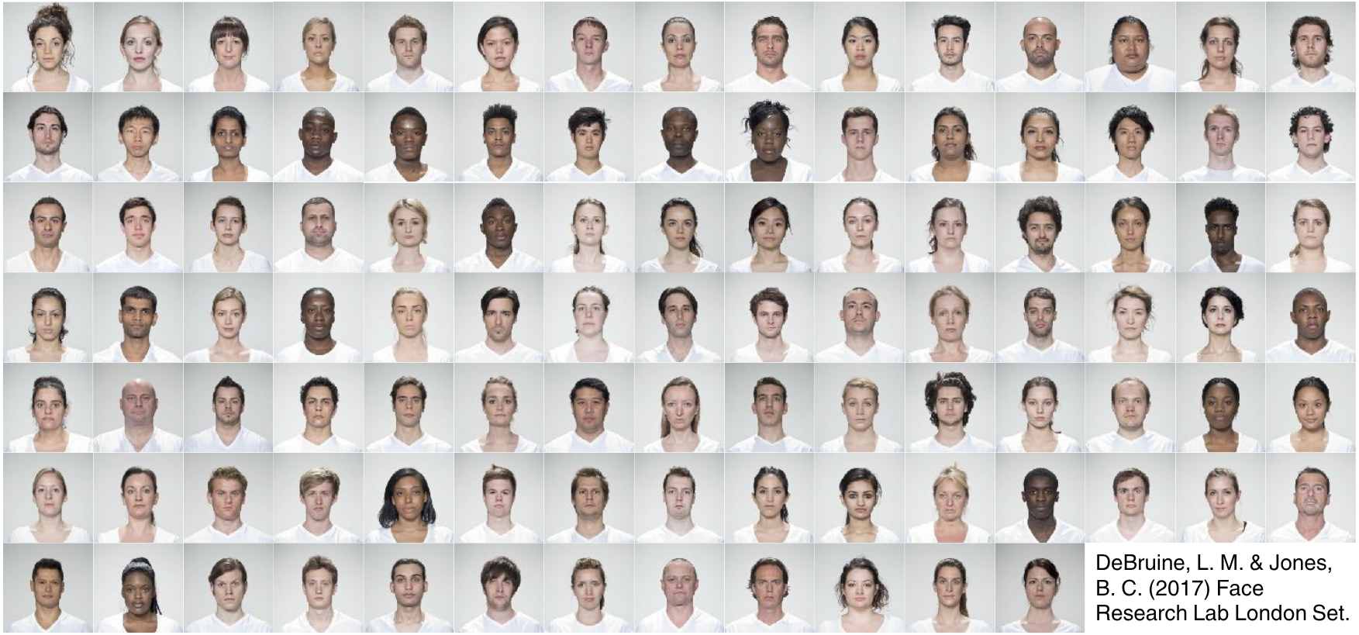
Face Research Lab London (FRLL) Set
ISR – VisTeam
IbPRIA
Notes:
We took in a publically available dataset, the FRLL, and distorted it using 4 different printer-proof steganography methods at

Slide 5
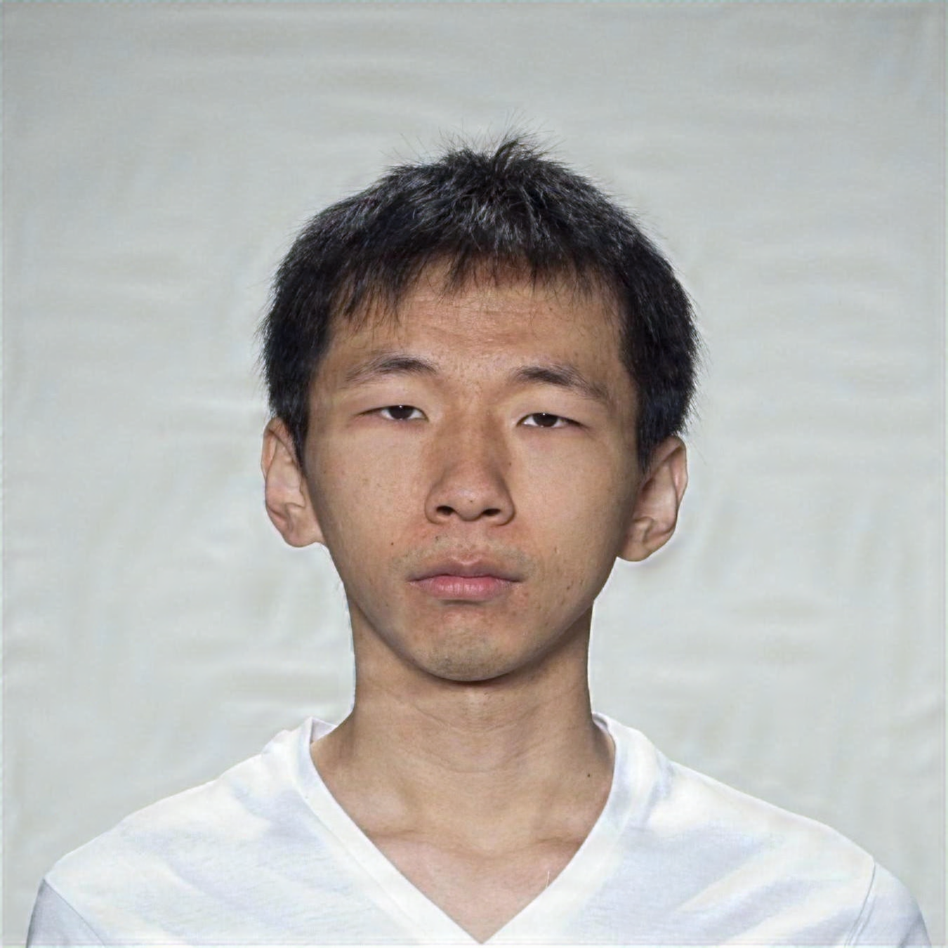
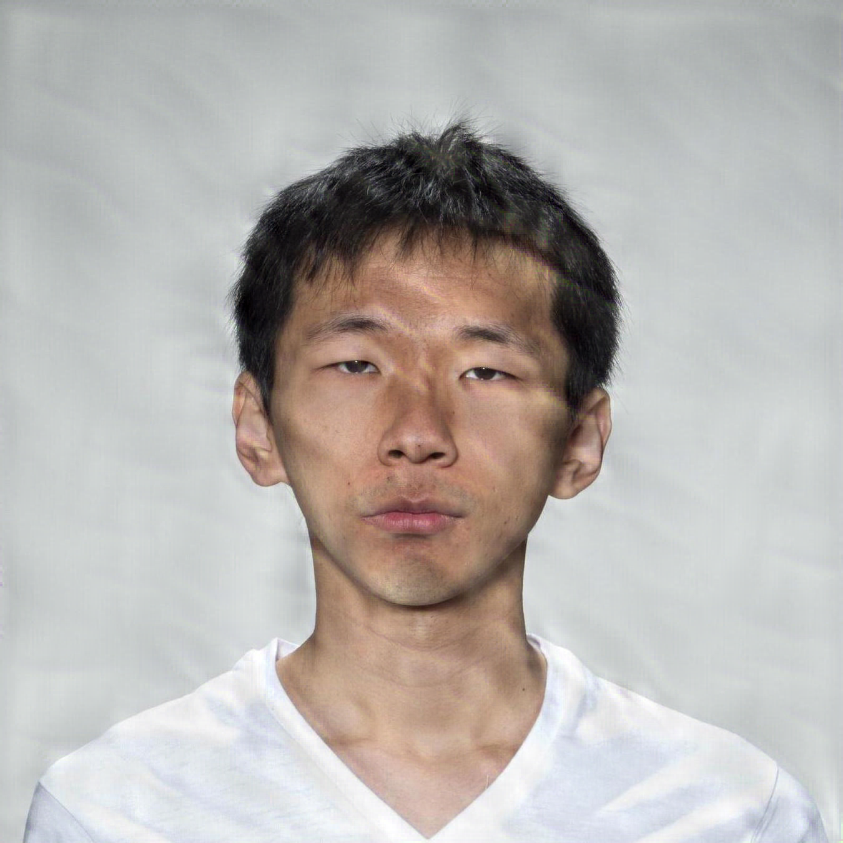
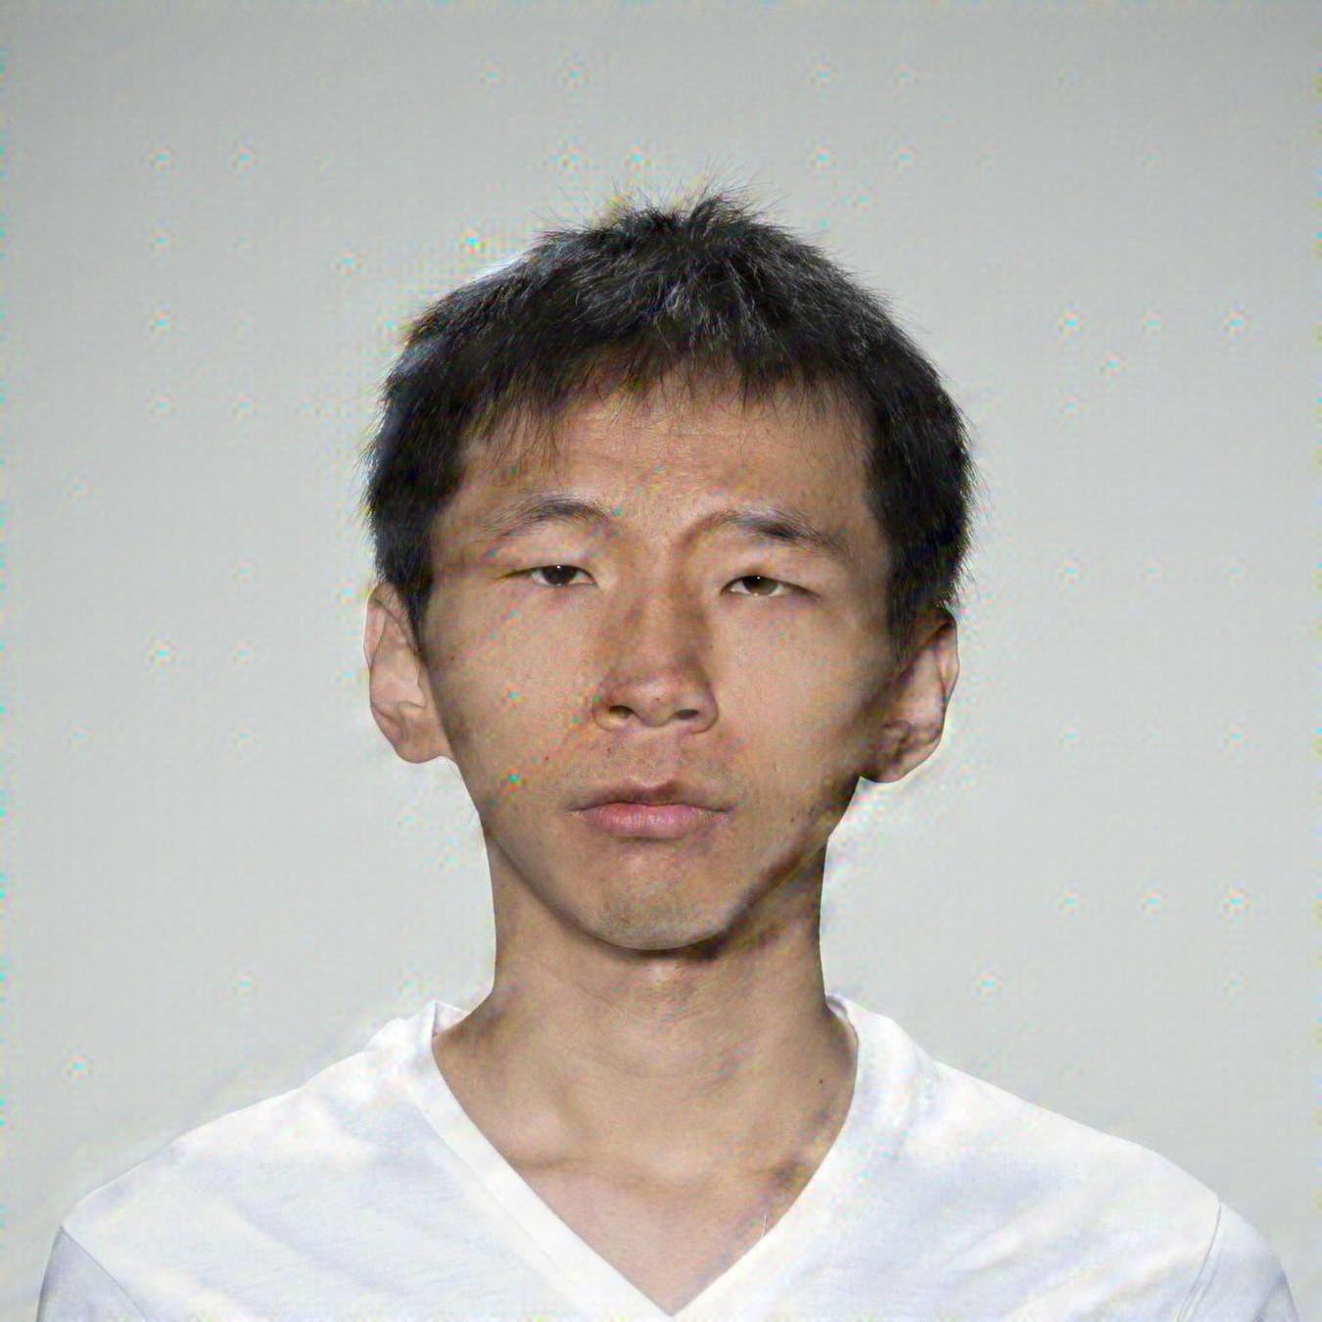
Printer-proof Steganographic Distortions
steganography
/ˌstɛɡəˈnɒɡrəfi/ · noun · [uncountable]
The practice of writing hidden messages in ordinary text, pictures, etc.
Reference
StegaStamp
CodeFace
RiemStega
StampOne
ISR – VisTeam
IbPRIA

Slide 6
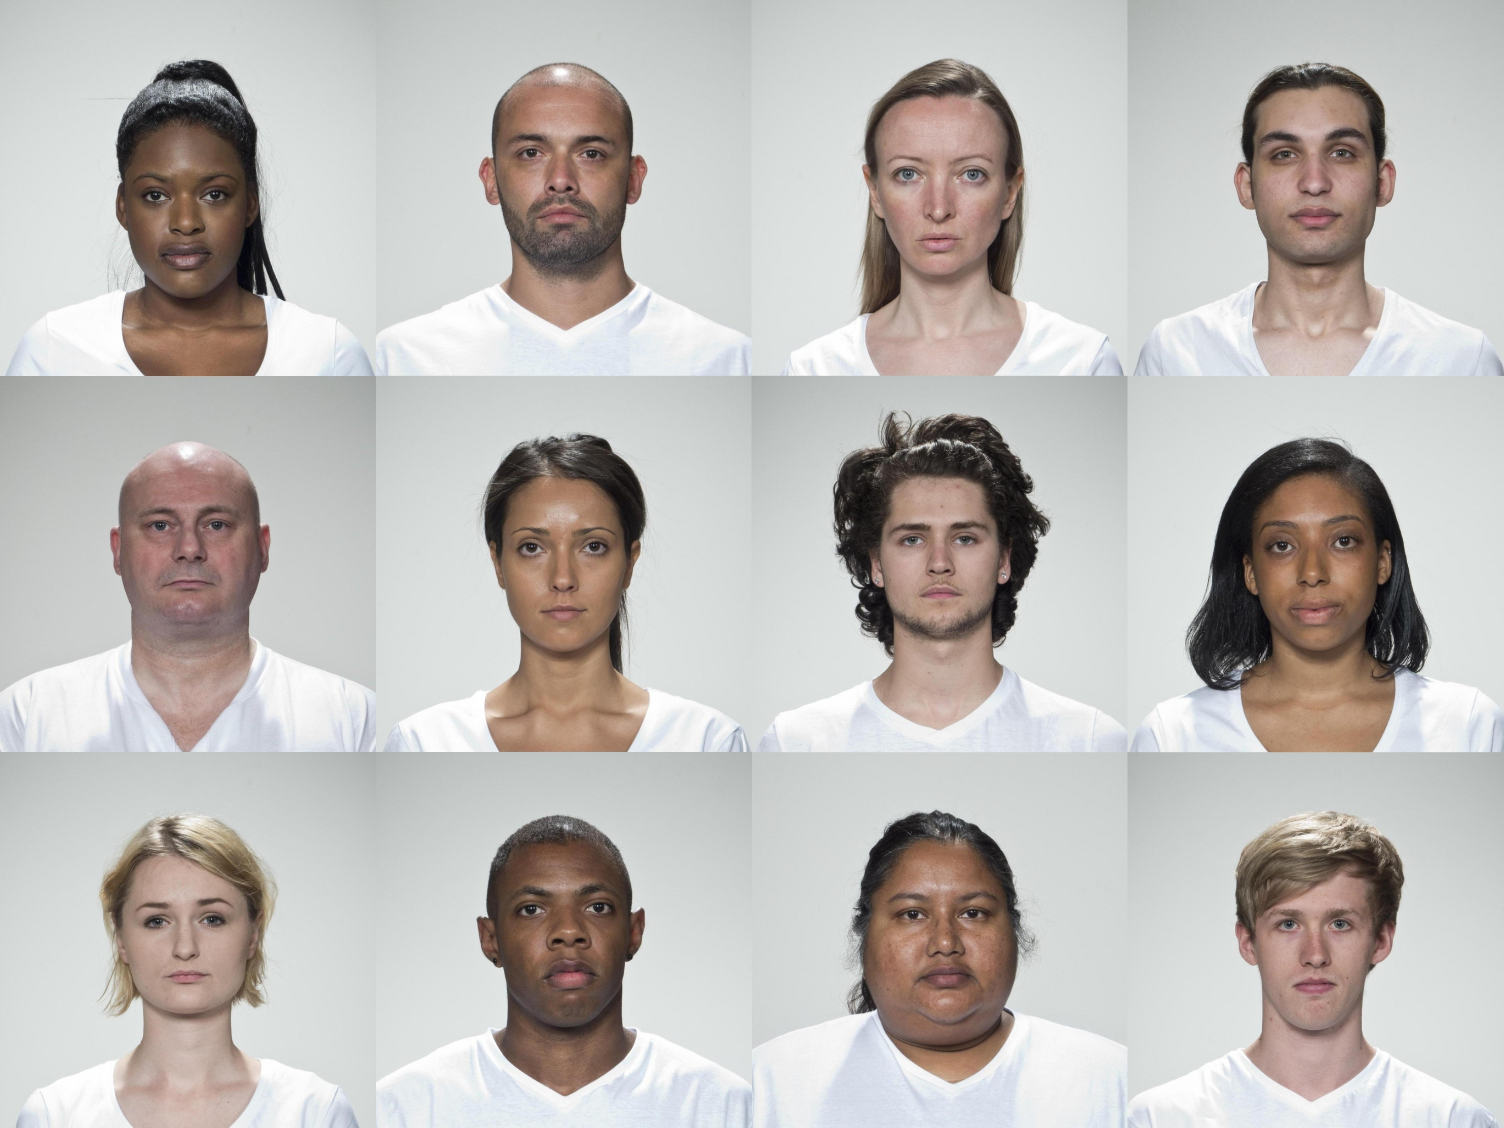
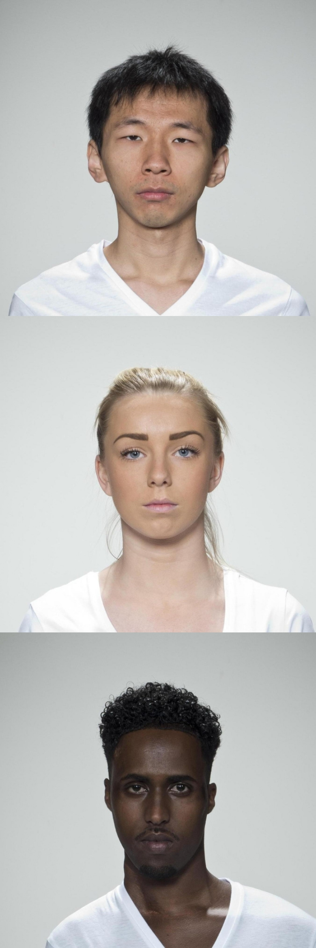
Dataset
MOS set
15 identities
540 images
MOS train set
3 identities
MOS test set
12 identities
Pseudo-MOS set
87 identities
3.132 images
MOS train set
MOS test set
ISR – VisTeam
IbPRIA

Slide 7
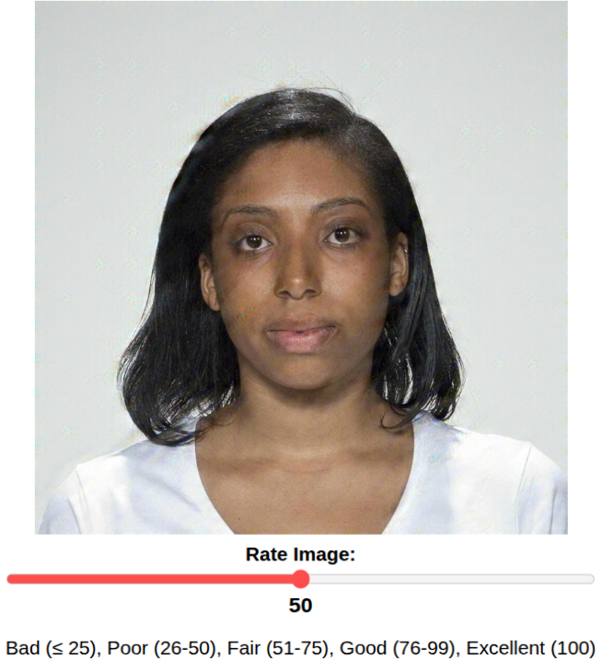
Subjective Labeling Protocol
Custom webapp built with Django for MOS collection.
Adopted ITU-R BT. 500-15 Single Stimulus protocol.
Over 200 participants rated ~70 images each, resulting in over 14.000 ratings
Demographics collected: gender, age, ethnicity, others.
ISR – VisTeam
IbPRIA

Slide 8
Removing Bias from Human Scores
Table 1. ANOVA results for observer and image attributes.
Factor | p-value | p-value (residualized)
Observer gender | $$0.022$$ | $$0.9930$$
Observer ethnicity | $${8.44 × 10 }^{-4}$$ | $$1$$
Subject gender | $${1.60 × 10 }^{-3}$$ | $$0.9720$$
Subject ethnicity | $${7.36 × 10 }^{-3}$$ | $$1$$
Observer gender $$×$$ Subject gender | $$0.6417$$ | $$0.6417$$
Observer ethnicity $$×$$ Subject ethnicity | $$0.0582$$ | $$0.0582$$
ISR – VisTeam
IbPRIA

Slide 9
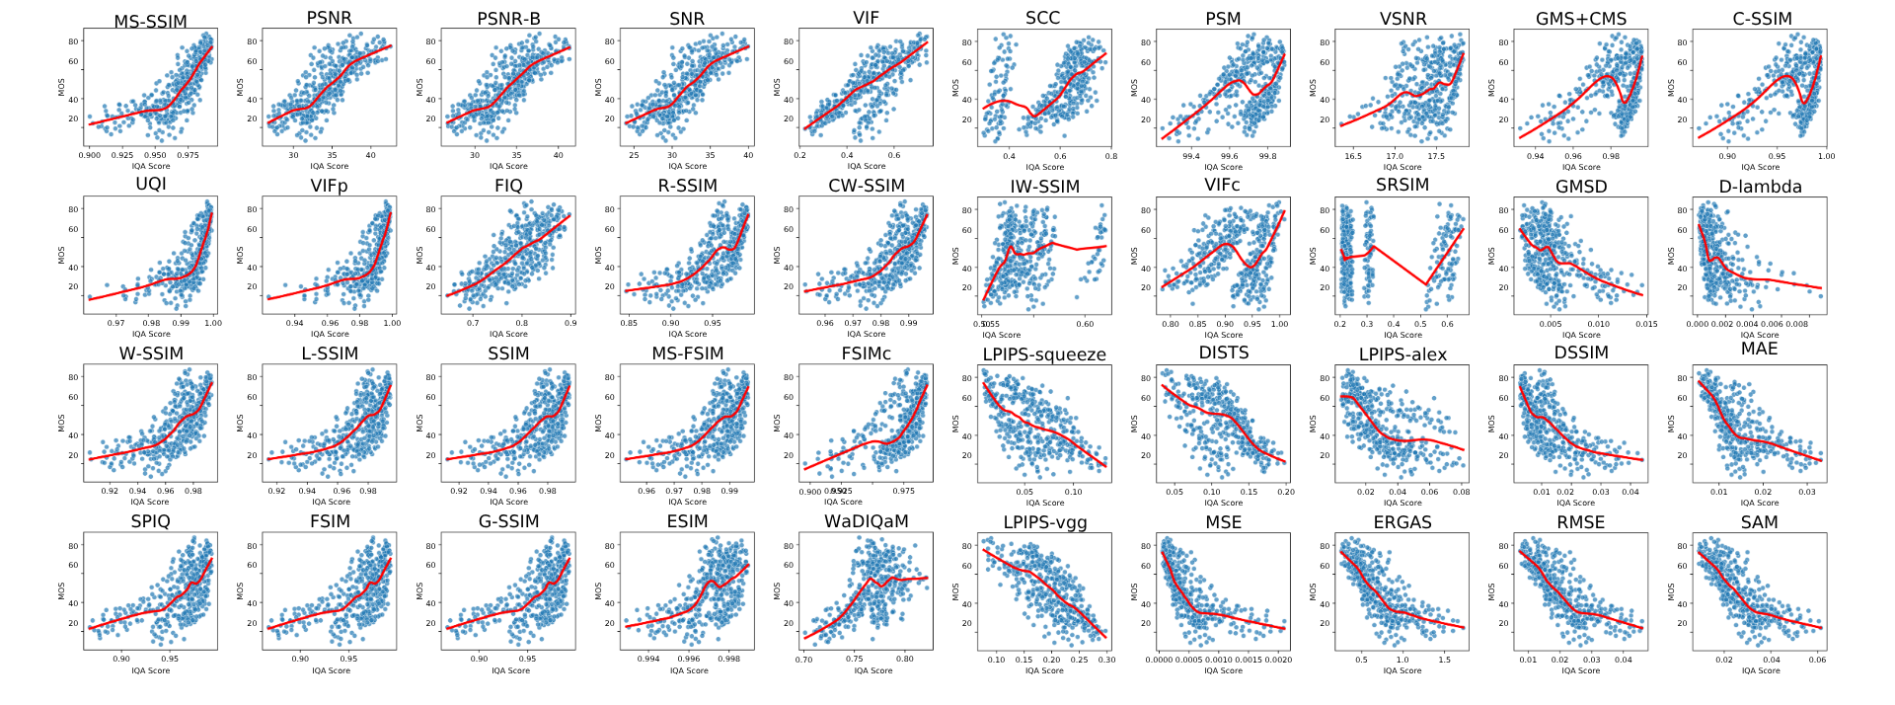
Relation between MOS and 40 FR-IQA Metrics
ISR – VisTeam
IbPRIA

Slide 10
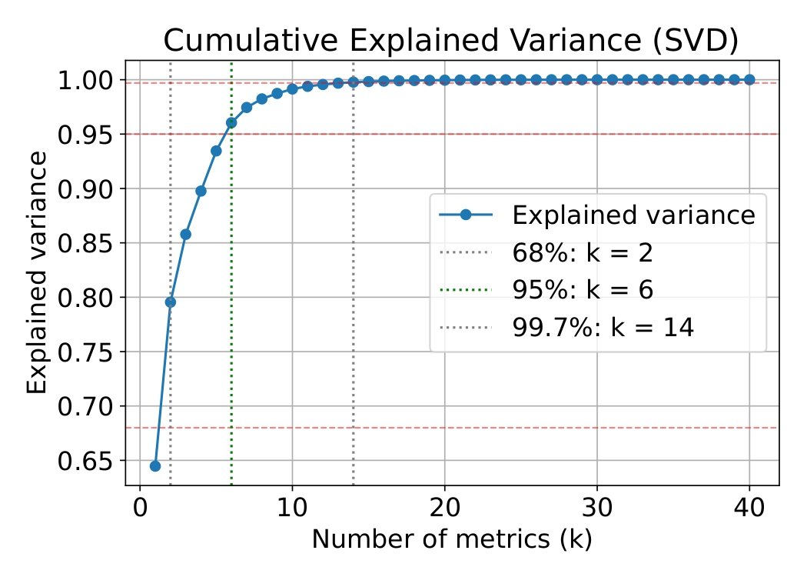
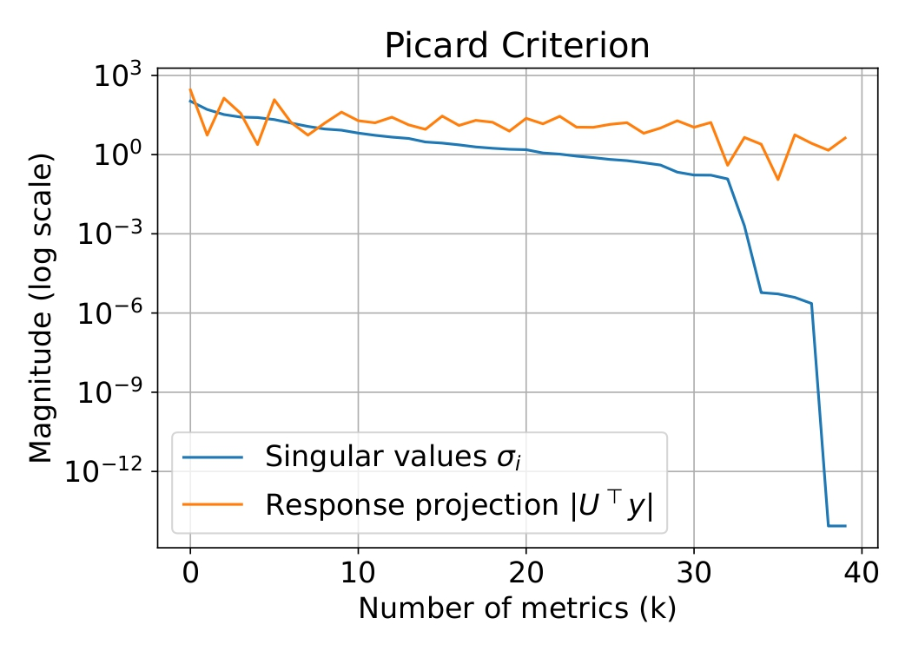
Full-Reference Fusion Metric
Top $$k=6$$ metrics were: MS-SSIM, PSNR, PSNR-B, SNR, VIF, and UQI. These stand for Multiscale Structural Similarity Index Metric, Peak Signal-to-Noise Ratio, PSNR-Blocks, Signal-to-Noise Ratio, Visual Information Fidelity, and Universal Quality Index, respectively
ISR – VisTeam
IbPRIA

Slide 11
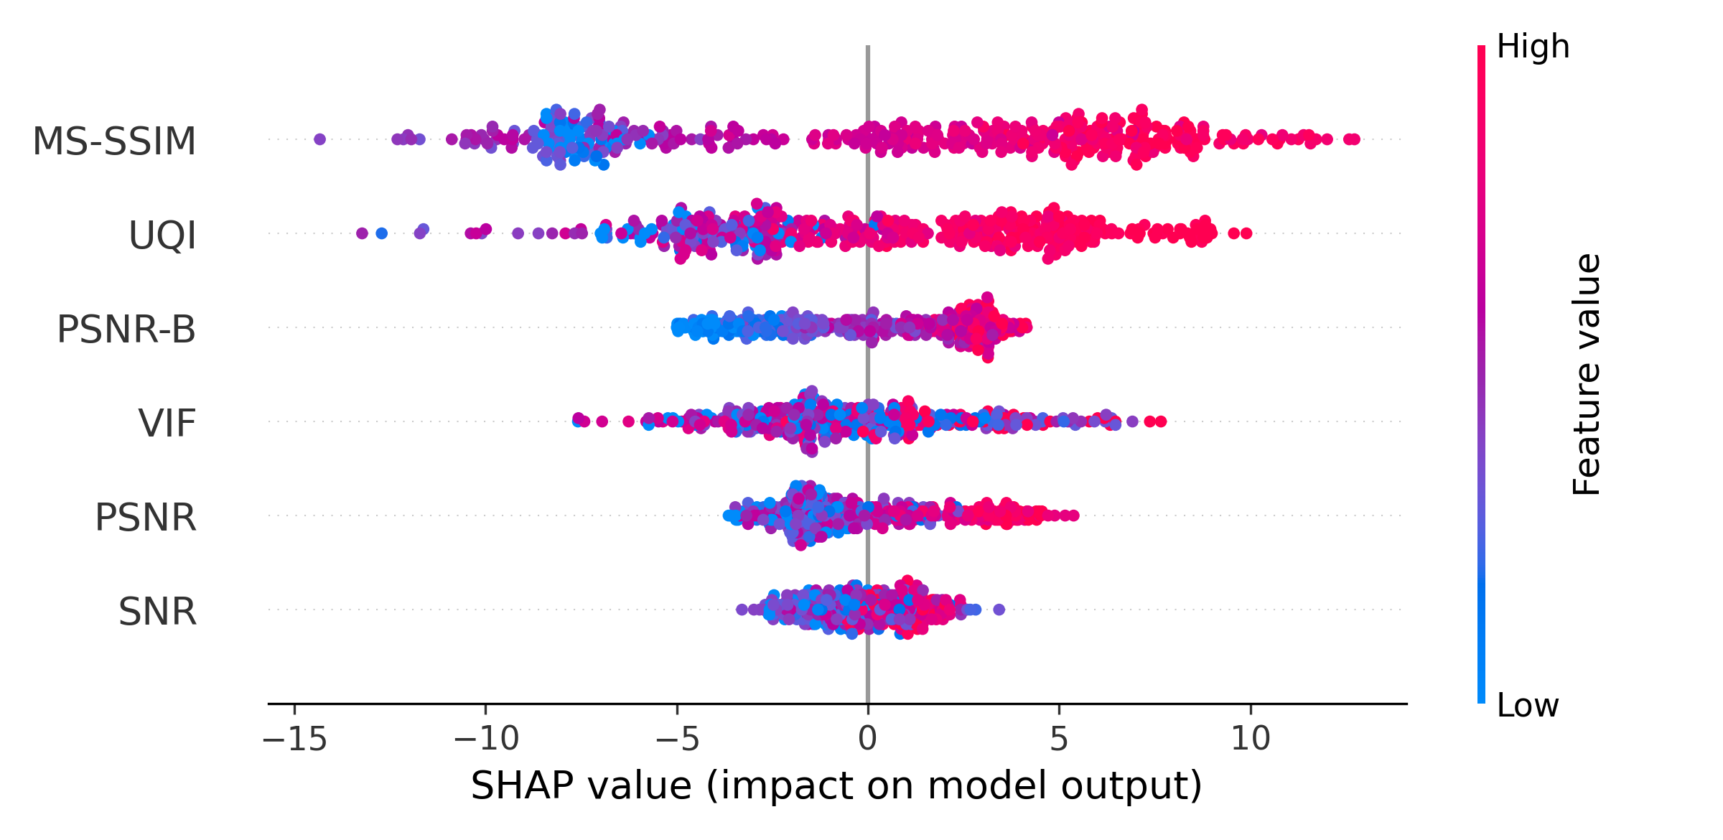
Pseudo-MOS Regression Model
Table 2. Performance of our Fusion metric and the selected FR-IQA metrics.
SHAP summary plot for $$k=6$$, generated from the best CatBoost model.
Metric | PLCC | SRCC | MSE | MAE
Fusion | $$0.8881$$ | $$0.8893$$ | $$65.07$$ | $$6.160$$
MS-SSIM | $$0.7712$$ | $$0.8489$$ | $$2542$$ | $$47.27$$
PSNR | $$0.8009$$ | $$0.8132$$ | $$420.7$$ | $$16.57$$
PSNR-B | $$0.7996$$ | $$0.8126$$ | $$434.8$$ | $$16.84$$
SNR | $$0.7931$$ | $$0.8047$$ | $$493.9$$ | $$18.08$$
VIF | $$0.7723$$ | $$0.7671$$ | $$2584$$ | $$47.75$$
UQI | $$0.6866$$ | $$0.8085$$ | $$2540$$ | $$47.24$$
ISR – VisTeam
IbPRIA

Slide 12
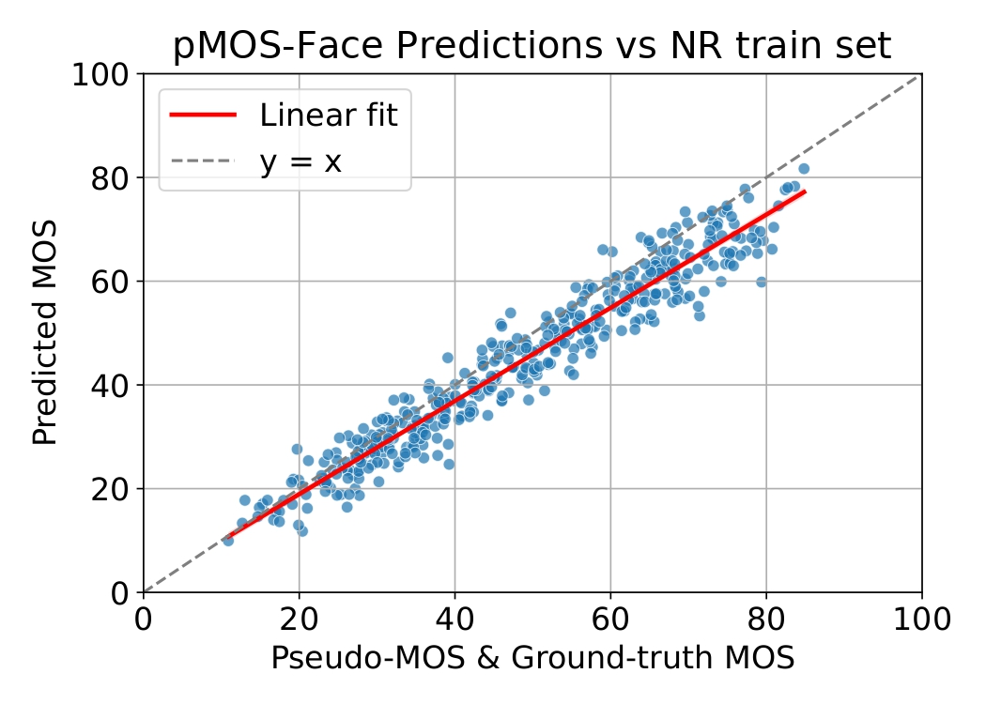
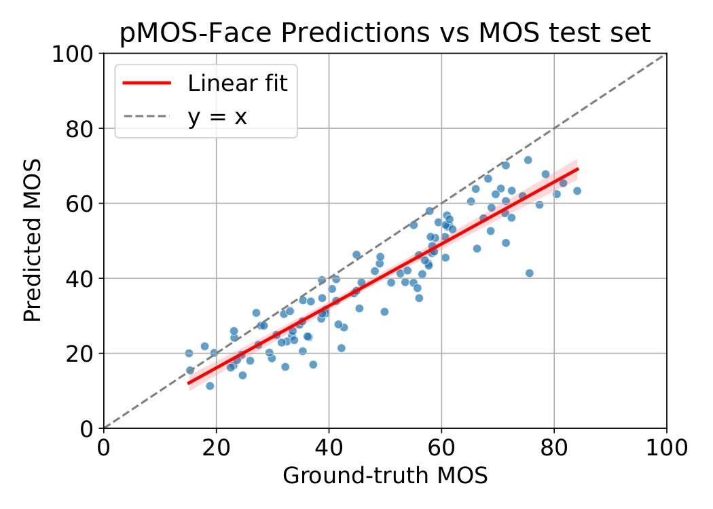
pMOS-FACE: No-Reference FIQA Model
We trained a deep regression model end-to-end using pseudo-MOS scores as targets.
The architecture is based on a ResNet18 backbone pretrained on ImageNet.
Its final classification layer is replaced by a lightweight multi-layer perceptron (MLP) regressor.
ISR – VisTeam
IbPRIA

Slide 13
pMOS-FACE Performance
Our model is more effective in predicting perceptual quality than classical NR-IQA metrics such as NIQE and PIQE, as well as task-specific approaches like SER-FIQ and MagFace.
Metric | PLCC | SRCC | MSE | MAE
pMOS-FACE | $$0.9285$$ | $$0.9345$$ | $$120.6$$ | $$9.158$$
NIQE | $$0.7536$$ | $$0.7431$$ | $$6859$$ | $$82.62$$
PIQE | $$0.2993$$ | $$0.3114$$ | $$3297$$ | $$57.05$$
SER-FIQ | $$-0.1648$$ | $$-0.1542$$ | $$123.5$$ | $$9.230$$
MagFace | $$-0.6095$$ | $$-0.6362$$ | $$4437$$ | $$66.24$$
ISR – VisTeam
IbPRIA

