Slide 1



Metrics of Automatic Image Qualitty Assessment based on Human Perception
A Comparative study and a proposal of a new metric
André Neto
Supervisors: Nuno Gonçalves e João Marcos
Coimbra | 2024-02-07
ISR – VisTeam
IMAGE QUALITY ASSESSMENT

Slide 2
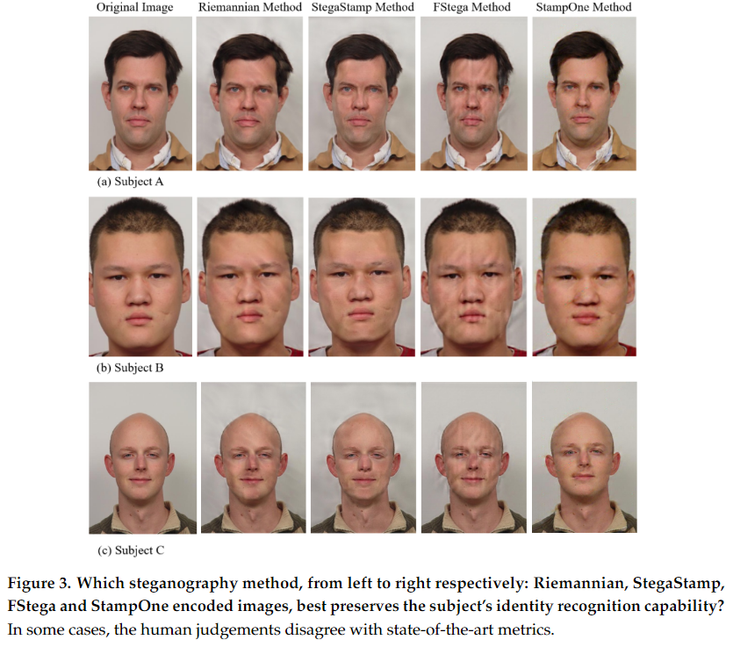
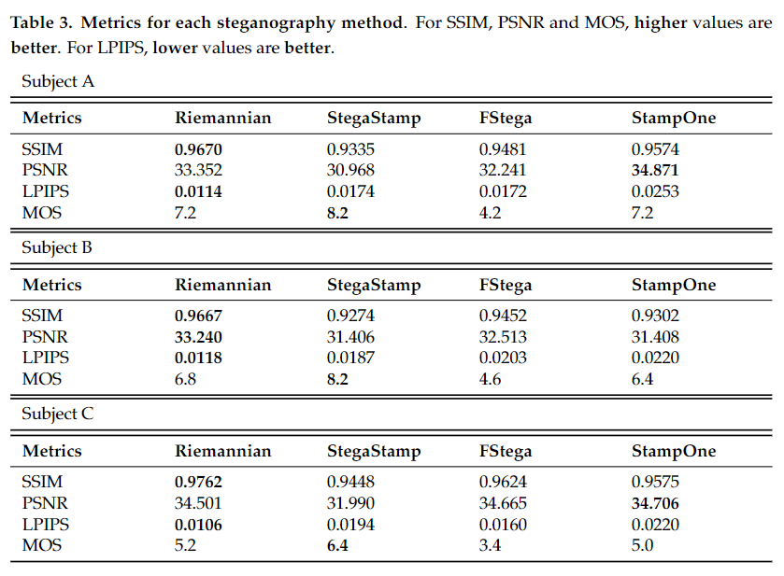
Image quality assessment – Overview
ISR – VisTeam
IMAGE QUALITY ASSESSMENT

Slide 3
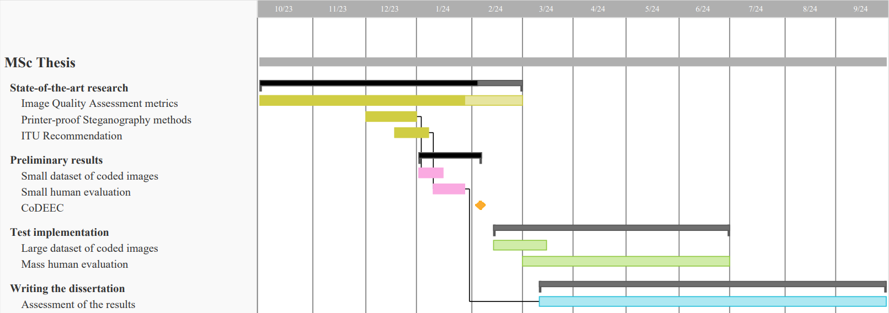
Motivation and Objectives
Motivation
Printer-proof Steganography adds one extra layer of security to ID cards, acting like a signature on visual content. Consequently, it introduces distortions in the image, degrading its original quality and compromising its content.
We rely on Image Quality Assessment (IQA) metrics to assess the quality of the images. However, these metrics often fail to assess image quality as a common human would!
Is there any metric that assesses images much like we, humans do?
Objectives
Comparison between the scores given by the objective metrics and the scores given by the observers.
Study a new metric that might provide a better matching between objective IQA and subjective evaluations.
ISR – VisTeam
IMAGE QUALITY ASSESSMENT

