Slide 1


Slide 2
André Guilherme dos Santos Neto
Metrics of Automatic Image Quality Assessment based on Human Perception
A Comparative Study and a Proprosal of a New Metric
Dissertação no âmbito do Mestrado em Engenharia Eletrotécnica e de Computadores orientada pelo Professor Doutor Nuno Miguel Mendonça da Silva Gonçalves e apresentada ao Departamento de Engenharia Eletrotécnica e de Computadores da Faculdade de Ciências e Tecnologia da Universidade de Coimbra.
Setembro de 2025

Slide 3

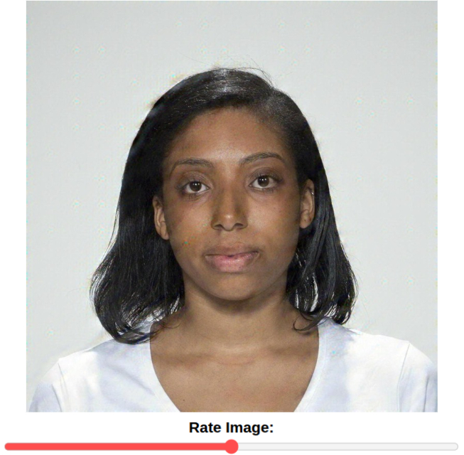
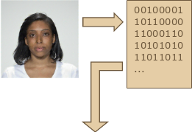
Image Quality Assessment
Image Quality is how well an image preserves visual fidelity and usability for human or machine perception. Image Quality Assessment (IQA) is the systematic evaluation of this quality.
There are two categories of IQA:
Subjective: relies on human observers to evaluate the quality of a given image, outputing a score known as Mean Opinion Score (MOS).
Objective: computational models, called metrics, can automatically estimate image quality.
score = 75%
Subjective
Objective
Notes:
A qualidade de imagem é o que define o quão bem, ou mal, uma imagem, adquirida, serve para a interpretação do ser humano, ou interpretação pelo computador.
A avaliação da qualidade de imagem é, tal como o nome indica, como devemos pontuar a qualidade de imagem para atingir este objetivo.
Existem dois tipos de categorias de IQA:
O IQA subjetivo, onde um agregado de pessoas avaliam a qualidade de uma imagem com base na sua opinião pessoal. Isto produz um score de opinião média, denominado por MOS. Esta categoria é o ápice da qualidade da avaliações de imagens para a maior parte de sistemas reais, porém exige um custo elevadíssimo no que conta à contratação de pessoas para darem a sua opinião e, eventualmente, treinarem uma métrica objetiva.
O IQA objetivo, onde computadores fazem esta mesma avaliação de maneira automática, usando diferentes tipos de modelos matemáticos e, por isso, gerando vários tipos diferentes de métricas, cada uma com a sua utilidade.

Slide 4
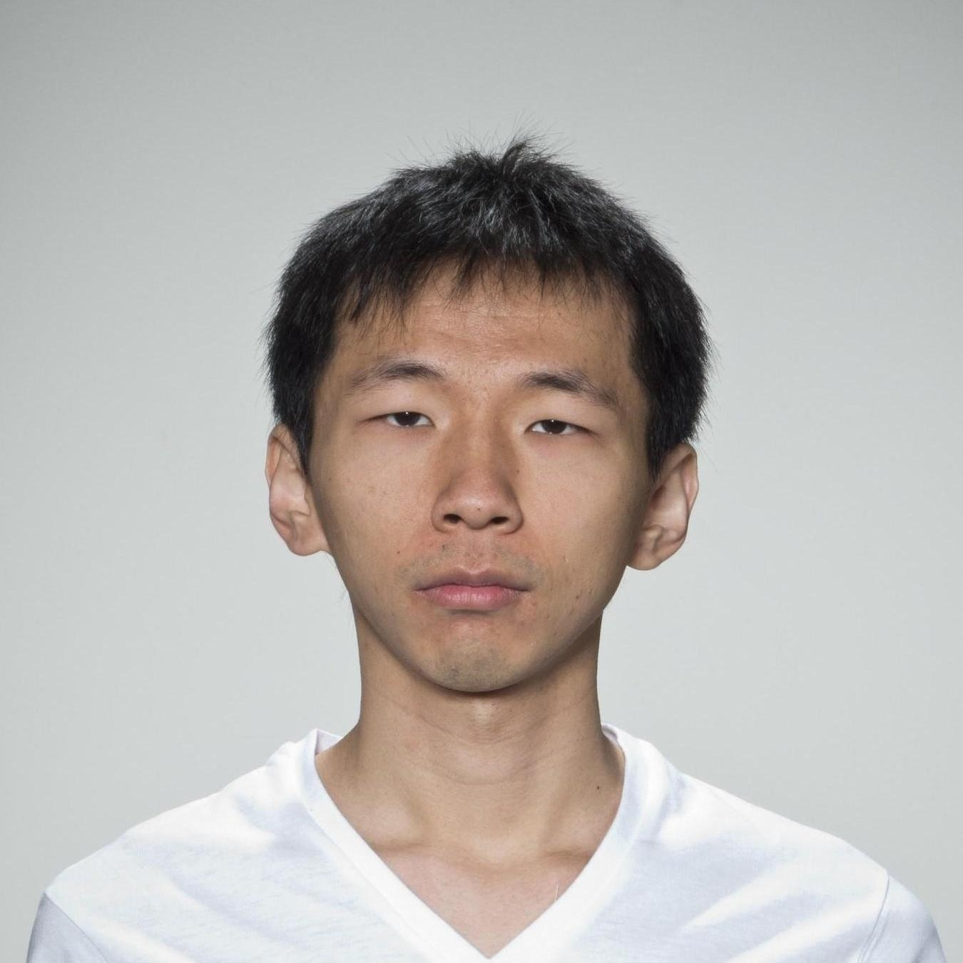
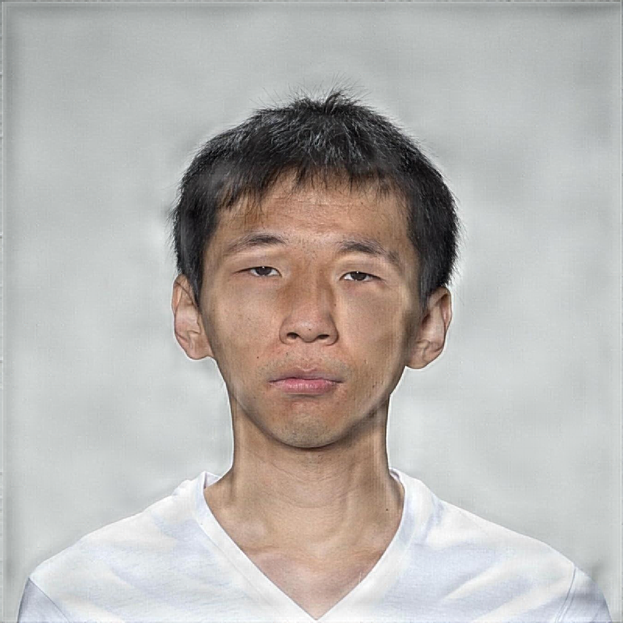
Objective Image Quality Assessment
There are two main types of Objective IQA metrics:
Full-Reference (FR): requires the original image to output the quality of its distorted version. It gives reliable scores, but is impractical in most real life scenarios.
No-Reference (NR): outputs the quality of an image without comparing it to an original version. It is often missaligned with human subjective perception.
Evaluations on the distorted image:
MOS (ground truth) = 0.42
FR-IQA metrics = 0.38
NR-IQA metrics = 0.79
Reference
Distorted
Notes:
Existem dois tipos de IQA objetivo:
Full-Reference IQA, que requer a presença da imagem de referência, não distorcida, para dar uma pontuação representativa da qualidade de uma imagem. Este tipo de IQA está, por norma, extremamente alinhado com a opinião humana, porém, não é prático na maioria dos cenários reais, onde na maior parte das vezes, não existe uma versão original de uma imagem que se quer avaliar em termos de qualidade.
No-Reference IQA, que, por sua vez, não requer uma imagem de referência para avaliar uma imagem, podendo assim

Slide 5
Face Image Quality Assessment
High quality facial images are essential for accuracte recognition in security, forensics, and surveillance.
FIQA must account for:
Pose, head and shoulder positionning;
Occlusion, certain parts of the face being obstructed;
Facial features, expression, emotions, etc;
Head wear, hat, cap, bandana, glasses, make up, masks, etc;
Demographic variability, age, ethnicity, gender, etc.

Slide 6
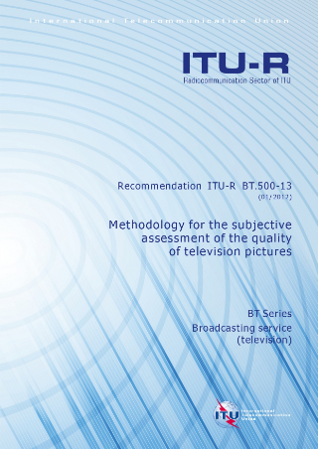
No-Reference Facial Image Quality Assessment Limitations
Human ratings are biased towards ethnicity, gender, and age;
By International Telecommunication Union - Radiocommunication Sector (ITU-R) Recommendations standards, each image needs ~30 evaluations;
Gathering sufficient, reliable MOS is time-consuming and costly.
... What if we could replicate MOS from a small annotated unbiased subset?

Slide 7
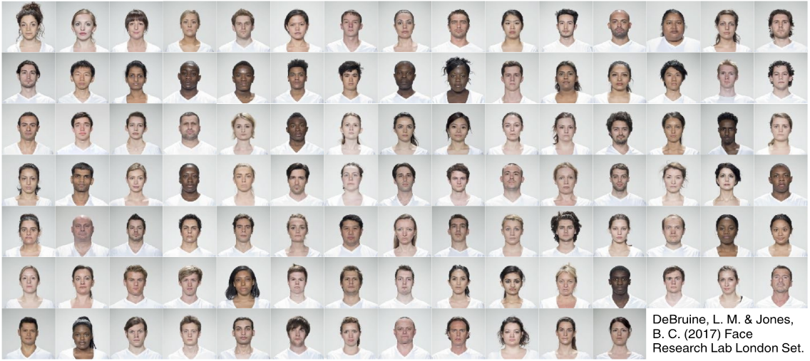
Face Research Lab London (FRLL) Set

Slide 8
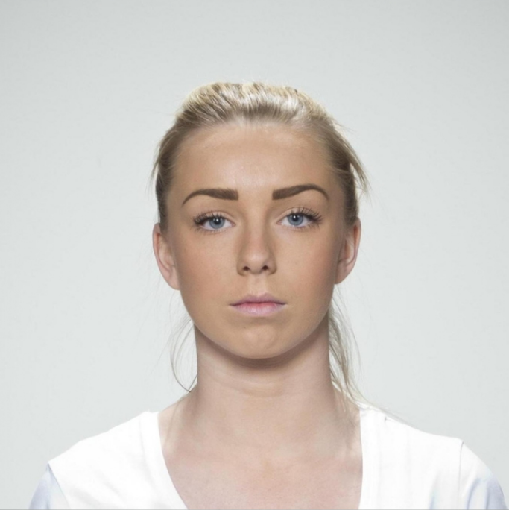
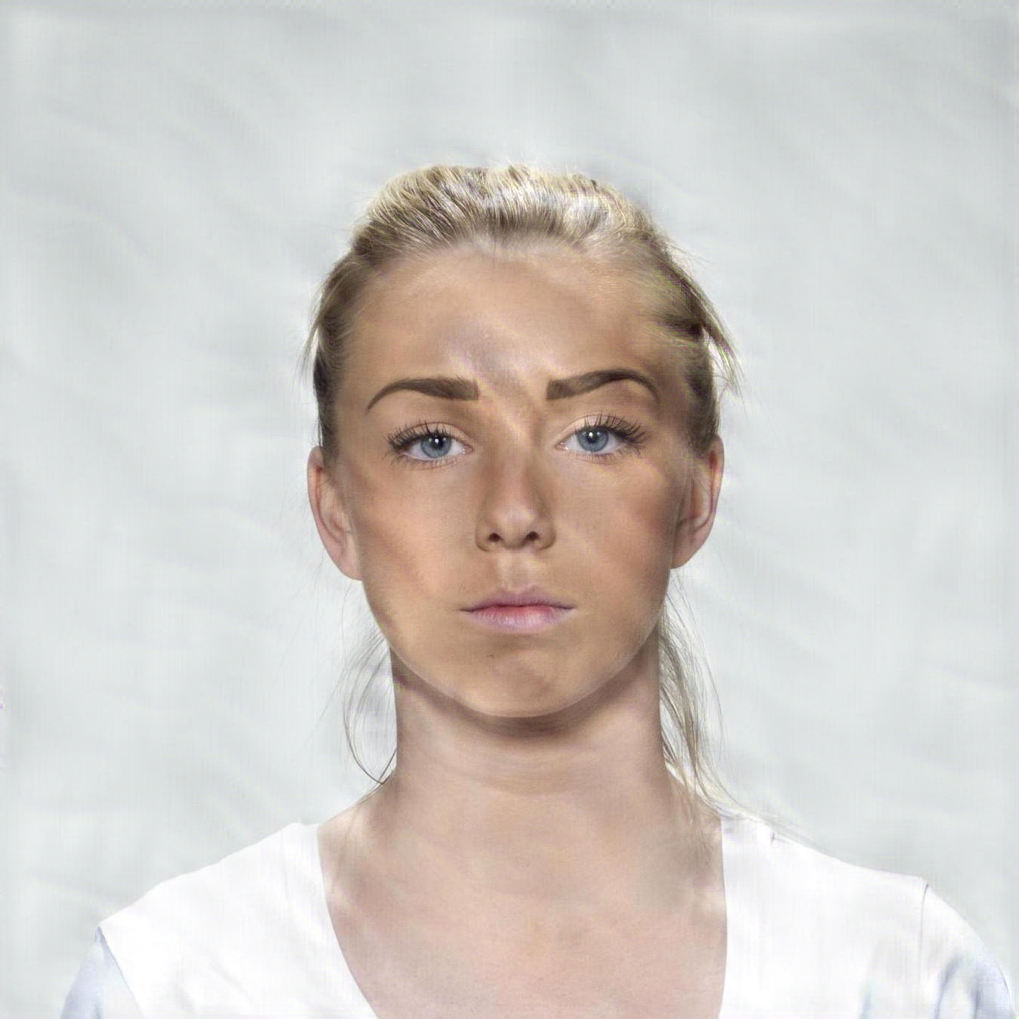
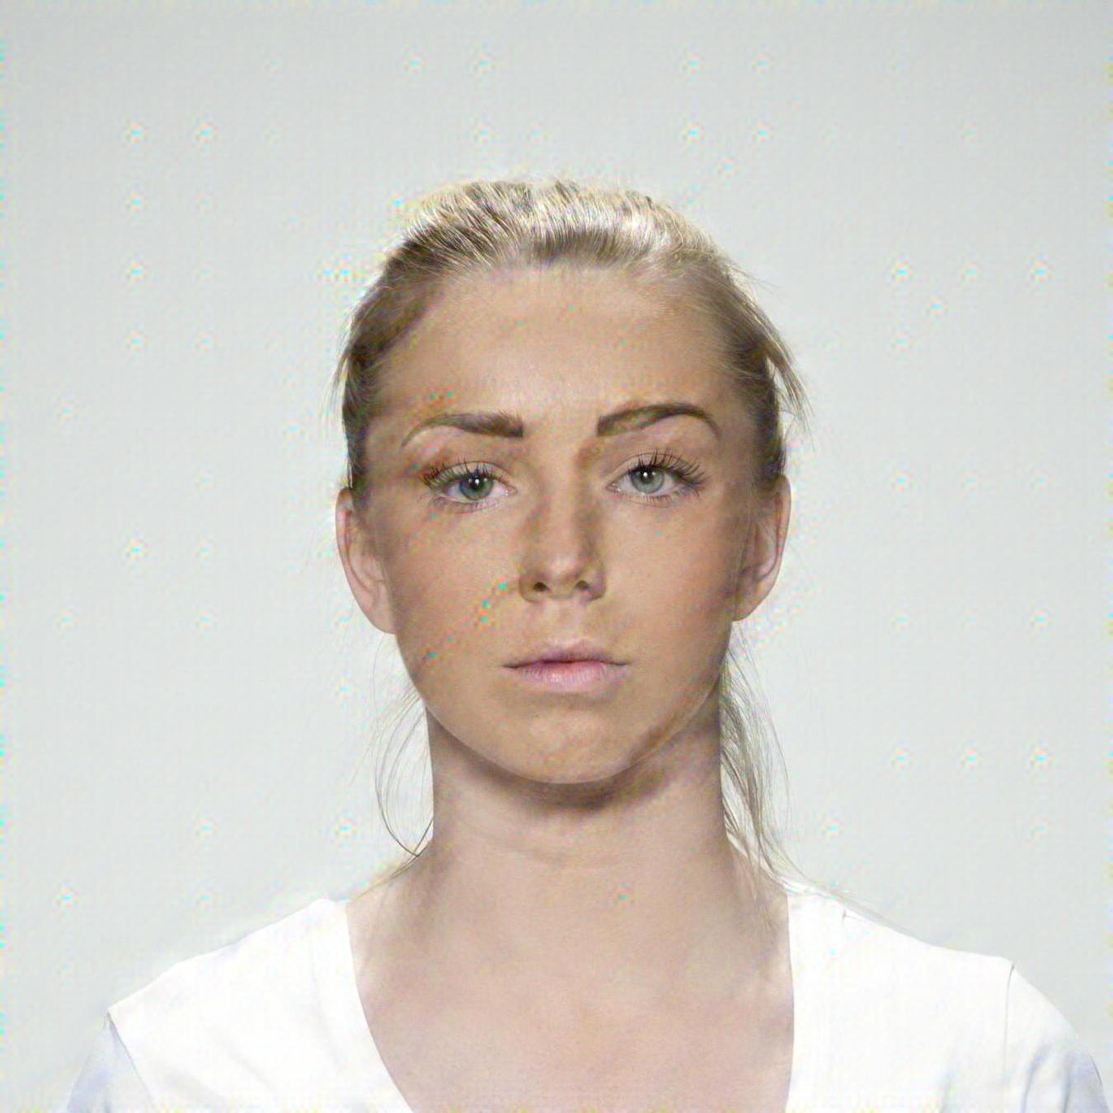
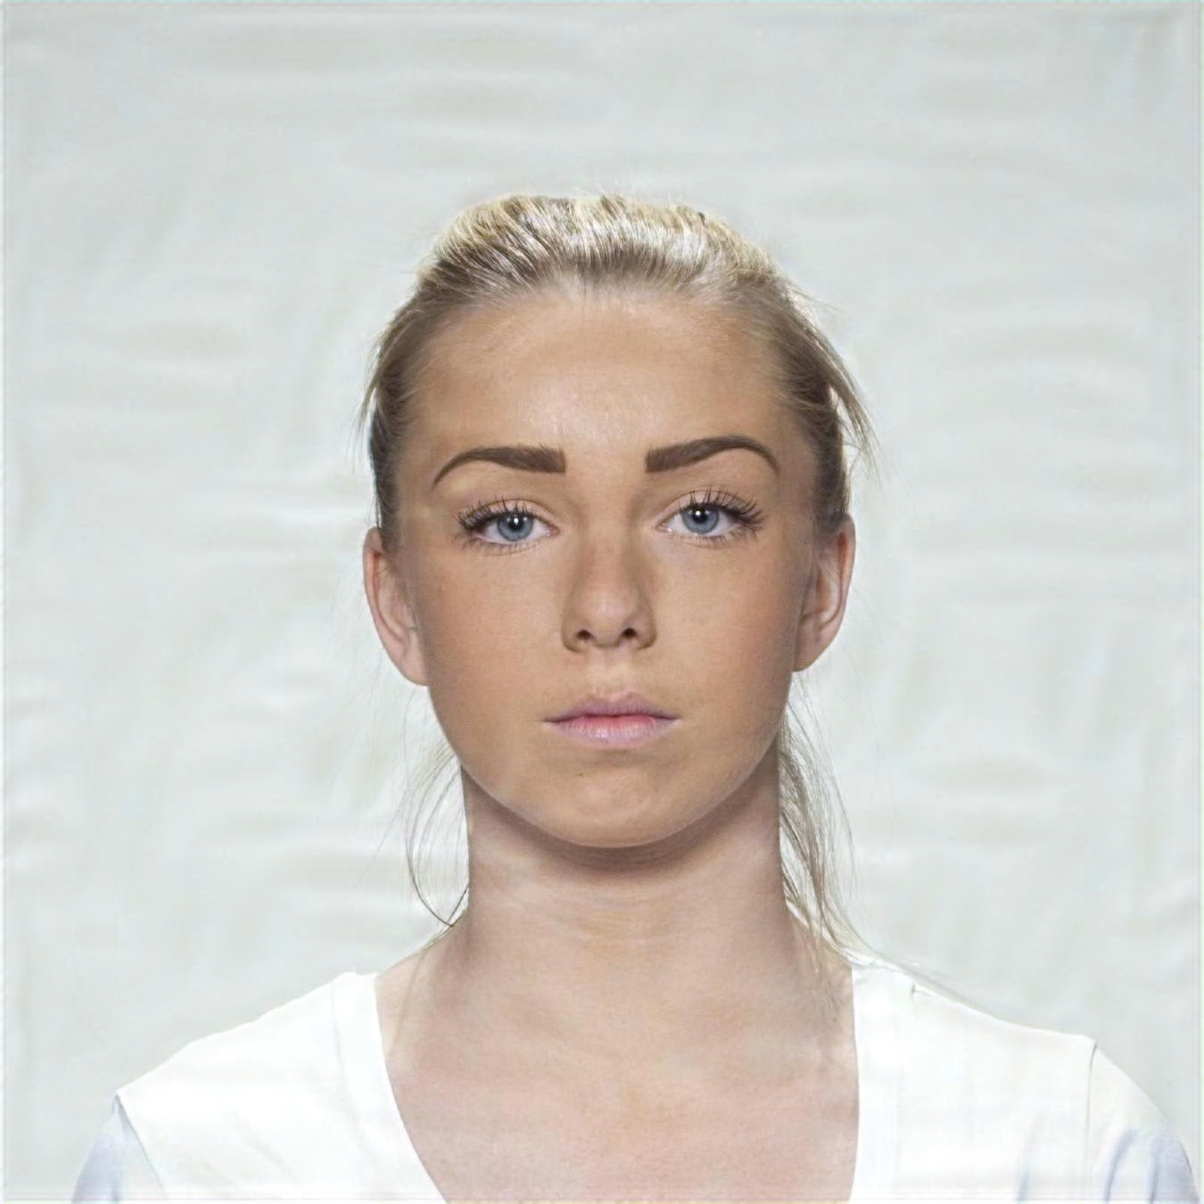
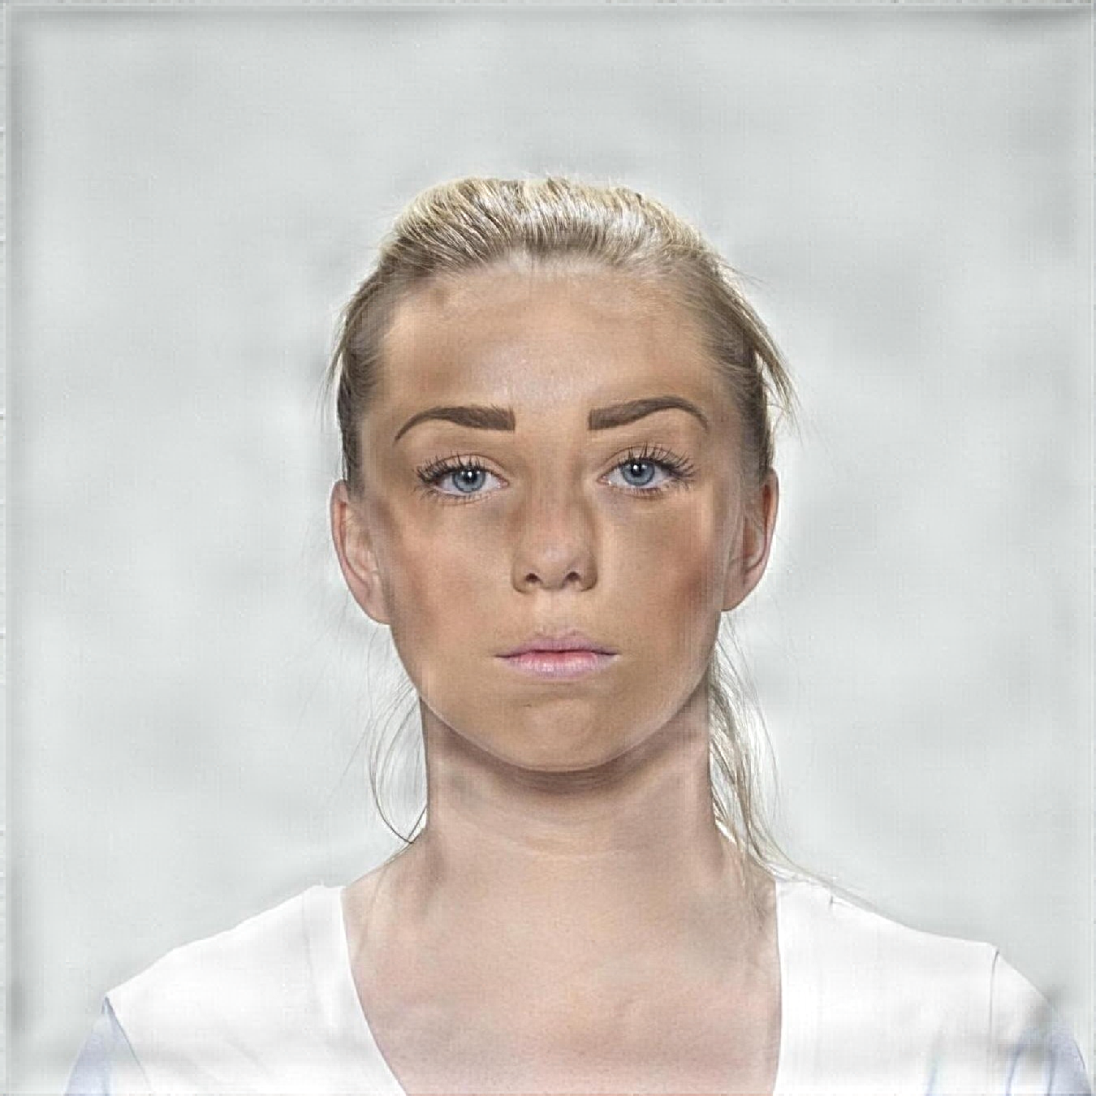
Printer-proof Steganographic Distortions
steganography
/ˌstɛɡəˈnɒɡrəfi/ · noun · [uncountable]
The practice of writing hidden messages in ordinary text, pictures, etc.
We encoded 102 images with 4 different steganography methods, at 9 levels of intensity each, resulting in a total of 3672 images.
Reference
StegaStamp
CodeFace
RiemStega
StampOne

Slide 9
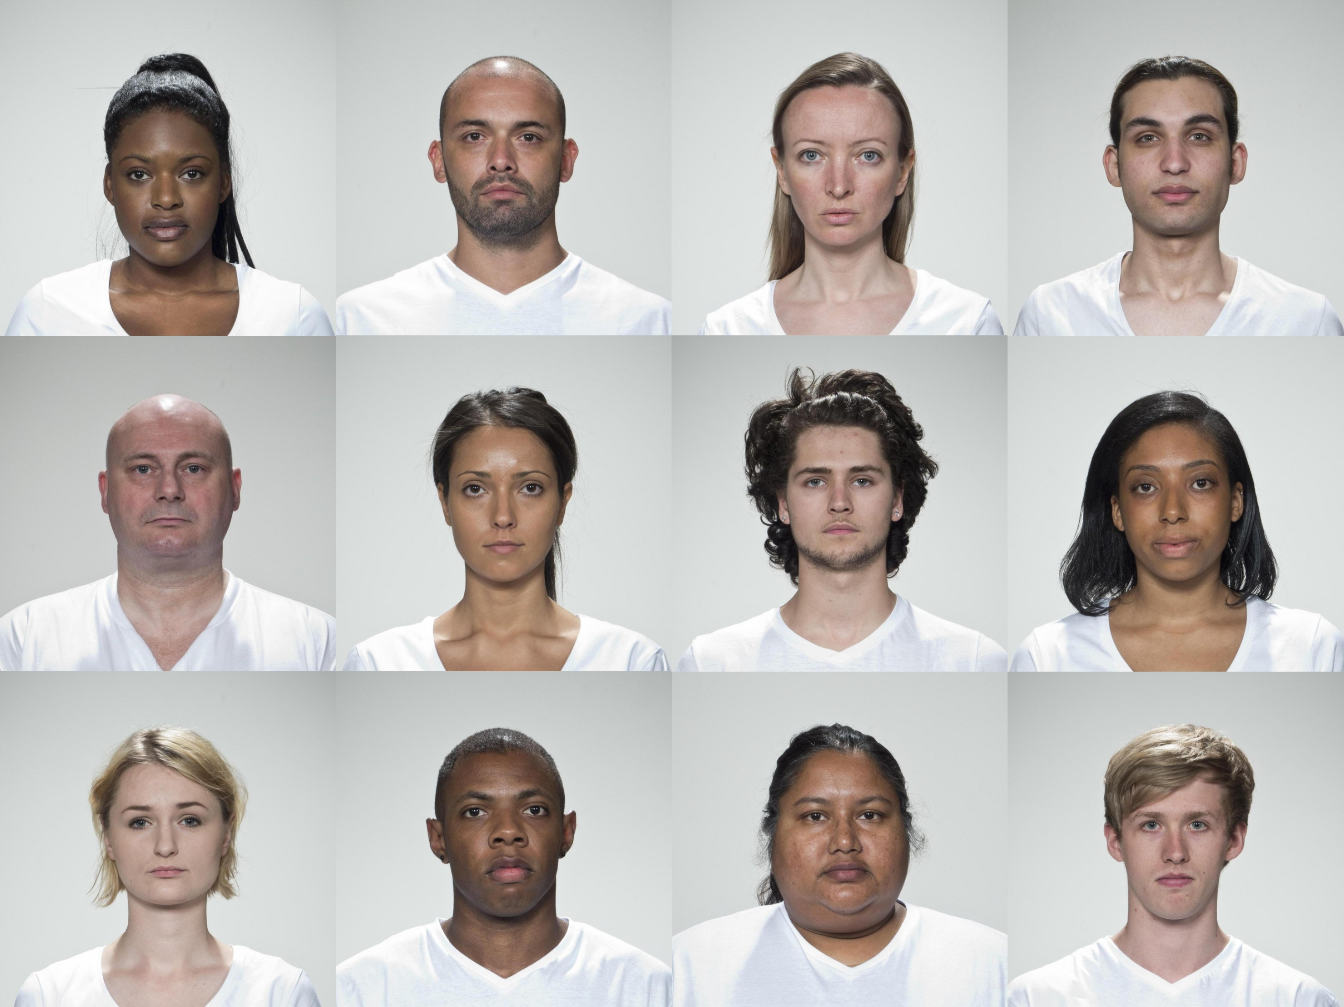
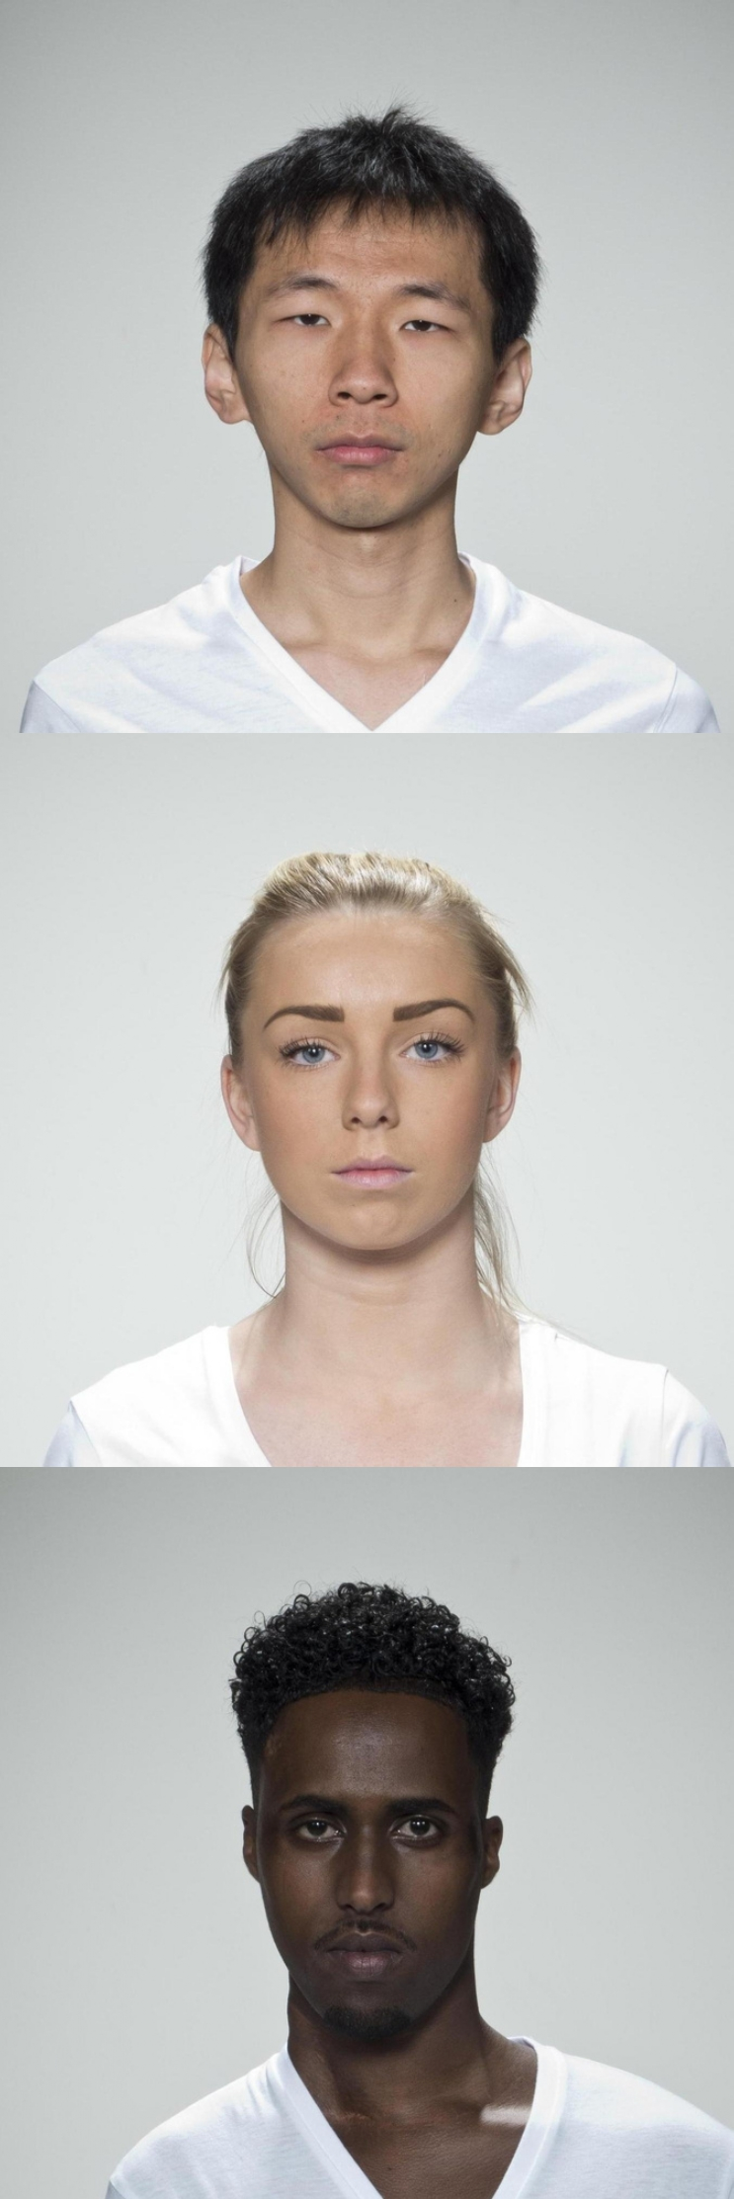
Dataset
MOS set:
15 identities
540 images
MOS train set:
12 identities
360 images
MOS test set:
3 identities
90 images
Pseudo-MOS set:
87 identities
3.132 images
MOS train set
MOS test set

Slide 10
Subjective Labeling Protocol
Custom web application built with Django for MOS collection;
Adopted ITU-R BT.500-15 Single Stimulus protocol;
Over 200 participants rated ~70 images each, resulting in over 14.000 ratings;
Information collected: gender, age, ethnicity, country of origin, education level, etc.
Gender | Count
Male | 143
Female | 59
Age | Count
<18 | 2
18-25 | 85
26-40 | 54
41-60 | 52
>60 | 9
Ethnicity | Count
White | 177
Latino | 8
Black | 6
Multiracial | 3
Oher | 7
Country | Count
Portugal | 170
Brazil | 16
Russia | 3
India | 2
Ohers | 11

Slide 11
Removing Bias from Human Scores
An Ordinary Least Squares (OLS) regression was fit to the MOS values, using observer and image attributes, and their pairwise interactions as categorical predictors.
Factor | p-value | p-value (residualized)
Subject attractiveness | 0.3173 | 0.3173
Observer gender | 0.022 | 0.9930
Observer ethnicity | 8.44 × 10^−4 | 1
Subject gender | 1.60 × 10^−3 | 0.9720
Subject ethnicity | 7.36 × 10^−3 | 1
Observer gender × Subject gender | 0.6417 | 0.6417
Observer ethnicity × Subject ethnicity | 0.0582 | 0.0582
Table shows ANOVA and mANOVA results for observer and image attributes. Before debiasing, several factors show statistically significant effects on MOS, p-value < 0.05. After residualization, all main effects show no significant impact, confirming the effectiveness of the debiasing procedure.

Slide 12
Relation between MOS and 40 FR-IQA Metrics

Slide 13
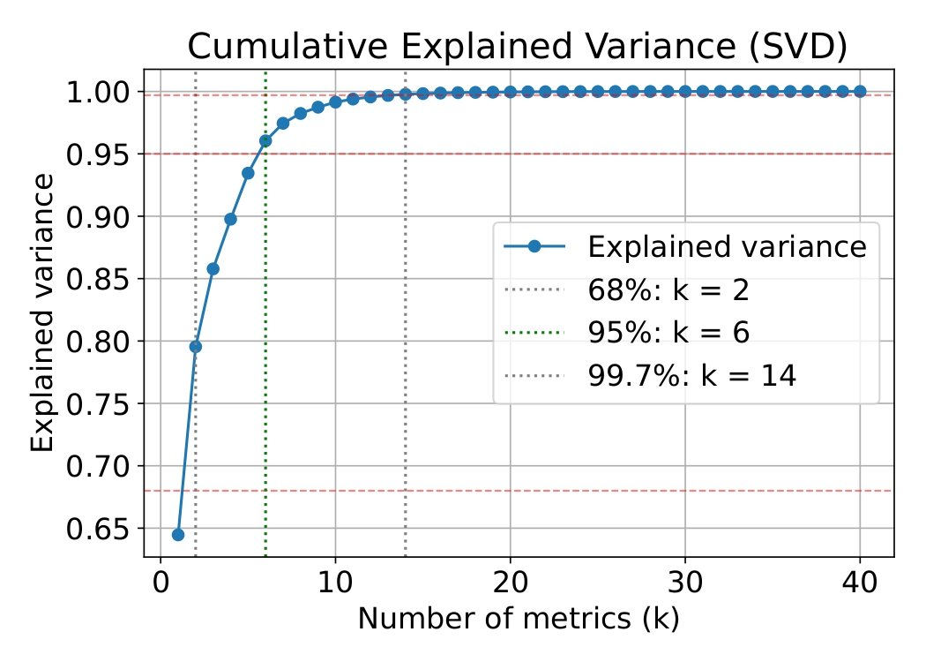
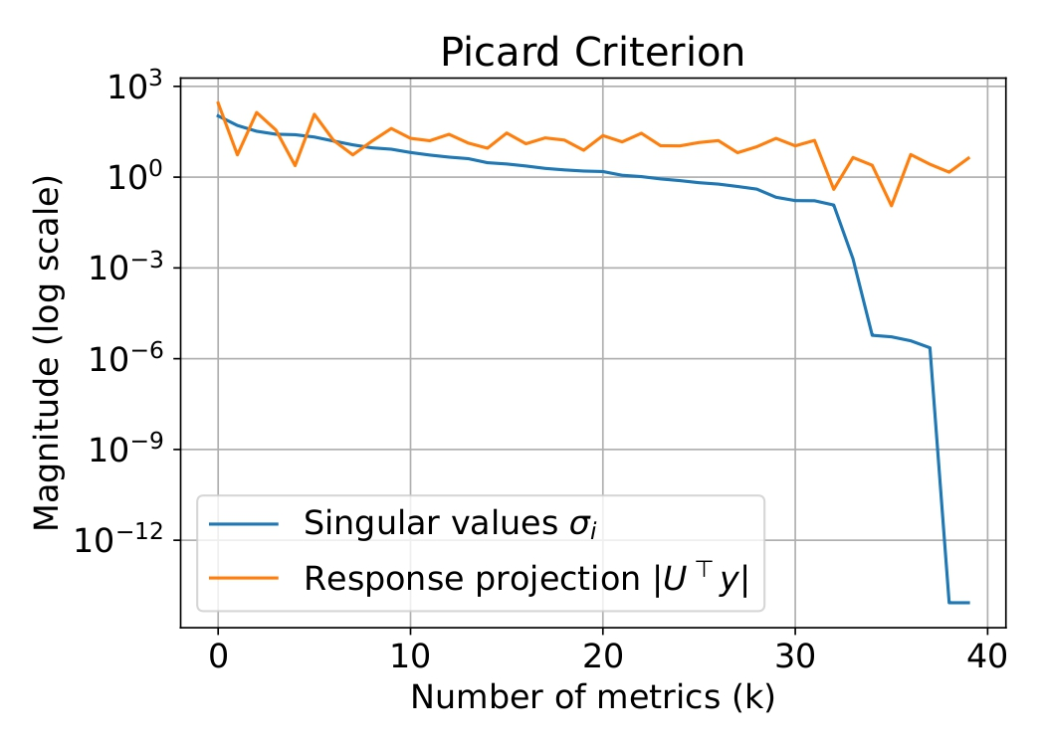
Full-Reference Fusion Metric
Top k=6 metrics were: MS-SSIM, PSNR, PSNR-B, SNR, VIF, and UQI. These stand for Multiscale Structural Similarity Index Metric, Peak Signal-to-Noise Ratio, PSNR-Blocks, Signal-to-Noise Ratio, Visual Information Fidelity, and Universal Quality Index, respectively.

Slide 14
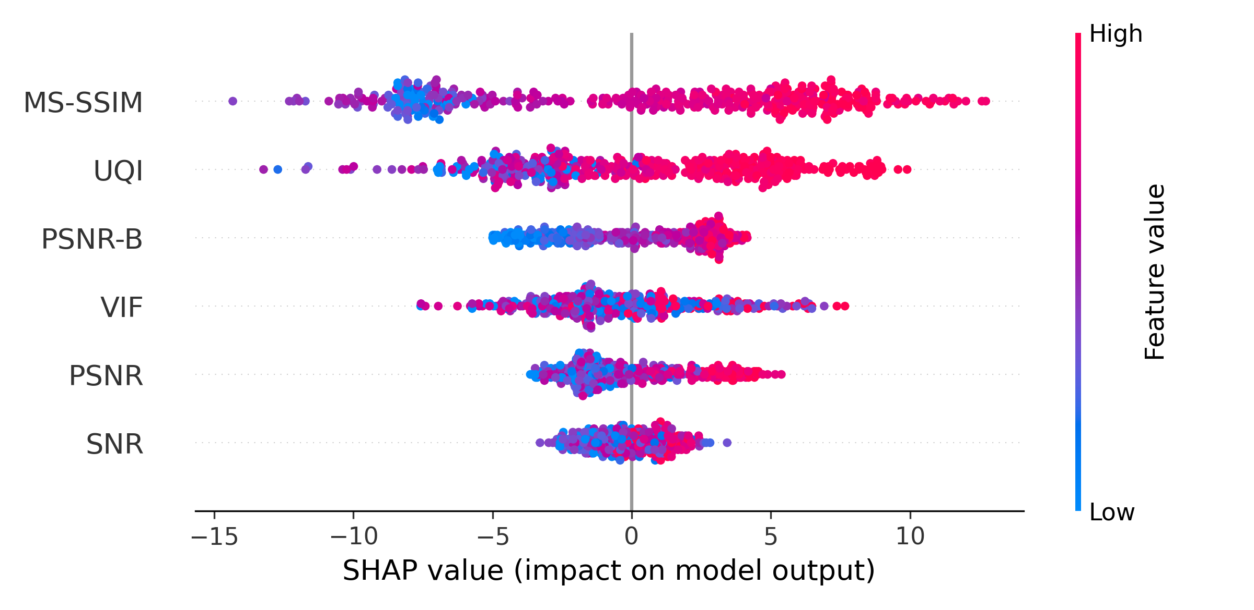
Pseudo-MOS Regression Model
Table shows the performance of our Fusion metric and the selected FR-IQA metrics.
SHAP summary plot for k=6, generated from the best CatBoost model.
Metric | PLCC | SRCC | MSE | MAE
Fusion | 0.8881 | 0.8893 | 65.07 | 6.160
MS-SSIM | 0.7712 | 0.8489 | 2542 | 47.27
PSNR | 0.8009 | 0.8132 | 420.7 | 16.57
PSNR-B | 0.7996 | 0.8126 | 434.8 | 16.84
SNR | 0.7931 | 0.8047 | 493.9 | 18.08
VIF | 0.7723 | 0.7671 | 2584 | 47.75
UQI | 0.6866 | 0.8085 | 2540 | 47.24

Slide 15
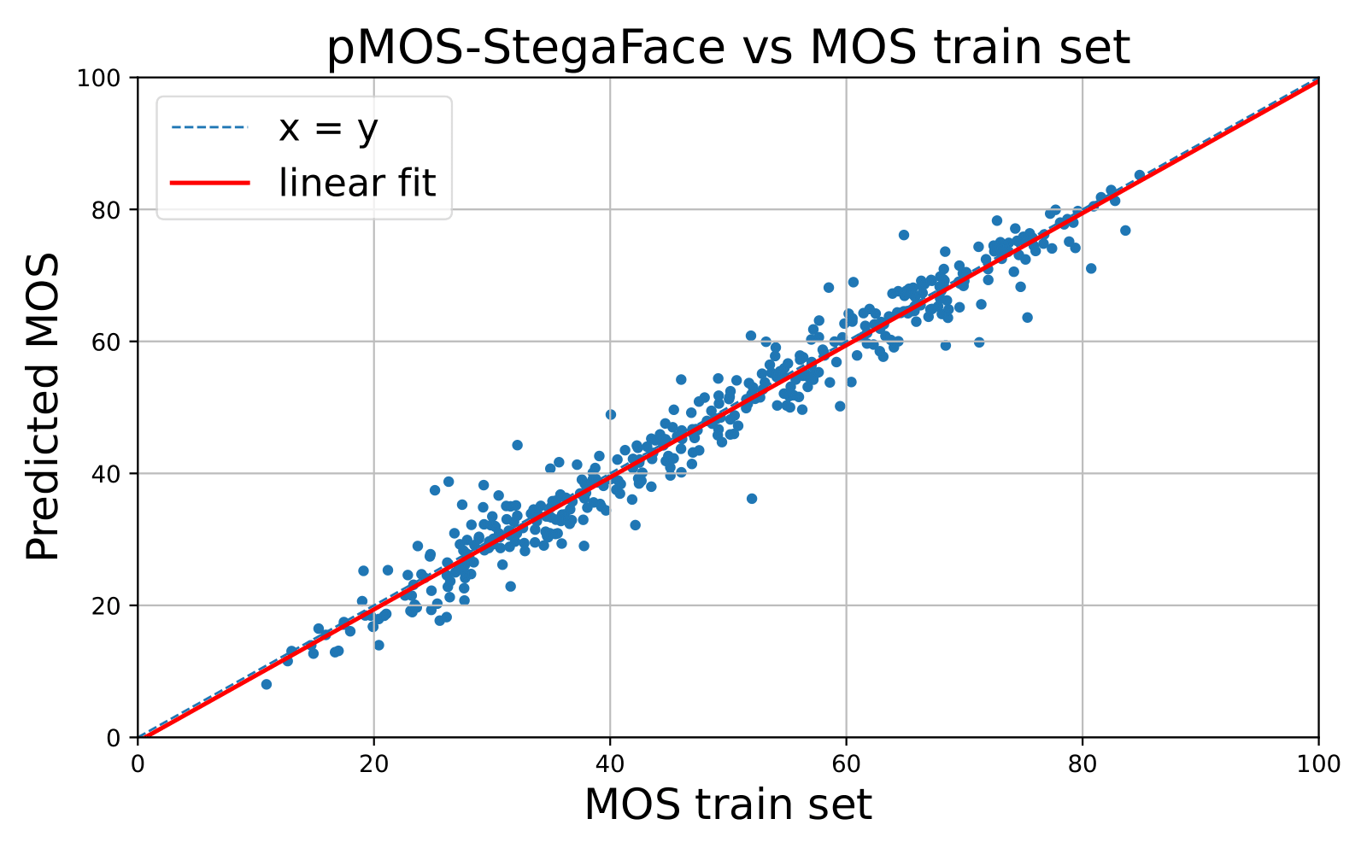
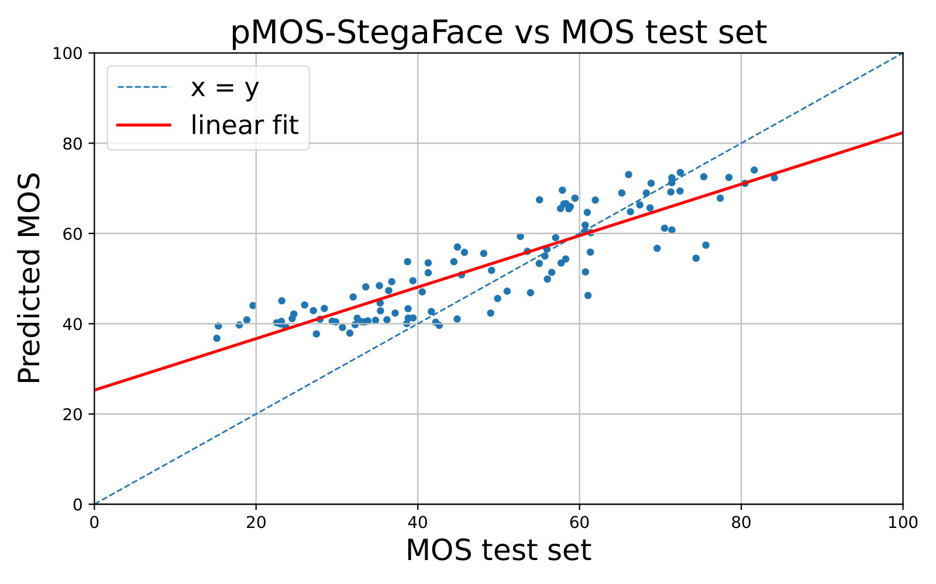
pMOS-StegaFace: No-Reference FIQA Model
We trained a deep regression model end-to-end using pseudo-MOS scores as targets/labels.
The architecture is based on a ResNet50 backbone pretrained on ImageNet.
Its final classification layer is replaced by a lightweight multi-layer perceptron regressor.

Slide 16
pMOS-StegaFace Performance
Our model is more effective in predicting perceptual quality than classical NR-IQA metrics such as NIQE, PIQE, and BRISQUE as well as task-specific approaches like FaceQnet, SER-FIQ and MagFace.
Metric | PLCC | SRCC | MSE | MAE
pMOS-StegaFace | 0.8747 | 0.8768 | 0.0118 | 0.0847
NIQE | 0.7536 | 0.7431 | 6859 | 82.62
PIQE | 0.2993 | 0.3114 | 3297 | 57.05
BRISQUE | 0.1234 | 0.5678 | 9101 | 23.45
FaceQnet | 0.4567 | 0.4789 | 5123 | 34.12
SER-FIQ | -0.1648 | -0.1542 | 123.5 | 9.230
MagFace | -0.6095 | -0.6362 | 4437 | 66.24

