Slide 1
AED Final Project
Smart Cities – Connecting Cars
Sarthak Agarwal
(001632151)

Slide 2
Problem Statement
The profound transformation in the auto industry in the next ten years will have an environmental impact. Consumers and regulators concerned about climate change are putting pressure to reduce CO2 emissions.
With IOT and our adaptation of smart cities, technology will lead this change. The idea is to build a system which encourages people to share their cars and other vehicles by getting rewards in return.

Slide 3
Proposed Solution
People, connected with each other and their cars will not only be able to share rides on common paths but also connect their idle cars with the customers that need them in exchange of some rewards.
Environment officer will be able to track car's emission ratings and reward the good drivers and penalize the bad ones.

Slide 4
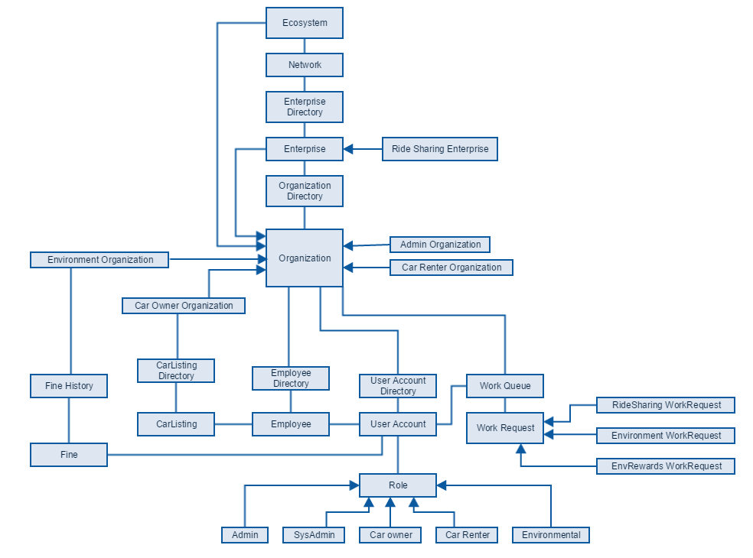
Object Model

Slide 5
Key Roles
Car Owner : Every person who registers his/her car. Can choose it to be On market or Off market.
Car Renter : Person who rents a car.
Environmental Officer : Officer in charge who will be able to keep a check on car’s pollution date and rewards or fine Car owners based on their data.

Slide 6
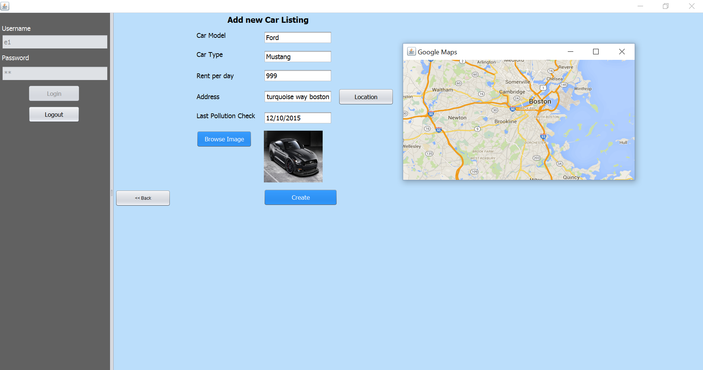
Key Features
Car Owners will be able to register their car listing along with an image of the car and google map location of the car.

Slide 7
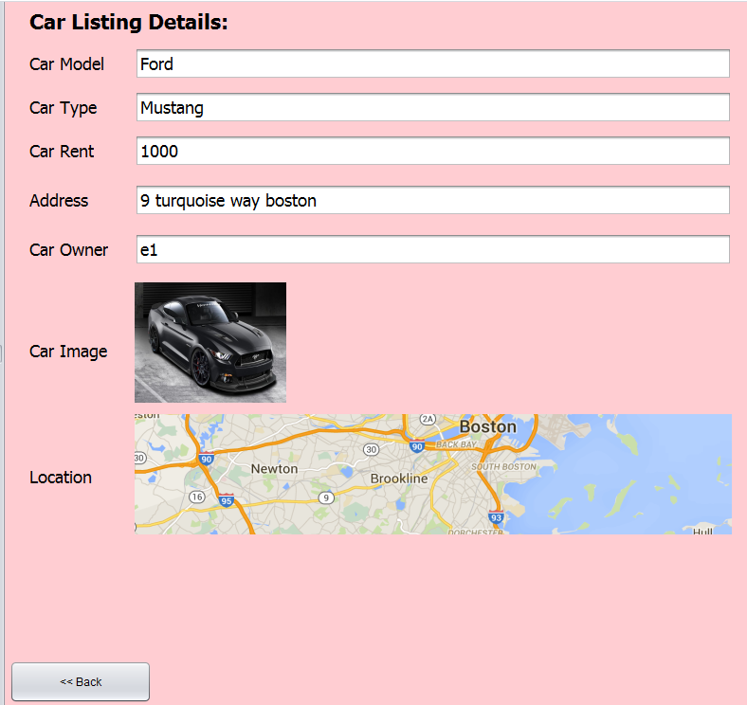
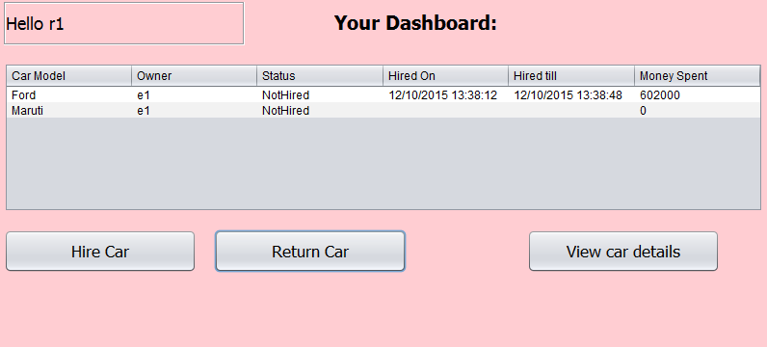
Key Features
Car renters will be able to hire and return cars. Duration and Money charged will be calculated automatically.

Slide 8
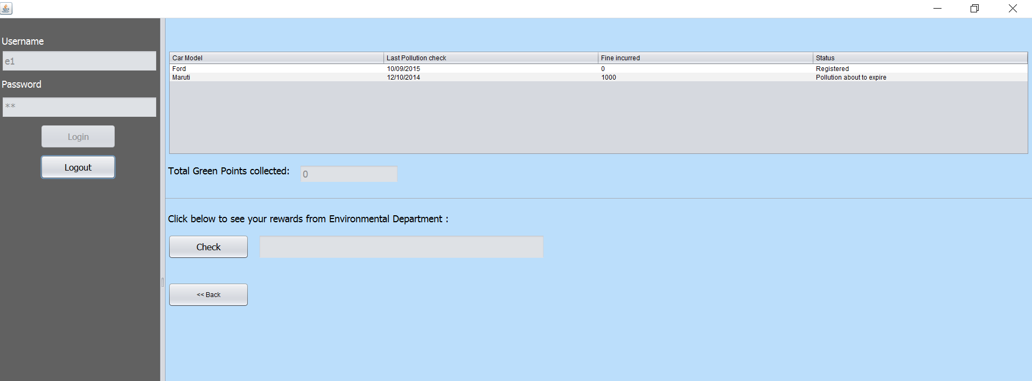
Key Features
Based on the last pollution check date, next pollution date will be calculated and notified to the car owner. Also, if charged with fine by the environmental officer, it will be displayed here.

Slide 9
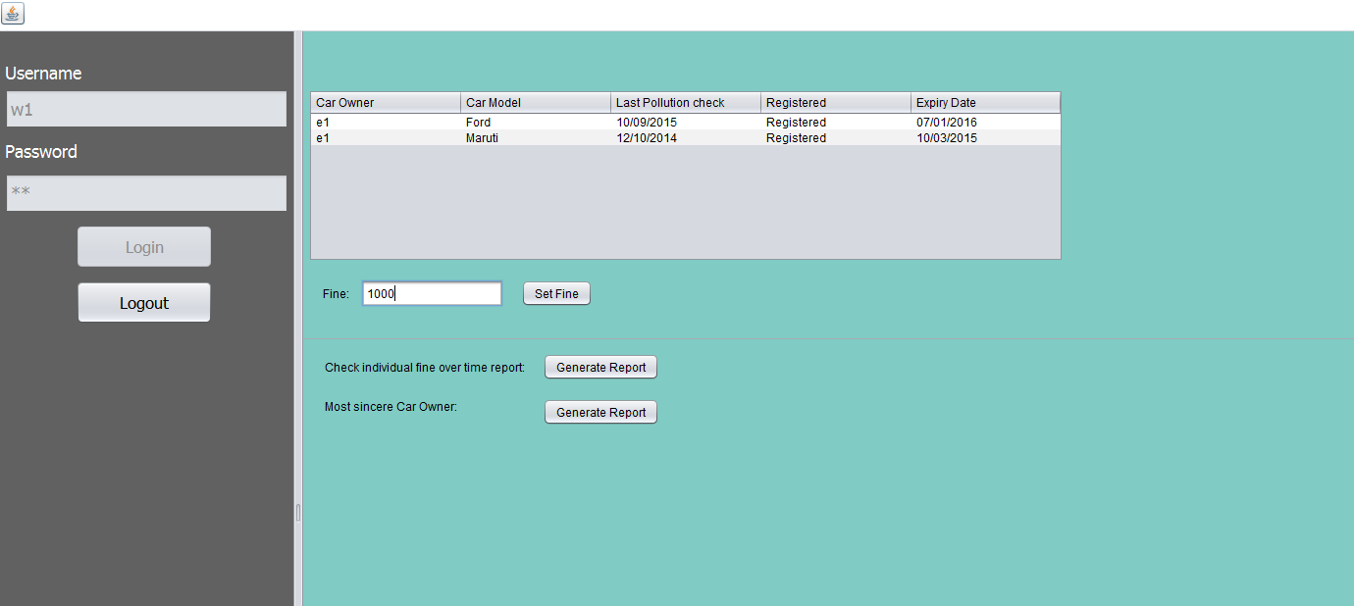
Key Features
This data on pollution date will also be provided to the environmental officer who can fine the car owners.

Slide 10
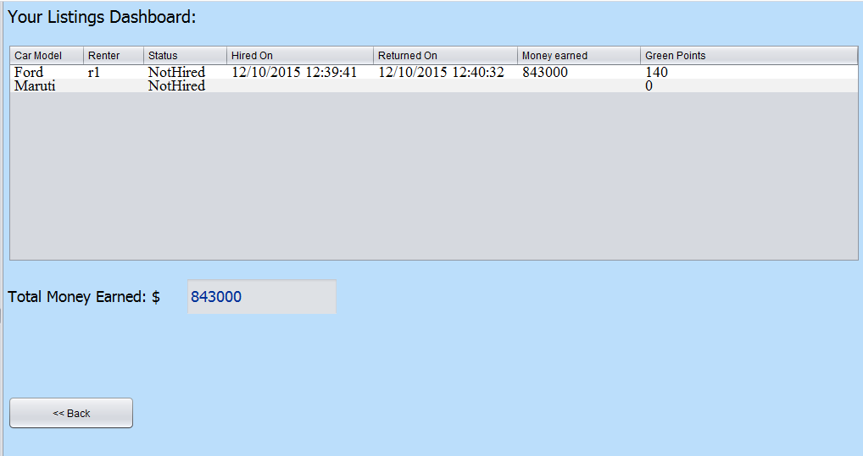
Key Features
Car owners will be notified about their car hired and returned, along with money and green points earned.

Slide 11
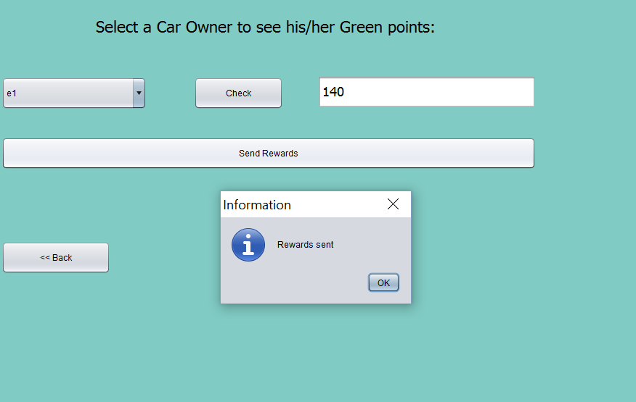
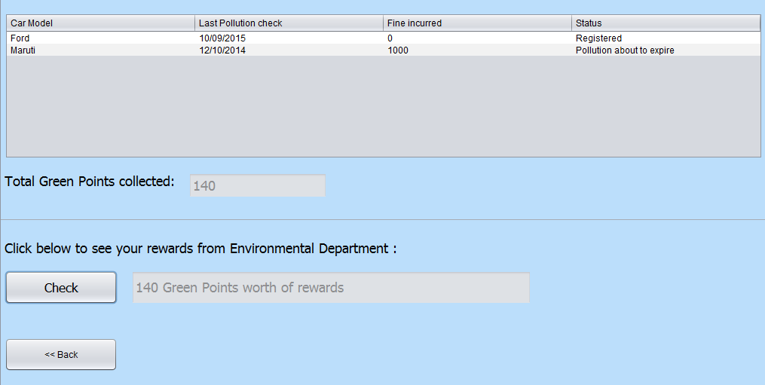
Key Features
Based on the duration of car hired, car owners will earn Green points and will be given rewards in return from the environmental officer.

Slide 12
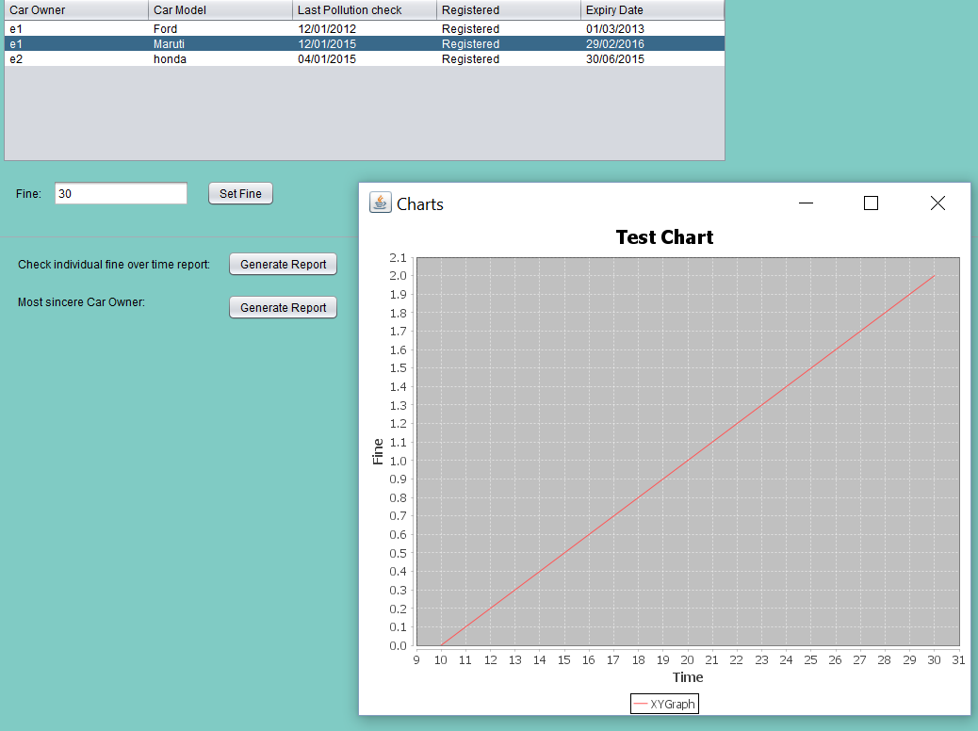
Extra Features
Environmental officer can check individuals fine history over the time on a x-y line graph.

Slide 13
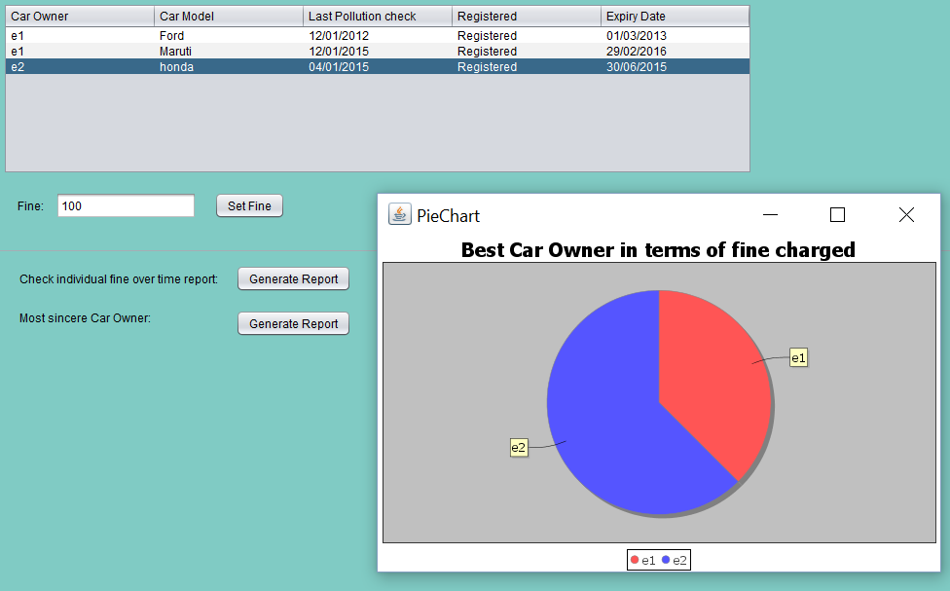
Extra Feature
Environmental officer can generate a report which shows a pie chart representing every car owner with their fine.

Slide 14
Thank you

