Slide 1
ADS Midterm
Team 9:
Aashri Tandon
Pragati Shaw
Sarthak Agarwal

Slide 2
Agenda
Data wrangling
Data download and pre-processing
Exploratory data analysis
Building blocks and evaluating models
Prediction
Classification

Slide 3
Part 1: Data Wrangling

Slide 4
Data Download and pre-processing
cleanup_dir()
clean_orig_files()
data_download(sys.argv[1],sys.argv[2])
clean_svcg_files()
generate_orig_summaries()
generate_svcg_summaries()
combine_files(True)
combine_files(False)

Slide 5
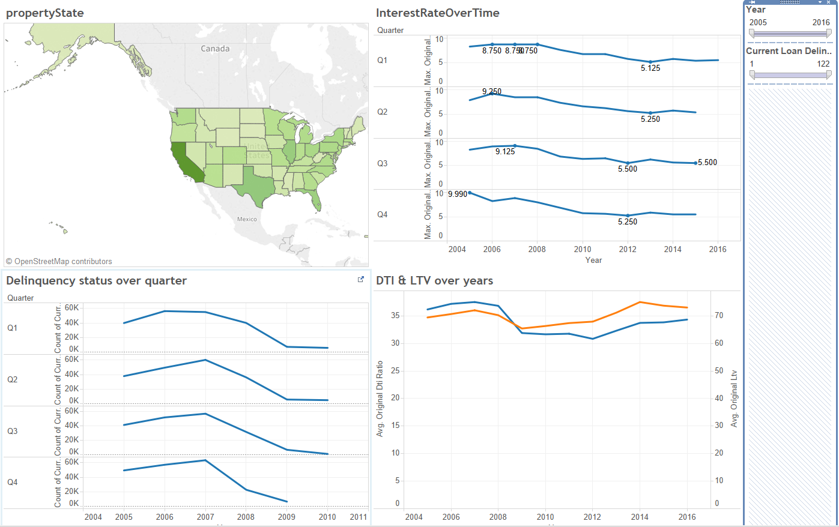
Exploratory Data Analysis

Slide 6
Part 2: Buliding Blocks and Evaluating models

Slide 7
Prediction
get_data()
clean_df(df1)
clean_df(df2)
LinearRegression() & calc_error_metric()
RandomForestRegressor(n_estimators=20) & calc_error_metric()
KNeighborsRegressor(n_neighbors=13) & calc_error_metric()
MLPRegressor() & calc_error_metric()
best_model

Slide 8
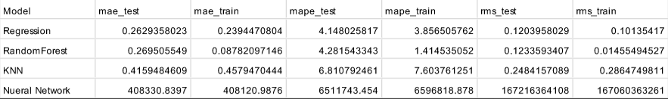


Output for args: Q12007

Slide 9
Classification
get_data(downloadQuarters)
load_data_df(q,nextQuarter)
remove_nan(df1)
remove_nan(df2)
Start processes for different models eg: Process(target=logred)
Process.join()
genMatrix()

Slide 10
multiprocessing
Generate Matrix
logred() process
rf() process
nn() process
svm() process

Slide 11
Output for args: Q11999 Q41999 (Parallel Computation Usage)

Slide 12
Thank You

